Slide 1
Chapter 6: Composition of Substances and Solutions

Slide 2
Formula/molecular mass
Formula mass (formula weight) – term for ionic compounds
Molecular mass (molecular weight) – term for covalent compounds
The sum of the average masses for all atoms in a chemical formula
Example: What is the molecular mass of chloroform (CHCl₃) in amu?
C
H
Cl
Practice: What is the formula mass of sodium chloride (NaCl) in amu?
Practice: What is the formula mass of aspirin (C₉H₈O₄) in amu?
Na
C
Cl
H
O

Slide 3
Percent composition
The percent composition by mass of an element in a compound can be found by knowing the mass of the element in the compound (m_{X}) and the mass of the sample.
m can be mass or molar mass
Example: What is the percent composition by mass of nitrogen in a 100 g, 200 g, and 5.0 mol sample of N₂?
Example: A 23.0 g sample of liquid is shown to contain only 15.5 g O and 7.5 g H. What is the percent composition (by mass) for each element in the sample?

Slide 4
Practice: Percent composition
What is the percent composition by mass of hydrogen in H₂O?
A: 11.2%
If talking about 1 water molecule…
If talking about 1 mol of water…

Slide 5
Empirical formulas
The empirical formula of a compound can be determined by knowing the mass or the percent composition by mass, of each element, and converting to moles.
Example (Part 1): A compound is found to contain 1.71 g C and 0.287 g H. What is the empirical formula of this compound?
Find mol C
Find mol H
Write empirical formula
Reduce
This may or may not be the molecular formula

Slide 6
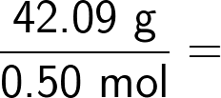
Empirical formulas
A molecular formula can be determined by multiplying the empirical formula by a ratio (n) of the molecular molar mass and the empirical formula molar mass.
Example (Pt. 2): If 0.50 mol of this compound (from Pt. 1; empirical formula: CH₂) was found to weigh 42.09 g, what is the molecular formula?
find molecular molar mass
empirical formula molar mass
ratio of molecular and empirical molar mass

Slide 7
Empirical formulas
The empirical formula of a compound can be determined by knowing the mass, or the percent composition by mass, of each element and converting to moles.
Example: A compound is found to contain 50.05% sulfur and 49.95% oxygen by mass. What is the empirical formula for this compound?
*Assume a 100 g sample so % becomes g.
If 0.8700 mol of this compound was found to have a mass of 55.74 g, what is the molecular formula?

Slide 8
Practice: Empirical formula
A compound is found to contain 5.31 g Cl and 8.40 g O. What is the empirical formula of this compound?
A: Cl₂O₇
Since we know the mass of each element in the compound, convert mass to moles
Write empirical formula

Slide 9
Molarity
A solution is a homogeneous mixture made up of solute(s) and a solvent.
The solvent is the majority component of a solution.
The solute is a minority component of a solution.
The concentration of a solute is the ratio of solute-to-solvent in a solution.
A dilute solution a relatively small amount of solute.
A concentrated solution has a relatively large amount of solute.
One common unit of concentration is molarity (M ; mol L^{–1})
*Note: molarity of a solution is also known as “molar concentration of a solution”

Slide 10
Example: Molarity
A 10.0 mL solution contains 0.001 mol sodium chloride. What is the molar concentration of sodium chloride?
A: 0.1
Example: Molarity
A 650 mL solution contains 5.00 g of benzene (C₆H₆). What is the molar concentration of benzene?
Find molar mass of solute
A: 0.0985
Find volume of solution in L
Find molar concentration

Slide 11
Practice: Molarity
How table sugar (m.m. = 342.3 g mol^{–1}) in g is contained in a can of Pepsi (355 mL) with a concentration of 0.338 M ?
A: 41.4 g

Slide 12
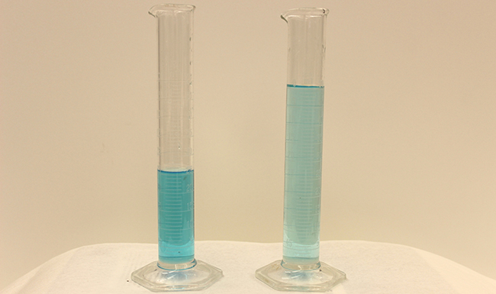
Dilution
The process of lowering the concentration of a solution by increasing the amount of solvent is called dilution.
The original solution (before it is diluted) is called the stock solution.
We dilute things everyday (laundry soap, dish soap, bleach, etc.).

Slide 13
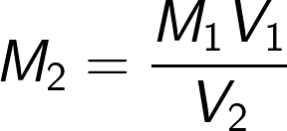
Dilution
For a dilution process, the amount of solute does not change. The amount of solvent increases and, therefore, the total volume (V) of the solution increases.
original solution
dilute solution
Example: If 0.500 L of a 10.00 M solution of sodium chloride is diluted 1.20 L by the addition of water, what is the new concentration (in M)?

