Slide 1
Chapter 9: Thermochemistry

Slide 2
Energy and Energy Changes
Thermochemistry is the study of heat (the transfer of thermal energy) in chemical reactions.
The system is a part of the universe that is of specific interest.
The surroundings constitute the rest of the universe outside the system. The system is usually defined as the substances involved in chemical and physical changes.
System
Surroundings
Universe = System + Surroundings
Heat is the transfer of thermal energy.
Heat is either absorbed or released during a process.
The SI energy unit is a Joule, J. Often calories are used, and 1 calorie is the amount of heat required to raise 1 g of water by 1°C.
1 cal = 4.184 J
calorie is not the same as a nutritional calorie (Cal)
1 Cal=1000 cal

Slide 3


Energy and Energy Changes
An exothermic process occurs when heat is transferred from the system to the surroundings. “Feels hot!”
2H₂(g) + O₂(g) $⟶$ 2H₂O(l) + energy
System
Heat
Surroundings
An endothermic process occurs when heat is transferred from the surroundings to the system. “Feels cold”
energy + 2HgO(s) $⟶$ 2Hg(l) + O₂(g)
System
Heat
Surroundings

Slide 4
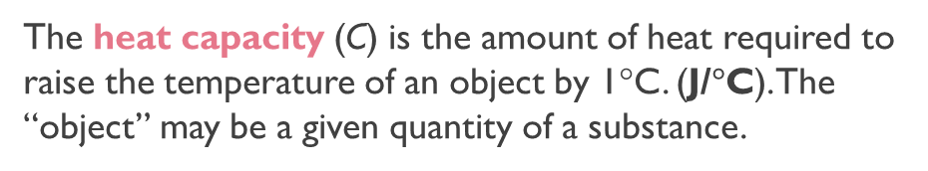
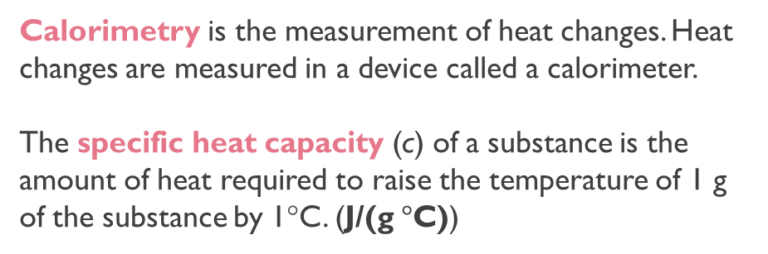
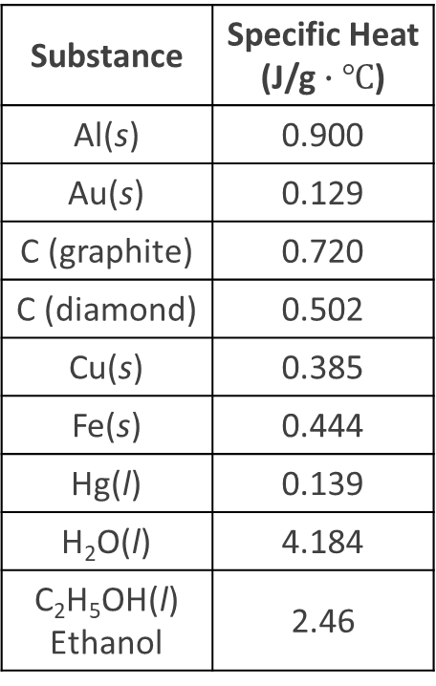
Calorimetry: Specific Heat and Heat Capacity
Substance | Specific Heat (J/g $∙℃$)
Al(s) | 0.900
Au(s) | 0.129
C (graphite) | 0.720
C (diamond) | 0.502
Cu(s) | 0.385
Fe(s) | 0.444
Hg(l) | 0.139
H₂O(l) | 4.184
C₂H₅OH(l) Ethanol | 2.46
Calorimetry is the measurement of heat changes. Heat changes are measured in a device called a calorimeter.
The specific heat capacity (c) of a substance is the amount of heat required to raise the temperature of 1 g of the substance by 1°C. (J/(g $°$C))
The heat capacity (C) is the amount of heat required to raise the temperature of an object by 1°C. (J/$°$C). The “object” may be a given quantity of a substance.
Heat capacity of 1 kg of water = $\frac{4.184 J}{1 g ∙ ℃}×1000 g=\frac{4184 J}{℃}$
Specific heat capacity of water
Heat Capacity of 1 kg water

Slide 5
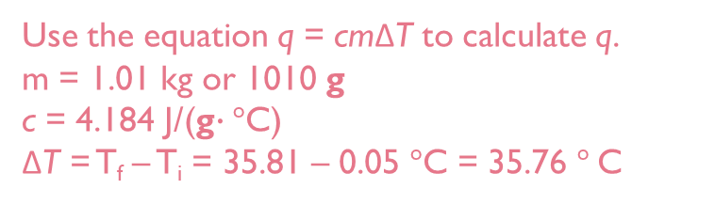
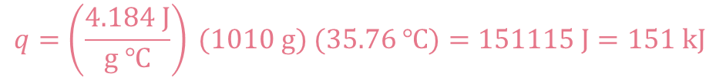
Specific Heat and Heat Capacity
The heat associated with a temperature change may be calculated:
m is the mass.
c is the specific heat capacity.
ΔT is the change in temperature (ΔT = T_{final} – T_{initial})
C is the heat capacity (C = cm)
q : transfer of thermal energy between two bodies at different temperatures
q = cmΔT
q = CΔT
Calculate the amount of heat required to heat 1.01 kg of water from 0.05°C to 35.81°C.
Use the equation q = cmΔT to calculate q.
m = 1.01 kg or 1010 g
c = 4.184 J/(g$∙$ $°$C)
ΔT = T_{f} – T_{i} = 35.81 – 0.05 $°$C = 35.76 $°$C
q = cmΔT
$$q=\left(\frac{4.184 J}{g ℃}\right) (1010 g) (35.76 ℃)=151115 J=151 kJ$$

Slide 6


Practice
Calculate the amount of heat (in kJ) required to heat 255 g of water from 25.2°C to 90.5°C.
$$q=mc∆T= \left(\frac{4.184 J}{g ℃}\right)\left(255 g\right)\left(90.5 ℃−25.2 ℃\right)=6.97 x {10}^{4}J=69.7 kJ$$
A 466–g sample of water is heated from 8.50°C to 74.60°C. Calculate the amount of heat absorbed (in kilojoules) by the water.
$$q=mc∆T= \left(\frac{4.184 J}{g ℃}\right)\left(466 g\right)\left(74.60 ℃−8.50 ℃\right)=1.29 x {10}^{4}J=12.9 kJ$$
If 1.45 kJ of heat are added to a 200. g sample of aluminum metal and the temperature of the metal increases by 7.98 ºC, what is the specific heat of aluminum?
$\frac{0.909 J}{g ℃}= \left(c\right)$
$$q=mc∆T$$
$1450 J= \left(c\right)\left(200 g\right)\left(+7.98 ℃\right)$
If a 352 g piece of glass is heated from 22ºC to 162ºC, how much heat is required?
The specific heat of glass is 0.739 J/g·ºC.
$$q=mc∆T= \left(\frac{0.739 J}{g ℃}\right)\left(352 g\right)\left(162 ℃−22 ℃\right)=36417.92 J= 36.42 kJ$$

Slide 7
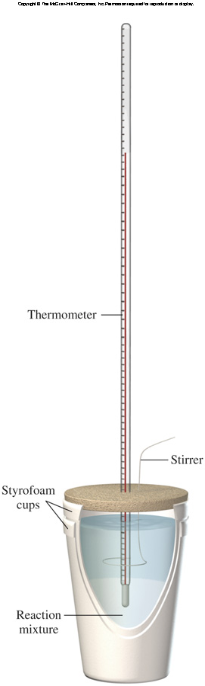
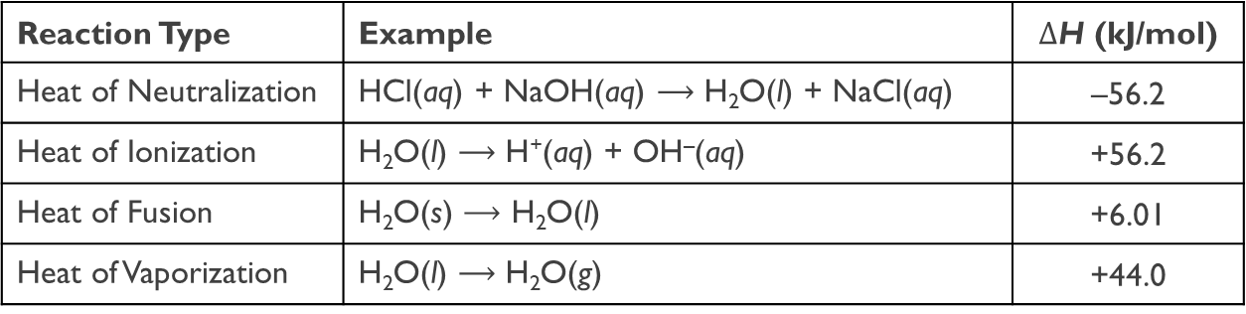
Constant Pressure Calorimetry
A coffee-cup calorimeter may be used to measure the heat exchange for a variety of reactions at constant pressure (allows heat to equal $∆$H):
Reaction Type | Example | $∆$H (kJ/mol)
Heat of Neutralization | HCl(aq) + NaOH(aq) $⟶$ H₂O(l) + NaCl(aq) | –56.2
Heat of Ionization | H₂O(l) $⟶$ H⁺(aq) + OH–(aq) | +56.2
Heat of Fusion | H₂O(s) $⟶$ H₂O(l) | +6.01
Heat of Vaporization | H₂O(l) $⟶$ H₂O(g) | +44.0
Concepts to consider for coffee-cup calorimetry:
q_{P} = ΔH
System: reactants and products
Surroundings: water in the calorimeter
Calorimetry Video 1
Calorimetry Video 2
For an exothermic reaction: the system loses heat (indicated with a negative sign)
For an endothermic reaction: the system gains heat (the system absorbs heat)
q_{sys} = −mcΔT
q_{surr} = mcΔT
q_{sys} = −q_{surr}

Slide 8










Practice
A metal pellet with a mass of 100.0 g, originally at 88.4°C, is dropped into 125 g of water originally at 25.1°C. The final temperature of both pellet and the water is 31.3°C. Calculate the heat capacity C (in J/°C) of the pellet.
q = CΔT
$$q_{H_{2}O}=−q_{metal}$$
q = cmΔT
$$m_{H_{2}O}c_{H_{2}O}∆T=−C_{metal}∆T$$
$$\left(125 g\right)\left(\frac{4.184 J}{g℃}\right)\left(31.3℃−25.1℃\right)=−C_{metal}\left(31.3℃−88.4℃\right)$$
$$3242.6 J=(57.10 g ℃) (C_{metal})$$
$$\frac{56.8 J}{℃}= C_{metal}$$
We can first find the specific heat capacity (c) and then the heat capacity (capital C)
$$q_{H_{2}O}=−q_{metal}$$
$$C=c_{metal}m_{metal}$$
$$m_{H_{2}O}c_{H_{2}O}∆T=−m_{metal}c_{metal}∆T$$
$C=\left(\frac{0.5679 J}{g ℃}\right)\left(100 g\right)$= $\frac{56.79 J}{ ℃}$
$$\left(125 g\right)\left(\frac{4.184 J}{g℃}\right)\left(31.3℃−25.1℃\right)=−{(100g)c}_{metal}\left(31.3℃−88.4℃\right)$$
$$3242.6 J=(5710 g ℃) (C_{metal})$$
$$\frac{0.568 J}{g℃}= C_{metal}$$

Slide 9




Practice
A 50.0 g sample of iron (specific heat capacity = 0.444 J/g°C) is heated to 75.2°C and placed into a calorimeter holding 70.0 g of water (specific heat capacity = 4.184 J/g°C) at a temperature of 25.0°C. Assuming no heat loss to the calorimeter, what will be the final temperature reached in the calorimeter.
$${−q}_{Fe}= q_{water}$$
$$−\left(50 g Fe\right)\left( \frac{0.444 J}{g℃}\right)\left(T_{f} −75.2℃\right)= (70 g water)(\frac{4.184 J}{g℃})(T_{f}−25℃)$$
$$−\left( \frac{22.2 J}{℃}\right)\left(T_{f} −75.2 C\right)= \left(\frac{292.88 J}{℃}\right)(T_{f}−25℃)$$
$$\left( \frac{−22.2 J}{℃}\right)\left(T_{f}\right)+1669.44 J= \left(\frac{292.88 J}{℃}\right)\left(T_{f}\right)−7322 J$$
$$\left(T_{f}\right)=28.56℃$$

Slide 10

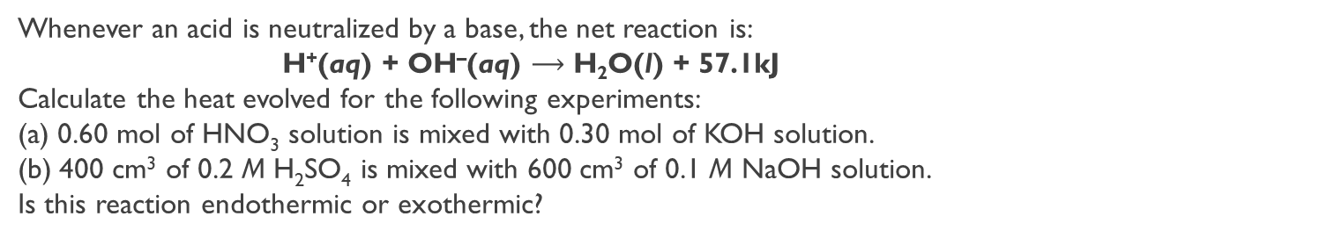


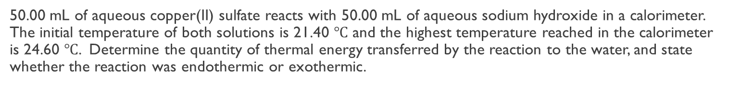








Practice
50.00 mL of aqueous copper(II) sulfate reacts with 50.00 mL of aqueous sodium hydroxide in a calorimeter. The initial temperature of both solutions is 21.40 $℃$ and the highest temperature reached in the calorimeter is 24.60 $℃$. Determine the quantity of thermal energy transferred by the reaction to the water, and state whether the reaction was endothermic or exothermic.
$q=mc∆T$
$q_{sol}= \left(\frac{4.184 J}{g ℃}\right)\left(50g+50 g\right)\left(24.6 ℃−21.40 ℃\right)$
$$q_{sol}= +1.34 kJ$$
$$q_{transfered}=1.34 kJ$$
$$q_{Rxn}=−1.34 kJ$$
Whenever an acid is neutralized by a base, the net reaction is:
H⁺(aq) + OH–(aq) $⟶$ H₂O(l) + 57.1kJ
Calculate the heat evolved for the following experiments:
(a) 0.60 mol of HNO₃ solution is mixed with 0.30 mol of KOH solution.
(b) 400 cm³ of 0.2 M H₂SO₄ is mixed with 600 cm³ of 0.1 M NaOH solution.
Is this reaction endothermic or exothermic?
a.)
HNO₃ + KOH $⟶$ KNO₃ + H₂O
b.)
H₂SO₄ + 2NaOH $⟶$ Na₂SO₄ + 2H₂O
$\left(\frac{0.60 mol {HNO}_{3}}{}\right)\left(\frac{1 mol H_{2}O}{1 mol {HNO}_{3}}\right)=0.60 mol H_{2}O$
$\left(\frac{0.4 L {HNO}_{3}}{}\right)\left(\frac{0.2 mol H_{2}{SO}_{4}}{1 L}\right)\left(\frac{2 mol H_{2}O}{1 mol{ H}_{2}{SO}_{4}}\right)=0.16 mol H_{2}O$
$\left(\frac{0.30 mol KOH}{}\right)\left(\frac{1 mol H_{2}O}{1 mol KOH}\right)=0.30 mol H_{2}O$
$\left(\frac{0.6 L NaOH}{}\right)\left(\frac{0.1 mol NaOH}{1 L}\right)\left(\frac{2 mol H_{2}O}{2 mol{ H}_{2}{SO}_{4}}\right)=0.06 mol H_{2}O$
$\left(\frac{0.30 mol H_{2}O}{}\right)\left(\frac{−57.1 kJ}{1 mol H_{2}O}\right)=−17.17 kJ$
$\left(\frac{0.06 mol H_{2}O}{}\right)\left(\frac{−57.1 kJ}{1 mol H_{2}O}\right)=−3.426 kJ$

Slide 11
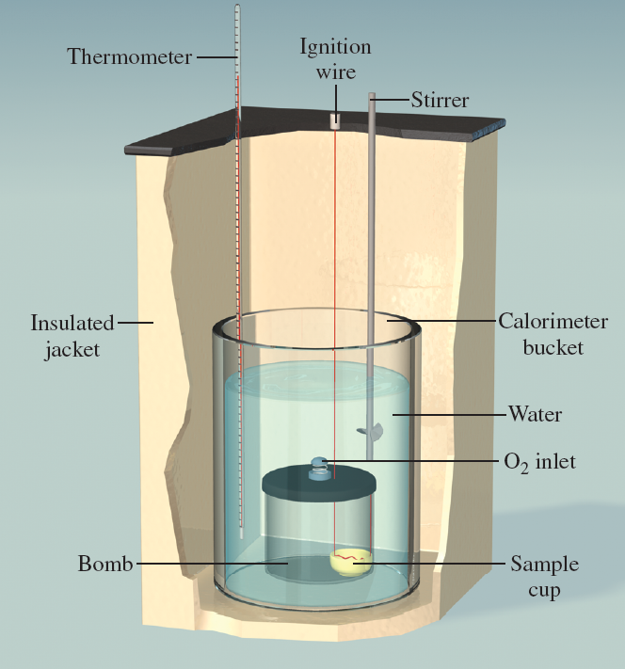
Constant Volume Calorimetry
Constant volume calorimetry is carried out in a device known as a constant-volume bomb. A constant-volume calorimeter is an isolated system. Bomb calorimeters are typically used to determine heats of combustion.
q_{cal} = –q_{rxn}
To calculate q_{cal}, the heat capacity of the calorimeter must be known.
q_{cal} = C_{cal}ΔT
q_{rxn} = –q_{cal}
q_{rxn} = −C_{cal}ΔT

Slide 12

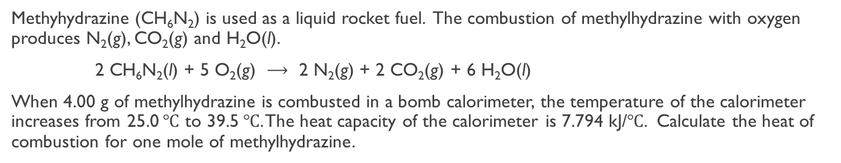









Practice
A 1.0 g sample of propane, C₃H₈, was burned in a calorimeter. The temperature rose from 28.5 $℃$ to 32.0 $℃$ and heat of combustion 10.5 kJ/g. Calculate the heat capacity of the apparatus in kJ/ $℃$ .
$\left(\frac{1.0 g}{}\right)\left(\frac{10.5 kJ}{g}\right)=10.5 kJ=q_{cal}$
$$q=C∆T$$
$10.5 kJ=C\left(32.0 ℃ −28.5℃\right)$
$$\frac{3 kJ}{℃}=C$$
Methyhydrazine (CH₆N₂) is used as a liquid rocket fuel. The combustion of methylhydrazine with oxygen produces N₂(g), CO₂(g) and H₂O(l).
2 CH₆N₂(l) + 5 O₂(g) $⟶$ 2 N₂(g) + 2 CO₂(g) + 6 H₂O(l)
When 4.00 g of methylhydrazine is combusted in a bomb calorimeter, the temperature of the calorimeter increases from 25.0 $℃$ to 39.5 $℃$. The heat capacity of the calorimeter is 7.794 kJ/$℃$. Calculate the heat of combustion for one mole of methylhydrazine.
$$q_{cal}=C∆T$$
$q_{cal}=\left(\frac{7.794 kJ}{℃}\right)\left(39.5 ℃ −25.0℃\right)$
$q_{cal}=113.01 kJ$
$q_{sys}=−113.01 kJ$
$\left(\frac{4.00 g {CH}_{6}N_{2}}{}\right)\left(\frac{1 mol {CH}_{6}N_{2}}{46 g{ CH}_{6}N_{2}}\right)=0.08696 mol{CH}_{6}N_{2}$
$\frac{−113.01 kJ}{0.08696 mol }=7299.56 kJ {mol}^{−1}$

Slide 13
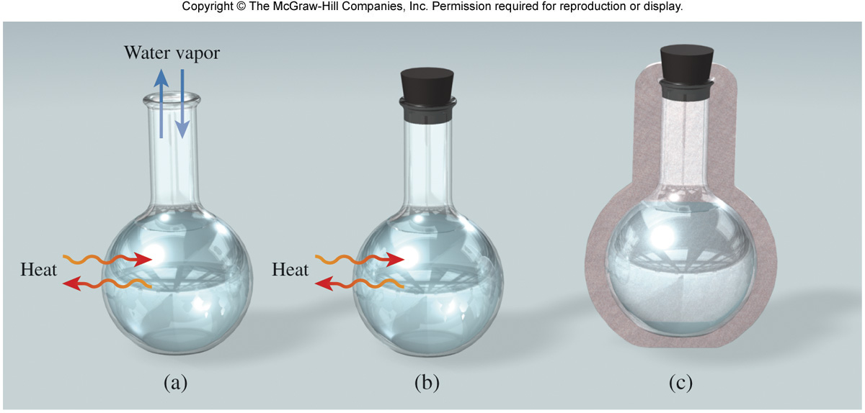
Introduction to Thermodynamics
Thermodynamics is the study of the interconversion of heat and other kinds of energy.
In thermodynamics, there are three types of systems:
An open system can exchange mass and energy with the surroundings.
A closed system allows the transfer of energy but not mass.
An isolated system does not exchange either mass or energy with its surroundings.

Slide 14
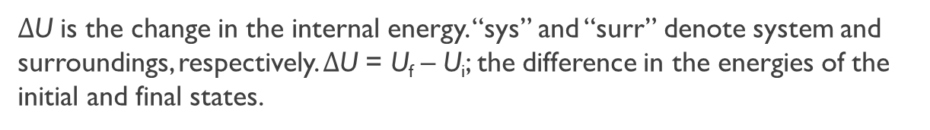
Introduction to Thermodynamics
State functions are properties that are determined by the state of the system, regardless of how that condition was achieved.
The magnitude of change depends only on the initial and final states of the system.
Energy
Pressure
Volume
Temperature
The first law of thermodynamics states that energy can be converted from one form to another but cannot be created or destroyed.
ΔU_{sys} + ΔU_{surr} = 0
$∆$U is the change in the internal energy. “sys” and “surr” denote system and surroundings, respectively. $∆$U = U_{f} – U_{i}; the difference in the energies of the initial and final states.
ΔU_{sys} = –ΔU_{surr}

Slide 15
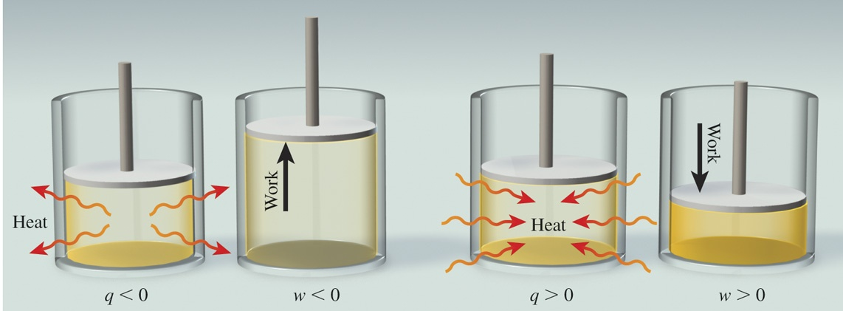
Work and Heat
The overall change in the system’s internal energy is given by:
ΔU = q + w
q is heat
q is positive for an endothermic process (heat absorbed by the system)
q is negative for an exothermic process (heat released by the system)
w is work
w is positive for work done on the system
w is negative for work done by the system

Slide 16
Practice
Calculate the overall change in internal energy, ΔU, (in joules) for a system that absorbs 188 J of heat and does 141 J of work on its surroundings.
ΔU = q + w = 188 J + (–141 J) = 47 J
Calculate the total change in internal energy, ΔE, of a system when 400 J heat is applied to expanding O₂(g) and the gas does 350 J of work on its surroundings.
ΔU = q + w = + 400 J + (–350 J) = +50 J
A reaction occurs in a closed container that releases 1150 J of heat into the surroundings. As the reaction proceeds, the product falls out as a solid and causes the container to contract. This results in the surroundings performing 480 J of work on the system. What is ∆E for the system?
ΔU = q + w = –1150 J +480 J = –670 J

Slide 17
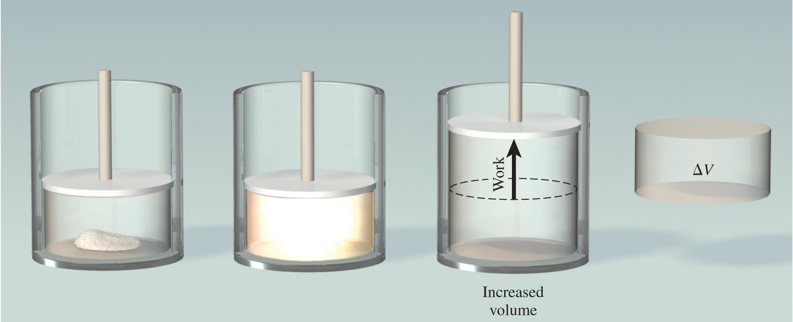

Enthalpy: Constant Volume or Constant Pressure
Sodium azide detonates to give a large quantity of nitrogen gas.
2NaN₃(s) $⟶$ 2Na(s) + 3N₂(g)
Under constant volume conditions, pressure increases:
Under constant pressure conditions, volume increases:

Slide 18
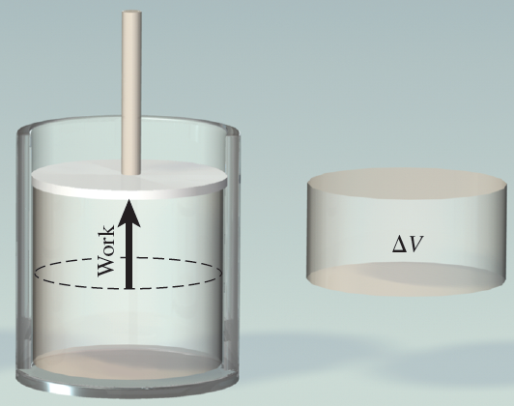
Enthalpy: Constant Volume or Constant Pressure
Pressure-volume, or PV work, is done when there is a volume change under constant pressure.
w = −PΔV
P is the external opposing pressure. ΔV is the change in the volume of the container.
Pressure-volume, or PV work, is done when there is a volume change under constant pressure.
w = −PΔV
substitute
ΔU = q + w
ΔU = q – PΔV
When a change occurs at constant volume, ΔV = 0 and no work is done.
q_{V} = ΔU
Under conditions of constant pressure:
q_{P} = ΔU + PΔV

Slide 19

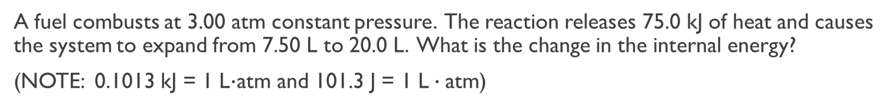


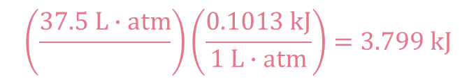
Practice
A fuel combusts at 3.00 atm constant pressure. The reaction releases 75.0 kJ of heat and causes the system to expand from 7.50 L to 20.0 L. What is the change in the internal energy?
(NOTE: 0.1013 kJ = 1 L$∙$atm and 101.3 J = 1 L $∙$atm)
ΔU = q + w
ΔU = q – PΔV
ΔU = –75.0 kJ – $\left[\left(3 atm\right)\left(20.0 L −7.50 L\right)\right]$
These can’t be added, units don’t match.
ΔU = –75.0 kJ – $37.5 L∙atm$
$$\left(\frac{37.5 L∙atm}{}\right)\left(\frac{0.1013 kJ}{1 L∙atm}\right)=3.799 kJ$$
ΔU = –75.0 kJ – $3.799 kJ$
ΔU = –78.8 kJ

Slide 20
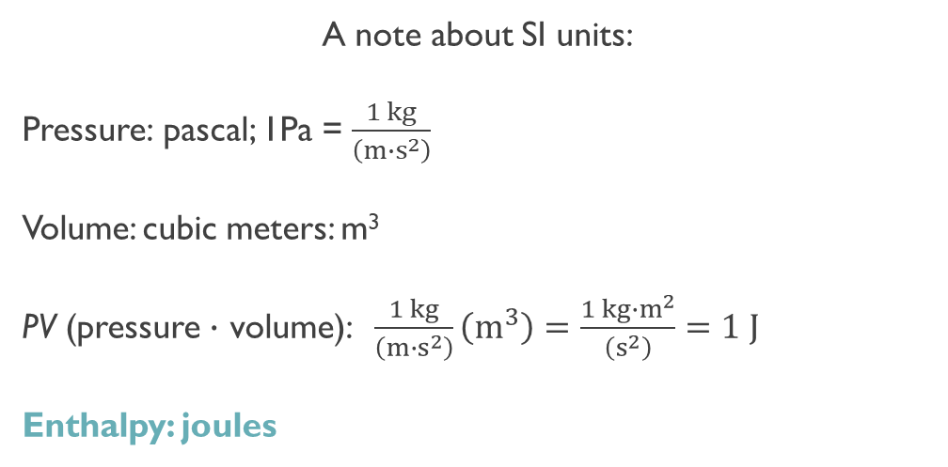
Enthalpy and Enthalpy Changes
The thermodynamic function of a system called enthalpy (H) is defined by the equation:
H = U + PV
A note about SI units:
Pressure: pascal; 1Pa = $\frac{1 kg}{\left({m∙s}^{2}\right)}$
Volume: cubic meters: m³
PV (pressure $∙$ volume): $\frac{1 kg}{\left({m∙s}^{2}\right)}\left(m^{3}\right)=\frac{1 kg∙m^{2}}{\left(s^{2}\right)}=1 J$
Enthalpy: joules
U, P, V, and H are all state functions.

Slide 21
Enthalpy and Enthalpy Changes
For any process, the change in enthalpy is:
ΔH = ΔU + Δ(PV)
(1)
If pressure is constant:
ΔH = ΔU + PΔV
(2)
Rearrange to solve for ΔU:
ΔU = ΔH – PΔV
(3)
Remember, q_{p}:
q_{p} = ΔU + PΔV
(4)
Substitute equation (3) into equation (4) and solve for q_{p}:
q_{p} = (ΔH − PΔV) + PΔV
(5)
q_{p} = ΔH
for a constant-pressure process

Slide 22
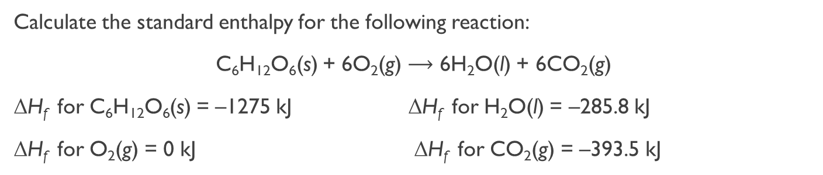
Enthalpy and Enthalpy Changes
The enthalpy of reaction (ΔH) is the difference between the enthalpies of the products and the enthalpies of the reactants:
Assumes reactions in the lab occur at constant pressure
ΔH > 0 (+) endothermic process
ΔH < 0 (–) exothermic process (sometimes called spontaneous reaction)
ΔH = H_{(products)} – H_{(reactants)}
Calculate the standard enthalpy for the following reaction:
C₆H₁₂O₆(s) + 6O₂(g) $⟶$ 6H₂O(l) + 6CO₂(g)
ΔH_{f} for C₆H₁₂O₆(s) = –1275 kJ ΔH_{f} for H₂O(l) = –285.8 kJ
ΔH_{f} for O₂(g) = 0 kJ ΔH_{f} for CO₂(g) = –393.5 kJ
ΔH_{f} = H_{products} – H_{reactants}
ΔH =
[(6)( –393.5 kJ) + (6)(–285.8 kJ)]
– [(–1275 kJ) + (6)(0 kJ)]
ΔH = –2800.8 kJ

Slide 23
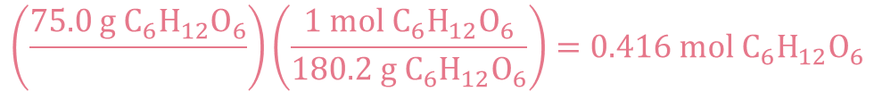

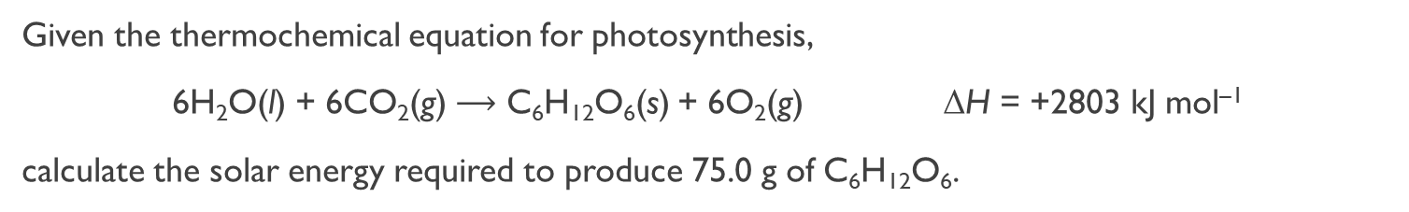
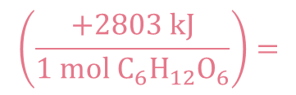
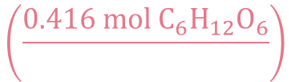
Practice
Given the thermochemical equation for photosynthesis,
6H₂O(l) + 6CO₂(g) $⟶$ C₆H₁₂O₆(s) + 6O₂(g) ΔH = +2803 kJ mol^{–1}
calculate the solar energy required to produce 75.0 g of C₆H₁₂O₆.
The enthalpy given is for 6 moles of H₂O(l) and 6 moles of CO₂(g) producing 1 mole of sugar and 6 moles of O₂(g). We are given 75.0 g sugar; we don’t know how many moles of sugar we have. We can only compare using the moles, so we convert grams to moles.
$$\left(\frac{+2803 kJ}{6 mol H_{2}O}\right)=\left(\frac{+2803 kJ}{6 mol CO_{2}}\right)=\left(\frac{+2803 kJ}{1 mol C_{6}H_{12}O_{6}}\right)=\left(\frac{+2803 kJ}{6 mol O_{2}}\right)$$
The molar mass of C₆H₁₂O₆ is 180.2 g mol^{–1}
$$\left(\frac{75.0 g C_{6}H_{12}O_{6}}{}\right)\left(\frac{1 mol C_{6}H_{12}O_{6}}{180.2 g C_{6}H_{12}O_{6}}\right)=0.416 mol C_{6}H_{12}O_{6}$$
Since we don’t have 1 mole of sugar, we must convert how much energy we would get from 0.416 mol C₆H₁₂O₆.
$$\left(\frac{0.416 mol C_{6}H_{12}O_{6}}{}\right)$$
$$\left(\frac{+2803 kJ}{1 mol C_{6}H_{12}O_{6}}\right)=$$
$$1.17 x {10}^{3} kJ$$

Slide 24
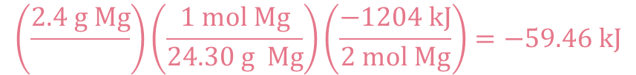
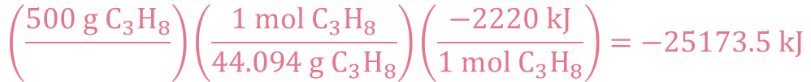
Practice
How much energy will be produced when 5.23 g of C₈H₁₈ reacts with excess oxygen for the reaction:
2 C₈H₁₈(l) + 25 O₂(g) → 16 CO₂(g) + 18 H₂O(l) ΔH = –10909 kJ.
$$\left(\frac{5.23 g C_{8}H_{18}}{}\right)\left(\frac{1 mol C_{8}H_{18}}{114.224 g C_{8}H_{18}}\right)\left(\frac{−10909 kJ}{2 mol C_{8}H_{18}}\right)=−249.75 kJ$$
Consider the following reaction: 2Mg(s) + O₂(g) → 2MgO(s) ΔH= –1204 kJ
a) Is this reaction endothermic or exothermic? b) Calculate the amount of heat transferred when 2.4g of Mg(s) reacts at constant pressure.
$$\left(\frac{2.4 g Mg}{}\right)\left(\frac{1 mol Mg}{24.30 g Mg}\right)\left(\frac{−1204 kJ}{2 mol Mg}\right)=−59.46 kJ$$
Calculate the heat generated when 500. g of propane burns in excess O_{2.}
C₃H₈(l) + 5O₂(g) → 3 CO₂(g) + 4 H₂O(l) ΔH° = – 2220. kJ
$$\left(\frac{500 g C_{3}H_{8}}{}\right)\left(\frac{1 mol{ C}_{3}H_{8}}{44.094 g{ C}_{3}H_{8}}\right)\left(\frac{−2220 kJ}{1 mol{ C}_{3}H_{8}}\right)=−25173.5 kJ$$

Slide 25
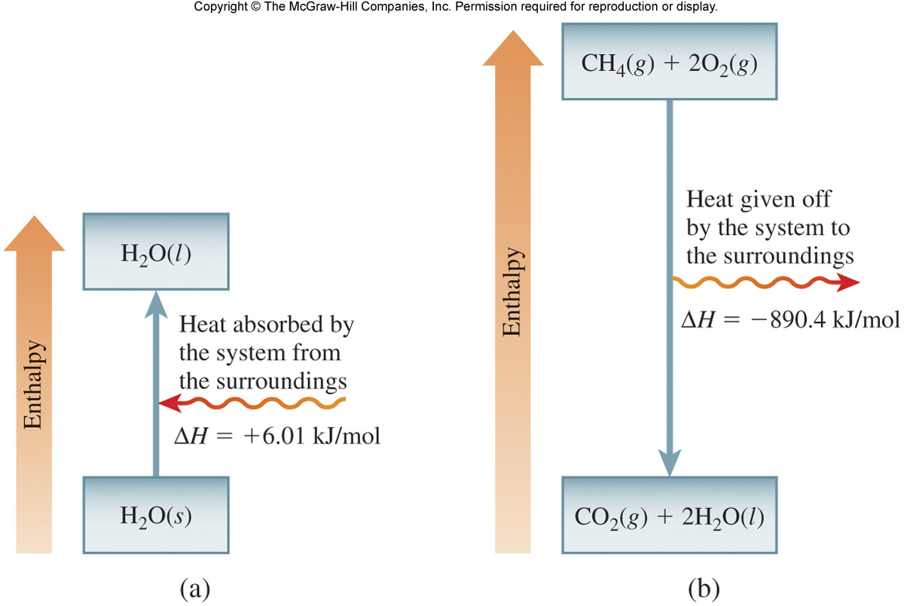
Thermochemical Equations
H₂O(s) $⟶$ H₂O(l) ΔH = +6.01 kJ/mol
Concepts to consider:
Is this a constant pressure process?
What is the system?
What are the surroundings?
ΔH > 0 endothermic
CH₄(g) + 2O₂(g) $⟶$ CO₂(g) + 2H₂O(l) ΔH = −890.4 kJ/mol
Concepts to consider:
Is this a constant pressure process?
What is the system?
What are the surroundings?
ΔH < 0 exothermic

Slide 26


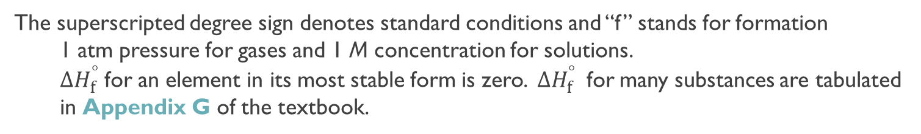

Standard Enthalpies of Formation
The standard enthalpy of formation ($∆H_{f}^{°}$) is defined as the heat change that results when 1 mole of a compound is formed from its constituent elements in their standard states.
C(graphite) + O₂(g) $⟶$ CO₂(g)
$∆H_{f}^{°}$= −393.5 kJ mol^{–1}
The superscripted degree sign denotes standard conditions and “f” stands for formation
  1 atm pressure for gases and 1 M concentration for solutions.
  $∆H_{f}^{°}$ for an element in its most stable form is zero. $∆H_{f}^{°}$ for many substances are tabulated in Appendix G of the textbook.
The standard enthalpy of reaction (Δ$H_{Rxn}^{°}$) is defined as the enthalpy of a reaction carried out under standard conditions.
aA + bB $⟶$ cC + dD
Δ$H_{Rxn}^{°}$= [cΔ$H_{f}^{°}$(C) + dΔ$H_{f}^{°}$(D) ] – [aΔ$H_{f}^{°}$(A) + bΔ$H_{f}^{°}$(B)]
Δ$H_{Rxn}^{°}$= ΣnΔ $H_{f}^{°}$(products) – ΣmΔ$H_{f}^{°}$(reactants)
n and m are the stoichiometric coefficients for the reactants and products.

Slide 27


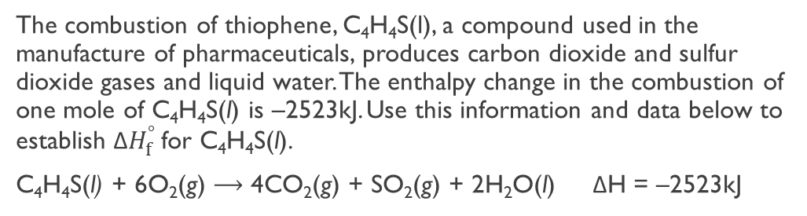

Practice
Using data from Appendix G (textbook link here), calculate Δ$H_{Rxn}^{°}$ for Ag⁺(aq) + Cl–(aq) $⟶$ AgCl(s).
Δ$H_{Rxn}^{°}$ = $n∆H_{f}^{°}$(AgCl) – [$n∆H_{f}^{°}$(Ag⁺) + n$∆H_{f}^{°}$(Cl⁻)]
= –127.0 kJ/mol – [(+105.9 kJ/mol) + (–167.2 kJ/mol)]
= –127.0 kJ/mol – (–61.3 kJ/mol) = –65.7 kJ/mol
The combustion of thiophene, C₄H₄S(l), a compound used in the manufacture of pharmaceuticals, produces carbon dioxide and sulfur dioxide gases and liquid water. The enthalpy change in the combustion of one mole of C₄H₄S(l) is –2523kJ. Use this information and data below to establish Δ$H_{f}^{°}$ for C₄H₄S(l).
C₄H₄S(l) + 6O₂(g) $⟶$ 4CO₂(g) + SO₂(g) + 2H₂O(l) ΔH = –2523kJ
CO₂(g) | –393.5kJ mol^{–1}
SO₂(g) | –296.8 kJ mol ^{–1}
O₂(g) | 0 kJ mol –
H₂O(l) | –285.8kJ mol ^{–1}
Δ$H_{Rxn}^{°}$ = $\left[n∆H_{f}^{°}\left({CO}_{2}\right)+n∆H_{f}^{°}\left({SO}_{2}\right)+n∆H_{f}^{°}\left(H_{2}O\right)\right]$ – $\left[n∆H_{f}^{°}\left(C_{4}H_{4}S\right)+n∆H_{f}^{°}\left(O_{2}\right)\right]$
$\frac{−2523 kJ}{mol}=\left[\left(4\right)\left(\frac{−393.5 kJ}{mol}\right)+\left(1\right)\left(\frac{−296.8 kJ}{mol}\right)+\left(2\right)\left(\frac{−285.8 kJ}{mol}\right)\right]$ – $\left[\left(1\right)\left(x\right)+\left(6\right)\left(0\right)\right]$
$$\frac{−80.6 kJ}{mol}=x$$
$$\frac{−80.6 kJ}{mol}=\text{Δ}H_{f_{C_{4}H_{4}S}}^{°}$$

Slide 28



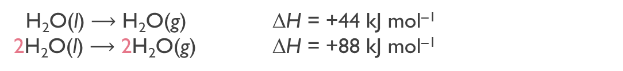



Thermochemical Equations
Enthalpy is an extensive property; these are properties dependent on the amount of matter involved.
H₂O(l) $⟶$ H₂O(g) ΔH = +44 kJ mol^{–1}
2H₂O(l) $⟶$ 2H₂O(g) ΔH = +88 kJ mol^{–1}
Double the amount of matter, double the enthalpy
1) Always specify the physical states of reactants and products because they help determine the actual enthalpy changes.
CH₄(g) + 2O₂(g) $⟶$ CO₂(g) + 2H₂O(g)
ΔH = −802.4 kJ mol^{–1}
CH₄(g) + 2O₂(g) $⟶$ CO₂(g) + 2H₂O(l)
ΔH = +890.4 kJ mol ^{–1}
2) When multiplying an equation by a factor (n), multiply the ΔH value by same factor.
CH₄(g) + 2O₂(g) $⟶$ CO₂(g) + 2H₂O(g)
ΔH = −802.4 kJ mol^{–1}
2CH₄(g) + 4O₂(g) $⟶$ 2CO₂(g) + 4H₂O(g)
ΔH = −1604.8 kJ mol^{–1}
3) Reversing an equation changes the sign but not the magnitude of ΔH.
CH₄(g) + 2O₂(g) $⟶$ CO₂(g) + 2H₂O(g)
ΔH = −802.4 kJ mol^{–1}
CO₂(g) + 2H₂O(g) $⟶$ CH₄(g) + 2O₂(g)
ΔH = +802.4 kJ mol^{–1}

Slide 29



Hess’s Law
Hess’s law states that the change in enthalpy for a stepwise process is the sum of the enthalpy changes for each of the steps.
CH₄(g) + 2O₂(g) $⟶$ CO₂(g) + 2H₂O(l)
ΔH = −890.4 kJ mol^{–1}
2H₂O(l) $⟶$ 2H₂O(g)
ΔH = +88 kJ mol^{–1}
CH₄(g) + 2O₂(g) $⟶$ CO₂(g) + 2H₂O(g)
ΔH =
−802.4 kJ mol^{–1}
CH₄(g) + 2O₂(g)
ΔH = −890.4 kJ
ΔH = −802.4 kJ
CO₂(g) + 2H₂O(g)
CO₂(g) + 2H₂O(l)
ΔH = +88.0 kJ

Slide 30
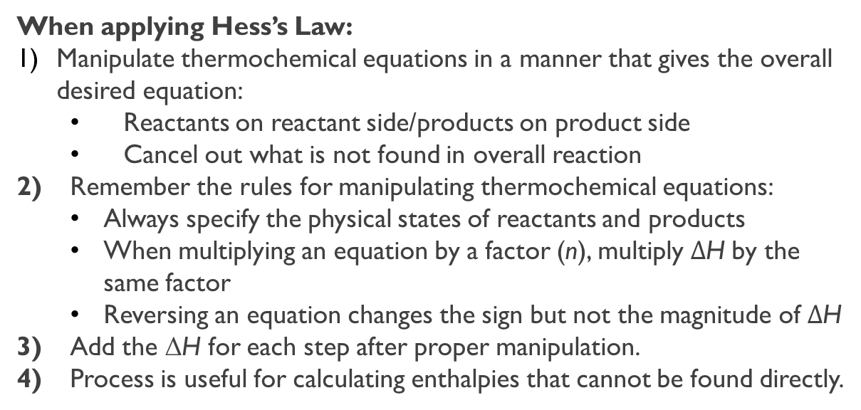
Hess’s Law
When applying Hess’s Law:
Manipulate thermochemical equations in a manner that gives the overall desired equation:
  Reactants on reactant side/products on product side
  Cancel out what is not found in overall reaction
2) Remember the rules for manipulating thermochemical equations:
  Always specify the physical states of reactants and products
  When multiplying an equation by a factor (n), multiply $∆$H by the same factor
  Reversing an equation changes the sign but not the magnitude of $∆$H
3) Add the ΔH for each step after proper manipulation.
4) Process is useful for calculating enthalpies that cannot be found directly.

Slide 31
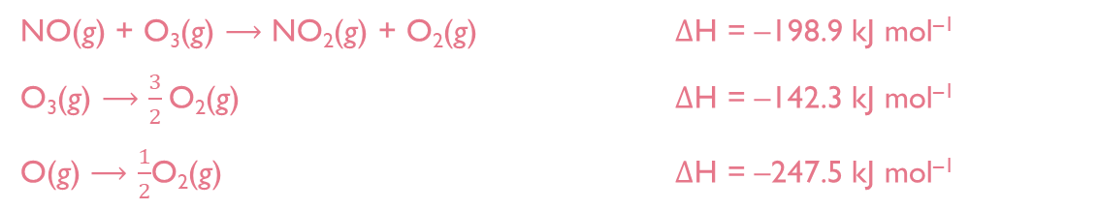
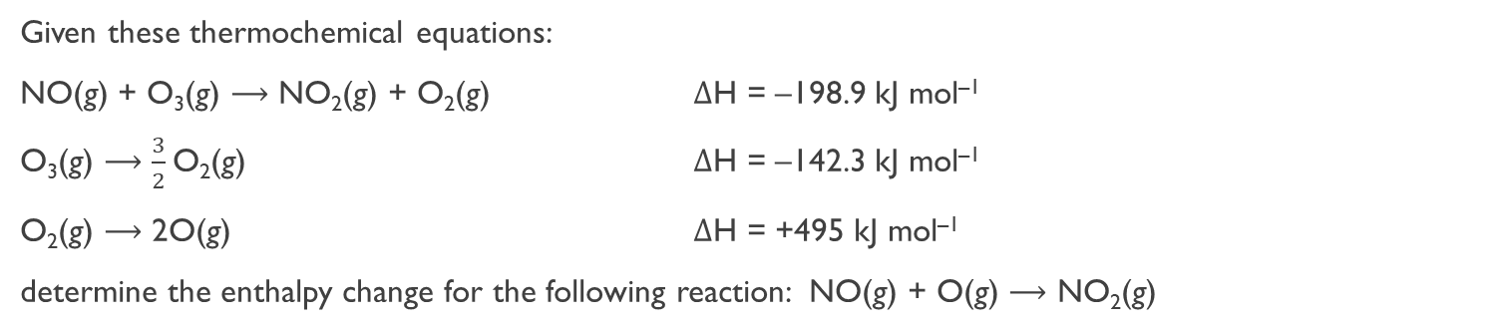



Hess’s Law
Given these thermochemical equations:
NO(g) + O₃(g) $⟶$ NO₂(g) + O₂(g) $∆$H = –198.9 kJ mol^{–1}
O₃(g) $⟶$ $\frac{3}{2}$O₂(g) $∆$H = –142.3 kJ mol^{–1}
O₂(g) $⟶$ 2O(g) $∆$H = +495 kJ mol^{–1}
determine the enthalpy change for the following reaction: NO(g) + O(g) $⟶$ NO₂(g)
The reactants are NO(g) and O(g) in the overall reaction, the thermochemical equations must have O(g) and NO(g) in the reactants. Equation 3 has O(g) as a product and too many O(g), it will need to be halved. It will need to be flipped. The NO₂(g) products are on the product side.
NO(g) + O₃(g) $⟶$ NO₂(g) + O₂(g) $∆$H = –198.9 kJ mol^{–1}
O₃(g) $⟶$ $\frac{3}{2}$O₂(g) $∆$H = –142.3 kJ mol^{–1}
O(g) $⟶$ $\frac{1}{2}$O₂(g) $∆$H = –247.5 kJ mol^{–1}
O₂(g) is not in the overall equation and must be canceled out. The second equation should be flipped to cancel out O₂(g) since it is the only one without products or reactants. Remember 1.5 is the same as 3/2 so all of the O₂(g) will cancel with the second equation flipped.
NO(g) + O₃(g) $⟶$ NO₂(g) + O₂(g) $∆$H = –198.9 kJ mol^{–1}
$\frac{3}{2}$O₂(g) $⟶$O₃(g) $∆$H = +142.3 kJ mol^{–1}
O(g) $⟶$ $\frac{1}{2}$O₂(g) $∆$H = –247.5 kJ mol^{–1}
NO(g) + O(g) $⟶$ NO₂(g)
$∆$H = –304 kJ mol^{–1}

Slide 32
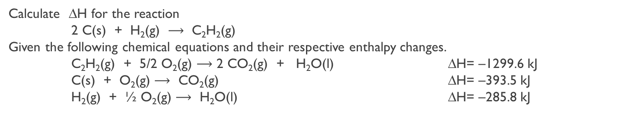
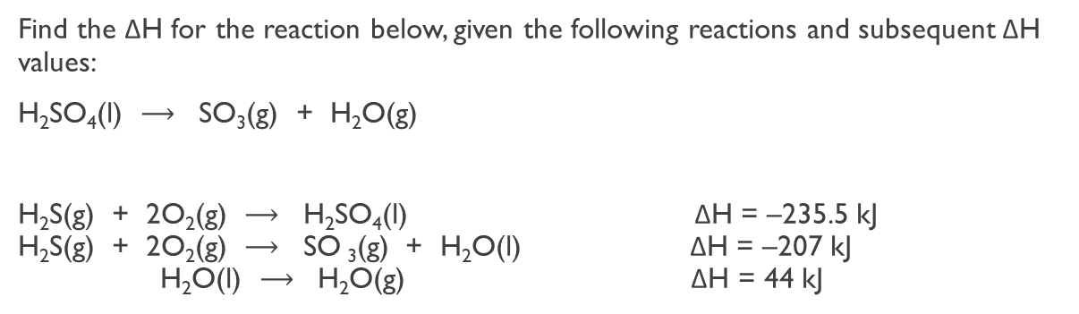
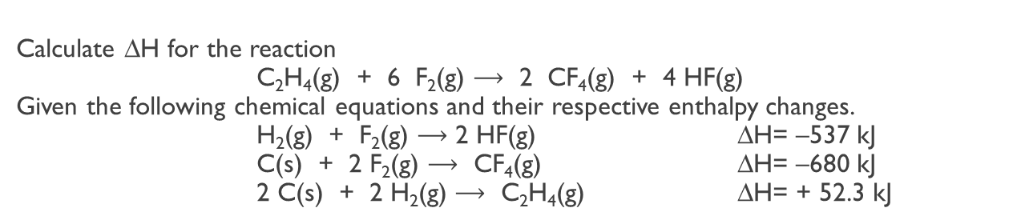
Practice
Find the ΔH for the reaction below, given the following reactions and subsequent ΔH values:
H₂SO₄(l) $⟶$ SO₃(g) + H₂O(g)
H₂S(g) + 2O₂(g) $⟶$ H₂SO₄(l) ΔH = –235.5 kJ
H₂S(g) + 2O₂(g) $⟶$ SO ₃(g) + H₂O(l) ΔH = –207 kJ
H₂O(l) $⟶$ H₂O(g) ΔH = 44 kJ
ΔH = +72.5 kJ
ΔH = +226.8 kJ
Calculate ∆H for the reaction
2 C(s) + H₂(g) $⟶$ C₂H₂(g)
Given the following chemical equations and their respective enthalpy changes.
C₂H₂(g) + 5/2 O₂(g) $⟶$ 2 CO₂(g) + H₂O(l) ∆H= –1299.6 kJ
C(s) + O₂(g) $⟶$ CO₂(g) ∆H= –393.5 kJ
H₂(g) + ½ O₂(g) $⟶$ H₂O(l) ∆H= –285.8 kJ
Calculate ∆H for the reaction
C₂H₄(g) + 6 F₂(g) $⟶$ 2 CF₄(g) + 4 HF(g)
Given the following chemical equations and their respective enthalpy changes.
H₂(g) + F₂(g) $⟶$ 2 HF(g) ∆H= –537 kJ
C(s) + 2 F₂(g) $⟶$ CF₄(g) ∆H= –680 kJ
2 C(s) + 2 H₂(g) $⟶$ C₂H₄(g) ∆H= + 52.3 kJ
ΔH = –2486.3 kJ

Slide 33

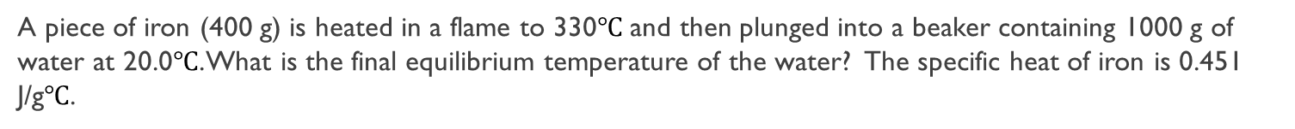



Practice
When 72 g of a metal at 97.0$℃$ is added to 100 g of water at 25.0$℃$, the final temperature is 45.5$℃$. What is the specific heat of the metal? (specific heat of H₂O = 4.184 J/g$℃$)
A piece of iron (400 g) is heated in a flame to 330$℃$ and then plunged into a beaker containing 1000 g of water at 20.0$℃$. What is the final equilibrium temperature of the water? The specific heat of iron is 0.451 J/g$℃$.
A 50.0 g sample of iron (specific heat capacity = 0.444 J/g°C) is heated to 75.2°C and placed into a calorimeter holding 70.0 g of water (specific heat capacity = 4.184 J/g°C) at a temperature of 25.0°C. Assuming no heat loss to the calorimeter, what will be the final temperature reached in the calorimeter.
$${−q}_{Fe}= q_{water}$$
$$−\left(50 g Fe\right)\left( \frac{0.444 J}{g℃}\right)\left(T_{f} −75.2℃\right)= (70 g water)(\frac{4.184 J}{g℃})(T_{f}−25℃)$$
$$−\left( \frac{22.2 J}{℃}\right)\left(T_{f} −75.2 C\right)= \left(\frac{292.88 J}{℃}\right)(T_{f}−25℃)$$
$$\left( \frac{−22.2 J}{℃}\right)\left(T_{f}\right)+1669.44 J= \left(\frac{292.88 J}{℃}\right)\left(T_{f}\right)−7322 J$$
$$\left(T_{f}\right)=28.56℃$$

Slide 34

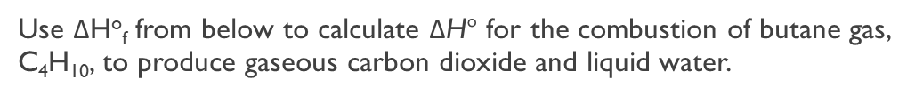
Practice
CO₂(g) | –393.5kJ mol^{–1}
C₄H₁₀(g) | –125.7kJ mol ^{–1}
O₂(g) | 0 kJ mol –
H₂O(l) | –285.8kJ mol ^{–1}
Use ΔHº_{f} from below to calculate ΔH$°$ for the combustion of butane gas, C₄H₁₀, to produce gaseous carbon dioxide and liquid water.
C₄H₁₀(g) + O₂(g) $⟶$ CO₂(g) + H₂O(l)

