Slide 1
Chapter 7: Stoichiometry of Chemical Reactions

Slide 2
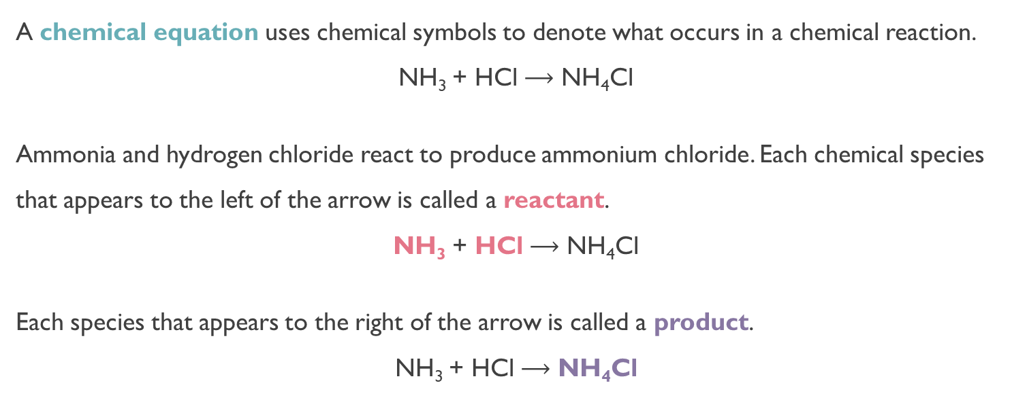
Chemical Equations: Interpreting and Writing
A chemical equation uses chemical symbols to denote what occurs in a chemical reaction.
NH₃ + HCl $⟶$ NH₄Cl
Ammonia and hydrogen chloride react to produce ammonium chloride. Each chemical species that appears to the left of the arrow is called a reactant.
NH₃ + HCl $⟶$ NH₄Cl
Each species that appears to the right of the arrow is called a product.
NH₃ + HCl $⟶$ NH₄Cl
Labels are used to indicate the physical states in a chemical equation:
  (g) gas, (l) liquid, (s) solid, (aq) aqueous [dissolved in water]
NH₃(g) + HCl(g) → NH₄Cl(s)
SO₃(g) + H₂O(l) → H₂SO₄(aq)

Slide 3
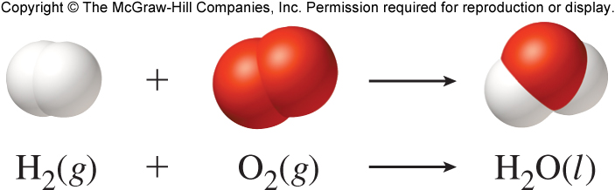
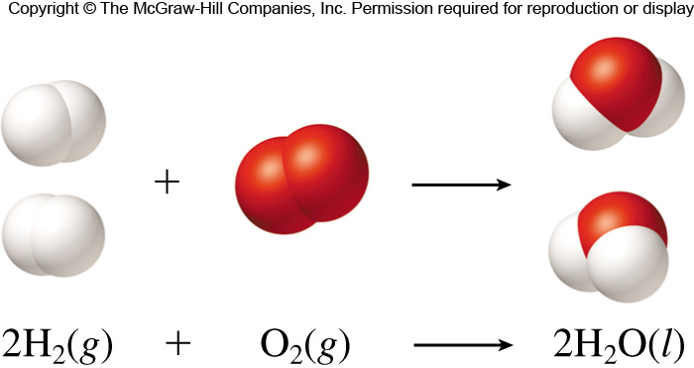

Balancing Chemical Equations
Chemical equations must be balanced so that the law of conservation of mass is obeyed.
Balancing is achieved by writing stoichiometric coefficients to the left of the chemical formulas.
How to “Read” Chemical Equations:
2 atoms Mg + 1 molecule O₂ makes 2 formula units MgO
2 moles Mg + 1 mole O₂ makes 2 moles MgO
48.6 grams Mg + 32.0 grams O₂ makes 80.6 g MgO
2Mg + O₂ $⟶$ 2MgO
This is NOT saying:
2 grams Mg + 1 gram O₂ makes 2 g MgO

Slide 4
Balancing Chemical Equations
Write the correct chemical formula(s) for the reactants on the left side and the correct chemical formula(s) for the product(s) on the right side of the equation.
Change the numbers in front of the formulas (coefficients) to make the number of atoms of each element the same on both sides of the equation. Do not change the subscripts. (subscripts balance charge, coefficients balance equations.
  Start by balancing those elements that appear in only one reactant and one product. The ones that occur the least.
  Balance those elements that appear in two or more reactants or products.
Check to make sure that you have the same number of each type of atom on both sides of the equation.
Link to an Extra Tips Video
Link to Extra Practice

Slide 5






Balancing Chemical Equations
Given the balanced chemical equation for ethane (C₂H₆) reacting with oxygen to form carbon dioxide and water (the combustion of ethane).
C₂H₆(g) + O₂(g) $⟶$ CO₂(g) + H₂O(l)
Start with Carbon (occurs least): 2 C reactants, but 1 C product
C₂H₆(g) + O₂(g) $⟶$ 2CO₂(g) + H₂O(l)
Notice: 2CO₂ NOT C₂O₄
Now, 6 H reactants, but 2 H products
C₂H₆(g) + O₂(g) $⟶$ 2CO₂(g) + 3H₂O(l)
Now, 2 O reactants, but 7 O products
Since there is a diatomic oxygen in the reactants, and we need 7 oxygens in the reactants, we use a fraction. We can get rid of the fraction by multiplying the entire equation by 2
C₂H₆(g) + $\frac{7}{2}$O₂(g) $⟶$ 2CO₂(g) + 3H₂O(l)
Can multiply by 2 to get rid of fraction.
(2)(C₂H₆(g) + $\frac{7}{2}$O₂(g) $⟶$ 2CO₂(g) + 3H₂O(l))
Multiply by 2
2C₂H₆(g) + 7O₂(g) $⟶$ 4CO₂(g) + 6H₂O(l))
Check it is
balanced.

Slide 6

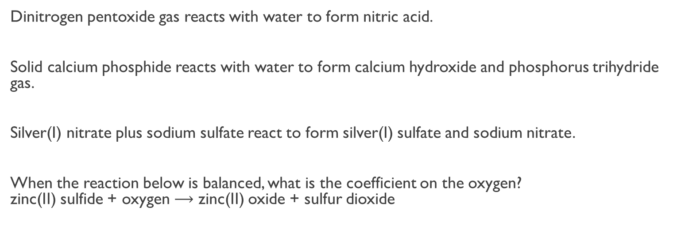

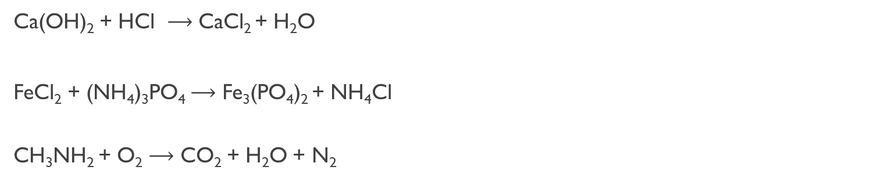






Practice
Ca(OH)₂ + 2HCl $⟶$ CaCl₂ + 2H₂O
Ca(OH)₂ + HCl $⟶$ CaCl₂ + H₂O
FeCl₂ + (NH₄)₃PO₄ $⟶$ Fe₃(PO₄)₂ + NH₄Cl
CH₃NH₂ + O₂ $⟶$ CO₂ + H₂O + N₂
3FeCl₂ + 2(NH₄)₃PO₄ $⟶$ Fe₃(PO₄)₂ + 6NH₄Cl
4CH₃NH₂ + 9O₂ $⟶$ 4CO₂ + 10H₂O + 2N₂
Dinitrogen pentoxide gas reacts with water to form nitric acid.
Solid calcium phosphide reacts with water to form calcium hydroxide and phosphorus trihydride gas.
Silver(I) nitrate plus sodium sulfate react to form silver(I) sulfate and sodium nitrate.
When the reaction below is balanced, what is the coefficient on the oxygen?
zinc(II) sulfide + oxygen $⟶$ zinc(II) oxide + sulfur dioxide
N₂O₅ + H₂O $⟶$ 2HNO₃
Ca₃P₂ + 6H₂O $⟶$ 3Ca(OH)₂ + 2PH₃
2AgNO₃+ Na₂SO₄ $⟶$ Ag₂SO₄ + 2NaNO₃
ZnS + O₂ $⟶$ ZnO + SO₂
Butanol(C₄H₉OH) gas reacts with oxygen to form carbon dioxide, and water.
C₄H₉OH + 6O₂$⟶$ 4CO₂ + 5H₂O

Slide 7
Reaction Types
Combination: two or more reactants combine to form a single product
NH₃(g) + HCl(g) → NH₄Cl(s)
Decomposition: two or more products form from a single reactant
CaCO₃(s) → CaO(s) + CO₂(g)
Combustion: a substance burns in the presence of oxygen. Combustion of a compound that contains C and H (or C, H, and O) produces carbon dioxide gas and liquid water.
CH₂O(l) + O₂(g) → CO₂(g) + H₂O(l)
Double displacement (metathesis, exchange): can be precipitation reaction or molecular product (CO₂,SO₂,H₂S)
Na₂SO₄ + 2AgNO₃ → 2NaNO₃ + Ag₂SO₄
Single displacement: one solid metal exchanges to produce a different solid metal, hydrogen, or halogen.
Al(s) + CuSO₄ (aq) → Al₂(SO₄)₃ (aq) + Cu(s)
Neutralization: (specific double displacement)- acid/base to get salt + water
HCl + NaOH → NaCl + H₂O
Condensation: two molecules combine, and water is released.

Slide 8
Practice
Determine whether each of the following equations represents a combination reaction, a decomposition reaction, or a combustion reaction:
H₂(g) + Br₂(g) → 2HBr(g)
2 reactants; 1 product: Combination
2HCO₂H(l) + O₂(g) → 2CO₂(g) + 2H₂O(l)
carbon with oxygen producing CO₂ and water: Combustion
2KClO₃(s) → 2KCl(s) + 3O₂(g)
1 reactant; 2 products: Decomposition
Remember:
In a molecular equation compounds are represented by chemical formulas as though they exist in solution as molecules or formula units. (What we have been doing)
Na₂SO₄(aq) + Ba(OH)₂(aq) $⟶$ 2NaOH(aq) + BaSO₄(s)
Reactions in which anions in two ionic compounds exchange cations are called double replacement reactions.

Slide 9

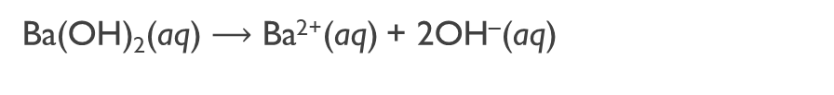

Complete and Net Ionic Equations
In a complete ionic equation compounds that exist completely or predominately as ions in solution are represented as those ions.
Na₂SO₄(aq) + Ba(OH)₂(aq) $⟶$ 2NaOH(aq) + BaSO₄(s)
In the reaction between aqueous Na₂SO₄and Ba(OH)₂ the aqueous species break into pieces as follows:
Na₂SO₄(aq) $⟶$ 2Na⁺(aq) + SO₄^{–2} (aq)
Ba(OH)₂(aq) $⟶$ Ba²⁺(aq) + 2OH–(aq)
NaOH(aq) $⟶$ Na⁺(aq) + OH–(aq)
Complete Ionic Equation
2Na⁺(aq) + SO₄^{–2} (aq) + Ba²⁺(aq) + 2OH–(aq) $⟶$ 2Na⁺(aq) + 2OH–(aq) + BaSO₄(s)
An equation that includes only the species that are involved in the reaction is called a net ionic equation. Ions that appear on both sides of the equation are called spectator ions. Spectator ions do not participate in the reaction and must be crossed out to find the net ionic equation.
2Na⁺(aq) + SO₄^{–2} (aq) + Ba²⁺(aq) +2OH–(aq) $⟶$ 2Na⁺(aq) + 2OH–(aq) + BaSO₄(s)
Ba²⁺(aq) + SO₄^{–2} (aq) $⟶$ BaSO₄(s)
But how do you know what is aqueous (dissolves) and what doesn’t?

Slide 10
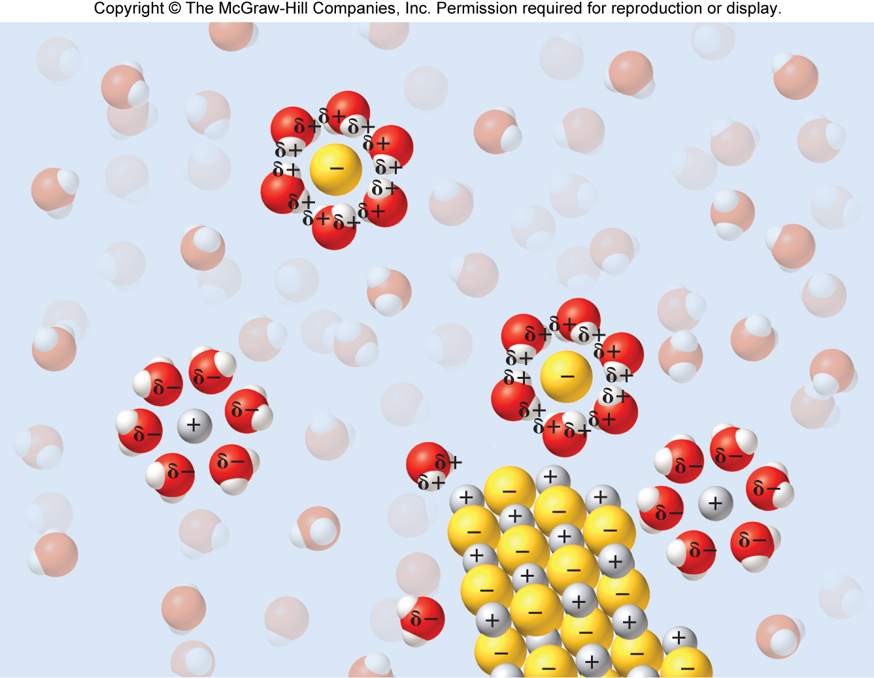
Solubility Guidelines for Ionic Compounds in Water
Water is a good solvent for ionic compounds because it is a polar molecule. The polarity of water results from electron distributions within the molecule. The oxygen atom has an attraction for the hydrogen atoms’ electrons and is therefore partially negative compared to hydrogen.
The oxygen atom is partially negative, and the hydrogen atoms are partially positive
δ–
δ⁺
δ⁺
δ–
δ–
δ⁺
δ⁺
δ⁺
δ⁺
Hydration occurs when water molecules remove the individual ions from an ionic solid surrounding them so the substances dissolves.

Slide 11
Solubility Guidelines for Ionic Compounds in Water
Solubility Rules (Memorize):
Salts of ammonium (NH₄⁺) and Group IA are always soluble.
All chlorides (Cl–) are soluble except AgCl, Hg₂Cl₂, and PbCl₂ which are insoluble.
All bromides (Br–) are soluble except AgBr, Hg₂Br₂, HgBr₂, and PbBr₂ which are insoluble.
All iodides (I–) are soluble except AgI, Hg₂I₂, HgI₂, and PbI₂ which are insoluble.
Chlorates (ClO₃–), bicarbonates (HCO₃–), nitrates (NO₃–), and acetates (CH₃COO– or C₂H₃O₂–) are soluble.
Sulfates (SO₄^{–2}) are soluble except CaSO₄, SrSO₄, BaSO₄, Hg₂SO₄, PbSO₄, and Ag₂SO₄ which are insoluble.
Phosphates (PO₄^{–3}), chromates (CrO₃^{–2}), oxides (O^{–2}), sulfides (S^{–2}) and carbonates (CO₃^{–2}) are insoluble except NH₄⁺ and Group IA compounds.
All metallic hydroxides (OH–), are insoluble except NH₄⁺, Group IA, and Ba²⁺
Most silver compounds are insoluble.
The anion tells you the rule, and the cation tells you the exception
Which compound below is water soluble?
Al₂S₃
KClO₃
BaSO₄

Slide 12
Practice
Which compound below is water soluble?
Na₃PO₄
PbCl₂
KI
MgCO₃
Ca₃(PO₄)₂
Mg(OH)₂
NaNO₃
PbSO₄
Soluble Rule 1 and 7
Insoluble Rule 2
Soluble Rule 4
Insoluble Rule 7
Insoluble Rule 7
Insoluble Rule 8
Soluble Rules 1 and 5
Insoluble Rule 6

Slide 13




Electrolytes and Nonelectrolytes
An electrolyte is a substance that dissolves in water to yield a solution that conducts electricity. (Ionic) An electrolyte undergoes dissociation and breaks apart into its constituent ions.
H₂O
NaCl(s) $⟶$ Na⁺(aq) + Cl–(aq)
Ionization is when a molecular compound forms ions when it dissolves
An electrolyte that dissociates completely (breaks apart completely) is known as a strong electrolyte.
Water soluble ionic compounds
H₂O
NaCl(s) $⟶$ Na⁺(aq) + Cl–(aq)
Strong Acids
H₂O
HCl(g) $⟶$ H⁺(aq) + Cl–(aq)
Strong Bases
H₂O
NaOH(s) $⟶$ Na⁺(aq) + OH–(aq)

Slide 14
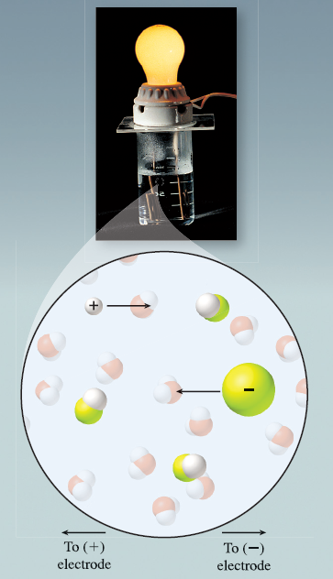
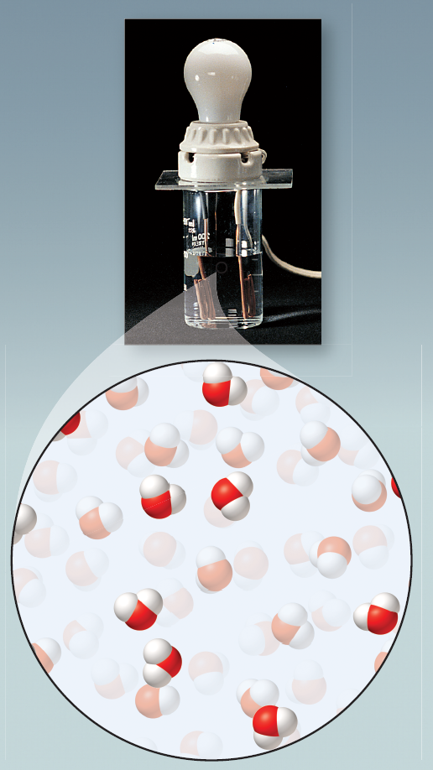

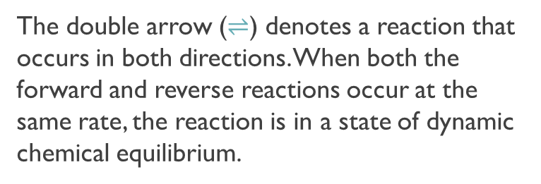


Electrolytes and Nonelectrolytes
A weak electrolyte is a compound that produces ions upon dissolving but exists in solution predominantly as molecules that are not ionized.
Weak Acids
HC₂H₃O₂(l) $⇌$ H⁺(aq) + C₂H₃O₂– (aq)
Weak Bases
NH₃(g) + H₂O(l) $⇌$ NH₄⁺(aq) + OH–(aq)
The double arrow ($⇌$) denotes a reaction that occurs in both directions. When both the forward and reverse reactions occur at the same rate, the reaction is in a state of dynamic chemical equilibrium.
A nonelectrolyte is a substance that dissolves in water to yield a solution that does not conduct electricity.(Molecular)
H₂O
C₁₂H₂₂O₁₁(s) $⟶$ C₁₂H₂₂O₁₁(aq)
The sucrose molecules remain intact upon dissolving.

Slide 15
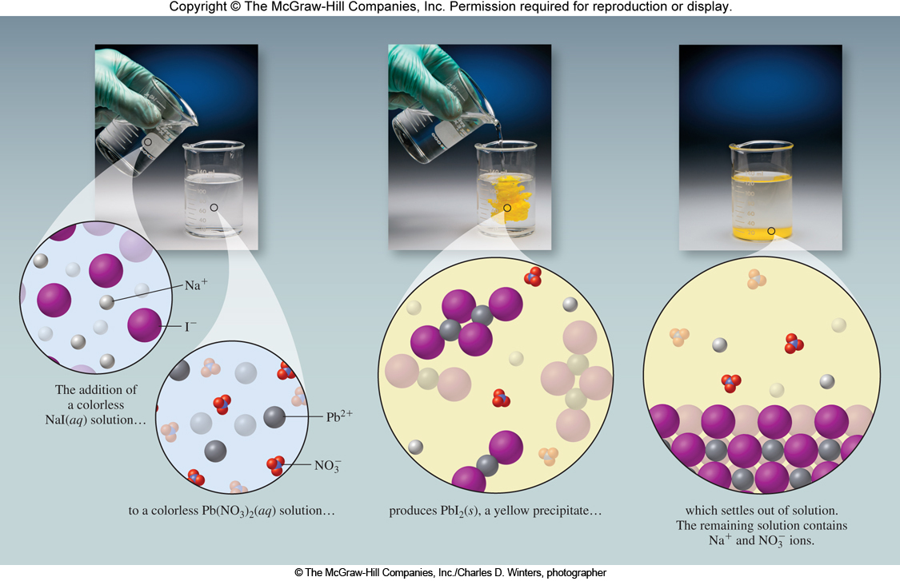
Precipitation Reactions
An insoluble product that separates from a solution is called a precipitate. In the example below, PbI₂(s) is the precipitate.
2NaI(aq) + Pb(NO₃)₂(aq) $⟶$ PbI₂(s) + 2NaNO₃(aq)
A chemical reaction in which a precipitate forms is called a precipitation reaction.

Slide 16
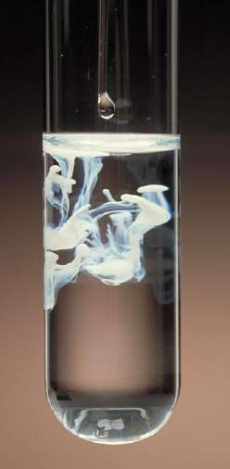

Precipitation Reactions
Na₂SO₄(aq) and Ba(NO₃)₂(aq) are mixed. Will they react (is there a product present that isn’t aqueous?
Na₂SO₄(aq) + Ba(NO₃)₂(aq) $⟶$
How do you find the products?
Na⁺ SO₄²⁻
Ba²⁺ NO₃⁻
You get NaNO₃ and BaSO₄ . Are either of these insoluble (solubility rules)?
Molecular Equation:
Na₂SO₄(aq) + Ba(NO₃)₂(aq) $⟶$
BaSO₄(s)
+ 2 NaNO₃(aq)
Full Ionic Equation:
2Na⁺(aq) + SO₄^{–2}(aq) + Ba²⁺(aq) + 2NO₃–(aq) $⟶$ BaSO₄(s) + 2Na⁺(aq) + 2NO₃–(aq)
Net Ionic Equation:
Yes, a reaction occurs.
SO₄^{–2}(aq) + Ba²⁺(aq) $⟶$ BaSO₄(s)

Slide 17

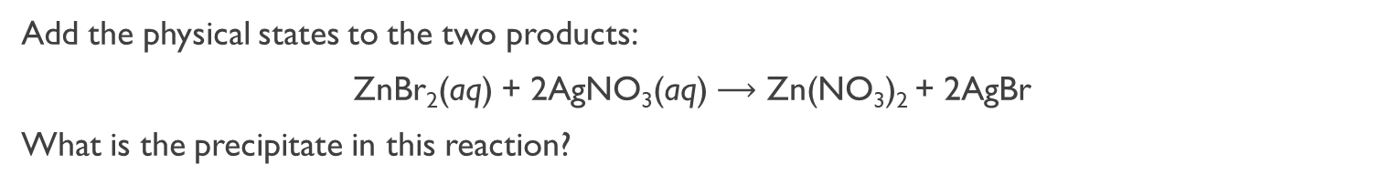
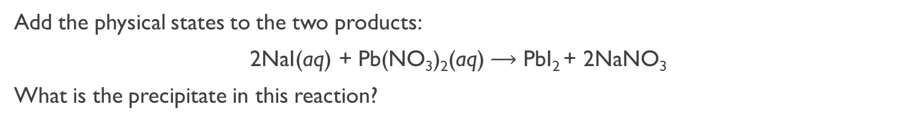

Practice
Add the physical states to the two products:
ZnBr₂(aq) + 2AgNO₃(aq) $⟶$ Zn(NO₃)₂ + 2AgBr
What is the precipitate in this reaction?
ZnBr₂(aq) + 2AgNO₃(aq) $⟶$ Zn(NO₃)₂(aq) + 2AgBr(s)
Net Ionic: 2Br–(aq) + 2Ag⁺(aq) $⟶$ 2AgBr(s)
Add the physical states to the two products:
2NaI(aq) + Pb(NO₃)₂(aq) $⟶$ PbI₂ + 2NaNO₃
What is the precipitate in this reaction?
2NaI(aq) + Pb(NO₃)₂(aq) $⟶$ PbI₂(s) + 2NaNO₃(aq)
Net Ionic: 2I–(aq) + Pb⁺²(aq) $⟶$ PbI₂(s)

Slide 18
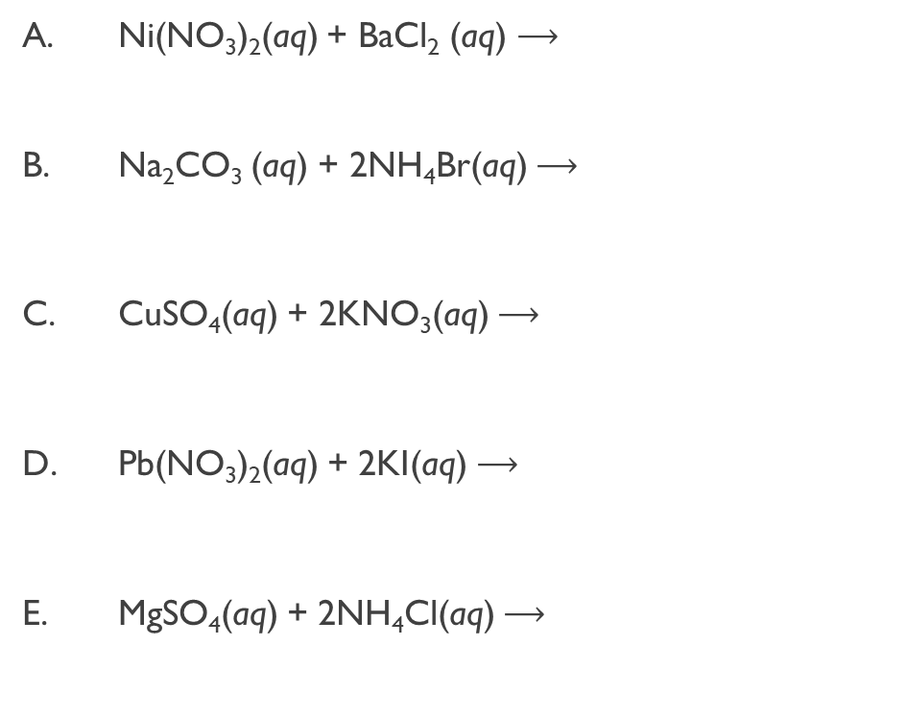
Practice (Don’t forget to balance)
Which combination of reactants will produce a precipitate?
Ni(NO₃)₂(aq) + BaCl₂ (aq) $⟶$
Na₂CO₃ (aq) + 2NH₄Br(aq) $⟶$
CuSO₄(aq) + 2KNO₃(aq) $⟶$
Pb(NO₃)₂(aq) + 2KI(aq) $⟶$
MgSO₄(aq) + 2NH₄Cl(aq) $⟶$
Ba(NO₃)₂(aq) + NiCl₂(aq)
2NaBr(aq) + (NH₄)₂CO₃(aq)
Cu(NO₃)₂(aq) + K₂SO₄(aq)
PbI₂(s) + 2KNO₃(aq)
(NH₄)₂SO₄(aq) + MgCl₂(aq)

Slide 19
Practice (Don’t forget to balance)
Predict the products from mixing the following reactants and give a balanced molecular equation, a complete ionic equation, and a net ionic equation:
Zinc(II) Bromide + Silver(I) nitrate
Ammonium sulfide + copper(II) nitrate
AgNO₃(aq) + KCl(aq)
Mg(NO₃)₂(aq) + Na₂CO₃(aq)
strontium bromide (aq) + potassium sulfate (aq)
chromium(III) nitrate (aq) + iron(II) sulfate (aq)
K₃PO₄(aq) + Al(NO₃)₃(aq)
Name the spectator ions when Pb(NO₃)₂(aq) and Na₂S(aq) are mixed

Slide 20
Acid-Base Reactions
Acids can be either strong or weak. A strong acid = strong electrolyte and strong bases = strong electrolytes (dissociate completely). Strong bases are the hydroxides of Group 1A and heavy Group 2A.
Strong Acids (Memorize)
HCl Hydrochloric acid
HBr Hydrobromic acid
HI Hydroiodic acid
HNO₃ Nitric acid
H₂SO₄ Sulfuric acid
HClO₄ Perchloric acid
Strong Bases (Memorize)
LiOH Lithium hydroxide
NaOH Sodium hydroxide
KOH Potassium hydroxide
RbOH Rubidium hydroxide
CsOH Cesium hydroxide
Ca(OH)₂ Calcium hydroxide
Ba(OH)₂ Barium hydroxide
Sr(OH)₂ Strontium hydroxide
Common Weak Acid
HF Hydrofluoric acid
H₃PO₄ Phosphoric acid
CH₃COOH Acetic acid
H₂CO₃ Carbonic acid
HCN Hydrocyanic acid
Common Weak Base
NH₃ Ammonia
CH₃NH₂ Methylamine

Slide 21




Acid-Base Reactions
An Arrhenius acid is one that ionizes in water to produce protons (H⁺).
An Arrhenius base is one that dissociates in water to produce OH– ions.
H₂O
HCl(g) $⟶$ H⁺(aq) + Cl–(aq)
H₂O
NaOH(s) $⟶$ Na⁺(aq) + OH–(aq)
A Brønsted acid is a proton donor (loses a proton) and a Brønsted base is a proton acceptor (gains a proton).
In these definitions, a proton refers to a hydrogen atom that has lost its electron—also known as a hydrogen ion (H⁺). If an acid is in water, the acid will donate a proton to water and the product is known as a hydronium ion (H₃O⁺).
hydrogen ion (H⁺)
proton
hydronium ion (H₃O⁺)
All referencing the same aqueous species
HF(aq) + H₂O(l) $⟶$ H₃O⁺(aq) + F–(aq)
HF is acid, lost a H⁺ (product is one proton less than reactant)
NH₃(aq) + H₂O(l) $⇌$ NH₄⁺(aq) + OH–(aq)
NH₃ is base, gained a H⁺ (product is one proton more than reactant.

Slide 22





Acid-Base Neutralization
A monoprotic acid has one proton to donate. Hydrochloric acid is an example:
HCl(g) $⟶$ H⁺(aq) + Cl–(aq)
A polyprotic acid has more than one acidic hydrogen atom. Sulfuric acid, H₂SO₄, is an example of a diprotic acid; there are two acidic hydrogen atoms.
Polyprotic acids lose protons in a stepwise fashion:
Step 1:
H₂SO₄(aq) $⟶$ H⁺(aq) + HSO₄– (aq)
In H₂SO₄, the first ionization is strong.
Step 2:
HSO₄(aq) $⇌$ H⁺(aq) + SO₄^{2–} (aq)
–
In H₂SO₄, the second ionization occurs only to a very small extent (equilibrium established).
A neutralization reaction is a reaction between an acid and a base. Generally, a neutralization reaction produces water and a salt.
HCl(aq) + NaOH(aq) $⟶$ H₂O(l) + NaCl(aq)
The net ionic equation of a strong acid– strong base reactions is:
H⁺(aq) + OH–(aq) $⟶$ H₂O(l)

Slide 23


Strong Acid-Strong Base Net Ionic
Strong Acid reacting with a Strong Base (remember that strong acids and bases completely ionize; they are strong electrolytes). Below is an example of a general strong acid/strong base reaction (M is metal):
Molecular Equation:
HX(aq) + MOH(aq) $⟶$ MX(aq) + H₂O(l)
Full Ionic:
H⁺(aq) + X–(aq) + M⁺(aq) + OH–(aq) $⟶$ M⁺(aq) + X–(aq) + H₂O(l)
Net Ionic:
H⁺(aq) + OH–(aq) → H₂O(l)
Give the net ionic equation for the reaction between hydrochloric acid and sodium hydroxide.
HCl(aq) + NaOH(aq)$⟶$NaCl(aq) + H₂O(l)
H⁺(aq) + Cl–(aq) + Na⁺(aq) + OH–(aq)$⟶$Na⁺(aq) + Cl–(aq) + H₂O(l)
H⁺(aq) + OH–(aq) $⟶$ H₂O(l)

Slide 24
Weak Acid-Strong Base Net Ionic
Weak Acid reacting with a Strong Base (remember that weak acids don’t completely ionize, they will make the product, but we can’t break them apart in full ionic equation. Below is an example of a general weak acid/strong base reaction:
Molecular Equation:
HX(aq) + MOH(aq) $⟶$ MX(aq) + H₂O(l)
Full Ionic:
HX(aq) + M⁺(aq) + OH–(aq) $⟶$ M⁺(aq) + X–(aq) + H₂O(l)
Weak electrolyte (weak acid) won’t break apart in full ionic equation but it does make the product (MX).
Net Ionic:
HX(aq) + OH–(aq) → X–(aq) + H₂O(l)

Slide 25







Acid/Base Net Ionic Equation Practice
Give the Net Ionic Equation for the following reactions:
HCOOH + OH– $⟶$ HCOO– + H₂O
HCOOH + NaOH
Sr(OH)₂ + HCl
HF + LiOH
CH₃COOH + Ba(OH)₂
HBr + NaOH
HNO₃ + NH₃
H⁺ + OH– $⟶$ H₂O
HF + OH– $⟶$ F– + H₂O
CH₃COOH + OH– $⟶$ CH₃COO– + H₂O
H⁺ + OH– $⟶$ H₂O
H⁺ + NH₃ $⟶$ NH₄⁺
What is the net ionic equation for the acid-base reaction that occurs when acetic acid and potassium hydroxide solutions are mixed?
CH₃COOH + OH– $⟶$ CH₃COO– + H₂O

Slide 26
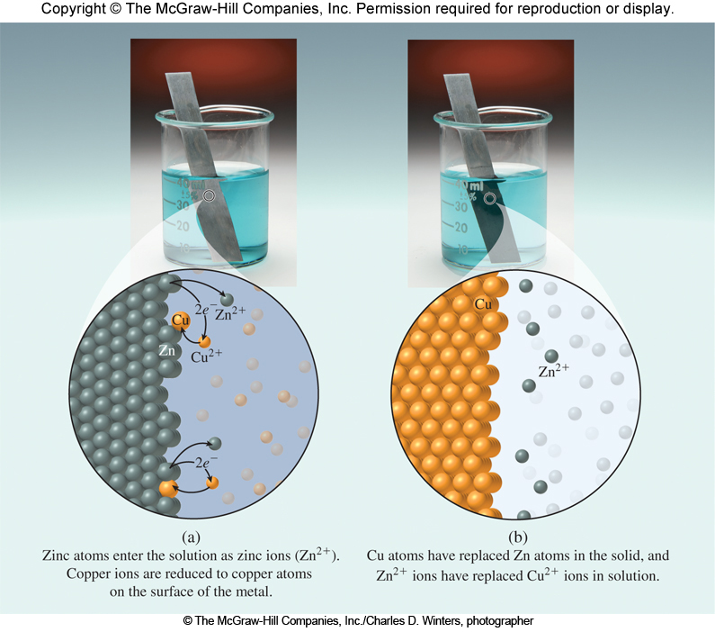

Oxidation-Reduction Reactions
An oxidation-reduction (RedOx) reaction is a chemical reaction in which electrons are transferred from one reactant to another.
Oxidation is the loss of electrons. Reduction is the gain of electrons.
Lost 2 e– (got more +)
Zn(s) + Cu²⁺(aq) $⟶$ Zn²⁺(aq) + Cu(s)
Gained 2 e– (got more –)
Zinc solid loses 2 e– and becomes aqueous zinc (meaning it is no longer a solid in solution but is dissolved). Zinc was oxidized to Zn²⁺. The compound that contains the elements/ion that is oxidized is the Reducing Agent (the compound that causes reduction), therefore Zn(s) is the reducing Agent.
Copper(II) gained 2 e– to become copper solid. Cu²⁺ was reduced to Cu(s). The compound that contains the elements/ion that is reduced is the Oxidizing Agent (the compound that causes the oxidation), therefore Cu²⁺ is the Oxidizing Agent.

Slide 27
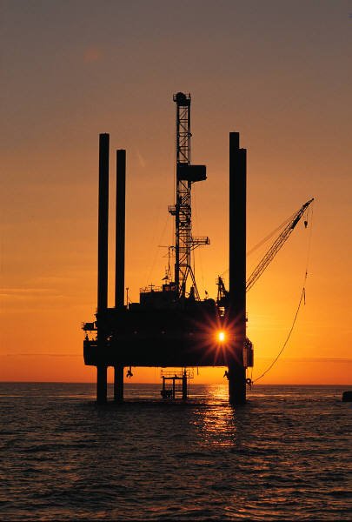




RedOx Reactions and Electron Transfer
Loss of electrons is oxidation
Gain of electrons is reduction
Oxidation is loss
Reduction is gain
LeO says GeR
OiL RiG
A redox reaction is the sum of an oxidation half-reaction and a reduction half-reaction.
Oxidation (lose 2e–)
Zn(s) + Cu²⁺(aq) $⟶$ Zn²⁺(aq) + Cu(s)
Reduction (gains 2e–)
Oxidation half-reaction:
Zn(s) $⟶$ Zn²⁺(aq) + 2e–
Reduction half-reaction:
Cu²⁺(aq) + 2e– $⟶$ Cu(s)
Overall redox reaction:
Cu²⁺(aq) + Zn(s) $⟶$ Zn²⁺(aq) + Cu(s)

Slide 28
Oxidation Numbers (Oxidation State)
The oxidation number is the charge an atom would have if electrons were transferred completely.
Oxidation Number Rules (Must be applied in order)
The oxidation number for an atom in its elemental form (how it is found in nature) is always zero.
  A substance is elemental if both of the following are true:
    Only one kind of atom is present
    Charge = 0
Example Rule 1: S₈: S oxidation number = 0
Fe(s) : Fe oxidation number = 0
The oxidation number of a monatomic ion = charge of the monatomic ion.
Example Rule 2: Oxidation number of S^{–2} = –2
The oxidation number of all Group 1A metals = +1 (unless elemental: Rule 1)
The oxidation number of all Group 2A metals = +2 (unless elemental: Rule 1)
Hydrogen (H) has two possible oxidation numbers:
  +1 when bonded to a nonmetal
  –1 when bonded to a metal
Oxygen (O) has two possible oxidation numbers:
  –1 in peroxides (O₂^{–2}) : Not very common (only assign through calculations)
  –2 in all other compounds : Most common
The oxidation number of fluorine (F) is always –1. All halogens –1 unless combined with O or other halogens.
The sum of the oxidation numbers of all atoms (or ions) in a molecule or polyatomic ion equals the charge on the molecule or ion

Slide 29
Assigning Oxidation Numbers
Assign the oxidation numbers to the elements in the compound H₂SO₄.
H₂SO₄
Is it elemental? (Is it an individual atom or is bound to something?)
No, not elemental
Is it a charged element (monatomic ion)?
No, not a charged element
Is a group I metal present?
No
Is a group II metal present?
No
Is a hydrogen present?
Yes
Is it bound to a metal or nonmetal?
Nonmetal
Oxidation number for hydrogen is +1
Is there an oxygen present?
Yes
Is the oxygen the only unknown oxidation number?
No, S not known
Oxidation number for oxygen is –2
Is a fluorine present?
No
The sum of all oxidation numbers must sum to the overall charge of the compound. The overall charge of the compound is zero. Solve for the unknown
(2)(+1) + (1)(x) + (4)(–2) = 0
2+ x – 8 = 0
x = +6 (Oxidation number for sulfur is +6)

Slide 30
Assigning Oxidation Numbers
ClO₃–
Is it elemental? (Is it an individual atom or is bound to something?)
No, not elemental
Is it a charged element (monatomic ion)?
No, not a charged element
Is a group I metal present?
No
Is a group II metal present?
No
Is a hydrogen present?
No
Is there an oxygen present?
Yes
Is the oxygen the only unknown oxidation number?
No, Cl not known
Oxidation number for oxygen is –2
Is a fluorine present?
No
The sum of all oxidation numbers must sum to the overall charge of the compound. The overall charge of the compound is zero. Solve for the unknown
(1)(x) + (3)(–2) = –1
X – 6 = –1
x = +5 (Oxidation number for chlorine is +5)

Slide 31
Oxidation Numbers
The oxidation number is sometimes called the oxidation state.
H₂(g) + F₂(g) → 2HF(g)
Oxidation number:
0
0
+1
–1
Total contribution to charge:
0
0
+1
–1
N₂(g) + 3H₂(g) → 2NH₃(g)
Oxidation number:
0
0
–3
+1
Total contribution to charge:
0
0
–3
+3

Slide 32
Practice
Assign the oxidation number for the underlined element.
KNO₂
Cs₂O
C₂O₄²⁻
KMnO₄
Mg(NO₃)₂
VO₃
PCl₅
H₃PO₃
IF₇
N: +3
Cs: +1
C: +3
Mn: +7
N: +5
V: +6
P: +5
P: +3
I: +7

Slide 33

Oxidation Numbers and RedOx Reactions
We use oxidation numbers to identify RedOx reactions. If there is an oxidation number change, then electrons (e–) are transferred. If electrons are transferred it is a RedOx reaction.
Oxidation numbers also allow us to track what loses electrons and what gains electrons. If negative charge is gained, electrons are gained. If negative charge is lost, electrons are lost.
If an oxidation number gets more positive, it lost electrons, the element was oxidized. If an oxidation number get more negative, it gained electrons, the element was reduced.
Which species is reduced in the following reaction?
2Al(s) + 3Br₂(l) $⟶$ 2AlBr₃(s)
2Al(s) + 3Br₂(l) $⟶$ 6AlBr₃(s)
Al
B. Br₂
C.AlBr₃
D. None of them
Oxidation Number:
0
0
+3
–1
Al lost negative charge, got more positive, it was oxidized.
Br gained negative charge, got more negative, it was reduced.
What is the oxidation number of the chromium atom in K₂CrO₄?
A. 2 B. 4 C. 6 D. 8

Slide 34
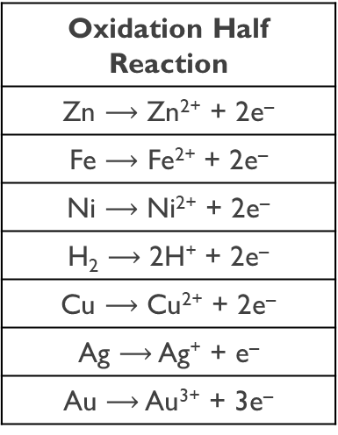
Oxidation of Metals in Aqueous Solutions
In a single displacement reaction, an atom or an ion in a compound is replaced by an atom of another element.
Zn(s) + CuCl₂(aq) → ZnCl₂(aq) + Cu(s)
Oxidation Number:
0
+2
–1
+2
–1
0
Zinc displaces or replaces copper in the dissolved salt. Zn is oxidized to Zn²⁺. Cu²⁺ is reduced to Cu. When a metal is oxidized by an aqueous solution, it becomes an aqueous ion.
The activity series is a list of metals (and hydrogen) arranged from top to bottom in order of decreasing ease of oxidation.
Oxidation Half Reaction
Zn $⟶$ Zn²⁺ + 2e–
Fe $⟶$ Fe²⁺ + 2e–
Ni $⟶$ Ni²⁺ + 2e–
H₂ $⟶$ 2H⁺ + 2e–
Cu $⟶$ Cu²⁺ + 2e–
Ag $⟶$ Ag⁺ + e–
Au $⟶$ Au³⁺ + 3e–
Metals listed at the top are called active metals.
Metals listed at the bottom are called noble metals.
An element in the series will be oxidized by the ions of any element that appears below it in the table.
Reaction 1: Zn(s) + CuCl₂(aq) → ZnCl₂(aq) + Cu(s)
Increasing ease of oxidation
Reaction 2: Cu(s) + ZnCl₂(aq) → no reaction
Reaction 1, Zn is oxidized by Cu. This is possible because Zn(s) is above Cu on the activity series.

Slide 35





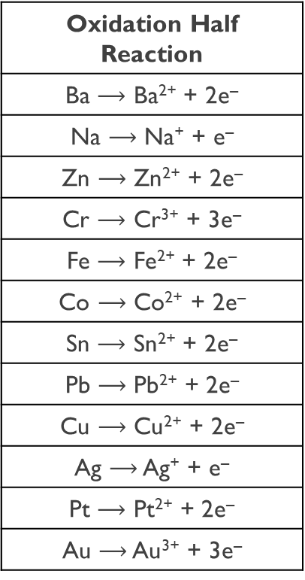

Oxidation of Metals in Aqueous Solutions
Which of the following reactions will occur?
Co(s) + BaI₂(aq) $⟶$
No Reaction
Oxidation Half Reaction
Ba $⟶$ Ba²⁺ + 2e–
Na $⟶$ Na⁺ + e–
Zn $⟶$ Zn²⁺ + 2e–
Cr $⟶$ Cr³⁺ + 3e–
Fe $⟶$ Fe²⁺ + 2e–
Co $⟶$ Co²⁺ + 2e–
Sn $⟶$ Sn²⁺ + 2e–
Pb $⟶$ Pb²⁺ + 2e–
Cu $⟶$ Cu²⁺ + 2e–
Ag $⟶$ Ag⁺ + e–
Pt $⟶$ Pt²⁺ + 2e–
Au $⟶$ Au³⁺ + 3e–
Is Cobalt below Barium?
Yes
Is Cobalt easier to oxidize than Barium?
No; Ba above Co
Sn(s) + CuBr₂(aq) $⟶$
SnBr₂(aq) + Cu(s)
Is Tin below Copper?
No
Is Tin easier to oxidize than Copper?
Yes
Ag(s) + NaCl(aq) $⟶$
No Reaction
Is Silver below Sodium?
Yes
Is Silver easier to oxidize than Sodium?
No; Na above Ag
Fe(s) + PtCl₂(aq) $⟶$
Pt(s) + FeCl₂(aq)
Is Iron below Platinum?
No
Is Iron easier to oxidize than Platinum?
Yes; Fe above Pt
Cr(s) + AuCl₃(aq) $⟶$
Au(s) + CrCl₃
Is Chromium below Gold?
No
Is Chromium easier to oxidize than Gold?
Yes; Cr above Au
Pb(s) + Zn(NO₃)₂₍aq) $⟶$
No Reaction
Is Lead below Zinc?
Yes
Is Lead easier to oxidize than Zinc?
No; Zn above Pb

Slide 36



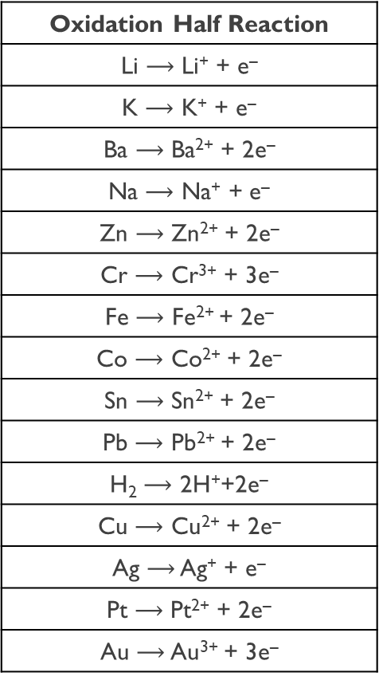



Oxidation of Metals in Aqueous Solutions
Oxidation Half Reaction
Li $⟶$ Li⁺ + e–
K $⟶$ K⁺ + e–
Ba $⟶$ Ba²⁺ + 2e–
Na $⟶$ Na⁺ + e–
Zn $⟶$ Zn²⁺ + 2e–
Cr $⟶$ Cr³⁺ + 3e–
Fe $⟶$ Fe²⁺ + 2e–
Co $⟶$ Co²⁺ + 2e–
Sn $⟶$ Sn²⁺ + 2e–
Pb $⟶$ Pb²⁺ + 2e–
H₂ $⟶$ 2H⁺+2e–
Cu $⟶$ Cu²⁺ + 2e–
Ag $⟶$ Ag⁺ + e–
Pt $⟶$ Pt²⁺ + 2e–
Au $⟶$ Au³⁺ + 3e–
Which of the following reactions will occur?
Is the solid above the aqueous?
Yes
Cr(s) + Au³⁺(aq) $⟶$
Yes
K(s) + CuCl₂(aq) $⟶$
Yes
Co(s) + Sn(NO₃)₂₍aq) $⟶$
Pb(s) + Cr(OH)₃(aq) $⟶$
No
No
H₂(g) + ZnCl₂(aq) $⟶$
Yes
Zn(s) + HCl(aq) $⟶$

Slide 37
Balancing Simple RedOx Equations
Redox reactions must have both mass balance and charge balance.
Cr(s) + Ni²⁺(aq) $⟶$ Cr³⁺(aq) + Ni(s)
Oxidation half-reaction:
Cr(s)
Cr³⁺(aq) + 3e–
Reduction half-reaction:
Ni²⁺(aq) + 2e–
Ni(s)
Before adding half-reactions, the electrons must balance.
Step 1: Balance the Electrons: Multiply the oxidation half-reaction by 2
Oxidation half-reaction:
2
Cr(s)
Cr³⁺(aq) + 3e–
Step 2: Balance the Electrons: Multiply the reduction half-reaction by 3
Reduction half-reaction:
3
Ni²⁺(aq) + 2e–
Ni(s)
Oxidation half-reaction:
2Cr(s)
2Cr³⁺(aq) + 6e–
Reduction half-reaction:
3Ni(s)
3Ni²⁺(aq) + 6e–
3Ni²⁺(aq) + 2Cr(s)
3Ni(s) + 2Cr³⁺(aq)
This is known as the half-reaction method.

Slide 38
Example
Predict which of the following reactions will occur, and for those that will occur, balance the equation and indicate which element is oxidized and which is reduced: (a) Al(s) + CaCl₂(aq) → ? (b) Cr(s) + Pb(C₂H₃O₂)₂(aq) → (c) Sn(s) + HI(aq) → ?
Solution
(a)No reaction. Calcium is above aluminum on the activity series table.
(b)The two half-reactions are represented by the following:
Oxidation: Cr(s) → Cr³⁺ (aq) + 3e⁻
Reduction: Pb²⁺(aq) + 2e⁻ → Pb(s)
In order to balance the charges, we must multiply the oxidation half-reaction by 2 and the reduction half-reaction by 3:
(2)[Cr(s) → Cr³⁺ (aq) + 3e⁻] = 2Cr(s) → 2Cr³⁺ (aq) + 6e⁻
(3)[Pb²⁺(aq) + 2e⁻ → Pb(s)] = 3Pb²⁺(aq) + 6e⁻ → 3Pb(s)
We can then add the two half-reactions, canceling the electrons on both sides to get
2Cr(s) + 3Pb²⁺(aq) → 2Cr³⁺ (aq) + 3Pb(s)
The overall balanced molecular equation is
2Cr(s) + 3Pb(C₂H₃O₂)₂(aq) → 2Cr(C₂H₃O₂)₃(aq) + 3Pb(s)
Chromium is oxidized (0 to +3) and lead is reduced (+2 to 0).

Slide 39
Example Continued (Part C)
Predict which of the following reactions will occur, and for those that will occur, balance the equation and indicate which element is oxidized and which is reduced: (a) Al(s) + CaCl₂(aq) → ? (b) Cr(s) + Pb(C₂H₃O₂)₂(aq) → (c) Sn(s) + HI(aq) → ?
Solution
The two half-reactions are as follows:
Oxidation: Sn(s) → Sn²⁺ (aq) + 2e–
Reduction: 2H⁺(aq) + 2e– → H₂(g)
Adding the two half-reactions and canceling the electrons on both sides yields
Sn(s) + 2H⁺(aq) → Sn²⁺ (aq) + H₂(g)
The overall balanced molecular equation is
Sn(s) + 2HI(aq) → SnI₂(aq) + H₂(g)
Tin is oxidized (0 to +2) and hydrogen is reduced (+1 to 0). Reactions in which hydrogen ion is reduced to hydrogen gas are known as hydrogen displacement reactions.
Think About It Check your conclusions by working each problem backward. Write each equation in reverse and compare the positions of the elements in the activity series.

Slide 40
Other Types of Redox Reactions
Combination reactions can involve oxidation and reduction. Hydrogen is oxidized from 0 to +1 and nitrogen is reduced from 0 to –3.
N₂(g) + 3H₂(g) $⟶$ 2NH₃(g)
Decomposition can also be a redox reaction. Na⁺ is reduced to Na and H– is oxidized to H₂.
NaH(s) $⟶$ 2Na(s) + 3H₂(g)
Disproportionation reactions occur when one element undergoes both oxidation and reduction. Oxygen in H₂O₂ (and other peroxides) has an oxidation number of –1.
2H₂O₂(aq) $⟶$ 2H₂O(l) + O₂(g)
Combustion is also a redox process.
CH₄(g) + 2O₂(g) $⟶$ CO₂(g) + 2H₂O(l)

Slide 41
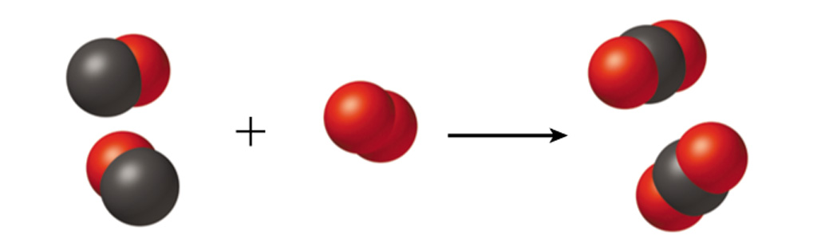
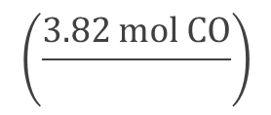



The Mole and Chemical Reactions
Consider the complete reaction of 3.82 moles of CO to form CO₂. Calculate the number of moles of O₂ needed.
2 CO(g) + O₂(g) $⟶$ 2CO₂(g)
The balanced chemical equation tells us that for every 2 CO moles we get 2 CO₂ moles, and for every 2CO moles we need 1O₂ mole; and for every 1O₂ mole we get 2CO₂ moles. These are the mole : mole conversion factors (they come from a balanced chemical equation).
$$\left(\frac{3.82 mol CO}{}\right)$$
$$\left(\frac{1 mol O_{2}}{2 mol CO}\right)$$
$$=1.91 mol O_{2}$$

Slide 42

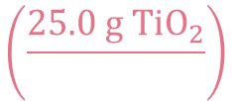


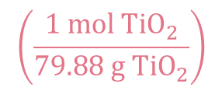

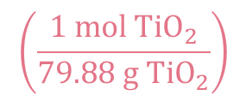
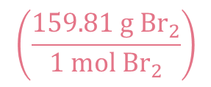
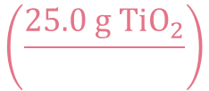
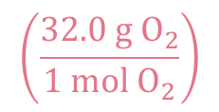
The Mole and Chemical Reactions
What mass of O₂ and Br₂ is produced by the reaction of 25.0 g of TiO₂ with excess BrF₃?
3 TiO₂(s) + 4 BrF₃(l) $⟶$ 3 TiF₄(s) + 2 Br₂(l) + 3 O₂(g)
Make sure equation is balance to find Stoichiometric ratios: 3TiO₂ gives 3O₂ ; 3TiO₂ gives 2Br₂; along with others…… everything in equation is related through coefficients
Excess BrF₃ means that there is enough BrF₃ to react all the TiO₂.
$$\left(\frac{25.0 g {TiO}_{2}}{}\right)$$
$$\left(\frac{1 mol {TiO}_{2}}{79.88 g {TiO}_{2}}\right)$$
$$\left(\frac{3 mol O_{2}}{3 mol{ TiO}_{2}}\right)$$
$$\left(\frac{32.0 g O_{2}}{1 mol O_{2}}\right)$$
$$=10.0 g{ O}_{2}$$
$$\left(\frac{25.0 g {TiO}_{2}}{}\right)$$
$$\left(\frac{1 mol {TiO}_{2}}{79.88 g {TiO}_{2}}\right)$$
$$\left(\frac{2 mol {Br}_{2}}{3 mol{ TiO}_{2}}\right)$$
$$\left(\frac{159.81 g {Br}_{2}}{1 mol {Br}_{2}}\right)$$
$$=33.4 g{ Br}_{2}$$

Slide 43

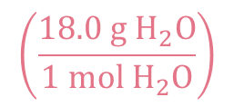


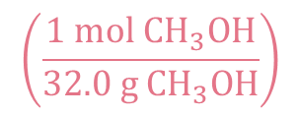
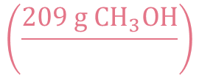
The Mole and Chemical Reactions
Mole Reactant
Mole Product
Mass Reactant
Mole Reactant
Mole Product
Mass Reactant
Mole Reactant
Mole Product
Mass Product
Write the balanced chemical equation. Convert quantities of known substances into moles, then use coefficients in balanced equation to calculate the number of moles of the sought quantity, and convert moles of sought quantity into desired units
Methanol burns in air according to the equation
2CH₃OH + 3O₂ $⟶$ 2CO₂ + 4H₂O
If 209 g of methanol are used up in the combustion, what mass of water is produced?
grams CH₃OH $⟶$ moles CH₃OH $⟶$ moles H₂O $⟶$ grams H₂O
$$\left(\frac{209 g {CH}_{3}OH}{}\right)$$
$$\left(\frac{1 mol{ CH}_{3}OH}{32.0 g {CH}_{3}OH}\right)$$
$$\left(\frac{4 mol H_{2}O}{2 mol{ CH}_{3}OH}\right)$$
$$\left(\frac{18.0 g{ H}_{2}O}{1 mol{ H}_{2}O}\right)$$
$$=235 g{ H}_{2}O$$

Slide 44
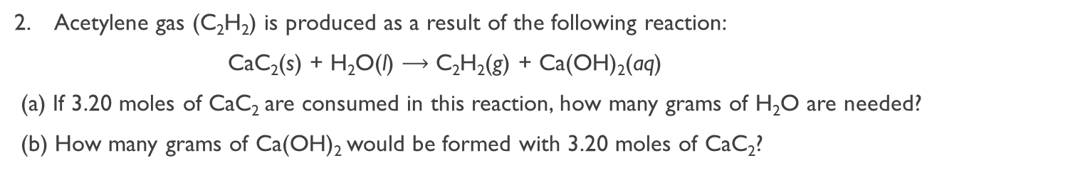
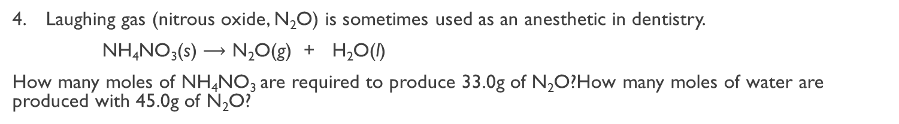
Practice
Manganese metal reacts with fluorine gas to form solid manganese(III) fluoride.
  (a) Write a balanced chemical equation
  (b) If you begin with 11.6 g F₂, how many grams of MnF₃ would be produced?
Acetylene gas (C₂H₂) is produced as a result of the following reaction:
CaC₂(s) + H₂O(l) $⟶$ C₂H₂(g) + Ca(OH)₂(aq)
(a) If 3.20 moles of CaC₂ are consumed in this reaction, how many grams of H₂O are needed?
(b) How many grams of Ca(OH)₂ would be formed with 3.20 moles of CaC₂?
How many moles of iron, Fe, are produced with 25.0 grams of magnesium, Mg?
Mg + Fe₂O₃ $⟶$ Fe + MgO
Laughing gas (nitrous oxide, N₂O) is sometimes used as an anesthetic in dentistry.
NH₄NO₃(s) $⟶$ N₂O(g) + H₂O(l)
How many moles of NH₄NO₃ are required to produce 33.0g of N₂O?How many moles of water are produced with 45.0g of N₂O?
A common preparation of oxygen gas is the thermal decomposition of potassium perchlorate. Calculate the number of grams of oxygen gas produced from 46.0 g of KClO₄. (the products are KCl and O₂)

Slide 45

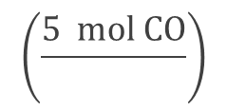
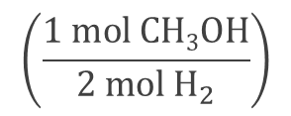

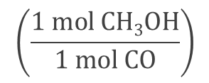
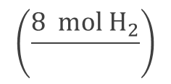
Limiting Reactants (Limiting Reagents)
The reactant used up first in a reaction is called the limiting reactant.
Excess reactants are those present in quantities greater than necessary to react with the quantity of the limiting reactant.
Calculate how much product you can generate with both reactants. The one that produces less product is the limiting reagent!
Consider the reaction between 5 moles of CO and 8 moles of H₂ to produce methanol via the following reaction:
CO(g) + 2H₂(g) $⟶$ CH₃OH(l)
How many moles of CH₃OH can be made from 5 mol CO?
$$\left(\frac{5 mol CO}{}\right)$$
$$\left(\frac{1 mol CH3OH}{1 mol CO}\right)$$
$$=5 mol CH3OH$$
How many moles of CH₃OH can be made from 8 mol H₂?
$$\left(\frac{8 mol H_{2}}{}\right)$$
$$\left(\frac{1 mol CH3OH}{2 mol{ H}_{2}}\right)$$
$$=4 mol CH3OH$$
H₂ will be used up first - limiting reactant.
CO is still available - excess reactant.

Slide 46
Limiting Reactants (Limiting Reagents)
Substance A
Substance B
Volume of substance A
Mass of A
Mass of B
Volume of substance B
density
density
molar mass
molar mass
stoichiometric
ratio
Moles of A
Moles of B
Volume of solution A
molarity
molarity
Volume of solution B
(mol : mol)
N_{A}
N_{A}
Number of particles A
Number of particles B

Slide 47
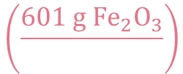
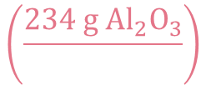
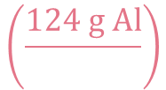




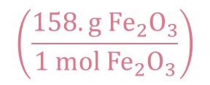
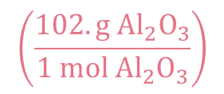
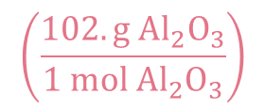
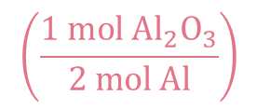
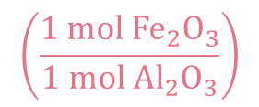
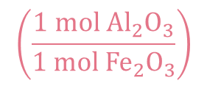



Practice
In one process, 124 g of Al are reacted with 601 g of Fe₂O₃, calculate the mass of Al₂O₃ formed. Calculate the mass of excess reactant left after the reaction is complete (assuming the reaction finishes completely)
2Al + Fe₂O₃ $⟶$ Al₂O₃ + 2Fe
Maximum Amount Possible: Theoretical Yield
$$\left(\frac{124 g Al}{}\right)$$
$$\left(\frac{1 mol Al}{27.0 g Al}\right)$$
$$\left(\frac{1 mol {Al}_{2}O_{3}}{2 mol Al}\right)$$
$$\left(\frac{102. g{ Al}_{2}O_{3}}{1 mol{ Al}_{2}O_{3}}\right)$$
$$=234 g{ Al}_{2}O_{3} possible$$
$$\left(\frac{601 g {Fe}_{2}O_{3}}{}\right)$$
$$\left(\frac{1 mol{ Fe}_{2}O_{3}}{158. g{ Fe}_{2}O_{3}}\right)$$
$$\left(\frac{1 mol {Al}_{2}O_{3}}{1 mol {Fe}_{2}O_{3}}\right)$$
$$\left(\frac{102. g{ Al}_{2}O_{3}}{1 mol{ Al}_{2}O_{3}}\right)$$
$$=388 g{ Al}_{2}O_{3} possible$$
Al is the limiting reagent and Fe₂O₃ is the excess reagent. To find the amount of excess reagent left over, you find how much excess reagent it requires to make the maximum amount of product possible from the limiting reagent.
$$\left(\frac{234 g{ Al}_{2}O_{3}}{}\right)$$
$$\left(\frac{1 mol{ Al}_{2}O_{3}}{102. g{ Al}_{2}O_{3}}\right)$$
$$\left(\frac{1 mol {Fe}_{2}O_{3}}{1 mol {Al}_{2}O_{3}}\right)$$
$$\left(\frac{158. g{ Fe}_{2}O_{3}}{1 mol {Fe}_{2}O_{3}}\right)$$
$$=362 g{ Fe}_{2}O_{3} USED$$
Excess Reactant Used + Excess Reactant Left Over = Total Excess Reactant
Excess Reactant Left Over = 601 g – 362 g = 239 g Fe₂O₃ left over

Slide 48
















Practice
3 NH₄NO₃ + Na₃PO₄ $⟶$ (NH₄)₃PO₄ + 3 NaNO₃
If you start with 30 g ammonium nitrate and 50 g sodium phosphate: a. what is the limiting reactant? b. how many grams of NaNO₃ would you make? c. How much of the excess reactant was used up? d. how much of the excess reactant was left over?
$$\left(\frac{30 g {NH}_{4}NO_{3}}{}\right)$$
$$\left(\frac{1 mol{ NH}_{4}NO_{3}}{80. 06 g {NH}_{4}NO_{3}}\right)$$
$$\left(\frac{3 mol NaNO_{3}}{3 mol{ NH}_{4}NO_{3}}\right)$$
$$\left(\frac{85. g NaNO_{3}}{1 mol NaNO_{3}}\right)$$
$$=31.85 g NaNO_{3}$$
$$possible$$
$$\left(\frac{50 g {Na}_{3}PO_{4}}{}\right)$$
$$\left(\frac{1 mol{ Na}_{3}PO_{4}}{163.94 g {Na}_{3}PO_{4}}\right)$$
$$\left(\frac{3 mol NaNO_{3}}{1 mol{ Na}_{3}PO_{4}}\right)$$
$$\left(\frac{85. g NaNO_{3}}{1 mol NaNO_{3}}\right)$$
$$=77.77 g NaNO_{3}$$
$$possible$$
a. ${NH}_{4}NO_{3} Limiting Reactant (so{ Na}_{3}PO_{4}excess reactant)$
b. $31.85 g NaNO_{3} maximum possible to make$
c.
$$\left(\frac{31.85 g NaNO_{3}}{}\right)$$
$$\left(\frac{1 mol NaNO_{3}}{85. g NaNO_{3}}\right)$$
$$\left(\frac{1 mol{ Na}_{3}PO_{4}}{3 mol NaNO_{3}}\right)$$
$$\left(\frac{163.94 g {Na}_{3}PO_{4}}{1 mol{ Na}_{3}PO_{4}}\right)$$
$$=20.48 g {Na}_{3}PO_{4} used to make max amount of NaNO_{3}$$
d.
$$50 g{Na}_{3}PO_{4} −20.48 g {Na}_{3}PO_{4}=29.52 g{ Na}_{3}PO_{4} left over$$

Slide 49


Practice
3 NH₄NO₃ + Na₃PO₄ $⟶$ (NH₄)₃PO₄ + 3 NaNO₃
If you start with 30 g ammonium nitrate and 50 g sodium phosphate: a. what is the limiting reactant? b. how many grams of NaNO₃ would you make? c. How much of the excess reactant was used up? d. how much of the excess reactant was left over?
In an experiment, 3.25 g of NH₃ are allowed to react with 3.50 g of O₂. according to the reaction below:
NH₃ + O₂ $⟶$ NO + H₂O.
a. Which reactant is the limiting reagent? b. How many grams of NO are formed? c. How much of the excess reactant remains after the reaction?
If 4.95 g of ethylene (C₂H₄) are combusted with 3.25 g of oxygen. a. What is the limiting reagent? b. How many grams of CO₂ are formed?

Slide 50

Reaction Yield
The theoretical yield is the amount of product that forms when all the limiting reactant reacts to form the desired product. This is the maximum amount of product that can form from the limiting reactant (based on calculations)
The actual yield is the amount of product actually obtained from a reaction.
The percent yield tells what percentage the actual yield is of the theoretical yield.
$$\% Yield= \frac{Actual Yield}{Theoretical Yield} x 100\%$$

Slide 51



















Practice
Consider the following reaction:
C₄H₉OH + NaBr + H₂SO₄ $⟶$ C₄H₉Br + NaHSO₄ + H₂O
If 15.0 g of C₄H₉OH react with 22.4 g of NaBr and 32.7 g of H₂SO₄ to yield 17.1 g of C₄H₉Br, what is the percent yield of this reaction?
$$\left(\frac{ 15.0 g C_{4}H_{9}OH}{}\right)$$
$$\left(\frac{1 mol{ C}_{4}H_{9}OH}{74.14 g{ C}_{4}H_{9}OH}\right)$$
$$\left(\frac{1 mol{ C}_{4}H_{9}Br}{1 mol{ C}_{4}H_{9}OH}\right)$$
$$\left(\frac{137.03 g{ C}_{4}H_{9}Br}{1 mol{ C}_{4}H_{9}Br}\right)$$
$$=27.72 g{ C}_{4}H_{9}Br$$
$$possible$$
$$\left(\frac{ 22.4 g NaBr}{}\right)$$
$$\left(\frac{1 mol NaBr}{102.89 g NaBr}\right)$$
$$\left(\frac{1 mol{ C}_{4}H_{9}Br}{1 mol NaBr}\right)$$
$$\left(\frac{137.03 g{ C}_{4}H_{9}Br}{1 mol{ C}_{4}H_{9}Br}\right)$$
$$=29.83 g{ C}_{4}H_{9}Br$$
$$possible$$
$$\left(\frac{ 32.7 g H_{2}{SO}_{4}}{}\right)$$
$$\left(\frac{1 mol{ H}_{2}{SO}_{4}}{98.09 g{ H}_{2}{SO}_{4}}\right)$$
$$\left(\frac{1 mol{ C}_{4}H_{9}Br}{1 mol{ H}_{2}{SO}_{4}}\right)$$
$$\left(\frac{137.03 g{ C}_{4}H_{9}Br}{1 mol{ C}_{4}H_{9}Br}\right)$$
$$=45.68 g{ C}_{4}H_{9}Br$$
$$possible$$
$$\% Yield= \frac{Actual Yield}{Theoretical Yield} x 100\%$$
$$\% Yield= \frac{17.1}{27.72} x 100\%$$
$$\% Yield=61.7\%$$

Slide 52


Practice
Consider the following reaction:
C₄H₉OH + NaBr + H₂SO₄ $⟶$ C₄H₉Br + NaHSO₄ + H₂O
If 15.0 g of C₄H₉OH react with 22.4 g of NaBr and 32.7 g of H₂SO₄ to yield 17.1 g of C₄H₉Br, what is the percent yield of this reaction?
Silicon nitride (Si₃N₄) is made by combining Si and nitrogen gas (N₂) at a high temperature. How much (in g) Si is needed to react with an excess of nitrogen gas to prepare 125 g of silicon nitride if the percent yield of the reaction is 95.0%?
Consider the following reaction :
C₆H₆ + Br₂ $⟶$ C₆H₅Br + HBr
a. What is the theoretical yield of C₆H₅Br if 42.1 g of C₆H₆ react with 73.0 g of Br₂? b. If the actual yield of C₆H₅Br is 63.6 g, what is the percent yield?

Slide 53

Aqueous Reactions and Chemical Analysis
Gravimetric analysis is an analytical technique based on the measurement of mass. Gravimetric analysis is highly accurate. Applicable only to reactions that go to completion or have nearly 100 % yield.
A 0.8633-g sample of an ionic compound containing chloride ions and an unknown metal cation is dissolved in water and treated with an excess of AgNO₃. If 1.5615 g of AgCl precipitate forms, what is the percent by mass of Cl in the original sample?
Strategy Using the mass of AgCl precipitate and the percent composition of AgCl, determine what mass of chloride the precipitate contains. The chloride in the precipitate was originally in the unknown compound. Using the mass of chloride and the mass of the original sample, determine the percent Cl in the compound.
$$\frac{35.45 g Cl}{\left(35.45 g+107.9 g AgCl\right)} x 100\%=24.72\% Cl in AgCl$$
$$\left(0.2472\right)\left(1.5615 g AgCl\right)=0.3860 g Cl in AgCl precipitate formed$$
$$\frac{0.3860 g Cl in AgCl}{0.8633 g unknown sample} x 100\%=44.71\% Cl in Unknown Sample$$

Slide 54
Molarity and Reaction in Aqueous Solution
Substance A
Substance B
Volume of substance A
Mass of A
Mass of B
Volume of substance B
density
density
molar mass
molar mass
stoichiometric
ratio
Moles of A
Moles of B
Volume of solution A
molarity
molarity
Volume of solution B
(mol : mol)
N_{A}
N_{A}
Number of particles A
Number of particles B

Slide 55






Molarity and Reaction in Aqueous Solution
What volume, in mL, of 0.0875 M H₂SO₄ is required to neutralize 25.0 mL of 0.234 M NaOH?
H₂SO₄(aq) + 2NaOH(aq) $⟶$ Na₂SO₄(aq) + 2H₂O(l)
Molarity
Molarity
Volume (L) $⟶$ Moles $⟶$ Moles of Sought Compound $⟶$ Volume of Sought Compound
Mol : Mol
$$\left(\frac{0.025 L NaOH}{}\right)$$
$$\left(\frac{0.234 mol NaOH}{1 L NaOH}\right)$$
$$\left(\frac{1 mol H_{2}{SO}_{4}}{2 mol NaOH}\right)$$
$$\left(\frac{1 L{ H}_{2}{SO}_{4}}{0.0875 mol H_{2}{SO}_{4}}\right)$$
$$\left(\frac{1000 mL}{1 L}\right)$$
$$=33.4 mL$$

Slide 56








Molarity and Reaction in Aqueous Solution
25.0 mL of 0.234 M FeCl₃ and 50.0 mL of 0.453 M NaOH are mixed. Which reactant is limiting? How many moles of Fe(OH)₃ will form?
FeCl₃(aq) + 3 NaOH(aq) → 3 NaCl(aq) + Fe(OH)₃(s)
Molarity
Volume (L) $⟶$ Moles $⟶$ Moles of Sought Compound
Mol : Mol
$$\left(\frac{0.025 L {FeCl}_{3}}{}\right)$$
$$\left(\frac{0.234 mol{ FeCl}_{3}}{1 L{ FeCl}_{3}}\right)$$
$$\left(\frac{1 mol {Fe(OH)}_{3}}{1 mol{ FeCl}_{3}}\right)$$
$$=0.00585 mol {Fe(OH)}_{3}$$
$$\left(\frac{0.050 L NaOH}{}\right)$$
$$\left(\frac{0.453 mol NaOH}{1 L NaOH}\right)$$
$$\left(\frac{1 mol {Fe(OH)}_{3}}{3 mol NaOH}\right)$$
$$=0.00755 mol {Fe(OH)}_{3}$$

Slide 57

Acid-Base Titrations
Quantitative studies of acid-base neutralization reactions are most conveniently carried out using a technique known as a titration.
A titration is a volumetric technique that uses burettes. The point in the titration where the acid has been neutralized is called the equivalence point. The equivalence point is usually signalled by a colour change. (A link to help with understanding titrations: titration curve link)
The colour change is brought about by the use of an indicator. Indicators have distinctly different colours in acidic and basic media. The indicator is chosen so that the colour change, or endpoint, is very close to the equivalence point. Phenolphthalein is a common indicator.
Sodium hydroxide solutions are commonly used in titrations. NaOH solutions must be standardized as the concentrations change over time. (NaOH reacts with CO₂ that slowly dissolves into the solution forming carbonic acid.)
The acid potassium hydrogen phthalate (KHP) is frequently used to standardize NaOH solutions. It only has 1 ionizable proton.

Slide 58






Practice
In a titration experiment, a student finds that 25.49 mL of an NaOH solution is needed to neutralize 0.7137 g of KHP (a monoprotic acid with a MM=204.2 g mol^{–1}). What is the concentration (in M) of the NaOH solution?
NaOH + HX $⟶$ NaX + H₂O(l)
Strategy Using the mass given and the molar mass of KHP, determine the number of moles of KHP. Recognize that the number of moles of NaOH in the volume given is equal to the number of moles of KHP. Divide moles of NaOH by volume (in liters) to get molarity.
$$\left(\frac{0.7137 g KHP}{}\right)$$
$$\left(\frac{1 mol KHP}{204.2 g KHP}\right)$$
$$\left(\frac{1 mol NaOH}{1 mol KHP}\right)$$
$$=0.003495 mol NaOH$$
$$\frac{0.003495 mol NaOH}{0.02549 L NaOH}=0.1371 M$$

Slide 59











Practice
What volume (in mL) of a 0.203 M NaOH solution is needed to neutralize 25.0 mL of a 0.188 M H₂SO₄ solution?
H₂SO₄(aq) + 2NaOH(aq) $⟶$ Na₂SO₄(aq) + 2H₂O(l)
$$\left(\frac{0.025 L H_{2}SO_{4}}{}\right)$$
$$\left(\frac{0.188 mol{ H}_{2}SO_{4}}{1 L{ H}_{2}SO_{4}}\right)$$
$$\left(\frac{2 mol NaOH}{1 mol{ H}_{2}SO_{4}}\right)$$
$$\left(\frac{1 L NaOH}{0.203 mol NaOH}\right)$$
$$=0.046 L NaOH$$
$$=46 mL NaOH$$
What volume of 0.115 M HClO₄ solution is needed to neutralize 50.00 mL of 0.0875 M NaOH?
HClO₄(aq) + NaOH(aq) $⟶$ NaClO₄(aq) + H₂O(l)
$$\left(\frac{0.05 L NaOH}{}\right)$$
$$\left(\frac{0.0875 mol NaOH}{1 L NaOH}\right)$$
$$\left(\frac{1 mol {HClO}_{4} }{1 mol NaOH}\right)$$
$$\left(\frac{1 L{ HClO}_{4}}{0.115 mol{ HClO}_{4}}\right)$$
$$=0.038 L{ HClO}_{4}$$

Slide 60
Practice
What volume (in mL) of a 0.203 M NaOH solution is needed to neutralize 25.0 mL of a 0.188 M H₂SO₄ solution?
What volume of 0.115 M HClO₄ solution is needed to neutralize 50.00 mL of 0.0875 M NaOH?
What volume of 0.128 M HCl is needed to neutralize 2.87 g of Mg(OH)₂?
How many milliliters of 0.120 M HCl are needed to completely neutralize 50.0 mL of 0.101 M Ba(OH)₂ solution?
Calculate the mass of the precipitate formed when 2.27 L of 0.0820 M Ba(OH)₂ are mixed with 3.06 L of 0.0664 M Na₂SO₄.
Calculate the volume of a 0.156 M CuSO₄ solution that would react with 7.89 g zinc.
It required 42.35 mL of H₂SO₄ to neutralize 21.17 mL of 0.5000 M NaOH. Calculate the concentration of H₂SO₄.

