Slide 1
Chapter 3: Composition of Substances and Solutions

Slide 2
Molecular and Formula Mass
The molecular mass is the mass in atomic mass units (amu) of an individual molecule.
To calculate molecular mass, multiply the atomic mass of each element in a molecule by the number of atoms of that element and then total the masses
Molecular mass of H₂O:
2(atomic mass units of H) +(1)(atomic mass units of O)
2(1.008 amu)
+ (1)(16.00 amu) =
18.02 amu
Because the atomic masses on the periodic table are average atomic masses, the result of such a determination is an average molecular mass, sometimes referred to as the molecular weight.
Although an ionic compound does not have a molecular mass, we can use its empirical formula to determine its formula mass (the mass of a “formula unit”), sometimes called the formula weight.
The process is the same:
To calculate formula mass, multiply the atomic mass for each element
in a formula unit by the number of atoms of that element and
then total the masses

Slide 3
Example Problem
Calculate the molecular mass or the formula mass, as appropriate, for each of the following:
(a) ethane, C₂H₆, (b) lithium hydroxide, (c) CaCl₂
(a) C₂H₆ : This says 2 carbon atoms and 6 hydrogen atoms. The molecular mass of ethane is:
$$(2)(12.01 amu)$$
$$+ (6)(1.008 amu)$$
$$=30.07 amu$$
(b) LiOH : This says 1 lithium atom and 1 oxygen atom and 1 hydrogen atom. The formula mass is:
$$(1)(6.94 amu)$$
$$+(1)(16.00 amu)$$
$$+ (1)(1.008 amu)$$
$$=23.95 amu$$
(c) CaCl₂: This says 1 calcium atom and 2 chlorine atoms. The formula mass is:
$$(1)(40.078 amu)$$
$$+ (2)(35.453 amu)$$
$$=110.984 amu$$

Slide 4
Practice Problem
Determine the Formula/Molecular weight for the following compounds:
Li₂NO₃
Potassium cyanide
Al₂O₃
Iron(III) sulfate
Carbon dioxide
Formula mass = 75.89 amu
Formula mass for KCN = 65.12 amu
Formula mass = 101.96 amu
Formula mass for Fe₂(SO₄)₃ = 399.88 amu
Molecular mass for CO₂ = 44.01 amu

Slide 5
Percent Composition of Elements
A list of the percent by mass of each element in a compound is known as the compound’s percent composition by mass.
where n is the number of atoms of the element in a molecule or formula unit of the compound
$$mass percent of an element= \frac{n x atomic mass of element}{molecular or formula mass of compound} x 100\%$$
For a molecule of H₂O₂:
$$\%H= \frac{(2)(1.008 amu H)}{34.02 amu H_{2}O_{2}} x 100\%$$
$$\%H=5.926 \%$$
$$\%O= \frac{(2)(16.00 amu O)}{34.02 amu H_{2}O_{2}} x 100\%$$
$$\%O=94.06 \%$$

Slide 6
Percent Composition of Elements
We could also have used the empirical formula of hydrogen peroxide (HO) for the calculation.
In this case, we could have used the empirical formula mass, the mass in amu of one empirical formula, in place of the molecular formula.
The empirical formula mass of H₂O₂ (the mass of HO) is 17.01 amu.
$$\%H= \frac{(1)(1.008 amu H)}{17.01 amu HO} x 100\%$$
$$\%H=5.926 \%$$
$$\%O= \frac{(1)(16.00 amu O)}{17.01 amu HO} x 100\%$$
$$\%O=94.06 \%$$

Slide 7
Examples
What is the percent composition of O in the following compounds?
ClO₄–
H₂SO₄
SiO₂
$\%O=\frac{4 ∗16.00 amu O}{99.45 amu ClO_{4}^{−}}$ * 100% = 64.35%
$\%O=\frac{4 ∗16.00 amu O}{98.076 amu H_{2}SO_{4}^{}}$ * 100% = 65.26%
$\%O=\frac{2 ∗16.00 amu O}{60.09 amu SiO_{2}^{}}$ * 100% = 53.25%
Calculate the percent composition of nitrogen in sodium azide (NaN₃).
64.64%
Lithium carbonate, Li₂CO₃, was the first “mood–stabilizing” drug approved by the FDA for the treatment of mania and manic-depressive illness, also known as bipolar disorder. Calculate the percent composition by mass of lithium carbonate.
Li: 18.79%; C: 16.25%; O: 64.96%

Slide 8
Determination of Empirical Formula and Molecular Formula from Percent Comp.
Using the concepts of the mole and molar mass, we can now use an experimentally determined percent composition to determine the empirical and/or molecular formula.
The empirical formula gives only the ratio of atoms in a molecule (many compounds can have the same empirical formula).
A compound’s empirical formula can be determined from its percent composition. A compound’s molecular formula is determined from the molar mass and empirical formula.
Given
Use Molar Mass
Mass Percentages
Moles
Mole Ratios
Empirical Formula
Molecular Formula
Use Molar Mass

Slide 9
Empirical and Molecular Formulas
An orange compound was found to be 26.6% K, 35.4% Cr and 38.0% O. Determine its empirical formula.
Assume a 100.0 g sample. Percent becomes mass in grams.
26.6% K becomes 26.6 g K; 35.4% Cr becomes 35.4 g Cr; 38.0% O becomes 38.0 g O
Divide each mass by its atomic mass. Gives the number of moles of each atom.
+$\left(\frac{26.6 g K}{}\right)\left(\frac{1 mol K}{39.10 g K}\right)=0.6803 mol K$
+$\left(\frac{35.4 g Cr}{}\right)\left(\frac{1 mol Cr}{52.00 g Cr}\right)=0.6808 mol Cr$
+$\left(\frac{38.0 g O}{}\right)\left(\frac{1 mol O}{16.00 g O}\right)=2.375 mol O$
Divide each by the smallest number of moles. The smallest whole number ratio is the empirical formula.
+$\frac{0.6803}{0.6803}=1$
+$\frac{0.6808}{0.6803}=1.001$
+$\frac{2.375}{0.6803}=3.491$
These ratios tell us: KCrO_{3.5}. These are NOT all whole numbers:
If necessary, multiply to get whole number ratios:
(2)(KCrO_{3.5}) = K₂Cr₂O₇

Slide 10
Practice
Determine the empirical formula of a compound that is 30.45 percent nitrogen and 69.55 percent oxygen by mass. Given that the molar mass of the compound is approximately 92 g mol^{–1}, determine the molecular formula of the compound.
$$\left(\frac{30.45 g N}{}\right)\left(\frac{1 mol N}{14.01 g N}\right)=2.173448 mol N$$
Assume 100 g of compound:
30.45 g N
69.55 g O
$$\left(\frac{69.55 g O}{}\right)\left(\frac{1 mol O}{16.00 g O}\right)=4.346875 mol O$$
$\frac{2.173448 mol N}{2.173448 mol N}=1 N:N$
$\frac{4.346875 mol O}{2.173448 mol N}=2$ O : 1 N
NO₂(Empirical): Molar Mass = 46.01 g
$$\frac{Molar Mass Compound}{Molar Mass {NO}_{2}}= \frac{\frac{92 g}{mol}}{\frac{46.01 g}{mol}}=2$$
$$\left(2\right)\left({NO}_{2}\right)=N_{2}O_{4}$$
Notes:
What is the empirical formula of an unknown compound with 43.95% Mo, 7.33% O and 48.72% Cl?
A compound known as Cacodyl has an almost intolerable garlic-like odor. Its molar mass is 210 g mol^{–1} and the percent composition is 22.88% C, 5.76% H and 71.36 % As. What are the empirical formula and the molecular formula?
A student determines the following mass ratios for an unknown compound. What is the empirical formula?
Element : % Composition
H : 6.5 %
C : 76.6 %
O : 17.0 %

Slide 11
Poll Question: Campusknot
(Ch. 6-Slide 11) How many carbon atoms are found in the empirical formula for a compound that contains 26.1% carbon, 4.3% hydrogen and 69.6 % oxygen?

Slide 12
Concentration
Solution: is a homogeneous mixture of 2 or more materials.
Solvent : largest fraction (largest concentration)
Solute(s) : minor fraction(s) (smaller concentration)
Solution Video
Concentration is the relative amounts of solute and solvent; many ways to express.
Dilute : small amount of solute
Concentrated : a lot of solute
Concentration: Molarity = $\frac{mol}{L}$ = mol L^{–1}
Temp. dependent
$$M=\frac{mole solute}{L solution}$$
or
$$M=\frac{n_{solute}}{L solution}$$
[KCl] means the molarity of the KCl solution.
Concentration: Molality = $\frac{mol}{kg}$ = mol kg^{–1}
Temp. Independent
$$m=\frac{mole solute}{kg Solvent}$$
$$m=\frac{n_{solute}}{kg Solvent}$$
or

Slide 13
Molarity
6.37 g of Al(NO₃)₃ are dissolved to make a 250. mL aqueous solution. Calculate (a) [Al(NO₃)₃] (b) [Al³⁺] and [NO₃–].
$Al{\left({NO}_{3}\right)}_{3} molar mass$:
+$\left(\frac{26.98 g}{mole}\right)+\left[\left(3\right)\left(\frac{14.00 g}{mol}\right)\right]+\left[\left(9\right)\left(\frac{16.00 g}{mol}\right)\right]= \frac{213.0 g}{mol}$
+$\left(\frac{6.37 g Al{\left({NO}_{3}\right)}_{3}}{}\right)\left(\frac{1 mol Al{\left({NO}_{3}\right)}_{3}}{213.0 g Al{\left({NO}_{3}\right)}_{3}}\right)={2.991 x 10}^{−2}mol Al{\left({NO}_{3}\right)}_{3}$
+$Al{\left({NO}_{3}\right)}_{3}= \frac{{2.991 x 10}^{−2} mol}{0.250 L}=0.11964 M$
There are 3 NO₃– and 1 Al³⁺: Information given from the ionic compound Al(NO₃)₃
+$\left(\frac{0.11964 mol Al{\left({NO}_{3}\right)}_{3}}{1 L}\right)\left(\frac{1 mol {Al}^{3+}}{1 mol Al{\left({NO}_{3}\right)}_{3}}\right)=0.11964 M {Al}^{3+}$
+$\left(\frac{0.11964 mol Al{\left({NO}_{3}\right)}_{3}}{1 L}\right)\left(\frac{3 mol {NO}_{3}^{−}}{1 mol Al{\left({NO}_{3}\right)}_{3}}\right)=0.35892 M{NO}_{3}^{−}$

Slide 14
Practice
What is the molarity of a solution made by dissolving 2.5 g of NaCl in enough water to make 125 mL of solution?
Determine molarity of solution if 68.4 g of Na₃PO₄ is added to water to make a final volume solution of 378 mL?
If I want to make 792 mL of a 0.218 M NaOH solution, how many grams of NaOH do I weigh out?
If I want to make 2.6 L of 0.185 M KMnO₄ solution, how many grams do I weigh out?

Slide 15
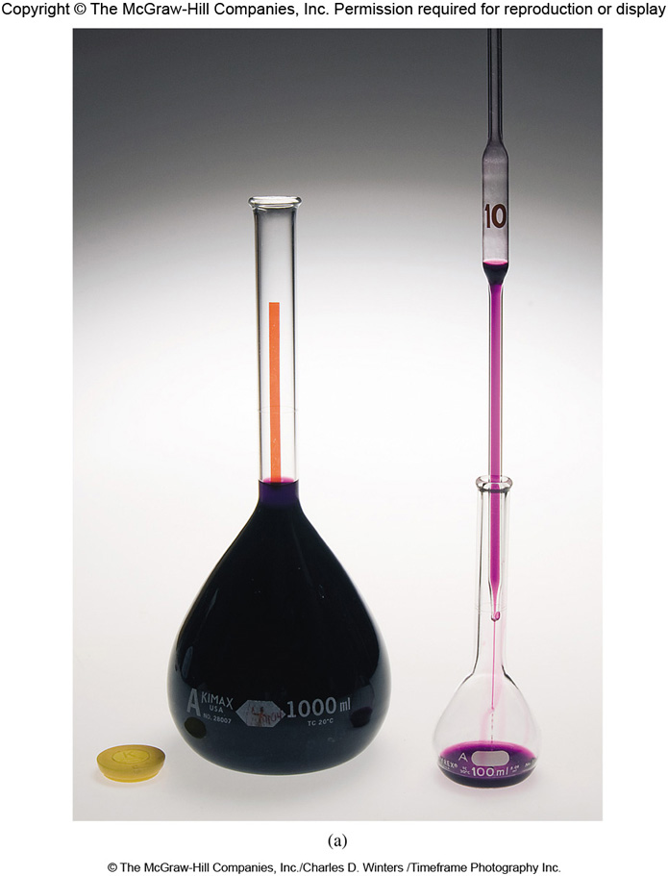
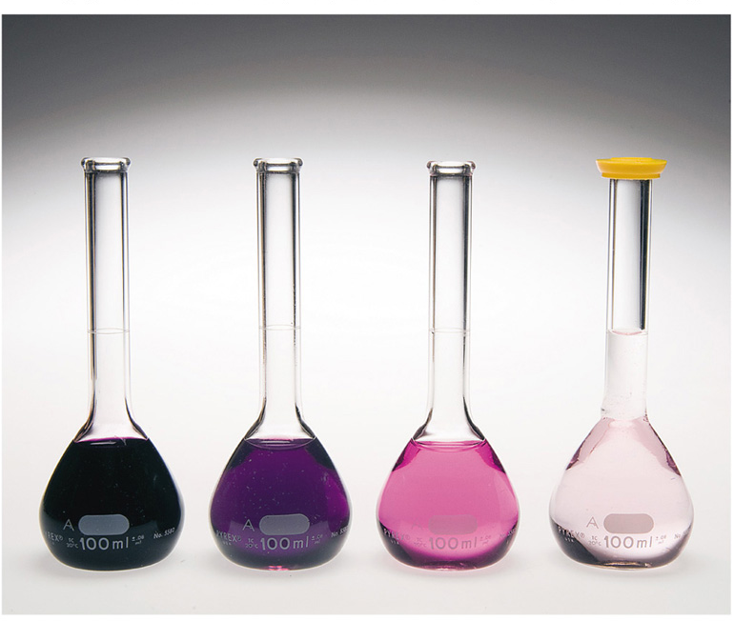
Dilution
Dilution is the process of preparing a less concentrated solution from a more concentrated one.
Dilution Video
M₁V₁ = M₂V₂
moles of solute before dilution = moles of solute after dilution
A series of dilutions that may be used to prepare several increasingly dilute solutions is called Serial Dilution.
1: Prepare a dilute solution from the stock
2: Dilute a portion of the prepared solution to make a more dilute solution
3: Repeat as needed

Slide 16
Dilution
In an experiment, a student needs 1.00 L of a 0.400 M KMnO₄ solution. A stock solution of 1.00 M KMnO₄ is available. How much of the stock solution is needed?
Solution: Use the relationship that moles of solute before dilution = moles of solute after dilution.
(1.00 M KMnO₄)(V₁) = (0.400 M KMnO₄)(1.00 L)
V₁ = 0.400 L or 400 mL
To make the solution:
1. Pipet 400 mL of stock solution into a 1.00 L volumetric flask.
2. Carefully dilute to the calibration mark.
Because most volumes measured in the laboratory are in milliliters rather than liters, it is worth pointing out that the equation can be written as
M₁ × mL₁ = M₂ × mL₂

Slide 17
Practice
Commercial concentrated sulfuric acid is 17.8 M. If 75.0 mL of this acid is diluted to 1.00 L, what is the final concentration of the acid?
M_{conc} = 17.8 M V_{conc} = 75.0 mL
M_{dil} = ? V_{dil} = 1000. mL
$$M_{dil}= \frac{M_{con}V_{con}}{V_{dil}}$$
$$= \frac{\left(17.8 M\right)\left(75.0 mL\right)}{\left(1000 mL\right)}$$
$$=1.34 M$$
Prepare a 0.5000 M solution of potassium permanganate in a 250.0 mL volumetric flask.
Mass of KMnO₄ required: to find mass we have to find moles. We can use the volume and concentration for this
$$Remember: M=\frac{mol}{L}$$
$$\left(\frac{0.2500 L}{}\right)$$
$$\left(\frac{0.5000 mol KMnO_{4}}{L}\right)$$
$$=0.1250 mol KMnO_{4}$$
$$\left(\frac{0.1250 mol}{}\right)$$
$$\left(\frac{158.03 g KMnO_{4}}{1 mol}\right)$$
$$=19.75 g KMnO_{4}$$

Slide 18
Practice
1. How many mL of 0.745 M solution do I use to make 750 mL of 0.680 M solution?
2. I have a standard solution KMnO₄ that is 0.500 M. How, using that standard solution, do I make 250 mL of a 0.218 M solution?
3. What volume of 0.62 M Na₂SO₄ solution should I use if I want to make 500 mL of 0.14 M solution?
4. What mass of 71% HNO₃ is contained in 0.500 L of solution knowing that the density of HNO₃ solution is 1.42 g/mL. Could also ask how many moles of HNO₃?

Slide 19
Concentration Units
$$Mass Fraction= \frac{mass solute}{Total mass of solution}$$
$$Mass Percent=Mass Fraction ∗100\%$$
Example Problem:
4.6 g of NaCl is dissolved in 500 g of water. What is the mass percent of NaCl?
$$\frac{4.6 g NaCl}{\left({500 g H}_{2}O+4.6 g NaCl\right) }=$$
$$Mass Fraction=$$
$$0.009116$$
$$Mass Percent=$$
$$\left(0.009116\right) \left(100\right)=$$
$$0.9116\%$$

Slide 20
Concentration: Mole fraction (no units)
$${χ }_{solute}=\frac{n_{solute}}{n_{solute}+n_{solvent}}$$
Large χ_{solute} = large amount of solute relative to solvent
$${χ }_{solvent}=\frac{n_{solvent}}{n_{solute}+n_{solvent}}$$
Large χ_{solvent}= large amount of solvent relative to solute
Concentration: Mole percent (mol %): mole fraction as a percentage
${mol \%}_{solute}=$ $\left({χ }_{solute}\right) ∗(100\%)$
${mol \%}_{solvent}=$ $\left({χ }_{solvent}\right) ∗(100\%)$

Slide 21
Concentration: Parts by mass
$\frac{mass solute}{mass solution}∗multiplication factor$
Percent by mass (%)
Mult. Factor = 100
Parts per million by mass (ppm)
Mult. Factor = 10⁶
Parts per billion by mass (ppb)
Mult. Factor = 10⁹
Concentration: Parts by volume
$\frac{volume solute}{volume solution}∗multiplication factor$
Percent by volume (%)
Mult. Factor = 100
Parts per million by volume (ppm)
Mult. Factor = 10⁶
Parts per billion by volume (ppb)
Mult. Factor = 10⁹

Slide 22
Converting Units
Sea water is 10,600 ppm Na⁺. Calculate the mass fraction and molarity of sodium ions in sea water. The density of sea water is 1.03 g/mL.
$$10,600 ppm=\frac{10,600 g {Na}^{+}}{{10}^{6}g solution}$$
$$mass fraction=\frac{10,600 g {Na}^{+}}{{10}^{6}g solution}=0.0106$$
$$Molarity= \frac{n_{solute}}{L_{solution}}$$
$$\left(\frac{10,600 g {Na}^{+}}{}\right)\left(\frac{1 mol{ Na}^{+}}{22.00 g{ Na}^{+}}\right)=461.1 mol$$
$$\left(\frac{{10}^{6} g solution}{}\right)\left(\frac{1 mL solution}{1.03 g solution}\right)={9.709 x 10}^{5} mL$$
$$Molarity= \frac{461.1 mol}{970.9 L}=0.475 M$$

Slide 23
Converting Units
A solution is prepared by dissolving 17.2 g ethylene glycol (C₂H₆O₂) in 0.500 kg of water (at 25ºC). The final solution volume is 515 mL. Calculate the following concentrations: a.) M b.) m c.) % by mass d.) mol fraction solute e.) mol % solute
$\left(\frac{17.2 g C_{2}H_{6}O_{2}}{}\right)\left(\frac{1 mol}{62.07 g}\right)=0.2771 mol C_{2}H_{6}O_{2}$
a.)
$$Molarity=\frac{n_{solute}}{L_{solution}}=\frac{0.2771 mol}{0.515 L}=0.538 M$$
b.)
$$Molality=\frac{n_{solute}}{{kg}_{solvent}}=\frac{0.2771 mol}{0.500 kg}=0.554 m$$
c.)
$Mass \%=\left(\frac{{mass}_{solute}}{{mass}_{total}}\right)\left(100\right)=\left(\frac{17.2 g}{\left(17.2+500 g\right)}\right)\left(100\right)=3.33 \%$
d.)
$\left(\frac{500 g H_{2}O}{}\right)\left(\frac{1 mol{ H}_{2}O}{18.02 g{ H}_{2}O}\right)=27.75 mol$
$Χ_{solute}=\frac{0.2771 mol}{\left(0.2771+27.75 mol\right)}={9.89 x10}^{−3}$
e.)
$$mol \% solute=\left({9.89 x10}^{−3}\right)\left(100\right)=0.989 \%$$

Slide 24
More Practice
Calculate the molarity and molality of a 30.0% H₂O₂ aqueous solution (d = $\frac{\text{1.11}g}{mL}$).
Assume 100 g solution: Gives 30.0 g H₂O₂ and 70.0 g H₂O
$\left(\frac{30.0 g H_{2}O_{2}}{}\right)\left(\frac{1 mol}{34.02 g}\right)=0.8818 mol{ H}_{2}O_{2}$
$m=\frac{n_{solute}}{{kg}_{solvent}}=\frac{0.8818 mol}{0.070 kg}=12.60 m$
$\left(\frac{70.0 g H_{2}O}{}\right)\left(\frac{1 mol}{18.02 g}\right)=3.885 mol H_{2}O$
$M=\frac{n_{solute}}{L_{solution}}=\frac{0.8818 mol}{0.09009 L}=9.79 M$
$\left(\frac{100 g solution}{}\right)\left(\frac{1 mL}{1.11 g}\right)=90.09 mL$
Calculate [CO₂] of a 0.400 m aq. solution (d = $\frac{1.025 g}{mL}$).
$\left(\frac{0.400 mol {CO}_{2}}{1 kg solvent}\right)\left(\frac{1 kg}{1000 g}\right)\left(\frac{1.025 g}{1 mL}\right)\left(\frac{1000 mL}{1 L}\right)=0.41 M$
What’s the mass % glucose (C₆H₁₂O₆ = $\frac{180.2 g}{mol}$) in 2.50 M aqueous glucose solution (d = $\frac{ 1.149 g}{mL}$)?
$\left(\frac{1 L}{}\right)\left(\frac{2.50 mol }{1 L}\right)\left(\frac{180.2 g }{1 mol}\right)=450 g C_{6}H_{12}O_{6}$
$\left(\frac{1 L}{}\right)\left(\frac{1000 mL }{1 L}\right)\left(\frac{1.149 g }{1 mL}\right)=1149 g H_{2}O$
$$mass \%= \frac{450 g}{\left(450 g+1149g\right)}\left(100\right)=28.14 \%$$

Slide 25
More Practice
How do I make a 203 g solution that is 13.6% NaBr? Assume the solution has the density of water is 1.00 g/mL.
$$\frac{13.6 \%}{100}=0.136$$
$$203 g −27.608 g=175.39 g H_{2}O$$
27.608 g NaBr:175.392 g H₂O
$$\left(203 g\right)\left(0.136\right)=27.6 g NaBr$$
A 12-oz (355 mL) Pepsi contains 38.9 mg of caffeine (molar mass= 194.2 g/mol). Assume that the Pepsi, mainly water, has a density of 1.01 g/mL. For such a Pepsi, calculate the caffeine concentration in ppm.
$$\left(\frac{355 mL}{}\right)\left(\frac{1.01 g}{1 mL}\right)=358.55 g$$
We have 38.9 mg/358.55 g solvent; we need to know how many mg/1000 g solvent per the ppm definition.
$$ppm= \frac{1 mg}{1000 g}$$
$$\left(\frac{1000 g}{}\right)\left(\frac{38.9 mg}{358.55 g solvent}\right)=108.49 ppm$$

Slide 26
More Practice
An aqueous solution is 6.75 % by mass NaCl and has a density of 1.02 g/mL. What is the a. molality, b. Molarity, and c. Mole percent of NaCl?
Assume 100 g of solution:
6.75 g NaCl
93.25 g H₂O
$\left(\frac{6.75 g NaCl}{}\right)\left(\frac{1 mol NaCl}{58.44 g NaCl}\right)=0.1155 mol NaCl$
a.
$$m=\frac{n_{solute}}{{kg}_{solvent}}$$
$$=\frac{0.1155 mol NaCl}{0.09325 kg H_{2}O}$$
$$=1.23 m$$
b.
$$M=\frac{n_{solute}}{L_{solution}}$$
$\left(\frac{100 g solution}{}\right)\left(\frac{1 mL}{1.02 g}\right)\left(\frac{1 L}{1000 mL}\right)=0.0980 L$
$$M=\frac{0.1155 mol NaCl}{0.0980 L}=1.18 M$$
c.
$$mol \% solute= \left(\frac{n_{solute}}{n_{total}}\right)\left(100\right)$$
$\left(\frac{93.25 g H_{2}O}{}\right)\left(\frac{1 mol{ H}_{2}O}{18.02 g{ H}_{2}O}\right)=5.175 mol{ H}_{2}O$
$$mol \% solute= \left(\frac{0.1155 mol NaCl}{0.1155+5.18}\right)\left(100\right)=2.18 \%$$

Slide 27
More Practice
In the lab, you are making 0.829 m manganese(II) sulfate solution using 350 grams of water. How many grams of MnSO₄ should you add?
$$\left(\frac{350 g H_{2}O}{}\right)\left(\frac{1 kg{ H}_{2}O}{1000 g{ H}_{2}O}\right)\left(\frac{0.829 mol MgSO_{4}}{1 kg{ H}_{2}O}\right)\left(\frac{120.364 g MgSO_{4}}{1 mol MgSO_{4}}\right)=34.924 g MgSO_{4}$$
Calculate the molality of a.) 2.50 M CaCl₂ solution (density of solution= 1.12 g/mL), b.) 48.2 % by mass KBr solution, and c.) 64.8 grams of ethylene glycol (C₂H₆O₂) mixed with water to make 3,500 grams of solution.
a.
$\left(\frac{1 L}{}\right)\left(\frac{1000 mL}{1 L}\right)\left(\frac{1.12 g}{1 mL}\right)=1120 g$
$$m=\frac{n_{solute}}{{kg}_{solvent}}= \frac{2.50 mol {CaCl}_{2}}{1.120 kg}=2.23 m$$
b.
Assume a 100 g solution; 48.2 g KBr and 51.8 g H₂O
$$m=\frac{n_{solute}}{{kg}_{solvent}}=\frac{0.405 mol KBr}{0.0518 kg H_{2}O}=7.82 m$$
$\left(\frac{48.2 g KBr}{}\right)\left(\frac{1 mol KBr}{119.002 g KBr}\right)=0.405 mol KBr$
c.
$\left(\frac{64.8 g C_{2}H_{6}O_{2}}{}\right)\left(\frac{1 mol{ C}_{2}H_{6}O_{2}}{62.08 g C_{2}H_{6}O_{2}}\right)=1.0438 mol{ C}_{2}H_{6}O_{2}$
$$m=\frac{n_{solute}}{{kg}_{solvent}}=\frac{1.0438 mol{ C}_{2}H_{6}O_{2}}{3.435 kg H_{2}O}=0.304 m$$

Slide 28
Practice Problems
A 1.000 L aq. solution contains 170.1 g of C₆H₁₂O₆ (180.0 g mol^{–1}) and has a density = $\frac{1.062 g}{mL}$. Calculate the (a) molar and (b) molal concentration.
a.
$$M=\frac{n_{solute}}{L_{solution}}$$
$\left(\frac{170.1 g}{}\right)\left(\frac{1 mol}{180.0 g}\right)=0.945 mol$
$$M=\frac{n_{solute}}{L_{solution}}=\frac{0.945 mol}{1 L}=0.945 M$$
$$m=\frac{n_{solute}}{{kg}_{solvent}}$$
Need kg solvent, but only given information on solution density. These are linked:
b.
kg_{solution} = kg_{solvent} + kg_{solute}
$$\left(\frac{1 L}{}\right)\left(\frac{1000 mL}{1 L}\right)\left(\frac{1.062 g}{1 mL}\right)=1.062 {x10}^{3}g=1.062 kg (total solution)$$
kg_{solution} = kg_{solvent} + kg_{solute}
$$1.062 kg −0.1701 kg=0.8919 kg$$
$$m=\frac{n_{solute}}{{kg}_{solvent}}=\frac{0.945 mol}{0.8919 kg}=1.06 m$$

