Slide 1
Chapter 5: Advanced Theories of Covalent Bonding

Slide 2







Valence Bond Theory
According to valence bond theory, atoms share electrons when atomic orbitals overlap.
  A bond forms when single occupied atomic orbitals on two atoms overlap.
  The two electrons shared in the region of orbital overlap must be of opposite spin.
  Formation of a bond results in a lower potential energy for the system.
The H−H bond in H₂ forms when the singly occupied 1s orbitals of the two H atoms overlap:
H
H
H
H
The F–F bond in F₂ forms when the singly occupied 2p orbitals of the two F atoms overlap:
y
y
y
y
$$↿$$
$$⇂$$
$$↿$$
$$⇂$$
$$↿$$
$$⇂$$
$$↿$$
x
F
F
x
F
F
2s²
2p⁵
z
z
z
z
Orbital Diagram for F
z
z
y
y
y
x
x
x
z

Slide 3
H
H
H
H
Valence Bond Theory
The H−F bond in HF forms when the singly occupied 1s orbital on the H atom overlaps with the single occupied 2p orbital of the F atom:
H
F
H
F
Bond Lengths and Bond Energies of H₂, F₂, and HF
 | Bond Length (Å) | Bond Energy (kJ/mol)
H₂ | 0.74 | 436.4
F₂ | 1.42 | 150.6
HF | 0.92 | 568.2

Slide 4
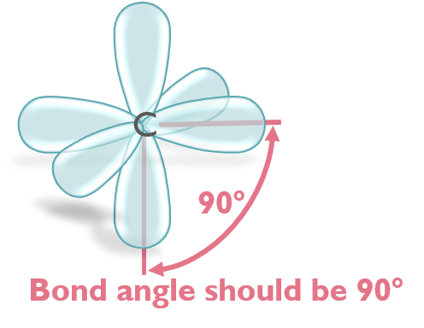
Valence Bond Theory
A covalent bond will form if the potential energy of the molecule is lower than the combined potential energies of the isolated atoms
Potential energy (kJ mol^{–1})
–436
74 pm
Hybridization or mixing of atomic orbitals can account for observed bond angles in molecules that could not be described by the direct overlap of atomic orbitals.
180°
O
C
O

Slide 5
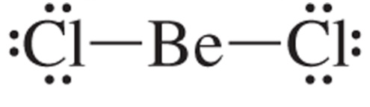
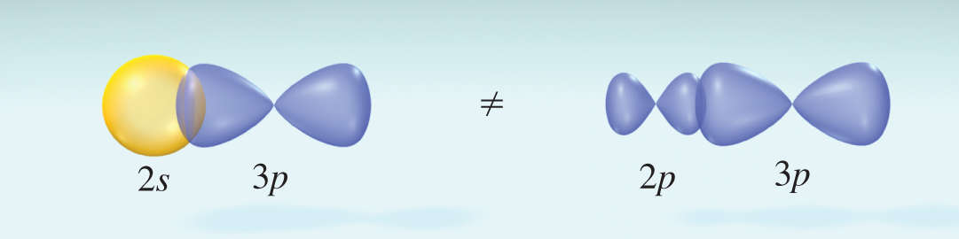





Hybridization of Atomic Orbitals
BeCl₂
Lewis theory and VSEPR theory predict Cl−Be−Cl bond angle of 180°
2 electron domains; Linear molecular geometry
A ground state beryllium atom can not form two bonds; there are no unpaired electrons.
Be
$$↿$$
$$⇂$$
2s²
2p
An excited state configuration for Be has two unpaired electrons and can form to bonds.
$$↿$$
$$⇂$$
Promotion
$$↿$$
$$↿$$
Be
Be*
2s²
2p
2s¹
2p¹

Slide 6
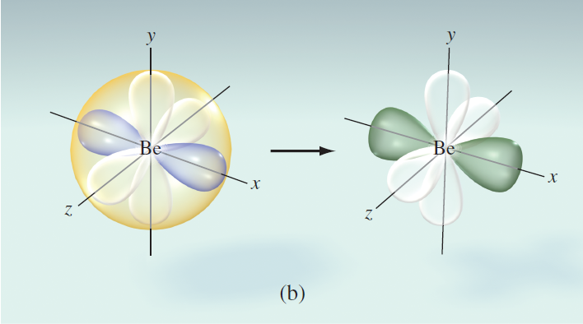



Hybridization of Atomic Orbitals
BeCl₂
Experimentally the bond in BeCl₂ bonds are identical in length and strength. Mixing of one s orbital and one p orbital to yield two sp orbitals.
$$↿$$
$$↿$$
Hybridization
$$↿$$
$$↿$$
Be*
2s
2p
2p
2p
sp
sp
2p
2p
The 2s orbital and one of the 2p orbitals on Be combine to form two sp hybrid orbitals.
Like any two electron domains, the hybrid orbitals on Be are 180° apart.

Slide 7
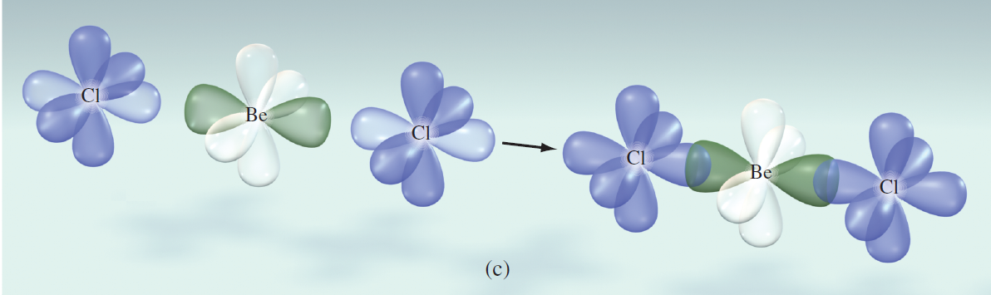
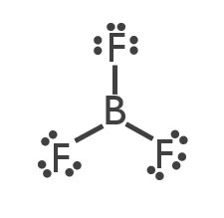
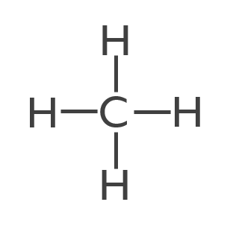
Hybridization of Atomic Orbitals
BeCl₂
The hybrid orbitals on Be each overlap with a singly occupied 3p orbital on a Cl atom.
The energy required to form an excited state Be atom is more than compensated for by the energy given off when a bond forms.
What is the hybridization of the central atom in BF₃ and CH₄?
Orbitals available in a single row on the Periodic Table:
1s; 3p; 5d; 7f
To find hybridization, use these orbitals to add up to the number of electron domains
sp²
sp³

Slide 8
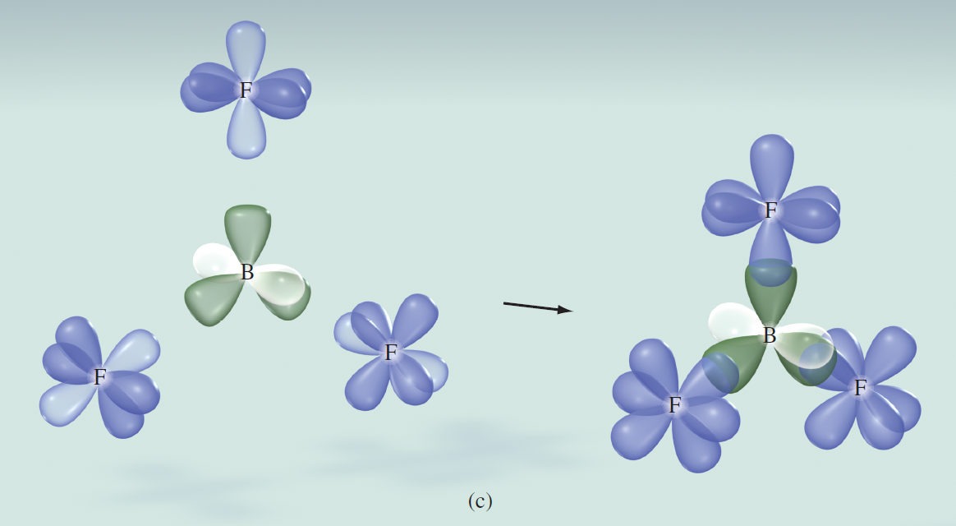
Hybridization of Atomic Orbitals
BF₃
Mixing of one s orbital and two p orbitals to yield three sp² orbitals.
Hybrid orbitals on boron overlap with 2p orbitals on fluorine.

Slide 9
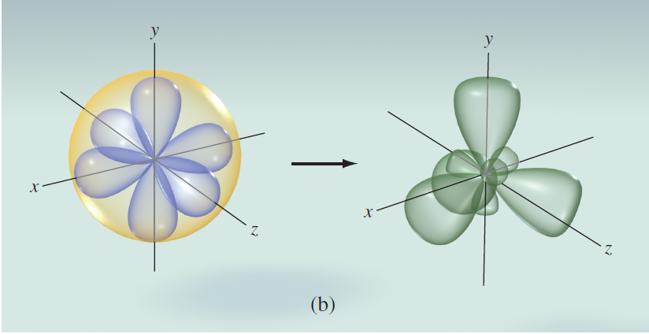
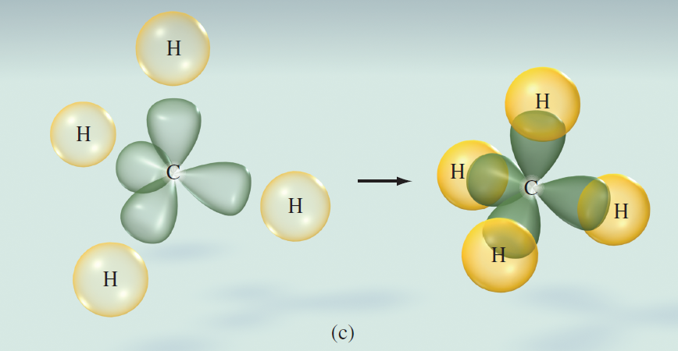
Hybridization of Atomic Orbitals
CH₄
Mixing of one s orbital and three p orbitals to yield four sp³ orbitals
Hybrid orbitals on carbon overlap with 1s orbitals on hydrogen.

Slide 10
Hybridization of Atomic Orbitals

Slide 11
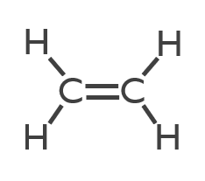
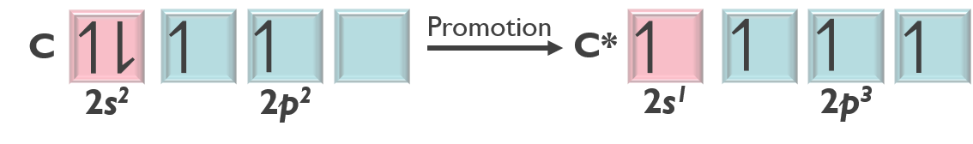
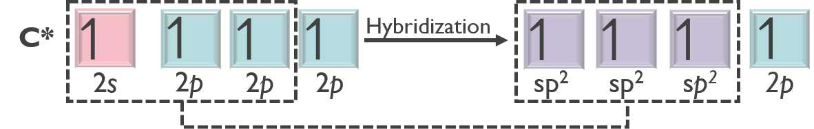
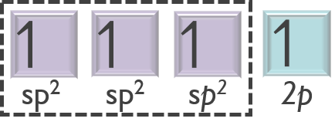
Hybridization in Molecules Containing Multiple Bonds
Valence bond theory and hybridization can be used to describe the bonding in molecules containing double and triple bonds.
Each carbon has three electron domains:
2 single bonds
1 double bond
ethylene
(C₂H₄)
Expect sp² hybridization
Maximize unpaired electrons on carbon by promotion:
Hybridize the required number of atomic orbitals (one for each e– domain on carbon)
One unhybridized atomic 2p orbital gives rise to multiple bonds
Three equivalent sp² hybrid orbitals explain three bonds around carbon

Slide 12
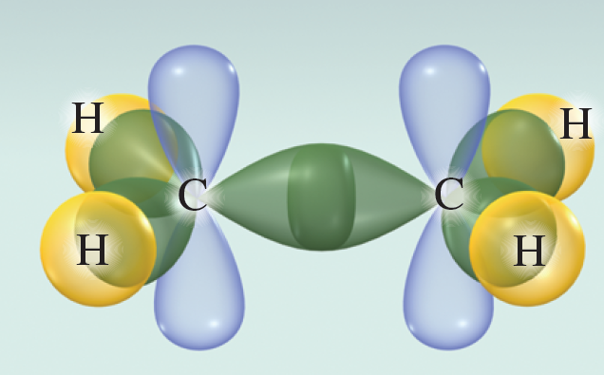
Hybridization in Molecules Containing Multiple Bonds
A sigma (σ) bond forms when sp² hybrid orbitals on the C atoms overlap. In a sigma bond, the shared electron density lies directly along the internuclear axis.
The ethylene molecule contains five sigma bonds:
1 between the two carbon atoms (sp² and sp² overlap)
4 between the C and H atoms (sp² and 1s overlap)

Slide 13
Hybridization in Molecules Containing Multiple Bonds
The remaining unhybridized p orbital is perpendicular to the plane in which the atoms of the molecule lie. The unhybridized p orbitals overlap in a sideways fashion to form a pi (π) bond.
ethylene
(C₂H₄)

Slide 14
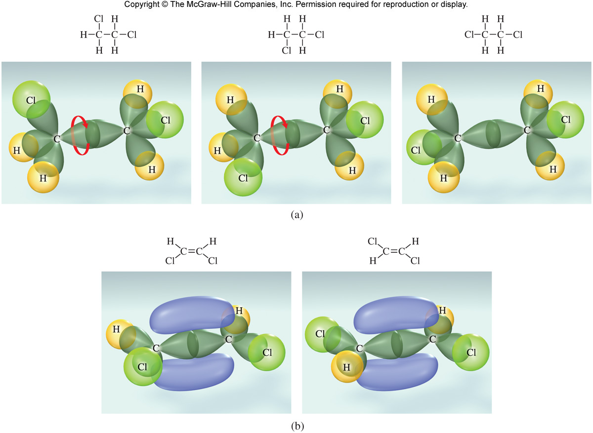
Hybridization in Molecules Containing Multiple Bonds
Sigma bonds exhibit free rotation around the bond axis.
All three Lewis structures represent the same molecule.
Pi bonds restrict free rotation around the bond axis.
There are two isomers of 1,2–dichloroethylene
cis-1,2-dichloroethylene
trans-1,2-dichloroethylene

Slide 15
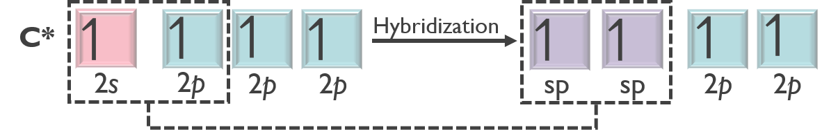
Hybridization in Molecules Containing Multiple Bonds
The acetylene molecule is linear with sp hybridized carbons.
H
C
C
H
acetylene (C₂H₂)
Promotion of an electron maximizes the number of unpaired electrons:
3 sigma bonds:
1 between the two carbon atoms (sp and sp)
2 between the C and H atoms (sp and 1s)
2 pi bonds
2 between the two carbon atoms (2p and 2p)
The 2s orbital and one of the 2p orbitals then mix to form two sp hybrid orbitals:

Slide 16
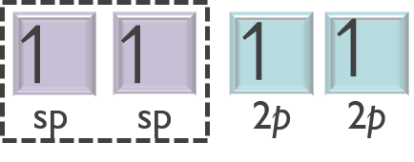
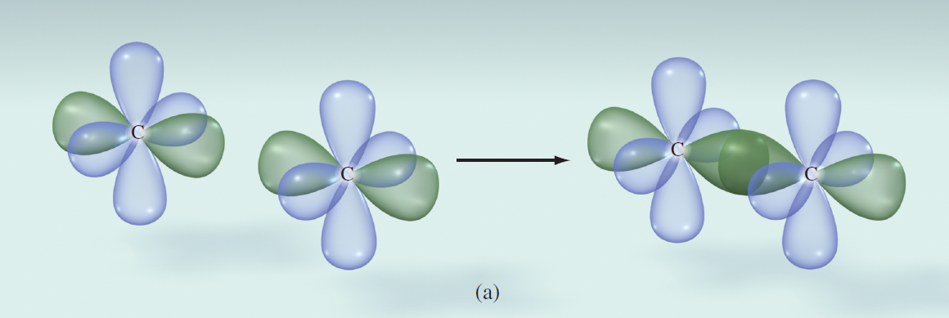
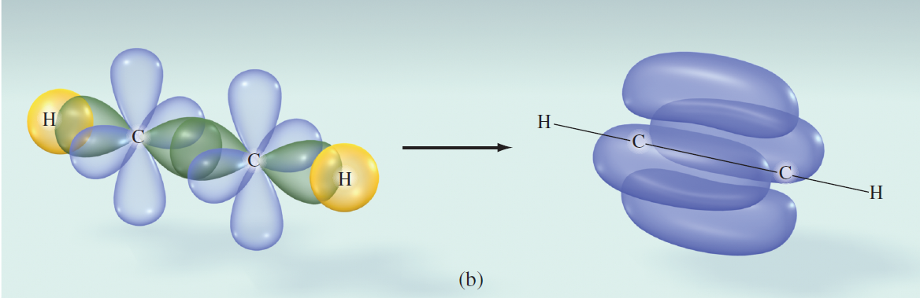
Hybridization in Molecules Containing Multiple Bonds
H
C
C
H
The acetylene molecule is linear with sp hybridized carbons.
acetylene (C₂H₂)
Two equivalent sp hybrid orbitals give rise to 2 sigma bonds
Two unhybridized atomic 2p orbitals gives rise to 2 pi bonds
3 sigma bonds:
1 between the two carbon atoms (sp and sp)
2 between the C and H atoms (sp and 1s)
2 pi bonds
2 between the two carbon atoms (2p and 2p)

Slide 17
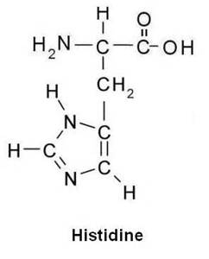
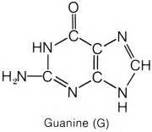
Practice
In addition to its use in aqueous solution as a preservative for laboratory specimens, formaldehyde gas is used as an antibacterial fumigant. Use hybridization to explain the bonding in formaldehyde (CH₂O).
Determine hybridization around each atom in histidine and list the total number of sigma and pi bonds.
The hybridization for carbons and nitrogens in guanine are:
All carbons sp²/nitrogens both sp² and sp³
Carbons both sp² and sp³/ all nitrogens sp²
All carbons sp²/all nitrogens sp²
Carbons both sp² and sp³/ nitrogens both sp² and sp³

Slide 18
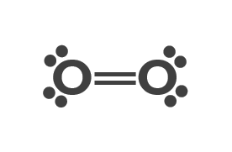
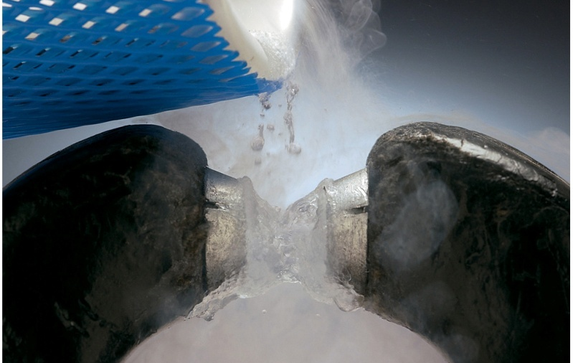
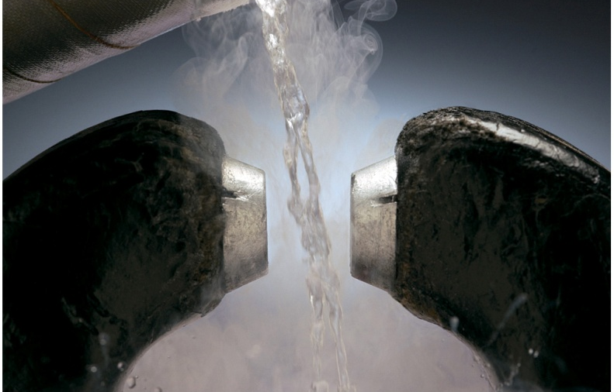
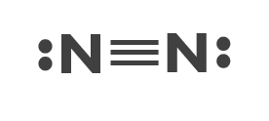
Molecular Orbital Theory
Lewis structures and valence bond theory fail to predict some important properties of molecules.
Paramagnetism is a result of a molecule’s electron configuration. Species that contain one or more unpaired electrons are paramagnetic. Paramagnetic species are attracted to magnet fields.
The Lewis structure for O₂ shows no unpaired electrons.
O₂ exhibits paramagnetism.
Species that contain paired electrons are diamagnetic. Diamagnetic species are weakly repelled by magnetic fields.
The Lewis structure for N₂ shows no unpaired electrons.
N₂ exhibits diamagnetism.

Slide 19
Molecular Orbital Theory
Another bonding theory is needed to describe the paramagnetism of O₂.
In molecular orbital theory, the atomic orbitals combine to form new orbitals that are the “property” of the entire molecule. The new orbitals are called molecular orbitals.
Molecular orbitals have characteristics like atomic and hybrid orbitals:
    specific shapes
    specific energies
    accommodate a maximum of 2 electrons each
    electron filling follows the Pauli exclusion principle
    the number of molecular orbitals obtained equals the number of orbitals combined
H₂ is the simplest homonuclear diatomic molecule.
Valence bond theory:
H₂ forms when from the overlap of the 1s orbitals.
Molecular orbital theory:
H₂ forms when the 1s orbitals combine to give molecular orbitals.
Molecular orbitals result from the constructive and destructive combination of atomic orbitals.

Slide 20
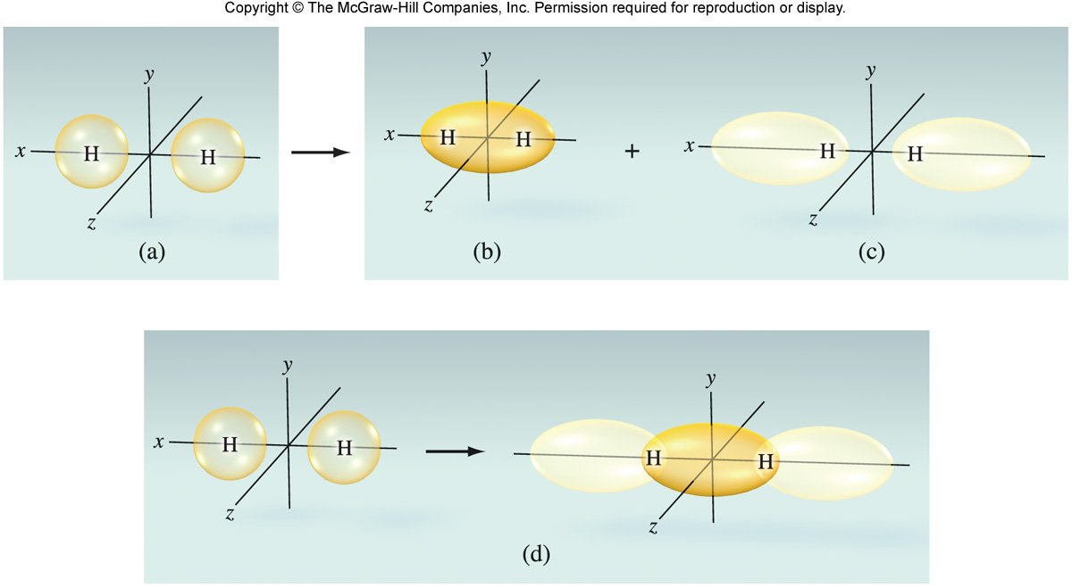
Bonding and Antibonding Molecular Orbitals
Constructive combination of the two 1s orbitals gives rise to a molecular orbital that lies along the internuclear axis (bonding molecular orbital).
Constructive combination increases the electron density between the two nuclei.
Destructive combination of the two 1s orbitals gives rise to a molecular orbital that lies along the internuclear axis but does not lie between the two nuclei (antibonding molecular orbital) .
Electron density in this molecular orbital pulls the two nuclei in opposite directions.

Slide 21






s orbitals combining to make Molecular Orbitals
Molecular orbitals that lie along the internuclear axis are referred to as σ molecular orbitals.
Examples:
σ_{1s} bonding molecular orbital from the combination of two 1s orbitals
σ*_{1s} antibonding molecular orbital from the combination of two 1s orbitals.
Molecular orbitals have specific energies. Electrons in bonding molecular orbitals stabilize the molecule and are LOWER in energy than the isolated atomic orbitals.
Electrons in antibonding molecular orbitals destabilize the molecule and are HIGHER in energy than the isolated atomic orbitals.
Molecular Orbital Diagram For H₂
$$σ_{1s}^{∗}$$
The * distinguishes an antibonding molecular orbital from a bonding orbital.
Energy
$$↿$$
$$↿$$
1s
$$↿$$
$$↿$$
1s
$$σ_{1s}$$
H–atom
H₂ Molecule
H–atom

Slide 22
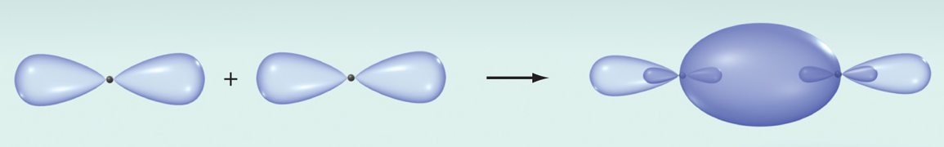
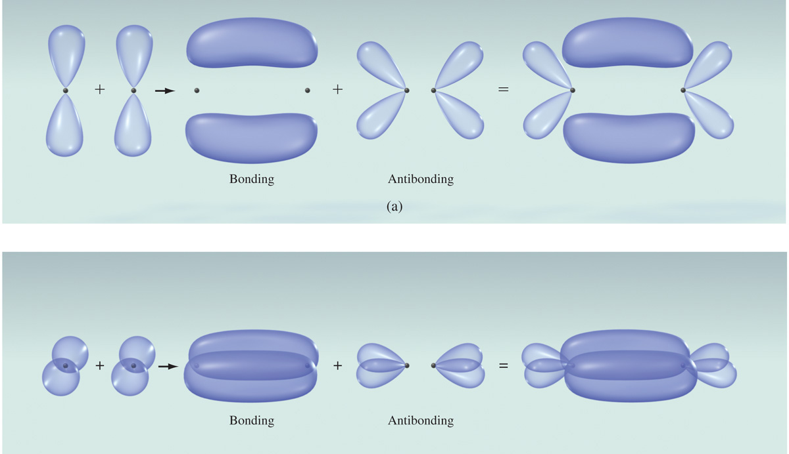
p Molecular Orbitals
p atomic orbitals also form molecular orbitals by both constructive and destructive combination.
The orientations of p_{x}, p_{y}, and p_{z} give rise to two different types of molecular orbitals:
σ molecular orbitals – electron density along the internuclear axis
bonding and antibonding σ molecular orbitals
p_{x} orbitals point towards each other
p atomic orbitals also form molecular orbitals by both constructive and destructive combination.
  π molecular orbitals – electron density above and below the internuclear axis
bonding and antibonding σ molecular orbitals

Slide 23
























Molecular Orbital Diagrams
Filling molecular orbital diagrams follows the same rules as the filling of atomic orbitals.
  Lower energy orbitals fill first.
  Each orbital can accommodate a maximum of two electrons with opposite spin.
  Hund’s rule is obeyed.
Let's look at two carbon atoms forming C₂ : Carbon has 4 Ve–
Atomic Orbitals
Molecular Orbitals
Atomic Orbitals
When making molecular orbitals, s orbitals only interact with s orbitals. p orbitals only interact with p orbitals
$$σ_{2p}^{∗}$$
$$π_{2p}^{∗}$$
$$π_{2p}^{∗}$$
$$↿$$
$$↿$$
$$↿$$
$$↿$$
Molecular orbitals resulting from the combination of p atomic orbitals are higher than those resulting from the combination of s atomic orbitals.
2p
2p
Energy
$$σ_{2p}$$
$$↿$$
$$↿$$
$$↿$$
$$↿$$
$$π_{2p}$$
$$π_{2p}$$
$$↿$$
$$↿$$
$$↿$$
$$↿$$
$$σ_{1s}^{∗}$$
$$↿$$
$$↿$$
2s
$$↿$$
$$↿$$
2s
$$σ_{2s}$$
Carbon 1 Valence Orbitals
C₂ Molecule Orbitals
Carbon 2 Valence Orbitals

Slide 24
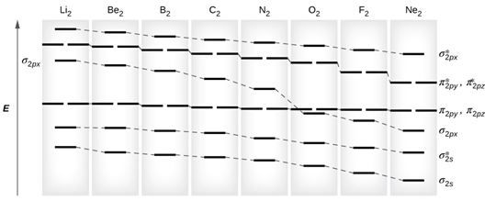
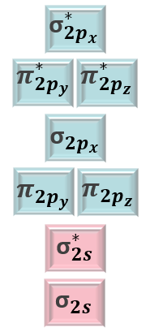
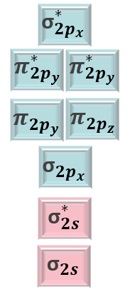
π Molecular Orbitals
This arrangement of orbitals is found in Li₂, B₂, C₂ and N₂.
This arrangement of orbitals is found in O₂, F₂, and Ne₂

Slide 25


















Bond Order
The bond order indicates how stable a molecule is. The higher the bond order, the more stable a molecule is.
$$bond order= \frac{No. of e^{−} in bonding orbitals −No. of e^{−} in antibonding orbitals}{2}$$
Find the bond order for the H₂ molecule:
$$σ_{1s}^{∗}$$
$$↿$$
Energy
$$↿$$
$$bond order= \frac{2−0}{2}=1$$
1s
$$↿$$
$$↿$$
1s
$$σ_{1s}$$
H–atom
H₂ Molecule
H–atom
Find the bond order for the He₂ molecule:
$$↿$$
$$↿$$
$$↿$$
$$σ_{1s}^{∗}$$
$$↿$$
$$↿$$
$$bond order= \frac{2−2}{2}=0$$
Energy
$$↿$$
1s
$$↿$$
$$↿$$
1s
$$σ_{1s}$$
He atom
He₂ Molecule
He atom

Slide 26















































































Molecular Orbitals of Homonuclear Diatomic Molecules
Li₂
B₂
C₂
N₂
O₂
F₂
Ne₂
$${\text{σ}}_{{2p}_{x}}^{∗}$$
$$↿$$
$$↿$$
$${\text{σ}}_{{2p}_{x}}^{∗}$$
$$π_{{2p}_{y},}^{∗}$$
$$π_{{2p}_{y}}^{∗}$$
$$↿$$
$$↿$$
$$↿$$
$$↿$$
$$↿$$
$$π_{{2p}_{y},}^{∗}$$
$$π_{{2p}_{y}}^{∗}$$
$$↿$$
$$↿$$
$$↿$$
$$↿$$
$$↿$$
$${\text{σ}}_{{2p}_{x}}$$
$$↿$$
$$↿$$
$$↿$$
$$↿$$
$$↿$$
$$↿$$
$$↿$$
$$π_{{2p}_{y}},π_{{2p}_{z}}$$
$$↿$$
$$↿$$
$$↿$$
$$↿$$
$$↿$$
$$↿$$
$$↿$$
$$π_{{2p}_{y}},π_{{2p}_{z}}$$
$$↿$$
$$↿$$
$$↿$$
$$↿$$
$$↿$$
$$↿$$
$${\text{σ}}_{{2p}_{x}}$$
$$↿$$
$$↿$$
$$↿$$
$$↿$$
$$↿$$
$$↿$$
$$↿$$
$$↿$$
$$↿$$
$$↿$$
$${\text{σ}}_{2s}^{∗}$$
$$↿$$
$$↿$$
$$↿$$
$$↿$$
$$↿$$
$$↿$$
$$↿$$
$$↿$$
$$↿$$
$$↿$$
$$↿$$
$$↿$$
$${\text{σ}}_{2s}^{∗}$$
$${\text{σ}}_{2s}$$
$$↿$$
$$↿$$
$$↿$$
$$↿$$
$$↿$$
$$↿$$
$$↿$$
$$↿$$
$$↿$$
$$↿$$
$$↿$$
$$↿$$
$$↿$$
$$↿$$
$${\text{σ}}_{2s}$$
Bond Order | 1 | 1 | 2 | 3 | 2 | 1 | 0
Bond Length (pm) | 267 | 159 | 131 | 110 | 121 | 142 | –
Bond Enthalpy (kJ/mol) | 104.6 | 288.7 | 627.6 | 941.4 | 498.7 | 156.9 | –
Magnetic Properties | Diamagnetic | Paramagnetic | Diamagnetic | Diamagnetic | Paramagnetic | Diamagnetic | –
Sigma Bonds | 1 | 0 | 0 | 1 | 1 | 1 | 0
Pi Bonds | 0 | 1 | 2 | 2 | 1 | 0 | 0
Remember that for O₂ and F₂, ${\text{σ}}_{{2p}_{x}}$ is lower in energy than ${\text{π}}_{{2p}_{y}}$ and ${\text{π}}_{{2p}_{z}}$

Slide 27










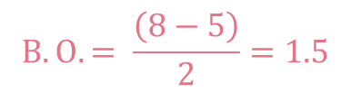























Practice
The superoxide ion (O₂–) has been implicated in several degenerative conditions, including aging and Alzheimer’s disease. Using molecular orbital theory, determine whether (O₂–) is paramagnetic or diamagnetic, and then calculate its bond order.
Oxygen has 6 valence electrons, and we have two oxygens. Also we have one negative charge.
6+6+1=13 e– to work with
O–
O₂–
O
$$σ_{2p}^{∗}$$
$$↿$$
$$↿$$
$$↿$$
$$π_{2p}^{∗}$$
$$π_{2p}^{∗}$$
$$↿$$
$$↿$$
$$↿$$
$$↿$$
$$↿$$
$$↿$$
$$↿$$
$$↿$$
$$↿$$
$$B.O. = \frac{\left(8−5\right)}{2}=1.5$$
2p
2p
$$↿$$
$$↿$$
$$↿$$
$$↿$$
Energy
$$π_{2p}$$
$$π_{2p}$$
Paramagnetic
$$↿$$
$$↿$$
$$σ_{2p}$$
$$↿$$
$$↿$$
$$↿$$
$$↿$$
$$σ_{1s}^{∗}$$
$$↿$$
$$↿$$
2s
$$↿$$
$$↿$$
2s
$$σ_{2s}$$
Oxygen 1 Valence Orbitals
O₂– Molecule Orbitals
Oxygen 2 Valence Orbitals

Slide 28
Bonding Theories and Descriptions of Molecules with Delocalized Bonding
Lewis Theory
Strength:
qualitative prediction of bond strength and bond length
Weakness:
two-dimensional model, real molecules are three dimensional
fails to explain why bonds form
Valence–Shell Electron–Pair Repulsion Model
Strength:
predict the shape of many molecules and polyatomic ions
Weakness:
fails to explain why bonds form (based on Lewis theory)
Valence Bond Theory
Strength:
covalent bonds form when atomic orbitals overlap
Weakness:
fails to explain the bonding in many molecules

Slide 29
Bonding Theories and Descriptions of Molecules with Delocalized Bonding
Hybridization of Atomic Orbitals
Strength:
an extension of valence bond theory. Using hybrid orbitals it is possible to explain the bonding and geometry of more molecules
Weakness:
fails to predict some important properties, such as magnetism
Molecular Orbital Theory
Strength:
accurately predict the magnetic and other properties of molecules
Weakness:
complex
Some molecules are best described using a combination of models. Benzene, C₆H₆, is represented with two resonance structures:
The π bonds in benzene are delocalized – spread out over the entire molecule.

Slide 30
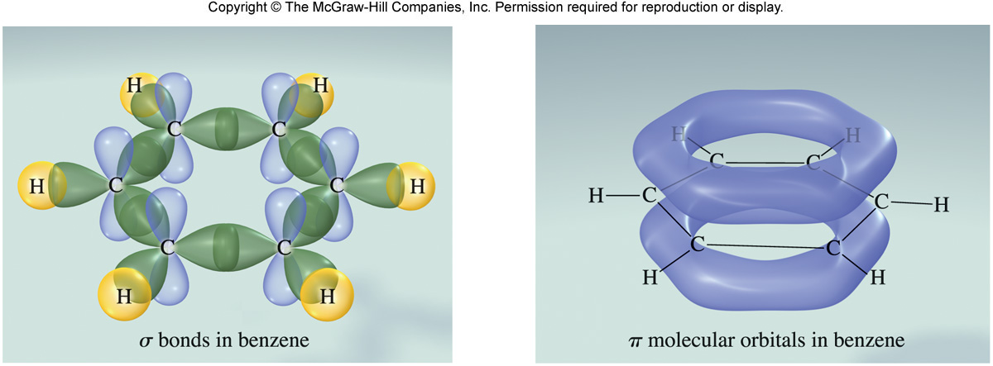
Bonding Theories and Descriptions of Molecules with Delocalized Bonding
The π bonds in benzene are delocalized – spread out over the entire molecule.

Slide 31
More Resonance Examples
It takes three resonance structures to represent the carbonate ion CO₃^{2–}:
–2
–2
–2
••
••
••
••
O
O
O
••
••
••
••
••
C
••
••
••
••
••
O
O
O
C
O
O
C
O
••
••
••
••
••
••
••
••
••
••
None of the three, though, is a completely accurate description. As with benzene, the bonds that are shown in the Lewis structure as one double and two single are three equivalent bonds. Use a combination of valence bond theory and molecular orbital theory to explain the bonding in CO₃^{2–}.

