Slide 1
Chapter 4: Chemical Bonding and Molecular Geometry

Slide 2

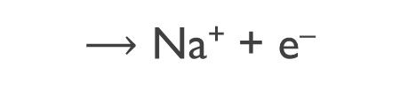

Compounds
A compound is a substance composed of two or more elements combined in a specific ratio and held together by chemical bonds.
Familiar examples of compounds
water and salt (sodium chloride).
Na
$⟶$ Na⁺ + e–
−
Cl
Cl + e– $⟶$
Ionic bonding refers to the electrostatic attraction that holds oppositely charged ions together in an ionic compound.
−
Cl
Na
$$⟶$$
Cl
+ Na⁺
The attraction between the cation and anion draws them together to form NaCl
The resulting electrically neutral compound, sodium chloride, is represented with the chemical formula NaCl.
The chemical formula, or simply formula, of an ionic compound denotes the constituent elements and the ratio in which they combine.
Ionic compounds typically have a metal ion and a non–metal ion to form the compound.

Slide 3
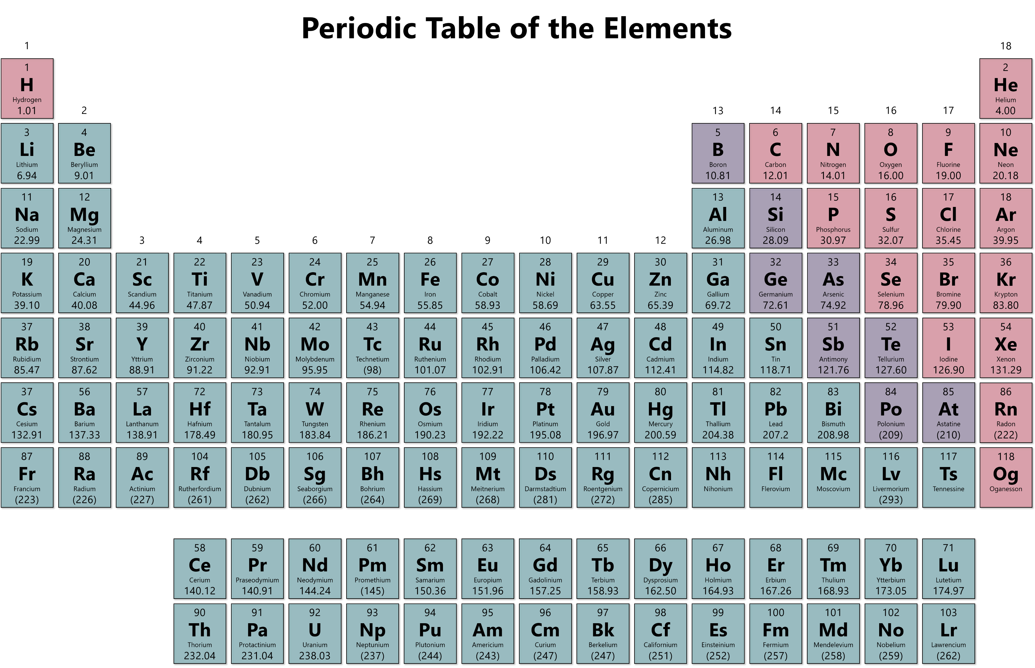
The Periodic Table
Elements can be categorized as metals, nonmetals, or metalloids.
Metals are good conductors of heat and electricity.
solids (except mercury – a liquid)
ductile (can be drawn into wires)
malleable (can be rolled into sheets)
Nonmetals are poor conductors of heat or electricity. (graphite is the one exception)
Occur in all physical states.
Metalloids have intermediate properties.
Boron, silicon, germanium, arsenic, antimony, tellurium, (astatine)
They exhibit metallic and nonmetallic properties:
Conduct electricity (not as well as metals).
Look like metals (shiny).
  semiconductors.

Slide 4
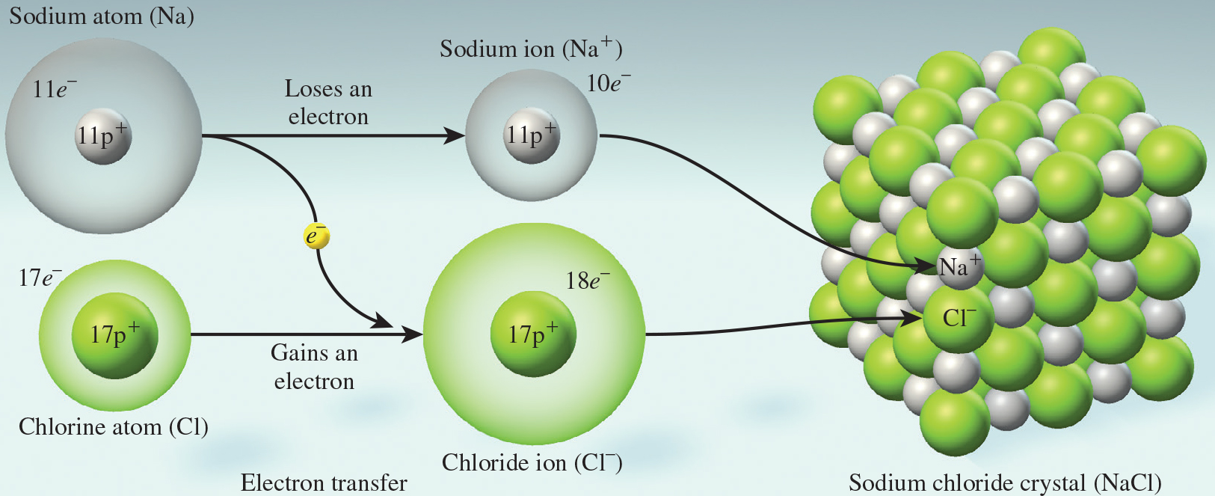

Ionic Compounds and Bonding
A three-dimensional array of oppositely-charged ions is called a lattice. Lattice energy is the amount of energy required to convert a mole of ionic solid to its constituent ions in the gas phase.
The formation of ionic bonds releases a large amount of energy
The magnitude of lattice energy is a measure of an ionic compound’s stability. Lattice energy depends on the magnitudes of the charge and on the distance between them.
Q₁
•
Q₂
Q = amount of charge
d = distance of separation
•
$$F ∝ \frac{Q_{1}∙Q_{2}}{d^{2}}$$
d

Slide 5
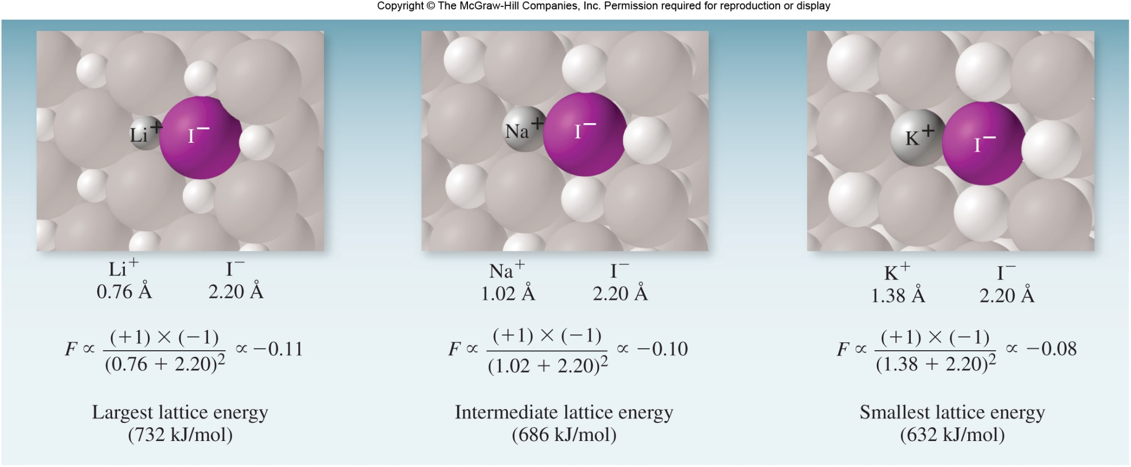
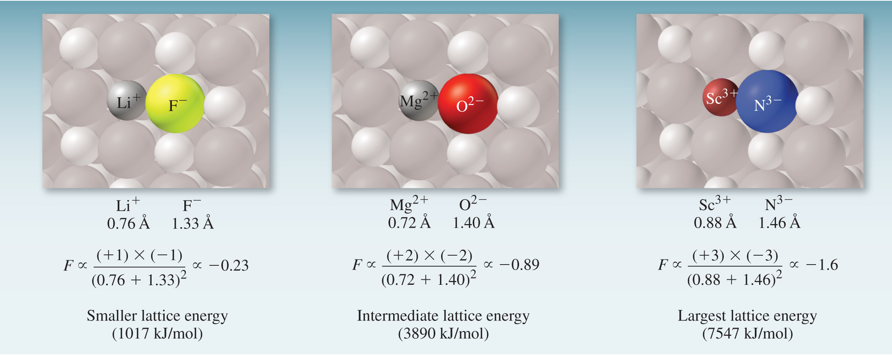
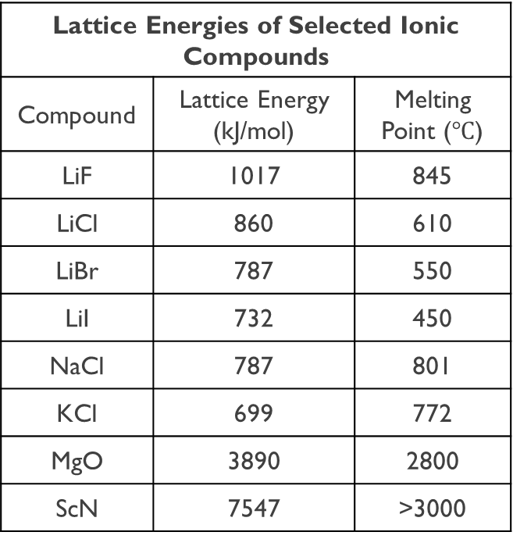
Ionic Compounds and Bonding
The magnitude of lattice energy is a measure of an ionic compound’s stability. Lattice energy depends on the magnitudes of the charge and on the distance between them.
Lattice Energies of Selected Ionic Compounds
Compound | Lattice Energy (kJ/mol) | Melting Point ($℃$)
LiF | 1017 | 845
LiCl | 860 | 610
LiBr | 787 | 550
LiI | 732 | 450
NaCl | 787 | 801
KCl | 699 | 772
MgO | 3890 | 2800
ScN | 7547 | >3000

Slide 6
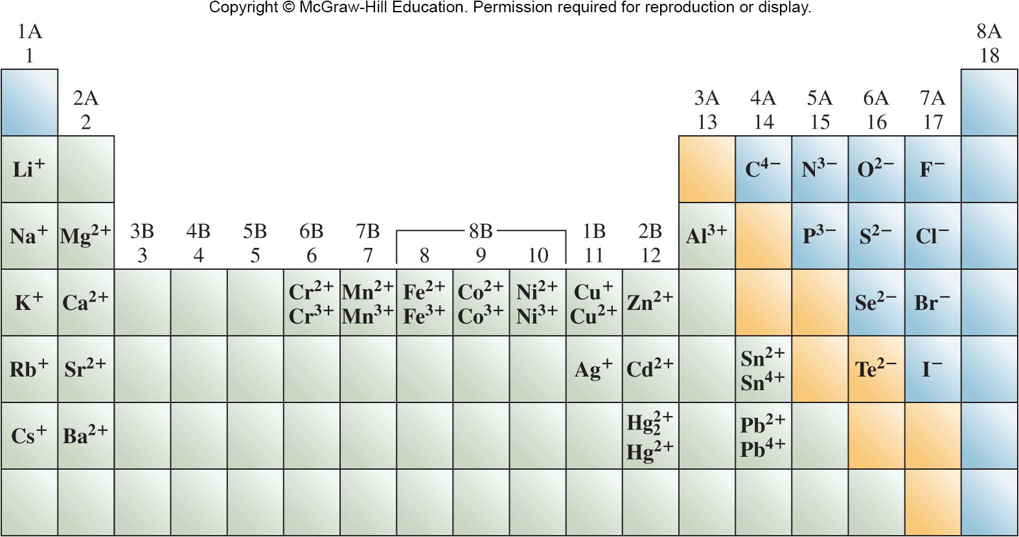
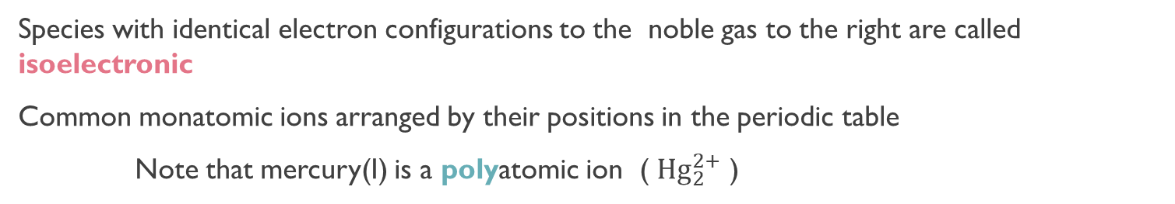
Electron Configurations of Ions
To write the electron configuration of an ion formed by a main group element:
1. Write the configuration for the atom.
2. Add or remove the appropriate number of electrons. Positive ions, remove electrons; negative ions, add electrons
Na:1s²2s²2p⁶3s¹
Na⁺: 1s²2s²2p⁶
10 electrons total, isoelectronic with Ne
Cl: 1s²2s²2p⁶3s²3p⁵
Cl–: 1s²2s²2p⁶3s²3p⁶
18 electrons total, isoelectronic with Ar
Species with identical electron configurations to the noble gas to the right are called isoelectronic
Common monatomic ions arranged by their positions in the periodic table
Note that mercury(I) is a polyatomic ion ( ${Hg}_{2}^{2+}$ )

Slide 7
Practice
Write electron configurations for the following ions of main group elements: (a) N^{3–}, (b) Ba²⁺, and (c) Be²⁺.
(a) [He]2s²2p⁶
(b) [Kr]5s²4d¹⁰5p⁶
(c) 1s²
Determine the electron configuration for the following ions:
Cl–
N^{3–}
K⁺
Ca²⁺
Are any of them isoelectronic?
[Ar]3s²3p⁶
[He]2s²2p⁶
[Ne]3s²3p⁶
[Ne]3s²3p⁶
Cl–, K⁺, Ca²⁺

Slide 8
Ions of d–Block Elements
Ions of d-block elements are formed by removing electrons first from the shell with the highest value of n.
For Fe to form Fe²⁺, two electrons are lost from the 4s subshell not the 3d.
Fe: [Ar]4s²3d ⁶
Fe²⁺: [Ar]3d ⁶
Fe can also form Fe³⁺, in which case the third electron is removed from the 3d subshell.
Fe: [Ar]4s²3d ⁶
Fe³⁺: [Ar]3d ⁵
Write electron configurations for the following ions of d-block elements: (a) Zn²⁺, (b) Mn²⁺, and (c) Cr³⁺.
[Ar]3d¹⁰
[Ar]3d⁵
[Ar]3d³

Slide 9
Practice
Determine the electron configuration for the following ions:
Fe⁺²
Fe⁺³
Cr⁺³
Ti⁺²
Ti⁺⁴
Ni⁺²
Ag⁺
[Ar]3d⁶
[Ar]3d⁵
[Ar]3d³
[Ar]3d²
[Ne]3s²3p⁶
[Ar]3d⁸
[Kr]4d¹⁰

Slide 10
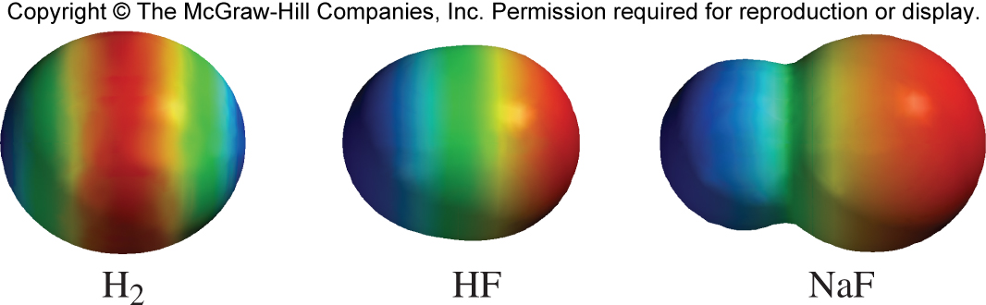
Electronegativity and Polarity
There are two extremes in the spectrum of bonding:
covalent bonds occur between atoms that share electrons
ionic bonds occur between a metal and a nonmetal and involve ions
Bonds that fall between these extremes are polar.
In polar covalent bonds, electrons are shared but not shared equally. The delta, δ, is used to denote partial charges on the atoms
Pure covalent bond
Neutral atoms held together by equally shared electrons
Polar covalent bond
Partially charged atoms bonded by unequally shared electrons
Ionic bond
Oppositely charged ions held together by electrostatic attraction
M:X
M^{δ+}X^{δ−}
M⁺X⁻
H₂
HF
NaF
Electron density maps show the distributions of charge. Electrons spend a
lot of time in red and very little time in blue.

Slide 11
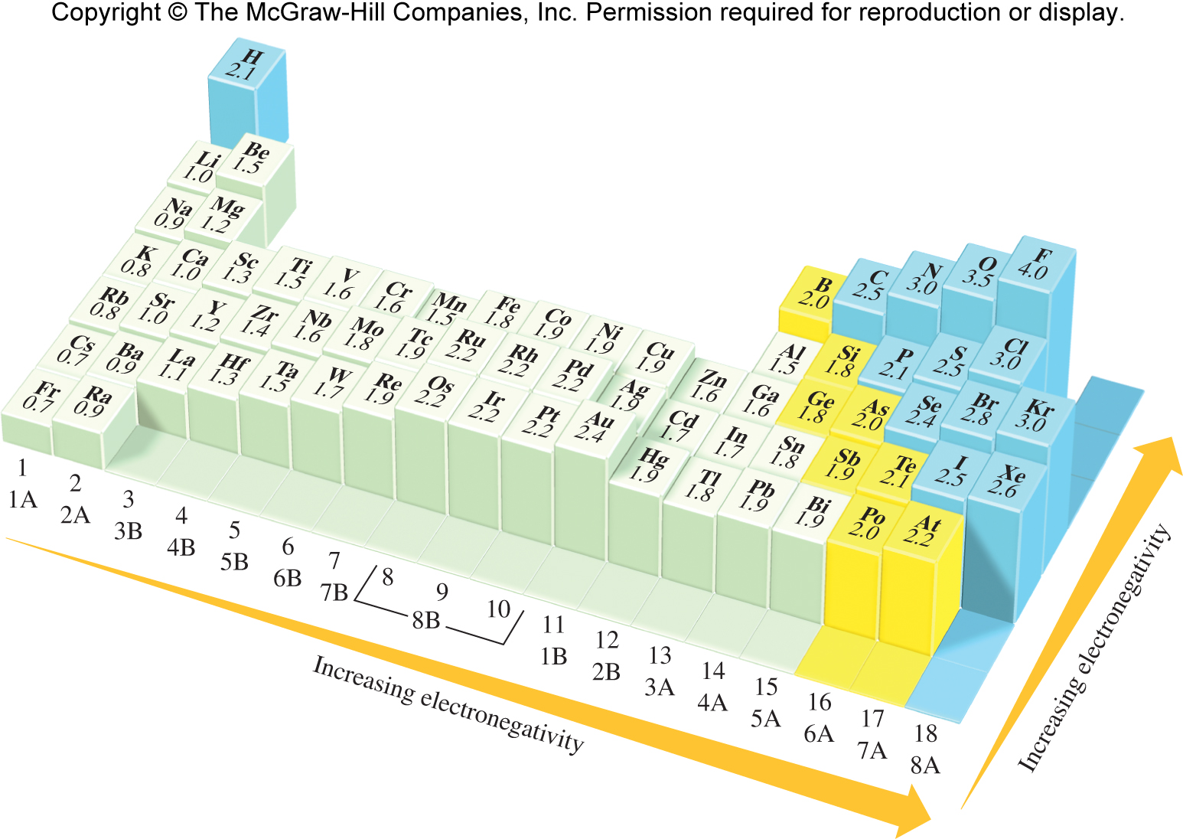
Increasing
Electronegativity and Polarity
Electronegativity
F
Electronegativity is the ability of an atom in a compound to draw electrons to itself. Electronegativity varies with atomic number.

Slide 12
Electronegativity
There is no sharp distinction between nonpolar covalent and polar covalent or between polar covalent and ionic.
The following rules help distinguish among them:
A bond between atoms whose electronegativites differ by less than 0.5 is general considered purely covalent or nonpolar.
A bond between atoms who’s electronegativies differ by the range of 0.5 to 2.0 is generally considered polar covalent.
A bond between atoms whose electronegativities differ by 2.0 or more is generally considered ionic.
Classify the following bonds as nonpolar, polar, or ionic: (a) the bond in ClF, (b) the bond in CsBr, and (c) the carbon-carbon double bond in C₂H₄.
The difference in electronegativies: F and Cl is 4.0 – 3.0 = 1.0. The bond in ClF is polar.
In CsBr, the difference is 2.8 – 0.7 = 2.1, making the bond ionic.
In C₂H₄, the two atoms are identical. The carbon-carbon double bond is C₂H₄ is nonpolar.

Slide 13
Polar Covalent Bonds
In polar covalent bonds, electrons are shared but not shared equally. The delta, δ, is used to denote partial charges on the atoms
HF
Electron density maps show the distributions of charge. Electrons spend a lot of time in red and very little time in blue.
••
H−
••
F
An arrow is used to indicate the direction of electron shift in polar covalent molecules.
••
δ+
δ−
••
H−
••
The consequent charge separation can be represented as Delta (δ) which denotes a partial positive or negative charge.
F
••

Slide 14
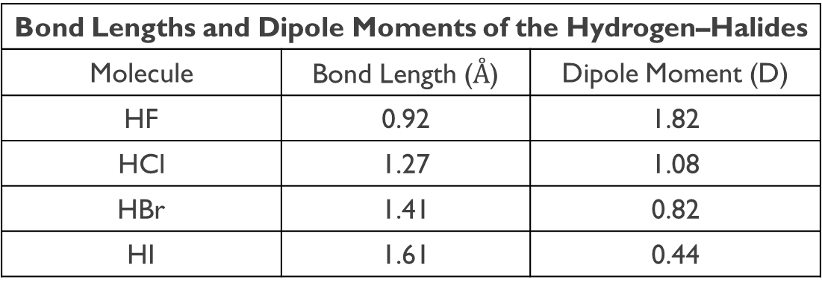
Dipole Moment, Partial Charges, and Percent Ionic Character
A quantitative measure of the polarity of a bond is its dipole moment (μ).
Q is the charge.
r is the distance between the charges.
μ is always positive and expressed in debye units (D).
1 D = 3.336 x10^{–30} C∙m. C is Coulomb, and m is meter
μ = Q x r
Bond Lengths and Dipole Moments of the Hydrogen–Halides
Molecule | Bond Length ($Å$) | Dipole Moment (D)
HF | 0.92 | 1.82
HCl | 1.27 | 1.08
HBr | 1.41 | 0.82
HI | 1.61 | 0.44

Slide 15
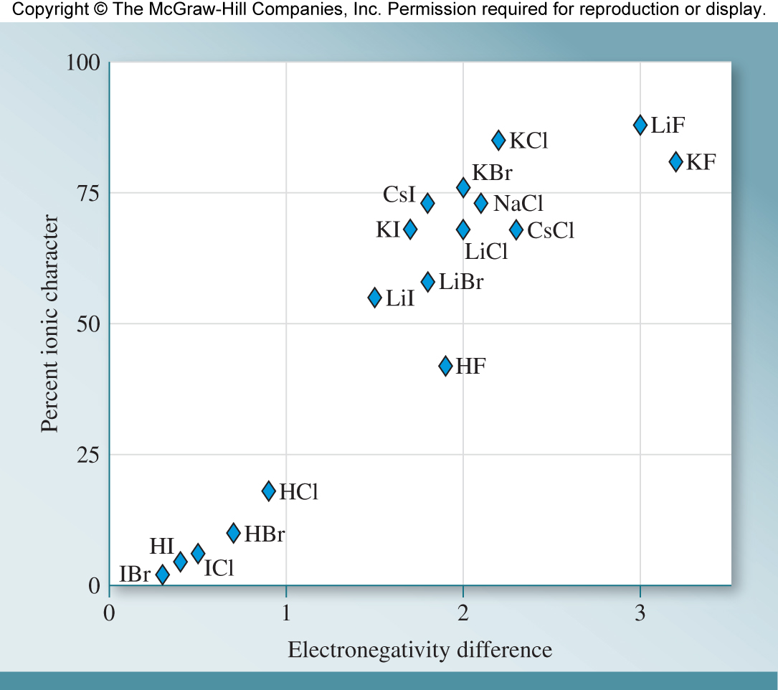
Dipole Moment, Partial Charges, and Percent Ionic Character
Although the designations “covalent,” “polar covalent,” and “ionic” can be useful, sometimes chemists wish to describe and compare chemical bonds with more precision.
Comparing the calculated dipole moment with the measured values gives us a quantitative way to describe the nature of a bond using the term percent ionic character.
$$percent ionic character= \frac{μ (observed)}{μ (calculated assuming discrete charges)}×100\%$$
The figure demonstrates the relationship between percent ionic character and the electronegativity difference in a heteronuclear diatomic molecule.

Slide 16








Practice
Determine the partial charges and direction of dipole for the following bonds:
H–Cl
C–O
O–H
N–F
Cl
H
$$δ^{+}$$
$$δ^{−}$$
3.0 – 2.1 = 0.9
H–Cl
O
C
$$δ^{+}$$
$$δ^{−}$$
3.5 – 2.5 = 1.0
C–O
O
H
$$δ^{+}$$
$$δ^{−}$$
3.5 – 2.1 = 1.4
H–O
F
N
$$δ^{+}$$
$$δ^{−}$$
4.0 – 3.0 = 1.0
N–F

Slide 17
Types of Ionic Compounds
There are two types of ionic compounds:
Ionic compounds formed between two elements: a metal and a non-metal
  Example: NaCl, CaCl₂
2. Ionic compound formed between a metal and a polyatomic ion (multiple atoms)
Example: Ca(BrO₃)₂
The list of polyatomics is given in your textbook, but in this case, the polyatomic ion is the bromate ion (BrO₃).
The polyatomic ions must be memorized.
Naming ionic compounds composed of only elemental ions requires you to know the names and symbols of the given metal and non-metal ions.
These are given in Table 5.2 of your book. I will also give uploaded notes with them.
To name ionic compounds:
Name the cation (omit the word ion)
*Use a Roman numeral if the cation can have more than one charge (this happens mostly for transition metals).
This roman numeral tells the charge on that transition metal.
2) Name the anion by replacing the ending with -ide (omit the word ion)

Slide 18
Naming Ionic Compounds
Naming Method Old System
Examples: NaBr sodium bromide
FeCl₂ iron (II)chloride ferrous chloride
FeCl₃ iron (III)chloride ferric chloride
To give ionic compound formula from the name:
When we want to go from the name to the formula there are a few things we need to remember.
Ionic compounds are electronically neutral.
For ionic compounds to be electronically neutral, the sum of the charges in each formula must be zero.
Your task: Find the smallest coefficients that will yield a compound with a neutral charge. People accomplish this one of two ways: (1) Sum of Charges or (2) Cross Multiplication
Example: Aluminum oxide: Al³⁺ and O^{2–} $⟶$ Al₂O₃
Sum of charges:
2(+3) + 3(–2) = 0
Cross Multiplication:
Al³⁺ O²⁻

Slide 19
Formulas of Ionic Compounds
If you chose to cross multiply, make sure that you are only reporting the empirical formula. What do I mean by that?
Example: What is the formula for Calcium Oxide?
Order to writing the chemical formula:
Look for Calcium (Ca) on the periodic table: It is in group 2A (typical ion charge of 2+).
Find Oxygen (O) on the periodic table: It is group 6A (typical ion charge of 2–).
We write Ca with a +2 charge. We write O with a –2 Charge.
We cross multiply
We divide to make the simplest coefficients possible.
Step 1 and 2
Step 3
~~~Step 4~~~
Step 5
Ca and O
Ca²⁺ O^{–2}
Ca⁺² O^{–2}
Ca₂O₂
CaO

Slide 20
Examples
Name the following ionic compounds: (a) CaO, (b) Na₃N, and (c) CuBr₂
(a) Calcium oxide
(b) Sodium nitride
(c) Copper(II) bromide
Deduce the formulas of the following ionic compounds: (a) Iron(II) chloride, (b) strontium(II) oxide, and (c) potassium bromide.
(c) K⁺ Br–
K⁺ Br–
KBr
(a) Fe²⁺ Cl^{–1}
Fe²⁺ Cl^{–1}
FeCl₂
(b) Sr²⁺ O^{–2}
Sr²⁺ O^{–2}
Sr₂O₂
SrO
Determine ion charges and make neutral compounds. (a) Mg and P, (b) Rb and F, (c) Na and N, (d) Al and Br, (e) Li and S
(a) Mg₃P₂
(b) RbF
(c) Na₃N
(d) AlBr₃
(e) Li₂S

Slide 21
Examples
Name the ionic complex made from the following
Mn²⁺ and N
Co⁺³ and I
Fe⁺² and P
Ti⁺⁴ and Cl
Ag⁺ and S
Sn⁺² and F
Manganese(II) Nitride
Cobalt(III) Iodide
Iron(II) Phosphide
Titanium(IV) Chloride
Silver(I) Sulfide
Tin(II) Flouride
Name the ionic complex made from the following:
Li and F
Mg and Br
Al and N
H and F
Ca and O
Lithium flouride
Magnesium bromide
Aluminum nitride
Hydrogen flouride
Calcium oxide

Slide 22
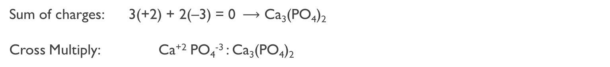
Ionic Compounds formed with polyatomic ions (covalently bonded species)
Polyatomic ions: consist of a combination of two or more atoms. A common list can be found in the textbook in Table 2.5 ( Textbook Link: Table 2.5 )
Formulas are determined following the same rules as for ionic compounds containing only monatomic ions: ions must combine in a ratio that give a neutral formula overall.
Calcium phosphate: Ca²⁺ and PO₄^{3–}
Sum of charges: 3(+2) + 2(–3) = 0 $⟶$ Ca₃(PO₄)₂
Cross Multiply: Ca⁺² PO₄⁻³ : Ca₃(PO₄)₂
Notice that when multiple polyatomic ions are coordinated, there are parenthesis around it. These aren’t needed for only one polyatomic ion.

Slide 23
Polyatomic Ions (Oxoanions)
Oxoanions are polyatomic anions that contain one or more oxygen atoms and one atom (the “central atom”) of another element.
Starting with the oxoanions that end in –ate, we can name these ions as follows:
The ion with one more O atom than the –ate ion is called the per…ate ion. Thus, ClO₃– is the chlorate ion, so ClO₄– is the perchlorate ion.
The ion with one less O atom than the –ate ion is called the –ite ion. Thus, ClO₂– is the chlorite ion.
The ion with two fewer O atom than the –ate ion is called the hypo…ite ion. Thus, ClO– is the hypochlorite ion.
You can apply these guidelines when necessary.
phosphate PO₄^{3–}
phosphite PO₃^{3–}
sulfate SO₄^{2–}
sulfite SO₃^{2–}
    perchlorate ClO₄–
    chlorate ClO₃–
    chlorite ClO₂–
    hypochlorite ClO–
    nitrate NO₃–
    nitrite NO₂–

Slide 24
Examples
Name the following ionic compounds: (a) Mn₃(PO₄)₂, (b) AlCl₃, and (c) Hg₂O.
(a) Manganese(II) Phosphate
(b) Aluminum chloride
(c) Mercury(I) oxide
Write formulas for the following ionic compounds:
Li⁺ and N^{3–},
(B) Fe²⁺ and Cl–,
Mn²⁺ and SO₄^{2–},
Co²⁺ and C₂H₃O₂–,
Mn⁷⁺ and CO₃^{2–}
(A) Li₃N
(B) FeCl₂
(C) MnSO₄
(D) Co(C₂H₃O₂)₂
(E) Mn₂(CO₃)₇
Name the following compounds: A) AlCl₃, B) AgF, C) CaBr₂, D)PbO₂
What is the correct, systematic name of Mn₂S₃?
Aluminum(III) chloride (b) Silver(I) fluoride (c) Calcium bromide (d) Lead(IV) oxide
Manganese(III) sulfide
Dimanganese trisulfide
Magnesium(II) sulfite
Dimagnesium trisulfide

Slide 25
Examples
Deduce the compounds from the following names:
sodium hypochlorite
dinitrogen pentoxide
potassium dichromate
ammonium perchlorate
hydrogen chloride
What is the formula for manganese (IV) phosphate?
Mn₃(PO₄)₂
Mg₃(PO₄)₂
Mn₃(PO₄)₄
Mn₂(PO₄)₄

Slide 26
Naming Molecular Compounds (New Rules)
Remember that binary molecular compounds are substances that consist of just two different elements. These are the rules for molecular compounds, not ionic compounds! Use when both elements are nonmetals!
Nomenclature:
1) Name the first element that appears in the formula.
Name the second element that appears in the formula, changing its ending to –ide.
Add Greek prefixes to elements (skip the mono- on the first element.)
Greek prefixes are used to denote the number of atoms of each element present.
Prefix | Meaning | Prefix | Meaning
Mono- | 1 | Hexa- | 6
Di- | 2 | Hepta- | 7
Tri- | 3 | Octa- | 8
Tetra- | 4 | Nona- | 9
Penta- | 5 | Deca- | 10

Slide 27
Naming Molecular Compounds
The prefix mono– is generally omitted for the first element.
For ease of pronunciation, we usually eliminate the last letter of a prefix that ends in “o” or “a” when naming an oxide.
  Example: N₂O₅ is dinitrogen pentoxide NOT dinitrogen pentaoxide
Compounds with Greek Prefixes
Compound | Name | Compound | Name
CO | Carbon monoxide | SO₃ | Sulfur trioxide
CO₂ | Carbon dioxide | NO₂ | Nitrogen dioxide
SO₂ | Sulfur dioxide | N₂O₅ | Dinitrogen pentoxide

Slide 28
Examples
Name the following binary molecular compounds: (a) PF₃ and (b) N₂O.
Phosphorous trifluoride
Dinitrogen monoxide
Write the chemical formulas for the following binary molecular compounds: (a) sulfur tetrafluoride and (b) tetraphosphorus decasulfide.
SF₄
P₄S₁₀
Name the following compounds: (a) SO₃, (b) CuSO₄, (c) S₂Cl₂, (d) SF₆
Sulfur trioxide
Copper(II) sulfate
Disulfur dichloride
Sulfur hexafluoride

Slide 29
Compounds Containing Hydrogen
The names of molecular compounds containing hydrogen usually do not conform to the systematic nomenclature guidelines. Many are common nonsystematic names that do not indicate explicitly the number of H atoms present.
Compound | Name | Compound | Name
B₂H₆ | Diborane | SiH₄ | Silane
NH₃ | Ammonia | PH₃ | Phosphine
H₂O | Dihydrogen monoxide/water | H₂S | Hydrogen Sulfide
An acid is a substance that produces hydrogen ions (H⁺) when dissolved in water (one definition). HCl is an example of a binary compound that is an acid when dissolved in water.
To name these types of acids:
1) remove the –gen ending from hydrogen
2) change the –ide ending on the second element to –ic.
hydrogen chloride → hydrochloric acid

Slide 30
Compounds Containing Hydrogen
A compound must contain at least one ionizable hydrogen atom to be an acid upon dissolving. An ionizable hydrogen becomes a proton (H⁺).
Some Simple Binary Acids
Formula | Binary compound name | Acid Name
HF | Hydrogen fluoride | Hydrofluoric acid
HCl | Hydrogen chloride | Hydrochloric acid
HBr | Hydrogen bromide | Hydrobromic acid
HI | Hydrogen iodide | Hydroiodic acid
Oxoacids, when dissolved in water, produce hydrogen ions and the corresponding oxoanions.
An acid based on an –ate ion is called………ic acid
HClO₃ is chloric acid
An acid based on an –ite ion is called………ous acid
HClO₂ is chlorous acid
Prefixes in oxoanion names are retained in naming the oxoacids
HClO₄ is perchloric acid
HClO is hypochlorous acid

Slide 31
Oxoacids
Oxoacids, can be monoprotic (one ionizable hydrogen/one H⁺) or polyprotic (more than one ionizable hydrogen/more than one H⁺)
The names of the anions indicate the number of the remaining hydrogens
        H₃PO₄ Phosphoric acid
        H₂PO₄– Dihydrogen phosphate ion
        HPO₄^{2–} Hydrogen phosphate ion
        PO₄^{3–} Phosphate ion

Slide 32
Poll Question: Campusknot
(Ch. 4-Slide 32) What is the name of the following compound:
P₂O₅

Slide 33
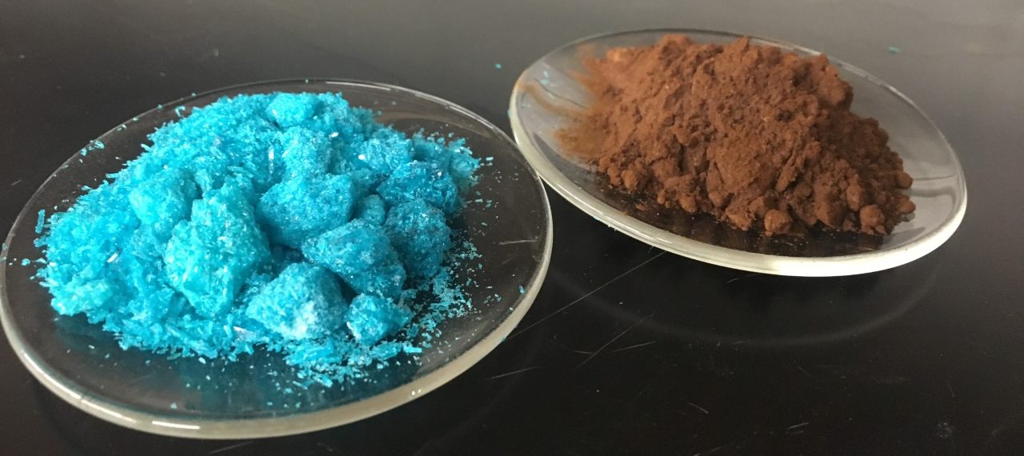
Hydrates
A hydrate is a compound that has a specific number of water molecules within its solid structure.
For example, in its normal state, copper(II) chloride has two water molecules associated with it (blue compound).
Systematic name: copper(II) chloride dihydrate
Formula: CuCl₂ ∙ 2H₂O
When the water molecules are driven off by heating, the resulting compound, is called anhydrous. Anhydrous: containing no water molecules
Some other hydrates:
BaCl₂ ∙ 2H₂O MgSO₄ ∙ 7H₂O
LiCl ∙ H₂O Sr(NO₃)₂ ∙ 4H₂O

Slide 34
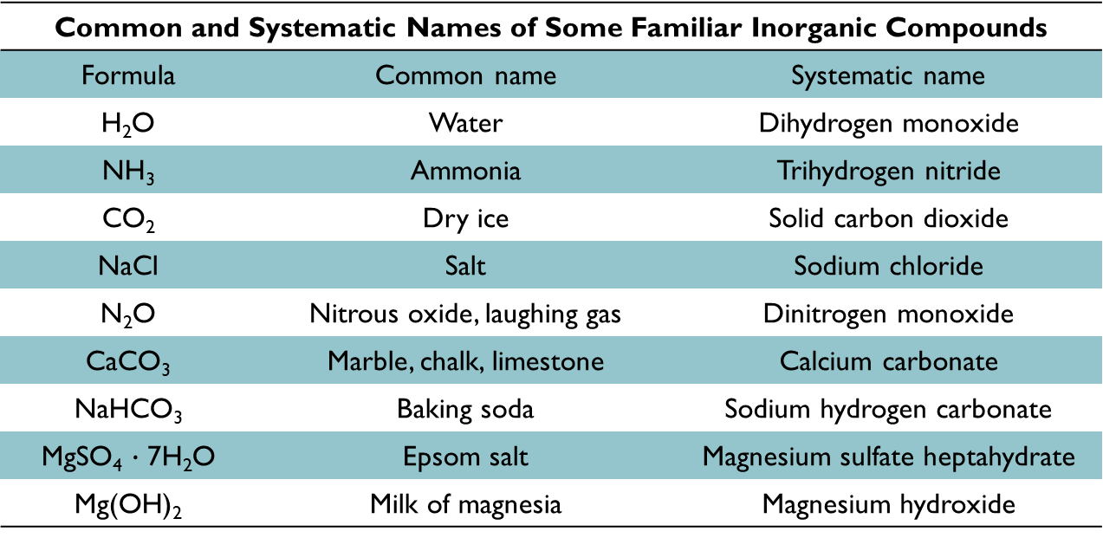
Familiar Inorganic Compounds
Common and Systematic Names of Some Familiar Inorganic Compounds
Formula | Common name | Systematic name
H₂O | Water | Dihydrogen monoxide
NH₃ | Ammonia | Trihydrogen nitride
CO₂ | Dry ice | Solid carbon dioxide
NaCl | Salt | Sodium chloride
N₂O | Nitrous oxide, laughing gas | Dinitrogen monoxide
CaCO₃ | Marble, chalk, limestone | Calcium carbonate
NaHCO₃ | Baking soda | Sodium hydrogen carbonate
MgSO₄ $∙$ 7H₂O | Epsom salt | Magnesium sulfate heptahydrate
Mg(OH)₂ | Milk of magnesia | Magnesium hydroxide

Slide 35
The Modern Periodic Table and Lewis Dot Symbols
The outermost electrons of an atom are called the valence electrons.
Valence electrons are involved in the formation of chemical bonds.
Similarity of valence electron configurations help predict chemical properties.
All electrons associated with the highest principal quantum number are valence
For Group 1A: [noble gas]ns¹
For Group 7A: [noble gas]ns²np⁵
core
valence
core
valence
When atoms form compounds, it is their valence electrons that actually interact.
A Lewis dot symbol consists of the element’s symbol with dots, where each dot represents a valence electron.
•
•
•
•
•
•
B
B
B
Boron: 1s²2s²2p¹
•
•
•
•
3 valence electrons
•
•
other reasonable Lewis dot symbols for boron (do not pair until needed)
B
Lewis dot symbol for boron

Slide 36
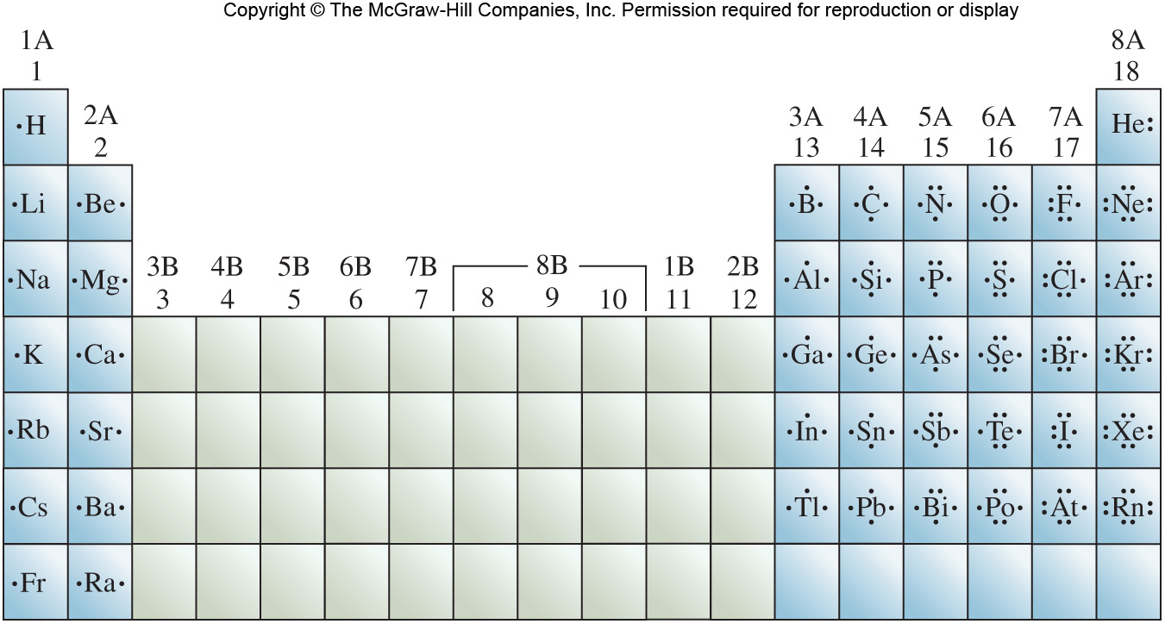
Lewis Dot Symbols
•
•
•
B
1s²2s²2p¹
•
•
•
C
•
1s²2s²2p²
•
•
•
N
•
•
1s²2s²2p³
•
5 valence electrons; first pair formed in the Lewis dot symbol
Na
For main group metals such as Na, the number of dots is the number of electrons that are lost.
••
•
•
For nonmetals in the second period, the number of unpaired dots is the number of bonds the atom can form.
O
••

Slide 37

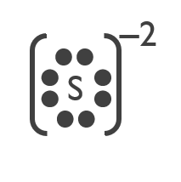
Lewis Dot Symbols
Ions may also be represented by Lewis dot symbols.
Remember the charge
Na
•
Na⁺
Na: 1s²2s²2p⁶3s¹
Na⁺: 1s²2s²2p⁶
Valence electron lost in the formation of the Na⁺ ion.
Core electrons not represented in the Lewis dot symbol
••
••
2‒
•
•
•
•
O
O
•
•
••
••
O: 1s²2s²2p⁴
O^{2–}: 1s²2s²2p⁶
Write Lewis dot symbols for (a) fluoride ion (F–), (b) potassium ion (K⁺), and (c) sulfide ion (S^{2–}).
(a)
(b) K⁺
(c)

Slide 38
Practice
What are the valence electrons and Lewis dot diagrams for the following elements?
Mg²⁺
P
Se
Li⁺
[Mg]²⁺
••
•
•
_{P}
•
••
_{Se}
•
•
••
[Li]⁺
What are the valence set of electrons for Si?
3s²3p²
2s²2p⁶
2s²2p⁶3s²3p²
3s²3p¹

Slide 39
Lewis Dot Symbols
Atoms combine in order to achieve a more stable electron configuration. Maximum stability results when a chemical species is isoelectronic with a noble gas.
Na: 1s²2s²2p⁶3s¹
Na⁺: 1s²2s²2p⁶
10 electrons total, isoelectronic with Ne
Cl: 1s²2s²2p⁶3s²3p⁵
Cl–: 1s²2s²2p⁶3s²3p⁶
18 electrons total, isoelectronic with Ar
According to the octet rule, atoms will lose, gain, or share electrons in order to achieve a noble gas electron configuration. Look at the molecule F₂.
Electron Config. of F: 1s²2s²2p⁵
••
••
••
••
••
•
••
•
••
Only valence electrons contribute to bonding. Only two valence electrons participate in the formation of the F₂ bond.
F
F
••
•
F
F
+
•
••
••
••
••
Each F counts both shared electrons to “feel” as though it has a Ne configuration.
••
••
••
••
••
•
••
or
••
••
F
F
F
F
the dash represents two e–. One e– from each F.
•
••
••
••
••
Pairs of valence electrons not involved in bonding are called lone pairs.

Slide 40
Lewis Structures and Multiple Bonds
A Lewis structure is a representation of covalent bonding. Shared electron pairs are shown either as dashes or as pairs of dots. Lone pairs are shown as pairs of dots on individual atoms.
H with 2 e⁻
H with 2 e⁻
••
••
••
••
H
O
H
H
O
H
••
••
O with 8 e⁻
Shared electrons shown as dashes (bonds)
In a single bond, atoms are held together by one electron pair. In a double bond, atoms share two pairs of electrons.
C with 8 e⁻
O with 8 e⁻
O with 8 e⁻
••
••
••
••
••
••
••
O
••
C
O
O
=
C
=
O
••
••
••
••
2 shared pairs of electrons result in double bonds

Slide 41
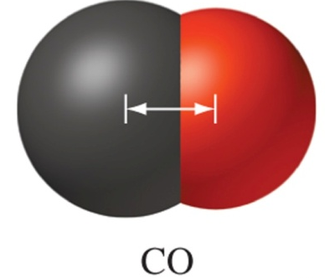
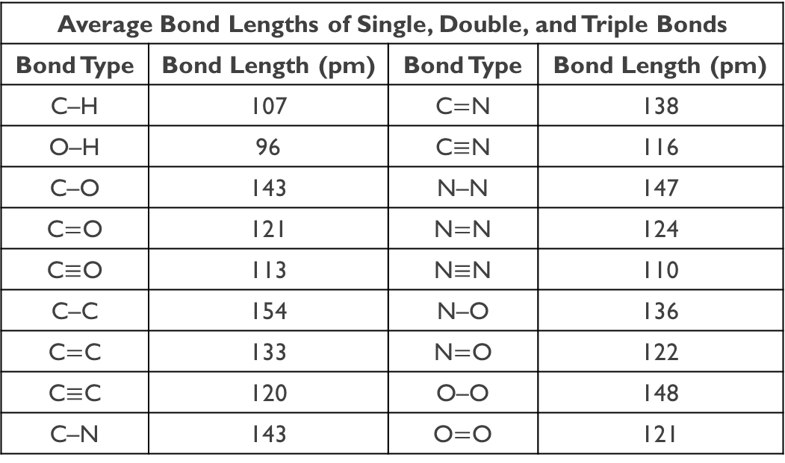
Lewis Structures and Multiple Bonds
A triple bond occurs when atoms are held together by three electron pairs.
each N has 8 e⁻
••
••
••
••
••
••
≡
••
N
N
N
N
3 shared pairs of electrons result in a triple bond
Average Bond Lengths of Single, Double, and Triple Bonds
Bond Type | Bond Length (pm) | Bond Type | Bond Length (pm)
C–H | 107 | C$=$N | 138
O–H | 96 | C$≡$N | 116
C–O | 143 | N–N | 147
C$=$O | 121 | N$=$N | 124
C$≡$O | 113 | N$≡$N | 110
C–C | 154 | N–O | 136
C$=$C | 133 | N$=$O | 122
C$≡$C | 120 | O–O | 148
C–N | 143 | O$=$O | 121
Bond length is defined as the distance between the nuclei of two covalently bonded atoms.

Slide 42

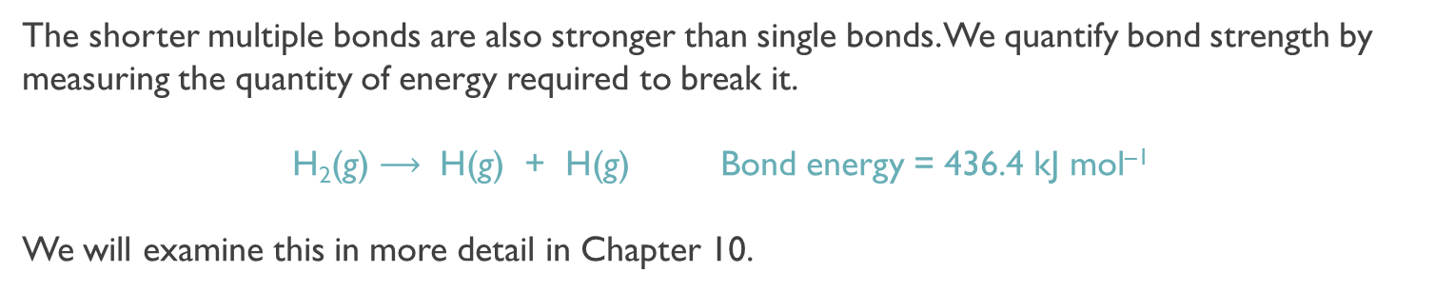
Multiple Bonds
Multiple bonds are shorter than single bonds.
For a given pair of atoms:
triple bonds are shorter than double bonds
double bonds are shorter than single bonds
N≡N
N=N
N−N
<
<
110 pm
124 pm
147 pm
The shorter multiple bonds are also stronger than single bonds. We quantify bond strength by measuring the quantity of energy required to break it.
H₂(g) $⟶$ H(g) + H(g) Bond energy = 436.4 kJ mol^{–1}
We will examine this in more detail in Chapter 10.
Which would be the strongest bond?
(b) Which would be the longest bond?
H
H
C
C
N
C$≡$N : Strongest Bond
C–C : Weakest and Longest Bond
H

Slide 43
Drawing Lewis Structures
Follow these steps when drawing Lewis structure for molecules and polyatomic ions.
Count the total number of valence electrons present; add electrons for negative charges and subtract electrons for positive charges
Draw the skeletal structure of the compound. The least electronegative atom is usually the central atom. Draw a single covalent bond between the central atom and each of the surrounding atoms.
Use the remaining electrons to complete octets of the terminal atoms by placing pairs of electrons on each atom. Complete the octets of the most electronegative atom first.
Place any remaining electrons in pairs on the central atom.
If the central atom has fewer than eight electrons, move one or more pairs from the terminal atoms to form multiple bonds between the central atom and terminal atoms.
Change Lewis structure to get the best formal charges

Slide 44
Drawing Lewis Structures
Draw the Lewis Structure for ClO₃⁻.
1. Count the total number of valence e– present; add e– for negative charges and subtract electrons for positive charges.
Cl: | 1 | x | 7 | = | 7 | e–
O: | 3 | x | 6 | = | 18 | e–
Charge: |  |  |  | = | 1 | e–
Total |  |  |  |  | 26 | Valence e–
2. Draw the skeletal structure of the compound. The least electronegative atom is usually the central atom. Draw a single covalent bond between the central atom and each of the surrounding atoms. Chlorine’s electronegativity = 3.0 and oxygen’s electronegativity = 3.5.
••
O
••
••
••
Cl
••
3. For each bond in the skeletal structure, subtract two e– from the total valence e–. 3 bonds x 2 e⁻ = 6 e⁻ and 26 – 6 = 20 e⁻ left over.
O
O
••
••
••
••
••
4. Use the remaining e– to complete octets of the terminal atoms by placing pairs of e– on each atom. Complete the octets of the most electronegative atom first.
18 e– placed on the terminal atoms. The structure now has a total of 24 valence e– of the 26.
5. Place any remaining e– on the central atom. Lewis structures for polyatomic ions are enclosed by square brackets and charges.
6. If the central atom has fewer than eight e–, move one or more pairs from the terminal atoms to form multiple bonds between the central atom and terminal atoms.

Slide 45
Practice
Draw the Lewis structure for carbonate (CO₃²⁻).
–2
C: | 1 | x | 4 | = | 4 | e–
O: | 3 | x | 6 | = | 18 | e–
Charge: |  |  |  | = | 2 | e–
Total |  |  |  |  | 24 | Valence e–
••
O
••
••
2
••
C
••
O
O
••
••
1
3
••
••
The center carbon does not have 8 e– around it. One pair must be moved from the outermost atoms to form a double bond. You should move e– from the least electronegative of the outermost atoms.
–2
–2
–2
••
••
••
O
O
O
••
••
••
••
••
••
2
2
2
O: 1
O: 3
••
C
••
••
••
••
••
O
O
O
C
O
O
C
O
••
••
3
1
3
••
1
3
••
1
••
••
••
••
••
••
O: 2
–2
Resonance Arrows
••
••
O
2
••
C
••
O
O
••
••
1
3
••
••

Slide 46
Practice
FNO₂ C₂H₂
ClF₂⁺ N₃–
NH₄⁺ HCN
NO– COCl₂

Slide 47
Formal Charge
Formal charge can be used to determine the most plausible Lewis Structure when more than one possibility exists for a compound.
Formal Charge = Valence e– – Associated e–
To determine associated electrons:
1) All the atom’s nonbonding electrons are associated with the atom. (Count each dot as 1)
2) Half the atom’s bonding electrons are associated with the atom. (Count each dash as 1)
Determine the formal charges on each oxygen atom in the ozone molecule (O₃).
••
••
••
••
••
O
O
O
Oxygen | Dots (e–) | Dashes (Bonds) | Associated e–
1 | 4 | 2 | 6
2 | 2 | 3 | 5
3 | 6 | 1 | 7
••
••
••
••
••
••
3
O
2
O
1
O
••
••
Oxygen | 1 | 2 | 3
Valence e– | 6 | 6 | 6
Associated e– | 6 | 5 | 7
Formal Charge (Difference) | 0 | +1 | –1

Slide 48
Lewis Structures and Formal Charge
When there is more than one possible structure, the best arrangement is determined by the best formal charge:
1) A Lewis structure in which all formal charges are zero is preferred.
2) Small formal charges are preferred to large formal charges.
3) Formal charges should be consistent with electronegativities.
••
••
••
Lewis Structures
O
OR
C
••
••
O
O
C
••
O
••
••
Formal charge
0
0
0
+1
0
–1
better structure
(based on formal charge)
Formaldehyde (CH₂O), which can be used to preserve biological specimens, is commonly sold as a 37 percent aqueous solution. Use formal charges to determine which skeletal arrangements of atoms shown here is the best choice for the Lewis structure of CH₂O.

Slide 49
Practice
Give the formal charge of each element contained within each structure:
0
••
0
H
0
0
O
0
+1
–1
0
0
0
–1
+1
0
0
+1
••
••
••
••
••
C
N
N
H₃C
O
N
O
C
O
H₃C
N
0
••
••
H
••
••
••
••
–1
O
••
••
+1
0
0
0
H
H
••
••
0
0
+1
–1
O
+1
0
O
–1
••
0
0
••
H
C
N
O
••
••
••
••
••
C
O
S
O
O
••
••
–1
••
••
••
••
0
••
H
O
O
H
••
0
••
••
0
0
0
0
0
0
0
0
H
0
0
0
0
••
••
0
0
H₃C
S
S
CH₃
N
••
H₃C
C
N
O
••
••
••
0
••
••
0
H
H
What is formal charge on N, O1(top) and O2(bottom)?
H
••
–1
••
O
1
H
C
N
••
O
0
••
H
2
••

Slide 50
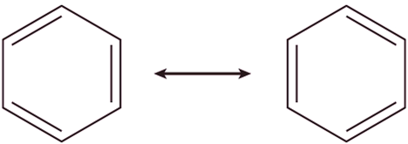
Resonance
A resonance structure is one of two or more Lewis structures for a single molecule that cannot by represented accurately by only one Lewis structure. Resonance structures are a human invention. Resonance structures differ only in the positions of their electrons.
Looking at ozone (O₃): There are two valid Lewis Structures and they only vary in the location of e–.
••
••
••
••
••
O
O
O
1
2
3
••
••
O: | 3 | x | 6 | = | 18 | e–
Total: |  |  |  |  | 18 | Valence e–
••
••
••
Resonance
••
••
••
••
••
O
O
O
O
O
O
1
2
3
1
2
3
••
••
••
••
The carbonate ion (CO₃^{2–}), another example of resonance, is shown on slide 26. Benzene is another example of resonance.

Slide 51
Practice
SCN– NO₃–
N₂O ClO₃–

Slide 52
Exceptions to the Octet Rule
Exceptions to the octet rule fall into three categories:
1) The central atom has fewer than eight electrons due to a shortage of electrons.
Elements in group 3A also tend to form compounds surrounded by fewer than eight electrons. Boron, for example, reacts with halogens to form compounds of the general formula BX₃ having six electrons around the boron atom.
H
Be
H
only 4 total valence e– in the system
2) The central atom has fewer than eight electrons due to an odd number of electrons.
Molecules with an odd number of electrons are sometimes referred to as free radicals.
••
•
••
O
N
••
17 valence e– in the system
••
O
••
3) The central atom has more than eight electrons. Atoms in and beyond the third period can have more than eight valence electrons. In addition to the 3s and 3p orbitals, elements in the third period also have 3d orbitals that can be used in bonding.
••
••
••
F
••
••
••
••
F
F
••
••
Sulfur has 6 bonds corresponding to 12 e–
S
••
••
••
••
F
F
••
••
••
F
••
••

Slide 53
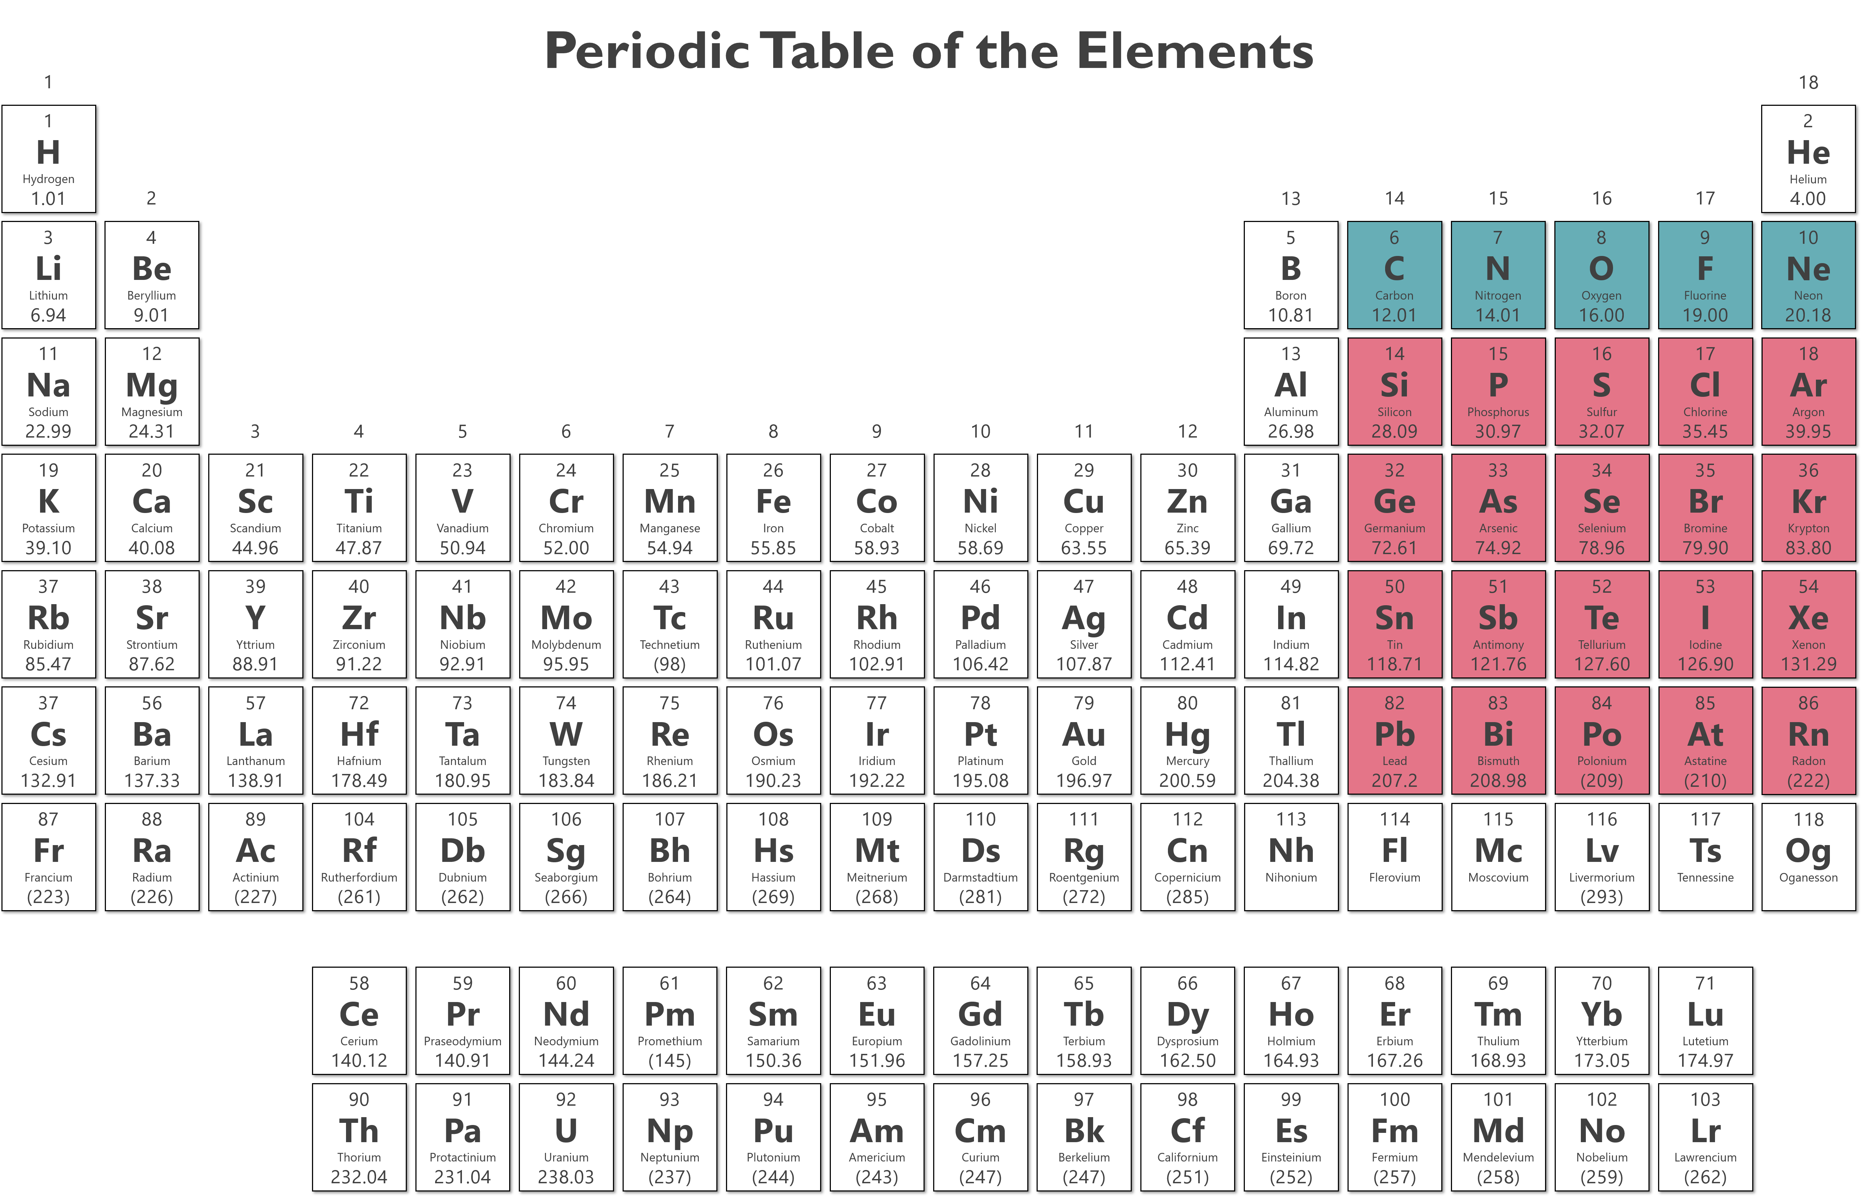
Exceptions to the Octet Rule
Must Obey: Can’t have more than 8
Typically Obey
What elements must obey the octet rule (i.e. 8 electrons around an atom)?
Draw the Lewis structure of Nitric oxide (NO).
••
••
••
••
••
••
••
N
O
••
N
O
N
O
••
N
O
••
•
•
•
••
•
Best Structure
These are not possible, N and O don’t have d orbitals

Slide 54
Practice
Draw the Lewis structure of arsenic pentafluoride (AsF₅).
As: | 1 | x | 5 | = | 5 | e–
F: | 5 | x | 7 | = | 35 | e–
Total |  |  |  |  | 40 | Valence e–
••
••
••
••
F
••
F
••
••
••
As
F
••
••
••
F
••
F
••
••
••
Draw the Lewis structure of xenon tetrafluoride (XeF₄).
Xe: | 1 | x | 8 | = | 8 | e–
F: | 4 | x | 7 | = | 28 | e–
Total |  |  |  |  | 36 | Valence e–
••
••
••
F
••
••
••
••
••
F
F
Xe
••
••
••
F
••
••
••

Slide 55
Practice
PCl₅ PO₄^{3–}
SF₆ KrF₂
SeF₆ SbCl₅
BrO₃–

Slide 56
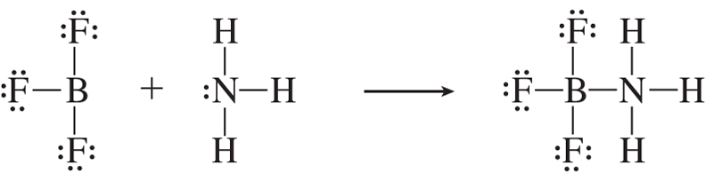
Exceptions to the Octet Rule
The bond between B–N has both the electrons contributed by the N atom.
This type of bond is a coordinate covalent or dative bond
This type of bond formation is an example of a Lewis acid–base process
BF₃ is a Lewis acid: it can accept a pair of electrons
NH₃ is a Lewis Base: it donates a pair of electrons

Slide 57
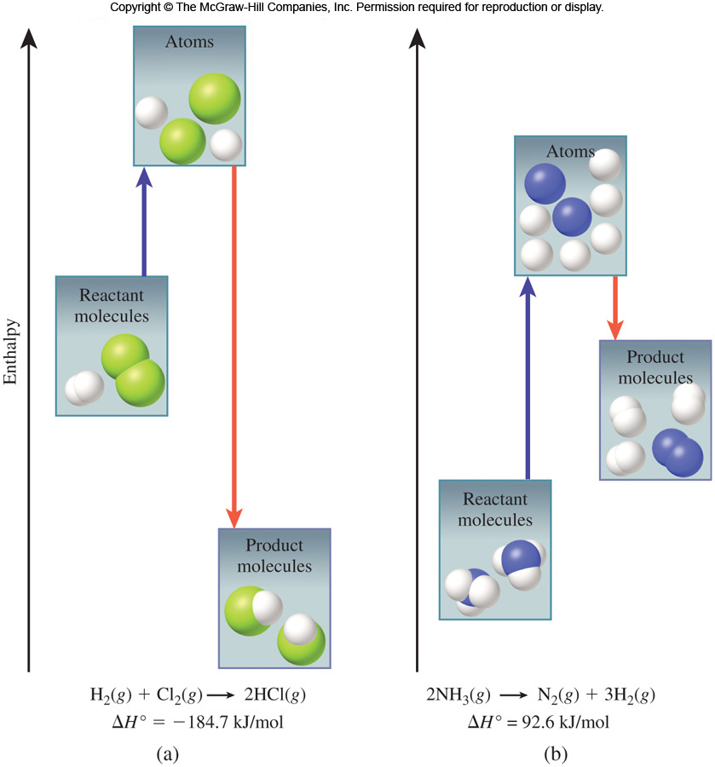
Bond Enthalpy and the Stability of Covalent Molecules
The bond enthalpy (ΔH°) is the enthalpy change associated with breaking a bond in 1 mole of gaseous molecule.
The enthalpy for a gas phase reaction is given by:
ΔH° = ΣBondEnergy(reactants) – ΣbondEnergy(products)
ΔH° = total energy input – total energy released
bonds broken
bonds formed
Bond enthalpy change in an exothermic reaction: Products are lower energy than reactants. Bond enthalpy change in an endothermic reaction: Products are higher energy than reactants.

Slide 58
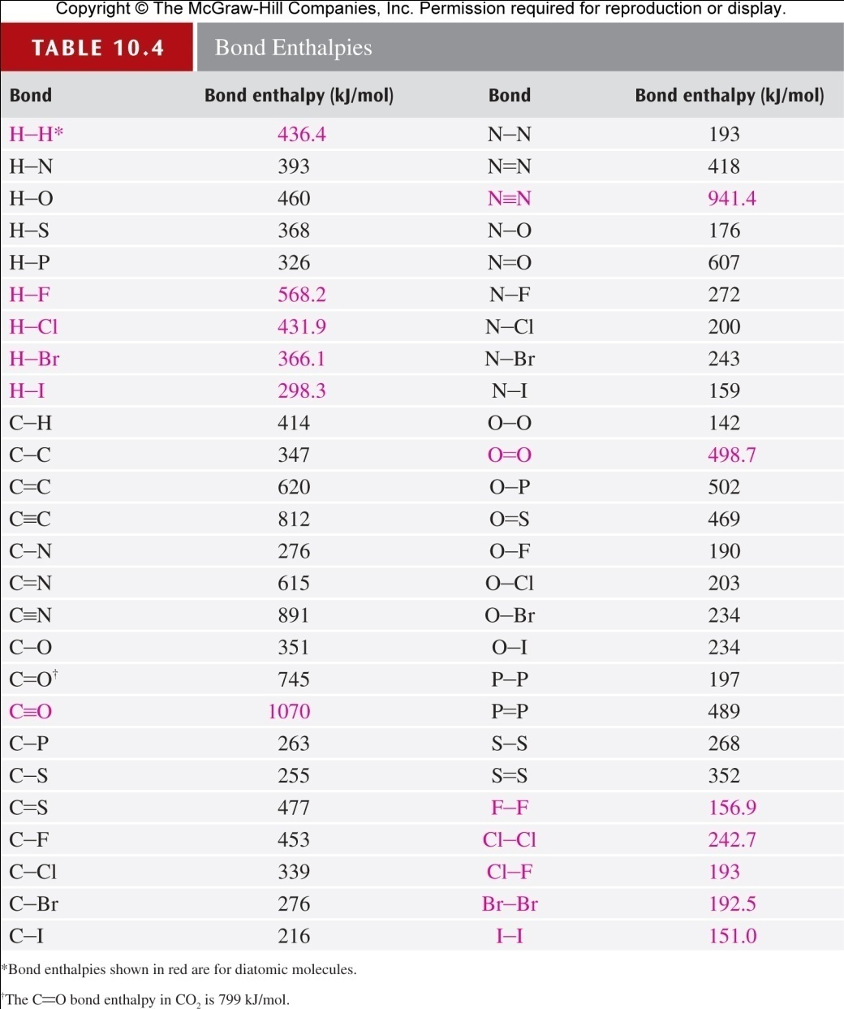
Bond Enthalpy and the Stability of Covalent Molecules

Slide 59

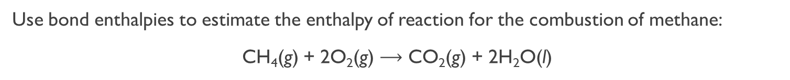
Practice
Use bond enthalpies to estimate the enthalpy of reaction for the combustion of methane:
CH₄(g) + 2O₂(g) $⟶$ CO₂(g) + 2H₂O(l)
Draw Lewis structures to determine what bonds are to be broken and what bonds are to be formed.
H
••
••
H
••
O
O
O
H
••
$$⟶$$
••
••
••
••
H
C
H
+
O
C
O
+
••
••
••
••
••
H
O
O
H
O
H
••
••
••
4 C–H bonds (CH₄) must be broken and 2 O=O bonds (O₂) must be broken. There are then two C=O bonds (CO₂) formed and 4 H–O bonds (H₂O) formed.
Bond enthalpies:
414 kJ/mol (C–H)
498.7 kJ/mol (O=O)
799 kJ/mol (C=O)
460 kJ/mol (H–O)
[4(414 kJ/mol) + 2(498.7 kJ/mol)] – [2(799 kJ/mol) + 4(460 kJ/mol)]
= –785 kJ/mol

Slide 60
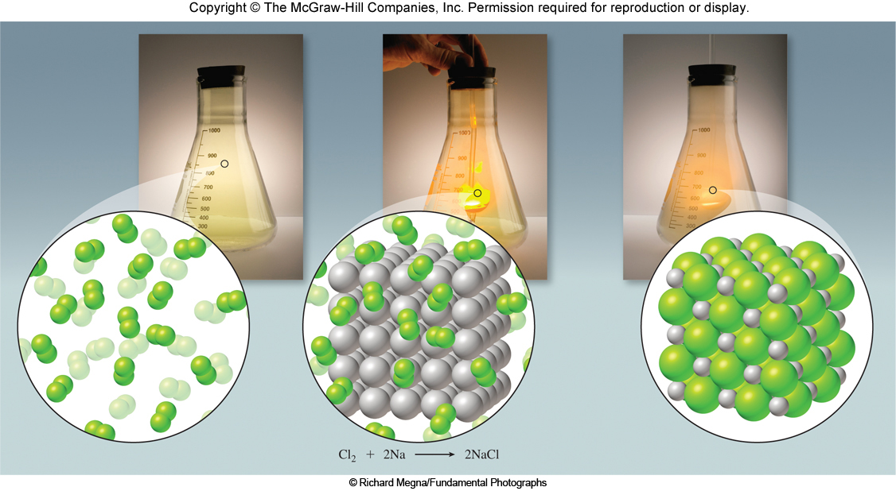
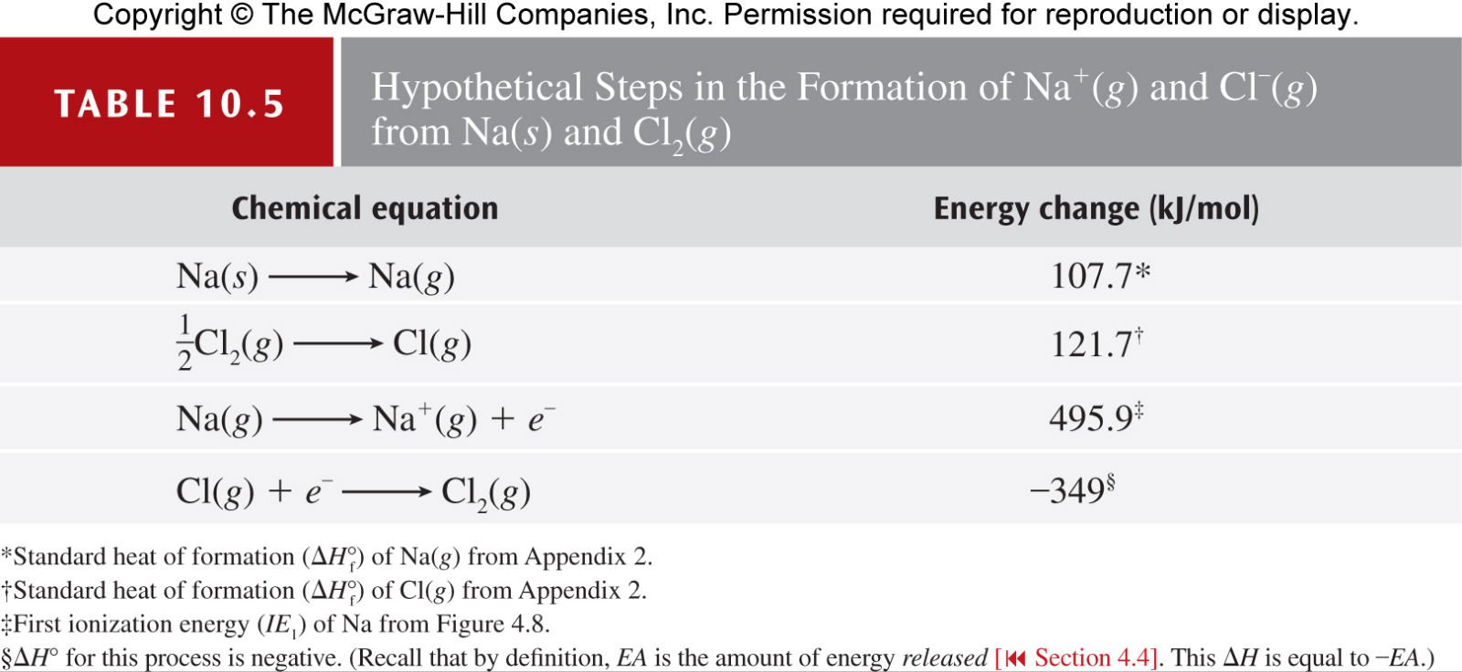
Lattice Energy and the Stability of Ionic Compounds
A Born–Haber cycle is a cycle that relates the lattice energy of an ionic compound to quantities that can be measured.
Na(s) + Cl₂(g) → Na⁺(g) + Cl–(g)
Lattice energy is the energy required to convert 1 mole of an ionic solid into its constituent ions in the gas phase. Lattice energy is not a quantity that we can measure directly. Rather, we determine lattice energy by combining tabulated values of a series of quantities that can be measured directly. Although the steps in the Born–Haber cycle are not necessarily the steps that take place, because they combine to give the correct overall process, the energy changes associated with them can be used (with Hess’s law) to determine the overall energy change.

Slide 61
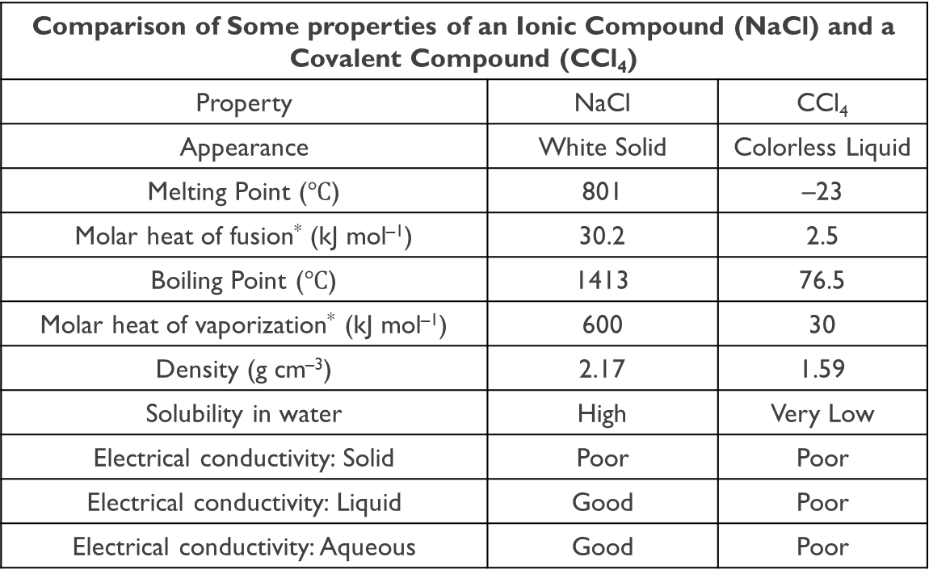
Ionic and Covalent Compounds differ in their general physical properties
Comparison of Some properties of an Ionic Compound (NaCl) and a Covalent Compound (CCl₄)
Property | NaCl | CCl₄
Appearance | White Solid | Colorless Liquid
Melting Point ($℃$) | 801 | –23
Molar heat of fusion* (kJ mol^{–1}) | 30.2 | 2.5
Boiling Point ($℃$) | 1413 | 76.5
Molar heat of vaporization* (kJ mol^{–1}) | 600 | 30
Density (g cm^{–3}) | 2.17 | 1.59
Solubility in water | High | Very Low
Electrical conductivity: Solid | Poor | Poor
Electrical conductivity: Liquid | Good | Poor
Electrical conductivity: Aqueous | Good | Poor
* The molar heat of fusion and the molar heat of vaporization are the amounts of heat needed to melt 1 mole of the solid and to vaporize 1 mole of the liquid, respectively.

Slide 62
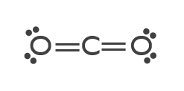
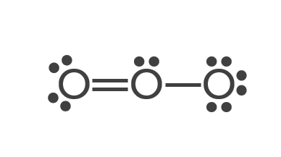
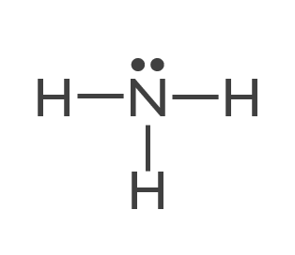
Molecular Geometry
Molecular shape can be predicted by using the valence-shell electron-pair repulsion (VSEPR) model.
A is the central atom surrounded by x B atoms.
x can have integer values of 2 to 6.
AB_{x}
Examples of Ab_{x} Molecules and Polyatomic Ions
AB₂ | BeCl₂, SO₂, H₂O, NO₂–
AB₃ | BF₃, NH₃, ClF₃, SO₃^{2–}
AB₄ | CCl₄, NH₄⁺, SF₄, XeF₄, ClO₄–
AB₅ | PCl₅, IF₅, SbF₅, BrF₅
AB₆ | SF₆, UF₆, TiCl₆^{3–}
The basis of the VSEPR model is that e– repel each other, and e– are found in various domains.
Lone pairs
Double bonds
Single bonds
Triple bonds
2 double bonds
2 single bond (σ)
1 double bond (π)
1 lone pair
2 e– domains
(on central atom)
3 single bonds (σ)
1 lone pair
3 e– domains
(on central atom)
4 e– domains
(on central atom)

Slide 63
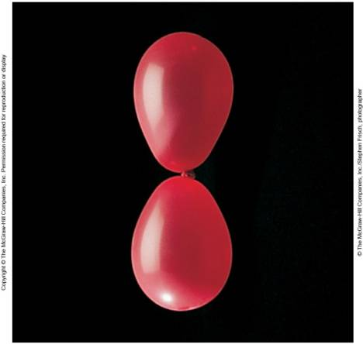
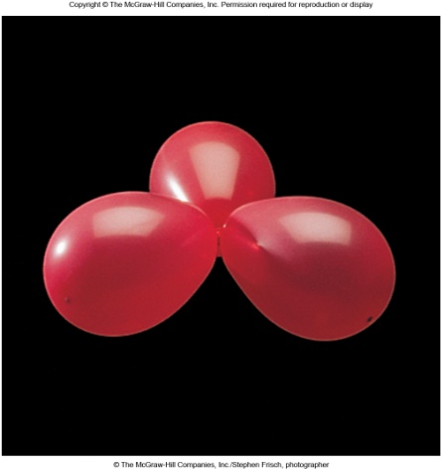
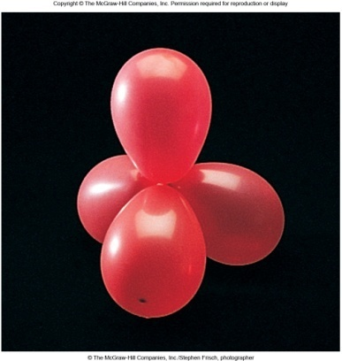

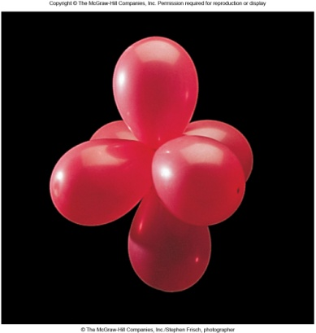
The VSEPR Model
The basis of the VSEPR model is that electrons repel each other. Electrons will arrange themselves to be as far apart as possible. Arrangements minimize repulsive interactions.
2 e– domains
Linear
3 e– domains
Trigonal planar
4 e– domains
Tetrahedral
5 e– domains
Trigonal bipyramidal
6 e– domains
Octahedral

Slide 64
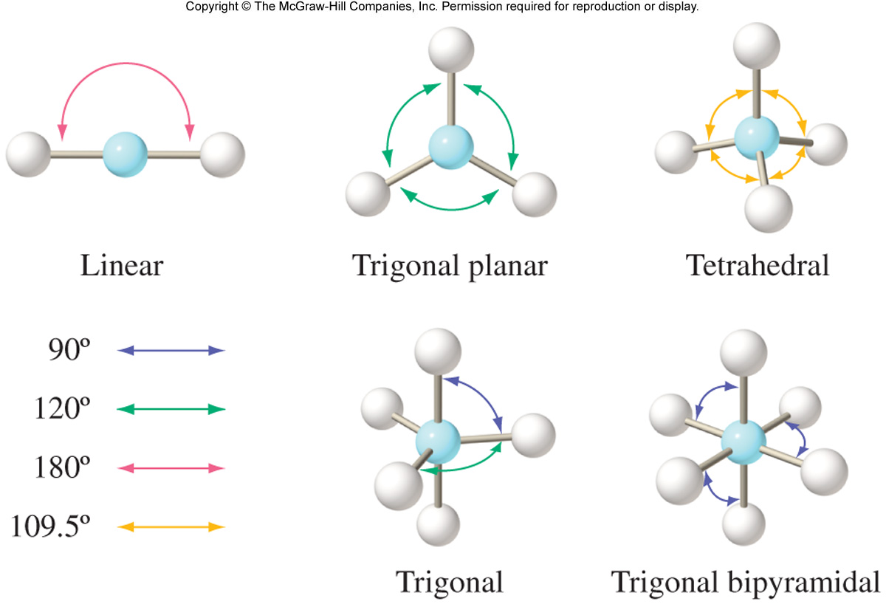


e– Domain Geometry and Molecular Geometry
The e– domain geometry is the arrangement of electron domains around the central atom.
The molecular geometry is the arrangement of bonded atoms.
In an AB_{x} molecule, a bond angle is the angle between two adjacent A-B bonds.
120°
109.5°
90°
180°
Linear
Trigonal planar
Tetrahedral
Octahedral
Axial positions; perpendicular to the trigonal plane
90°
120°
Equatorial positions; three bonds arranged in a trigonal plane.
Trigonal bipyramidal
Axial: 90$°$
Equatorial: 120$°$

Slide 65
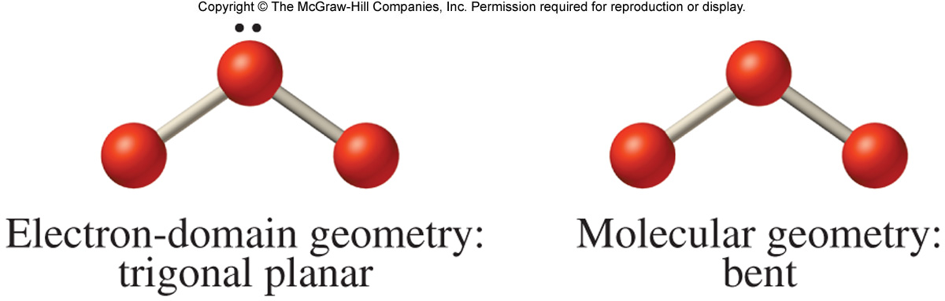
e– Domain Geometry and Molecular Geometry
When the central atom in an AB_{x} molecule bears one or more lone pairs, the electron–domain geometry and the molecular geometry are no longer the same.
Electron-domain geometry: trigonal planar
Molecular geometry:
bent

Slide 66
e– Domain Geometry and Molecular Geometry
e^{–Domains}
https://phet.colorado.edu/sims/html/molecule-shapes/latest/molecule-shapes_en.html

Slide 67
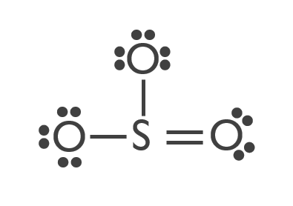
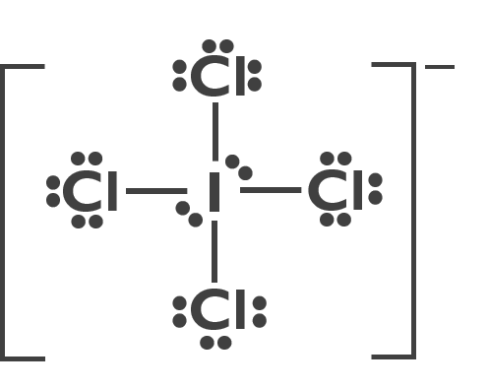
Electron–Domain Geometry and Molecular Geometry
The steps to determine the electron-domain and molecular geometries are as follows:
Step 1: Draw the Lewis structure of the molecule or polyatomic ion.
Step 2: Count the number of electron domains on the central atom.
Step 3: Determine the electron-domain geometry by applying the VSEPR model.
Step 4: Determine the molecular geometry by considering the positions of the atoms only.
Use Lewis structures and the VSEPR model to determine first the electron–domain geometry and then the molecular geometry (shape).
(a) The Lewis structure of SO₃ is:
(b) The Lewis structure of ICl₄– is:
There are 3 e– domains on the central atom: one double bond and two single bonds.
There are 6 e– domains on the central atom in ICl₄–: four single bonds and two lone pairs.
e– Geometry: Trigonal Planar
Molecular Geometry: Trigonal Planar
e– geometry: Octahedral
Molecular Geometry: Square Planar

Slide 68
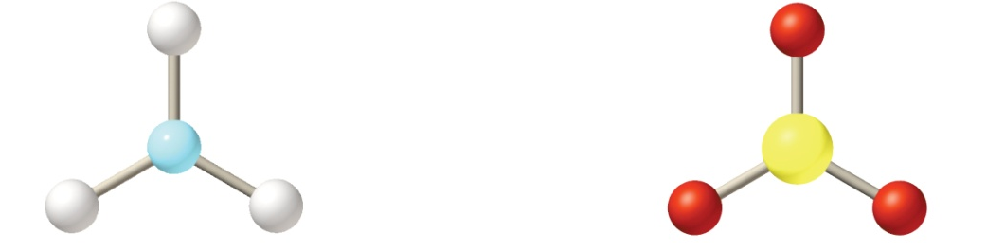
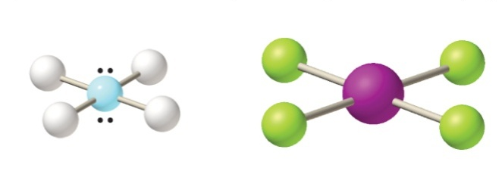
Electron–Domain Geometry and Molecular Geometry
(a) According to the VSEPR model, three electron domains will be arranged in a trigonal plane. Since there are no lone pairs on the central atom in SO₃, the molecular geometry is the same as the electron-domain geometry. Therefore, the shape of SO₃ is trigonal planar.
Electron-domain geometry: Trigonal Planar → Molecular Geometry: Trigonal Planar
(b) Six electron domains will be arranged in an octahedron. Two lone pairs on an octahedron will be located on opposite sides of the central atom, making the shape of ICl₄⁻ square planar.
Electron-domain geometry: Octahedral → Molecular Geometry: Square Planar

Slide 69
Practice
Trigonal bipyramidal
EDG: Octahedral;
MG: Square Pyramidal
PCl₅
H₂O
XeF₂
XeF₄
SO₂
CO₂
SF₄
BrF₅
BrF₃
SF₆
NH₃
CH₄
BF₃
Bent
EDG: Trigonal Bipyramidal;
MG: T-Shaped
EDG: Octahedral;
MG: Octahedral
Linear
EDG: Tetrahedral;
MG: Trigonal Pyramidal
Square planar
Bent
EDG: Tetrahedral;
MG: Tetrahedral
EDG: Trigonal Planar;
MG: Trigonal Planar
Linear
Seesaw
Predict the Electronic Geometry and the Molecular Geometry for IF₄⁺
EDG: Trigonal Bipyramidal;
MG: See-Saw

Slide 70
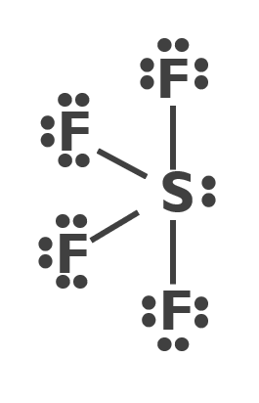
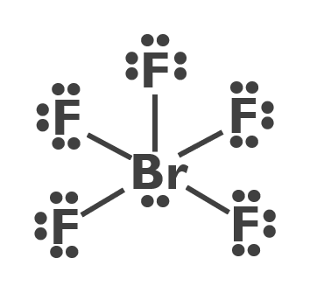
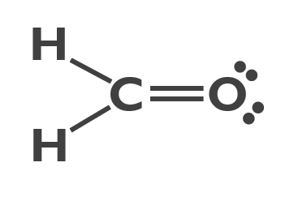
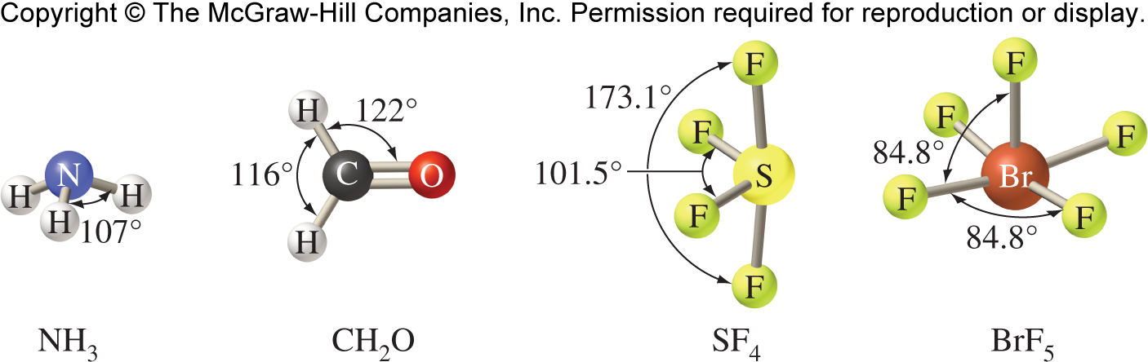
Deviation from Ideal Bond Angles
Some electron domains are better than others at repelling neighboring domains.
Lone pairs take up more space than bonded pairs of electrons.
Multiple bonds repel more strongly than single bonds.
The geometry of more complex molecules can be determined by treating them as though they have multiple central atoms.
Central O atom
No. of e– domains: 4
e– geometry: tetrahedral
Molecular geometry: bent
H
••
H
C
O
H
••
Central C atom
No. of e– domains: 4
e– geometry: tetrahedral
Molecular geometry: tetrahedral
H

Slide 71
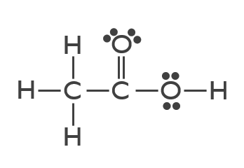

Practice
Acetic acid, the substance that gives vinegar its characteristic smell and sour taste, is sometimes used in combination with corticosteroids to treat certain types of ear infections. It has a molecular formula of CH₃COOH. Its Lewis structure is:
Determine the molecular geometry about each of the central atoms and determine the approximate value of each of the bond angles in the molecule. Which if any of the bond angles would you expect to be smaller than the ideal values?
~109.5$°$
>120°
<120°
<109.5°
According to the VSEPR theory, the actual O–C–O bond angles in the CO₃^{2–} ion are predicted to be:

Slide 72
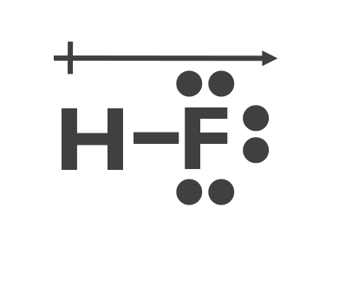
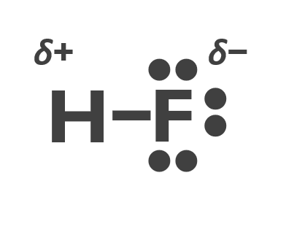
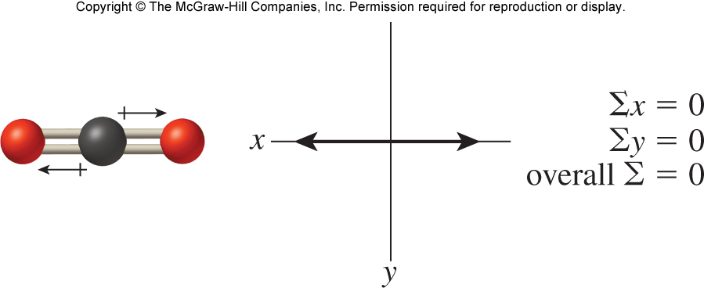
Molecular Geometry and Polarity
Molecular polarity is one of the most important consequences of molecular geometry.
A bond is polar when the electronegativities of the two atoms are different, this is also true for a diatomic molecule (where the molecule only has the one bond.
HF
The polarity of a molecule made up of three or more atoms depends on:
(1) the polarity of the individual bonds
(2) the molecular geometry
For a molecule made of three or more atoms, it will be polar if you superimpose vectors over polar bonds (pointing toward the atom of higher electronegativity) do NOT sum to zero.
Carbon dioxide, CO₂
The bonds in CO₂ are polar but the molecule is nonpolar.

Slide 73


Molecular Geometry and Polarity
The polarity of a molecule made up of three or more atoms depends on:
(1) the polarity of the individual bonds
(2) the molecular geometry
For a molecule made of three or more atoms, it will be polar if you superimpose vectors over polar bonds (pointing toward the atom of higher electronegativity) do NOT sum to zero.
Water, H₂O
Boron trifluoride, BF₃
The bonds in H₂O are polar and the molecule is polar.
The bonds in BF₃ are polar but the molecule is nonpolar.

Slide 74

Molecular Geometry and Polarity
The polarity of a molecule made up of three or more atoms depends on:
(1) the polarity of the individual bonds
(2) the molecular geometry
For a molecule made of three or more atoms, it will be polar if you superimpose vectors over polar bonds (pointing toward the atom of higher electronegativity) do NOT sum to zero.
The bonds in CCl₄ are polar but the molecule is nonpolar
The bonds in CHCl₃ are polar and the molecule is polar

Slide 75

Practice
Determine whether PCl₅ is polar.
First draw the Lewis structure for PCl₅.
With five identical electron domains around the central atom, the electron-domain and molecular geometries are trigonal bipyramidal. The equatorial bond dipoles will cancel one another, just as in the case of BF₃, and the axial bond dipoles will also cancel each other.
PCl₅ is nonpolar.
Determine whether (b) H₂CO (C double bonded to O) is polar.
H
First draw the Lewis structure for H₂CO.
C
••
O
H
••
The bond dipoles, although symmetrically distributed around the C atom, are not identical and therefore will not sum to zero.
H₂CO is polar.

Slide 76


Molecular Geometry and Polarity
Dipole moments can be used to distinguish between structural isomers.
trans-dichloroethylene
nonpolar
cis-dichloroethylene
polar

Slide 77
Practice
Do these molecules have a dipole? (same molecules from slide 50)
PCl₅
H₂O
XeF₂
XeF₄
SO₂
CO₂
SF₄
BrF₅
BrF₃
SF₆
NH₃
CH₄
BF₃
nonpolar
polar
polar
polar
nonpolar
nonpolar
nonpolar
polar
polar
nonpolar
nonpolar
nonpolar
polar
Explain why CO₂ and CCl₄ are both nonpolar even though they contain polar bonds.
Due to the canceling of all polar bonds
(a) For SCl₂, Does it have polar bonds? (b) Does it have a dipole?
a. Yes b. Yes

Slide 78

Bonding Forces: 2 Types
1. Intramolecular forces
Strong attractive forces between atoms in molecules. Also known as Covalent bonds.
2. Intermolecular forces (Much weaker than intramolecular forces)
Dispersion
Dipole-dipole
Hydrogen bond (specific dipole-dipole)

Slide 79

Intermolecular forces (IMFs)
Also known as van der Waals (vdW) forces
Forces increase as Kinetic Energy (K.E.) of particles decreases
Physical properties depend on the balance between:
  IMFs which pull molecules together
  (stronger IMFs = stronger interactions between molecules)
  K.E. which separates molecules

Slide 80



Intermolecular forces (IMFs)
Dispersion
Weakest discussed: Resulting from instantaneous dipoles that arise from random e– motion in a molecule/atom This affects surround atoms/molecules.
Found in all molecules
Heavier molecule = more e– = stronger dispersion = Higher M.P./B.P.
Larger surface area = more dispersion = higher M.P./B.P.
Dipole-dipole
Stronger than dispersion, attractive force between molecules with permanent dipoles (polar covalent molecules)
Hydrogen bond (specific dipole-dipole)
Stronger than other dipoles, occurs between molecules that contain a covalent bond between H and O, N, or F (example H₂O)

Slide 81

Intermolecular forces (IMFs)
Melting and Boiling Points of the Halogens
Halogen | Molar Mass | Atomic Radius | Melting Point (K) | Boiling Point (K)
F₂ | 38 g/mol | 72 pm | 53 | 85
Cl₂ | 71 g/mol | 99 pm | 172 | 238
Br₂ | 160 g/mol | 114 pm | 266 | 332
I₂ | 254 g/mol | 133 pm | 287 | 457
Dispersion
Hydrogen bond
Dipole-dipole

Slide 82
Other Intermolecular forces (IMFs)
Dipole/induced dipole
Occurs between a molecule with a permanent dipole and another molecule without a permanent dipole (non-polar)
Weaker than dipole/dipole; stronger than dispersion
Ion/dipole
Occurs between an ion and another molecule with a permanent dipole
Ion/ion
Occurs between two ions
Ion/induced dipole
Occurs between an ion and another molecule without a permanent dipole

Slide 83
Intermolecular forces
Trends
Stronger intermolecular forces = Higher Melting Point/ Boiling Point
Increasing molecular weight = Higher Melting Point/ Boiling Point
Increasing surface area = Higher Melting Point/ Boiling Point
Overall IMFs Strength:
Ionic > H-bonding > dipole/dipole > dispersion
Predict the relative boiling points (largest to smallest) for the following – water, sodium chloride, chlorine gas
NaCl
H₂O
Cl₂
>
>
Ion/ion
H-bond
Dispersion
Predict the relative boiling points (largest to smallest) for the following non-polar alkanes : C₂H₄, C₄H₁₀, C₈H₁₈
C₈H₁₈
C₄H₁₀
>
>
C₂H₄
Dispersion: larger molecules = stronger dispersion

