Slide 1
Chapter 3: Electronic Structure and Periodic Properties of Elements

Slide 2


Energy and Energy Changes
Energy is the capacity to do work or transfer heat.
All forms of energy are either kinetic or potential.
Kinetic energy (E_{k}) is the energy of motion.
One form of kinetic energy of interest to chemists is thermal energy, which is the energy associated with the random motion of atoms and molecules.
$$E_{k}= \frac{1}{2}mu^{2}$$
m is the mass of the object
u is its velocity
Potential energy is the energy possessed by an object by virtue of its position.
There are two forms of potential energy of great interest to chemists:
Chemical energy is energy stored within the structural units of chemical substances.
Electrostatic energy is potential energy that results from the interaction of charged particles.
$$E_{el}= \frac{Q_{1}Q_{2}}{d}$$
Q₁ and Q₂ represent two charges separated by the distance, d.

Slide 3
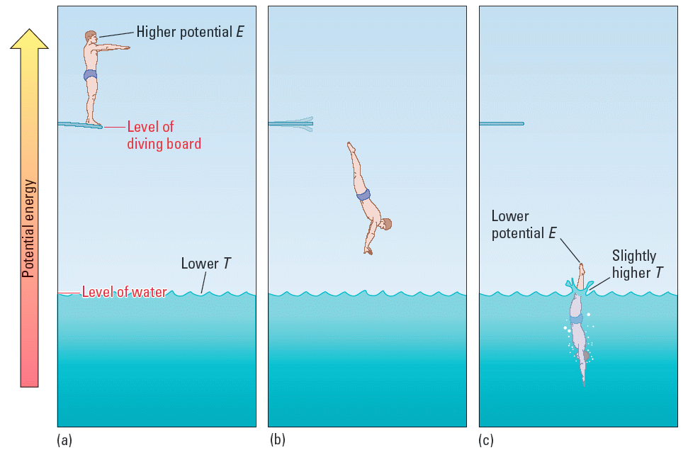
Energy and Energy Changes
Kinetic and potential energy are interchangeable – one can be converted to the other.
Although energy can assume many forms, the total energy of the universe is constant.
  Energy can neither be created nor destroyed.
  When energy of one form disappears, the same amount of energy reappears in another form or forms.
  This is known as the law of conservation of energy.
A diver:
Has E_{p} due to macroscale position.
Converts E_{p} to macroscale E_{k}.
Converts E_{k,macroscale} to E_{k,nanoscale} (motion of water, heat)

Slide 4
Practice
Water in a damned-up lake :
Water rushing through turbines:
Moving baseball:
Diver standing on a cliff:
Gallon of gas:
Potential
Kinetic
Kinetic
Potential
Potential (chemical)

Slide 5
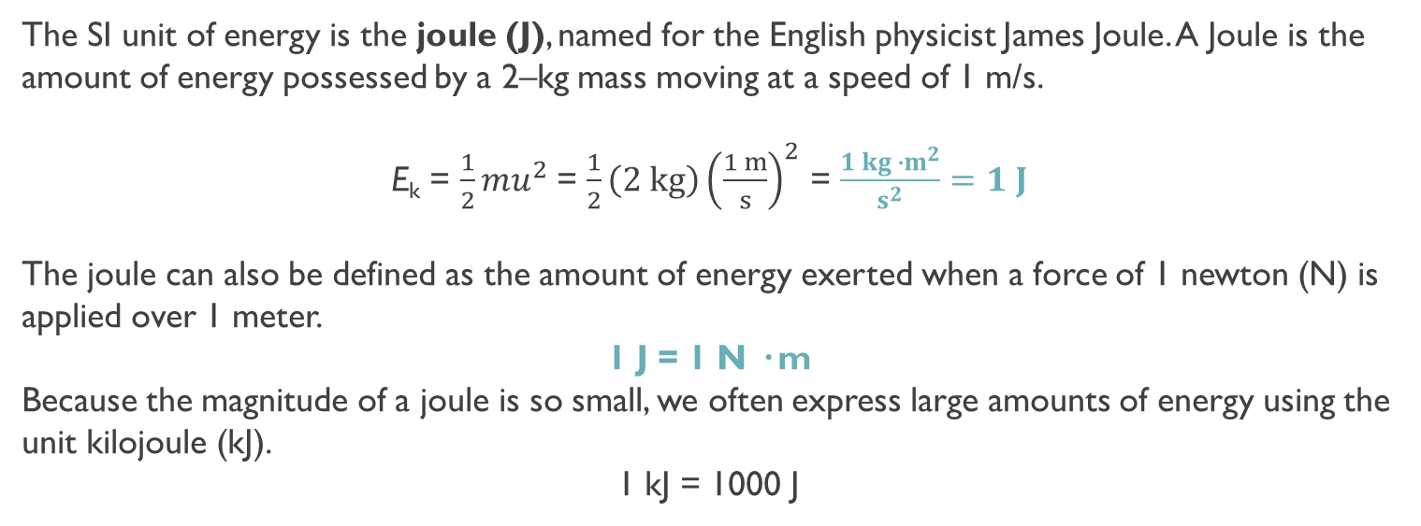
Units of Energy
The SI unit of energy is the joule (J), named for the English physicist James Joule. A Joule is the amount of energy possessed by a 2–kg mass moving at a speed of 1 m/s.
E_{k} = $\frac{1}{2}mu^{2}$= $\frac{1}{2}{\left(2 kg\right)\left(\frac{1 m}{s}\right)}^{2}$ = $\frac{1 kg ∙m^{2}}{s^{2}}=1 J$
The joule can also be defined as the amount of energy exerted when a force of 1 newton (N) is applied over 1 meter.
1 J = 1 N · m
Because the magnitude of a joule is so small, we often express large amounts of energy using the unit kilojoule (kJ).
1 kJ = 1000 J
calorie (cal)
Originally: “The energy needed to heat of 1g of water from 1°C.”
Now: 1 cal = 4.184 J (exactly)
Dietary Calorie (Cal) – the “big C” calorie. Used on food products.
1 Cal = 1000 cal = 1 kcal

Slide 6
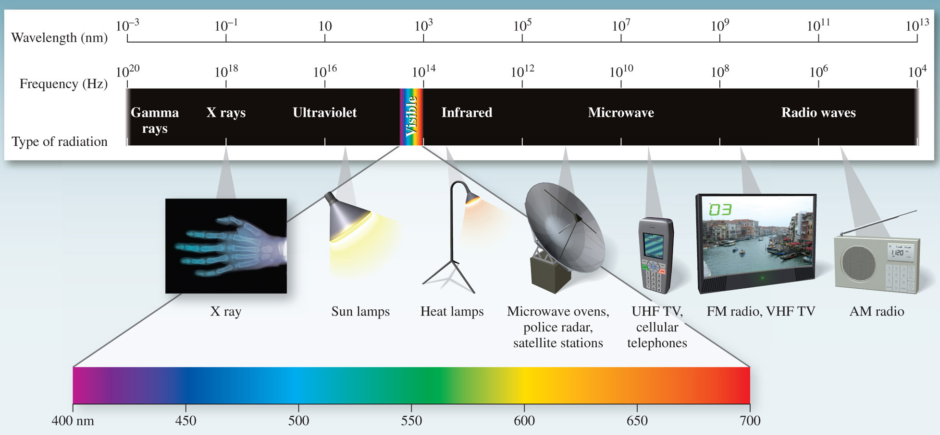
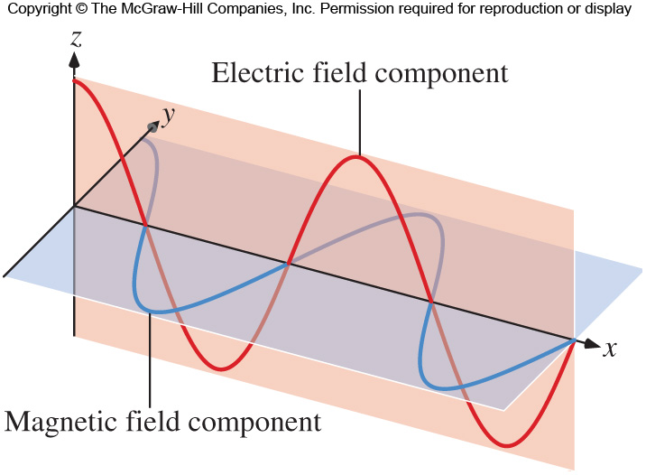
The Nature of Light
Visible light is only a small component of the continuum of radiant energy known as the electromagnetic spectrum.
All forms of electromagnetic radiation travel in waves. Waves are characterized by:
Wavelength (λ) – the distance between identical points on successive waves
Frequency (ν) – the number of waves that pass through a point in 1 second.
Amplitude – the vertical distance from the midline of a wave to the top of the peak or the bottom of the trough.
An electromagnetic wave has both an electric field component and a magnetic component.
The electric and magnetic components have the same frequency and wavelength.

Slide 7
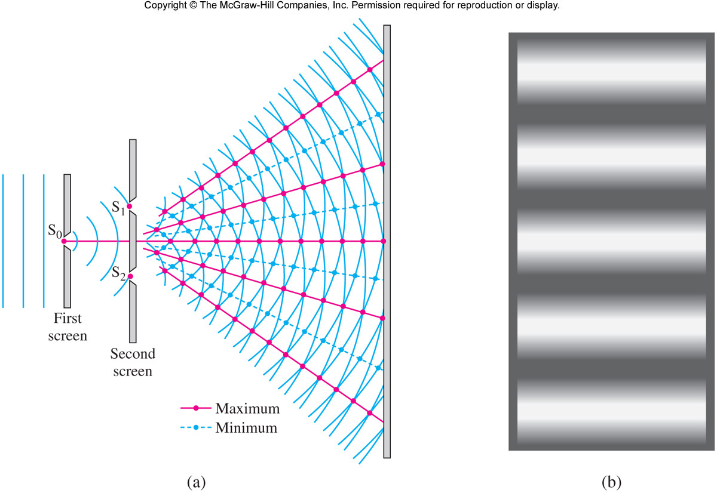
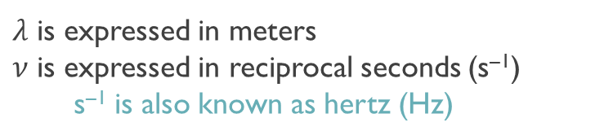

The Double–Slit Experiment
When light passes through two closely spaced slits, an interference pattern is produced.
Constructive interference is a result of adding waves that are in phase.
Destructive interference is a result of adding waves that are out of phase.
This type of interference is typical of waves and demonstrates the wave nature of light.
The speed of light (c) through a vacuum is a constant: c = 2.998 x10⁸ m s^{–1}.
Speed of light, frequency and wavelength are related:
$λ$ is expressed in meters
$ν$ is expressed in reciprocal seconds (s^{–1})
s^{–1} is also known as hertz (Hz)
$$c=λν$$

Slide 8















Practice
(a) What is the frequency of radiation with a wavelength of 280 nm? (b) What is the wavelength of light with a frequency of 5.65 x 10¹⁴ Hz?
a) c = 2.998 x 10⁸ m s^{–1} so our units must be in m and seconds. The 280 nm must be converted to meters.
$\left(\frac{280 nm}{}\right)\left(\frac{1 x {10}^{−9}m}{1 nm}\right)=2.80 x {10}^{−7}m$
$$c= λν$$
$ν=\frac{c}{λ}=$
$\frac{2.998 x {10}^{8}m s^{−1}}{2.80 x {10}^{−7} m}=$
$1.07 x {10}^{15} s^{−1}$
b)
$$c= λν$$
$λ=\frac{c}{ν}=$
$\frac{2.998 x {10}^{8}m s^{−1}}{5.65 x {10}^{14} s^{−1}}=$
$$5.31 x {10}^{−7} m=531 nm$$
What is the frequency for 500. nm light?
$ν=\frac{c}{λ}=$
$\frac{2.998 x {10}^{8}m s^{−1}}{500 x {10}^{−9} m}=$
$$6.0 x {10}^{14} Hz$$
Assume a microwave oven operates at a frequency of 1.80 x 10¹¹ s^{–1}. What is the wavelength?
$λ=\frac{c}{ν}=$
$\frac{2.998 x {10}^{8}m s^{−1}}{1.80 x {10}^{11} s^{−1}}=$
$$1.67 x {10}^{−3} m=1.67 x {10}^{6}nm$$

Slide 9
Practice
What is the wavelength of light if the frequency is 2.86 x 10¹⁴ s^{–1}? Where does this wavelength fall in the EM spectrum?
What is the frequency of light with a wavelength of 366 nm?
8.17 x 10⁵ s^{–1}
1.09 x 10²⁰ s^{–1}
8.17 x 10⁻⁴ s^{–1}
8.17 x 10¹⁴ s^{–1}

Slide 10
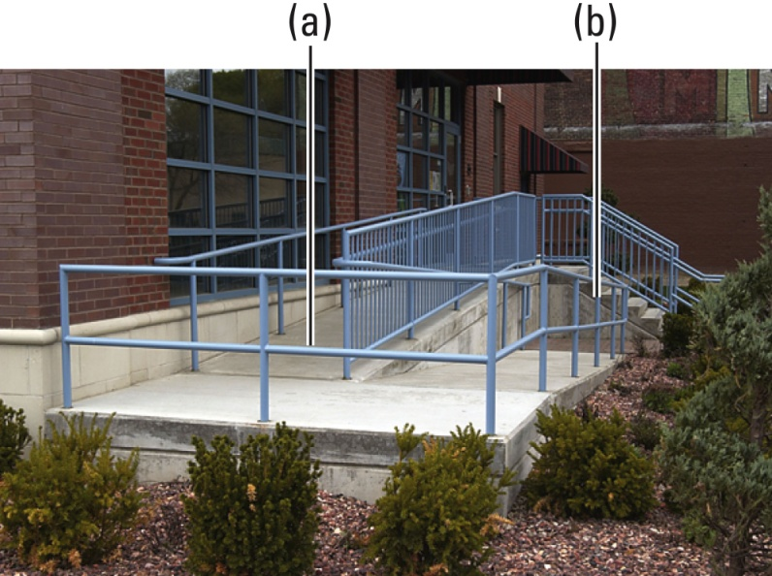
Quantum Theory
Early attempts by nineteenth-century physicists to figure out the structure of the atom met with only limited success. They were using the laws of classical physics. These laws describe the behavior of macroscopic objects.
Over time, the realization and acceptance was the behavior of subatomic particles is NOT governed by the same physical laws as larger objects. This became known as Quantum Mechanics.
Ramp (“classical”) & stairs (quantized)

Slide 11





Quantization of Energy
When a solid is heated, it emits electromagnetic radiation, known as blackbody radiation, over a wide range of wavelengths. The amount of energy given off at a certain temperature depends on the wavelength. Classical physics assumed that radiant energy was continuous; that is, could be emitted or absorbed in any amount.
Max Planck suggested that radiant energy is only emitted or absorbed in discrete quantities, like small packages or bundles. A quantum of energy is the smallest quantity of energy that can be emitted (or absorbed).
The energy E of a single quantum of energy is
  h : Planck’s constant: 6.626 x10^{–34} J∙s
The idea that energy is quantized rather than continuous is like walking up a staircase or playing the piano. You cannot step or play anywhere (continuous), you can only step on a stair or play on a key (quantized).
$$E=hν$$
Einstein proposed that the beam of light is really a stream of particles. These “particles” of light are now called photons.
$$c=λν$$
$$ν=\frac{c}{λ}$$
$$E=hν$$
$$E=\frac{hc}{λ}$$

Slide 12
















Practice
Calculate the energy (in joules) of (a) a photon with a wavelength of 501 nm and (b) a photon with a wavelength of 50.1 nm.
(a)
$E=\frac{hc}{λ}=$
$\frac{\left({6.63 x 10}^{−34}J∙s\right)\left({2.998 x 10}^{8} {m s}^{−1}\right)}{{501 x 10}^{−9} m}$
(b)
$E=\frac{hc}{λ}=$
$\frac{\left({6.63 x 10}^{−34}J∙s\right)\left({2.998 x 10}^{8} {m s}^{−1}\right)}{{50.1 x 10}^{−9} m}$
$$E=3.97x {10}^{−19} J$$
$$E=3.97x {10}^{−18} J$$
What is the energy of a photon at 379. nm?
$E=\frac{hc}{λ}=$
$\frac{\left({6.63 x 10}^{−34}J∙s\right)\left({2.998 x 10}^{8} {m s}^{−1}\right)}{{379 x 10}^{−9} m}=5.24x {10}^{−19} J$
What is the energy of a photon of frequency 4.86 x 10¹¹ s⁻¹?
$E=hν=$
$$\left({6.63 x 10}^{−34}J∙s\right)\left({4.86 x 10}^{11} { s}^{−1}\right)$$
$$={3.22 x 10}^{−22} J$$
What is the frequency of light having an energy of 1.93 x 10^{–17} J
$ν=\frac{E}{h}=$
$\frac{\left({1.93 x 10}^{−17}J\right)}{\left({6.63 x 10}^{−34}J∙s\right)}$
$=2.91 x {10}^{16} Hz$
The nitrogen laser emits light at 337.1 nm. What is the energy of this light?
$E=\frac{hc}{λ}=$
$\frac{\left({6.63 x 10}^{−34}J∙s\right)\left({2.998 x 10}^{8} {m s}^{−1}\right)}{{337.1 x 10}^{−9} m}=5.90 x {10}^{−19} J$

Slide 13
Poll Question: Campusknot
(Ch. 3-Slide 13) Calculate the energy (in joules) of a photon with a wavelength of 602 nm.

Slide 14

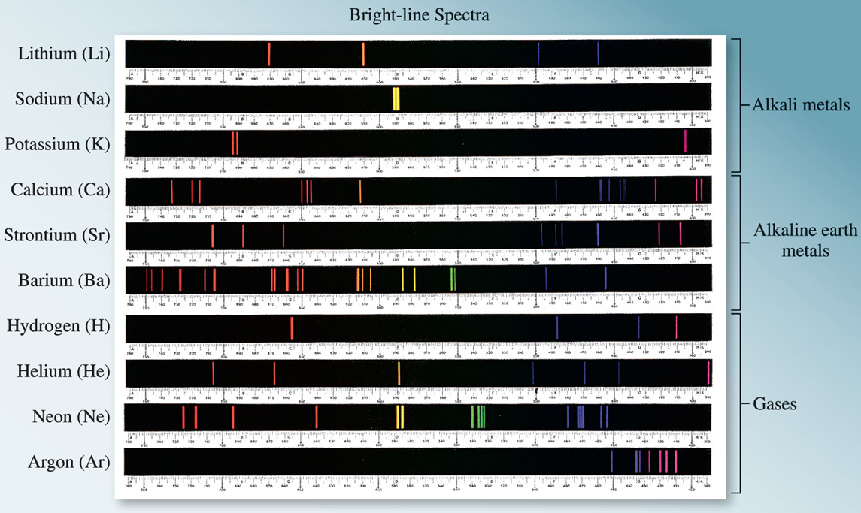
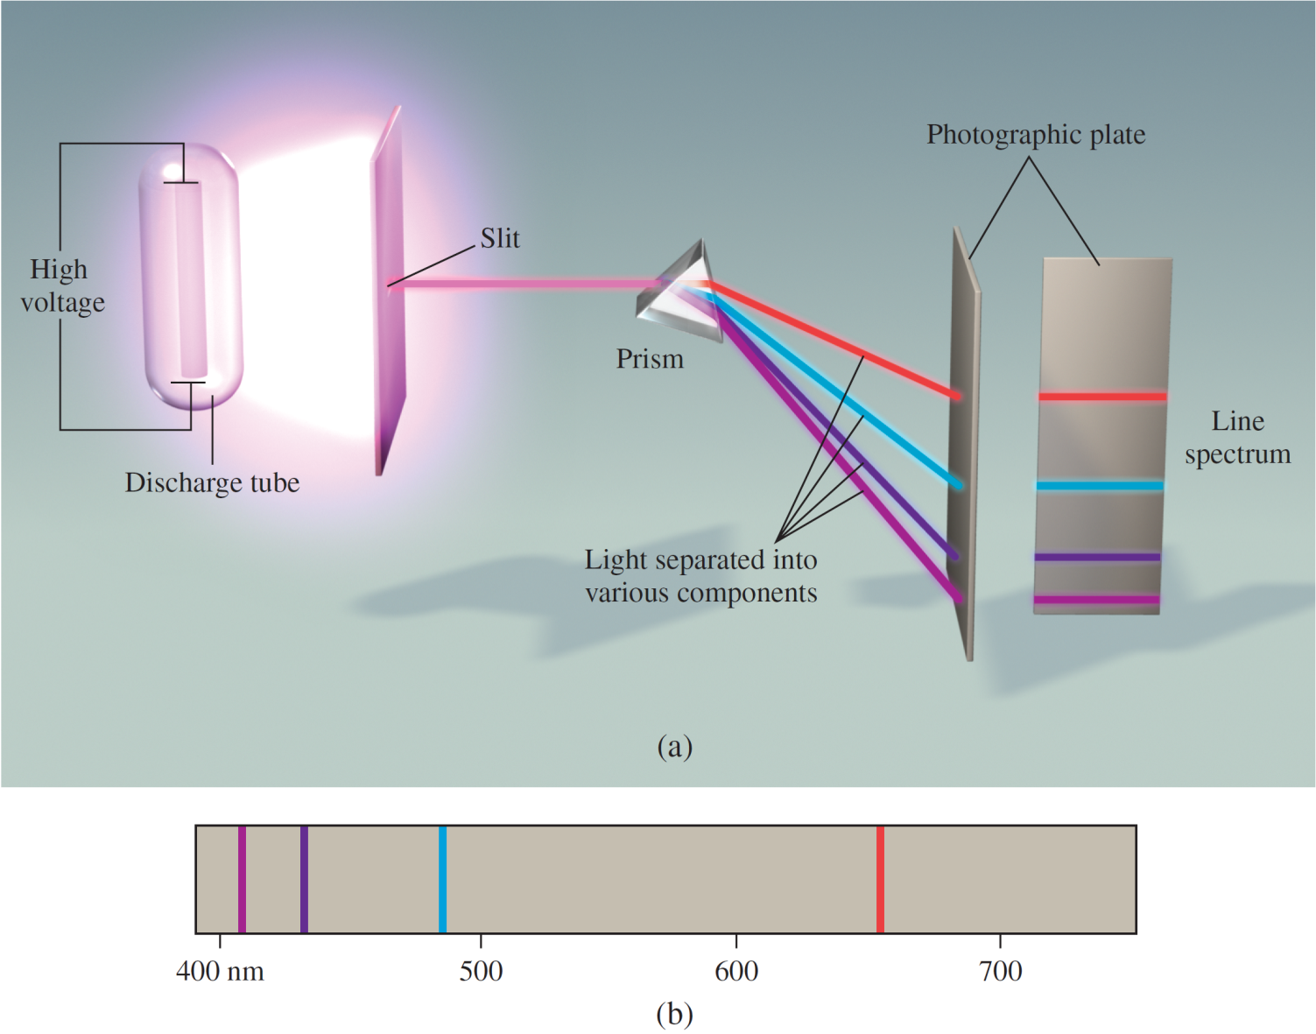
Bohr’s Theory of the Hydrogen Atom
The emission spectrum of a substance can be seen by energizing a sample of material with some form of energy.
The “red hot” or “white hot” glow of an iron bar removed from a fire is the visible portion of its emission spectrum.
The emission spectrum of both sunlight and a heated solid are continuous; all wavelengths of visible light are present.
Line spectra are the emission of light only at specific wavelengths. Every element has its own unique emission spectrum.

Slide 15
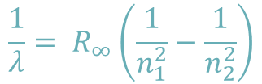
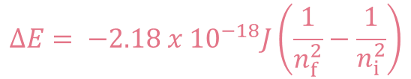
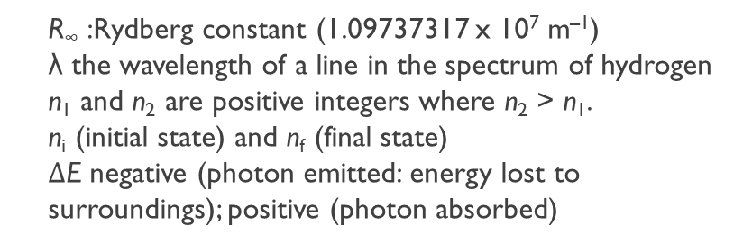
Atomic Line Spectra
The Rydberg equation can be used to calculate the wavelengths of the four visible lines in the emission spectrum of HYDROGEN.
$$\frac{1}{λ}= R_{∞}\left(\frac{1}{n_{1}^{2}}−\frac{1}{n_{2}^{2}}\right)$$
R∞ :Rydberg constant (1.09737317 x 10⁷ m^{–1})
λ the wavelength of a line in the spectrum of hydrogen
n₁ and n₂ are positive integers where n₂ > n₁.
n_{i} (initial state) and n_{f} (final state)
$∆$E negative (photon emitted: energy lost to surroundings); positive (photon absorbed)
$$∆E= {−2.18 x 10}^{−18}J\left(\frac{1}{n_{f}^{2}}−\frac{1}{n_{i}^{2}}\right)$$
Bohr’s theory explains the line spectrum of the hydrogen atom. Radiant energy absorbed by the atom causes the electron to move from the ground state (n = 1) to an excited state (n > 1).
Conversely, radiant energy is emitted when the electron moves from a higher–energy state to a lower–energy excited state or the ground state.
The quantized movement of the electron from one energy state to another
is analogous to a ball moving and down steps.

Slide 16
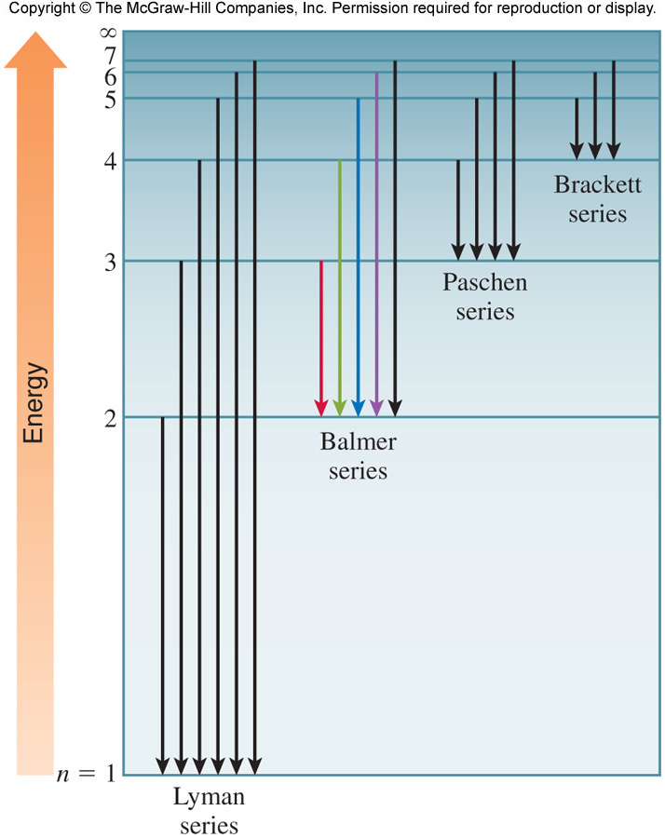
Atomic Line Spectra
The quantized movement of the electron from one energy state to another is analogous to a ball moving and down steps.

Slide 17
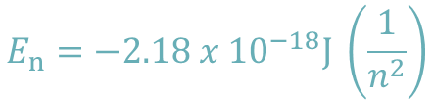
The Line Spectrum of Hydrogen
Neils Bohr attributed the emission of radiation by an energized hydrogen atom to the electron dropping from a higher–energy orbit to a lower one.
As the electron dropped, it gave up a quantum of energy in the form of light.
Bohr showed that the energies of the electron in a hydrogen atom are given by the equation:
$$E_{n}=−2.18 x {10}^{−18}J \left(\frac{1}{n^{2}}\right)$$
E_{n} energy
n a positive integer
As an electron gets closer to the nucleus, n decreases. E_{n} becomes larger in absolute value (more negative) as n gets smaller.
E_{n} is most negative when n = 1.
Called the ground state, the lowest energy state of the atom
For hydrogen, this is the most stable state
The stability of the electron decreases as n increases.
Each energy state in which n > 1 is called an excited state.

Slide 18



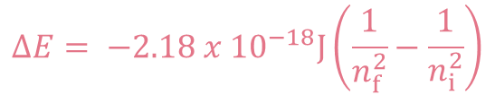



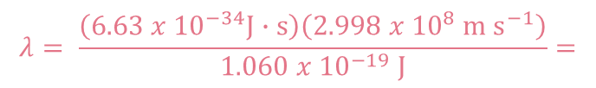


The Line Spectrum of Hydrogen
$$∆E= {−2.18 x 10}^{−18}J\left(\frac{1}{n_{f}^{2}}−\frac{1}{n_{i}^{2}}\right)$$
Emission Series in the Hydrogen Spectrum
Series | n_{f} | n_{i} | Spectrum Region
Lyman | 1 | 2,3,4,…. | Ultraviolet (UV)
Balmer | 2 | 3,4,5,…. | Visible and UV
Paschen | 3 | 4,5,6,…. | Infrared
Brackett | 4 | 5,6,7…. | Infrared
Calculate the wavelength (in nm) of the photon emitted when an electron transitions from the n = 4 state to the n = 3 state in a hydrogen atom.
$$E= \frac{hc}{λ}$$
$$λ= \frac{hc}{E}$$
$$∆E= {−2.18 x 10}^{−18}J\left(\frac{1}{n_{f}^{2}}−\frac{1}{n_{i}^{2}}\right)$$
$$λ= \frac{\left({6.63 x 10}^{−34}J∙s\right)\left({2.998 x 10}^{8} {m s}^{−1}\right)}{1.060 x {10}^{−19} J}=$$
$$∆E= {−2.18 x 10}^{−18}J\left(\frac{1}{3^{2}}−\frac{1}{4^{2}}\right)$$
$$1.88 x {10}^{−6} m$$
$$\left(\frac{1.88 x {10}^{−6} m}{}\right)\left(\frac{1 nm}{1.0 x {10}^{−9} m}\right)=1880 nm$$
$$∆E=−1.060 x {10}^{−19} J$$
$$E=1.060 x {10}^{−19} J$$

Slide 19






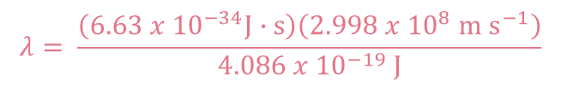





Practice
Calculate the ΔE and wavelength (in nm) for an H–atom undergoing an n = 4 to n = 2 transition.
$$∆E= {−2.18 x 10}^{−18}J\left(\frac{1}{2^{2}}−\frac{1}{4^{2}}\right)=−4.086 x {10}^{−19} J$$
$$λ= \frac{\left({6.63 x 10}^{−34}J∙s\right)\left({2.998 x 10}^{8} {m s}^{−1}\right)}{4.086 x {10}^{−19} J}$$
$$λ=4.862 x {10}^{−7} m$$
$$E=4.086 x {10}^{−19} J$$
$$\left(\frac{4.862 x {10}^{−7} m}{}\right)\left(\frac{1 nm}{1.0 x {10}^{−9} m}\right)=486.2 nm$$
$$E= \frac{hc}{λ}$$
$$λ= \frac{hc}{E}$$
Calculate the wavelength emitted with an electron changes from n = 6 to n = 2 in the H atom. What is the Energy for that photon?
$$∆E= {−2.18 x 10}^{−18}J\left(\frac{1}{2^{2}}−\frac{1}{6^{2}}\right)=−4.84 x {10}^{−19} J$$
$$E=4.84 x {10}^{−19} J$$
What is energy (in kJ) for 1 mole of those photons?
$\left(\frac{4.84 x {10}^{−19} J}{photon}\right)\left(\frac{{6.022 x 10}^{23} photons}{1 mol}\right)$
$=\frac{291464.8 J}{1 mol}$
$E=\frac{291.5 k J}{ mol}$

Slide 20
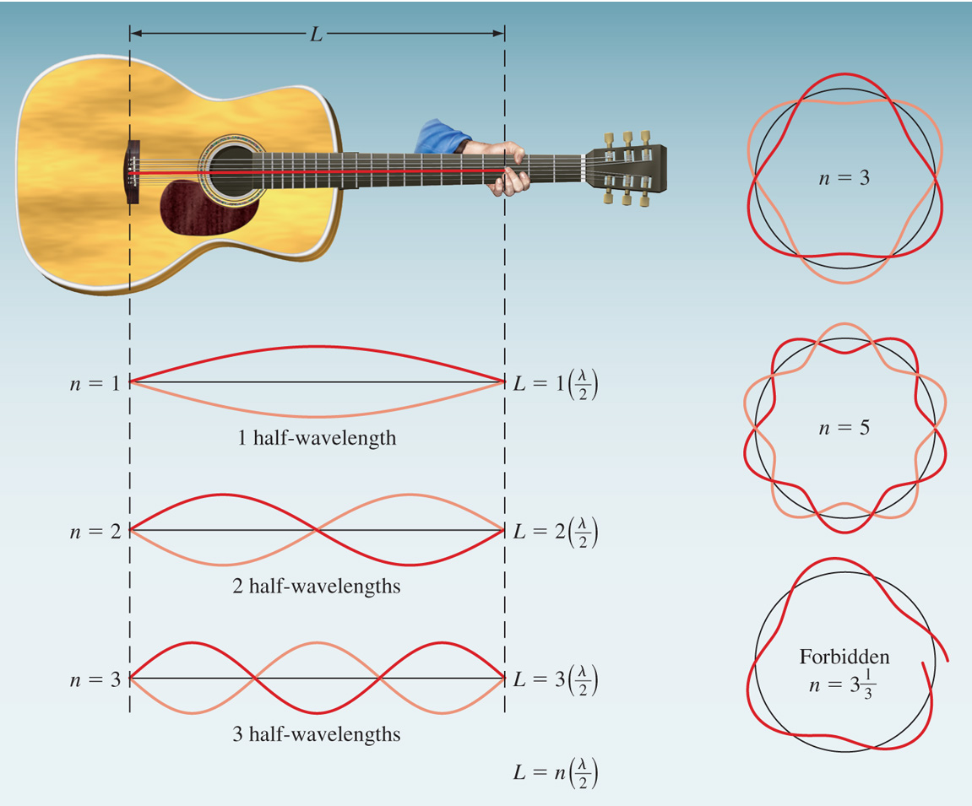

Wave Properties of Matter
Louis de Broglie reasoned that if light can behave like a stream of particles (photons), then electrons could exhibit wavelike properties.
According to de Broglie, electrons behave like standing waves.
Only certain wavelengths are allowed.
At a node, the amplitude of the wave is zero.
De Broglie deduced that the particle and wave properties are related by the following expression:
λ is the wavelength associated with the particle
m is the mass (in kg)
u is the velocity (in m/s)
$$λ=\frac{h}{mu}$$
The wavelength calculated from this equation is known as the de Broglie wavelength.

Slide 21


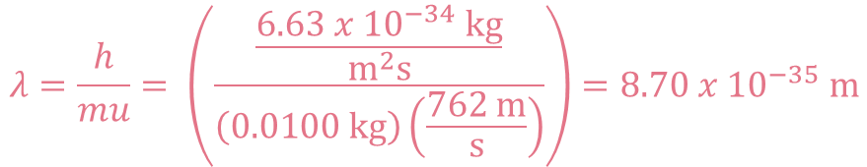
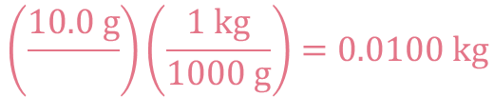
Practice
Calculate the de Broglie wavelength of the “particle,” when considering a 10.0 g bullet traveling at 762 m/s.
$$λ=\frac{h}{mu}$$
$$h=6.63 x {10}^{−34} J= \frac{6.63 x {10}^{−34} kg}{m^{2}s}$$
$$\left(\frac{10.0 g}{}\right)\left(\frac{1 kg}{1000 g}\right)=0.0100 kg$$
$$λ=\frac{h}{mu}= \left(\frac{\frac{6.63 x {10}^{−34} kg}{m^{2}s}}{\left(0.0100 kg\right)\left(\frac{762 m}{s}\right)}\right)=8.70 x {10}^{−35} m$$

Slide 22
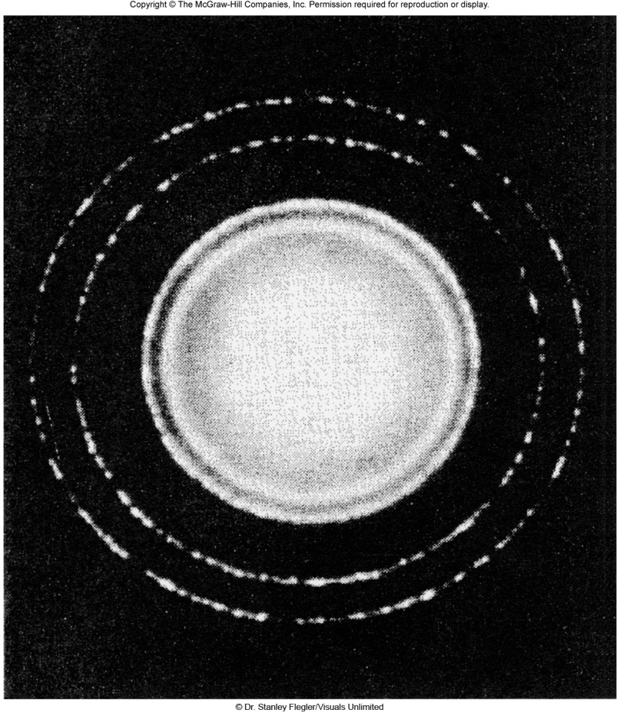
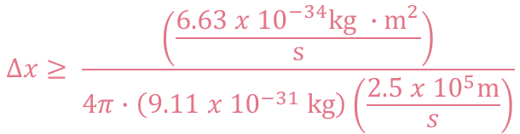

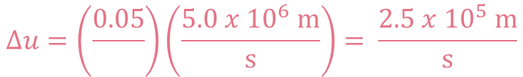




Electron diffraction pattern of aluminum foil.
Diffraction of Electrons
Experiments have shown that electrons do indeed possess wavelike properties:
The Heisenberg uncertainty principle states that it is impossible to know simultaneously both the momentum p and the position x of a particle with certainty.
$$Δx∙ Δp ≥ \frac{h}{4π}$$
Δx is the uncertainty in position in meters
Δp is the uncertainty in momentum
$$Δx∙mΔu ≥ \frac{h}{4π}$$
Δu is the uncertainty in velocity in m/s
m is the mass in kg
An electron in a hydrogen atom is known to have a velocity of 4.99×10⁶ m/s + 5 percent. Using the uncertainty principle, calculate the minimum uncertainty in the position of the electron. (the mass of an electron is 9.11 x 10^{–31} kg)
$$∆u=\left(\frac{0.05}{}\right)\left(\frac{5.0 x {10}^{6} m}{s}\right)= \frac{2.5 x {10}^{5} m}{s}$$
$$Δx∙mΔu ≥ \frac{h}{4π}$$
$$Δx≥ \frac{h}{4π∙mΔu}$$
$$Δx≥ \frac{\left(\frac{6.63 x {10}^{−34}kg ∙m^{2}}{s}\right)}{4π∙\left(9.11 x {10}^{−31} kg\right)\left(\frac{2.5 x {10}^{5}m}{s}\right)}$$
$$Δx≥2.3 x {10}^{−10} m$$

Slide 23
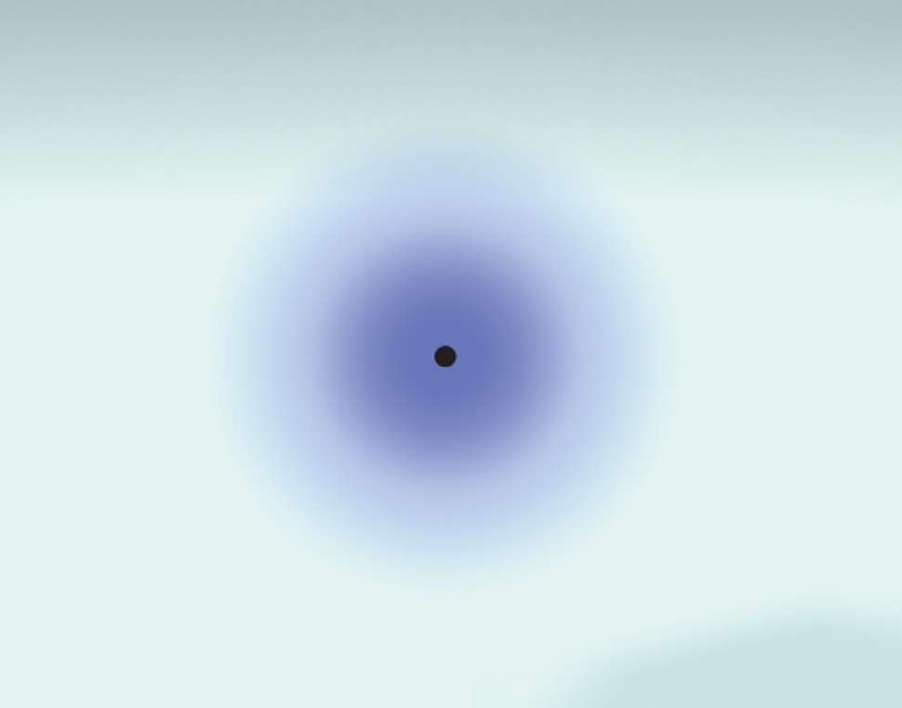
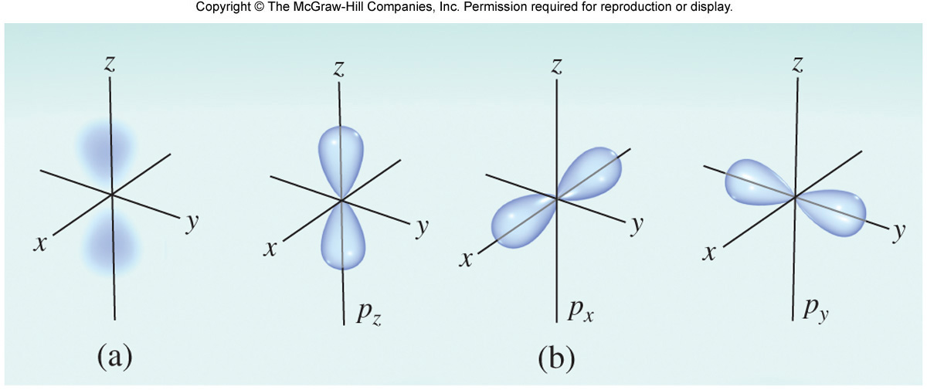
The Schrödinger Equation and The Quantum Mechanical Description of the H–Atom
Erwin Schrödinger derived a complex mathematical formula to incorporate the wave and particle characteristics of electrons. Wave behaviour is described with the wave function ψ.
The probability of finding an electron in a certain area of space is proportional to ψ² and is called electron density.
Quantum Mechanics defines the region where the electron is most likely to be at a given time
Probability map of an electron in an H atom
The Schrödinger equation specifies possible energy states an electron can occupy in a hydrogen atom.
The energy states and wave functions are characterized by a set of quantum numbers.
Instead of referring to orbits as in the Bohr model, quantum numbers and wave functions describe atomic orbitals.

Slide 24
Quantum Numbers
Quantum numbers are required to describe the distribution of electron density in an atom (location of the electron.)
There are three quantum numbers necessary to describe an atomic orbital.
The principal quantum number (n) – designates size
Larger values of n correspond to larger orbitals (higher energy).
The allowed values of n are integral numbers: 1, 2, 3 and so forth.
The value of n corresponds to the value of n in Bohr’s model of the hydrogen atom.
A collection of orbitals with the same value of n is frequently called a shell.
The angular moment quantum number (l) – describes shape
The values of l are integers that depend on the value of the principal quantum number
The allowed values of l range from 0 to n – 1. Example: If n = 2, l can be 0 or 1.
A collection of orbitals with the same value of n and l is referred to as a subshell.
The magnetic quantum number (m_{l}) – specifies orientation/direction
The values of m_{l} are integers that depend on the value of the angular moment quantum number:
– l,…0,…+l
l | 0 | 1 | 2 | 3
Orbital Designation (Shape) | s | p | d | f

Slide 25
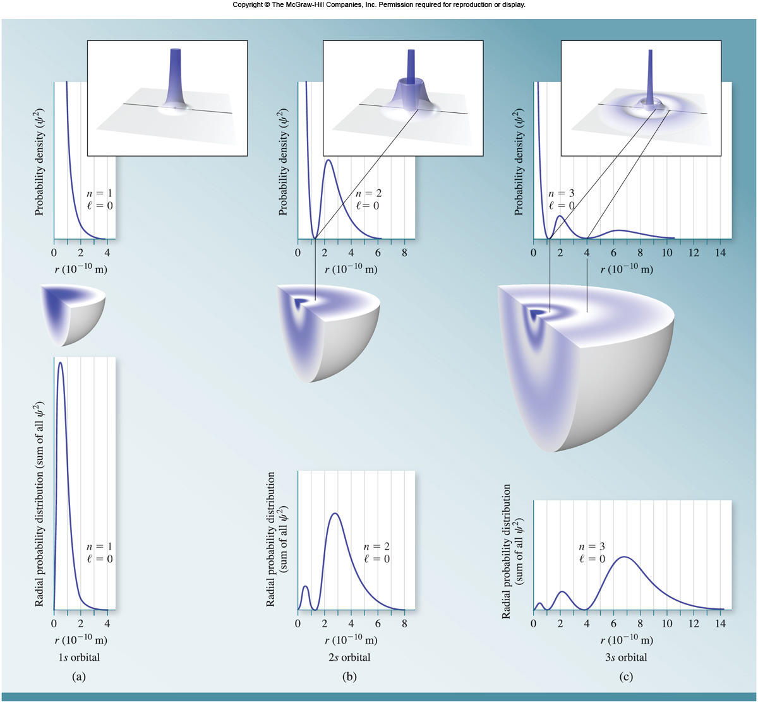
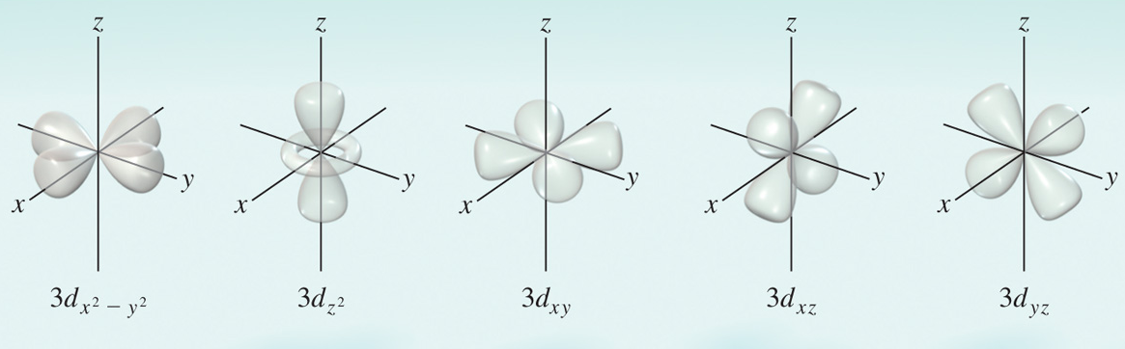
Atomic Orbitals
All s orbitals are spherical: One orientation:
l =0
m_{l} =0
principal quantum number (n = 2)
angular momentum quantum number (l = 0)
m_{l} = 0; only 1 orientation possible
2s
p orbitals are dumbbell shaped: Three orientations:
l =1
m_{l} = –1, 0, +1
d orbitals: Five orientations:
l =2
m_{l} = –2, –1, 0, +1, or +2

Slide 26
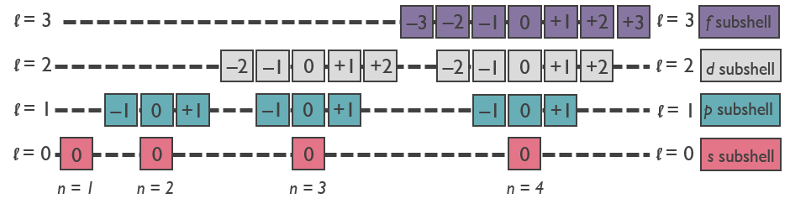
Quantum Numbers
Allowed Values of the Quantum Numbers n, l, and m_{l}
n | l can be | When l is | m_{l} can be
1 | Only 0 | 0 | Only 0
2 | 0 or 1 | 0 | Only 0
 |  | 1 | –1, 0, or +1
3 | 0, 1, or 2 | 0 | Only 0
 |  | 1 | –1, 0, or +1
 |  | 2 | –2, –1, 0, +1, +2
4 | 0, 1, 2, or 3 | 0 | Only 0
 |  | 1 | –1, 0, or +1
 |  | 2 | –2, –1, 0, +1, +2
 |  | 3 | –3, –2, –1, 0, +1, +2, +3
Quantum numbers designate shells, subshells, and orbitals.

Slide 27
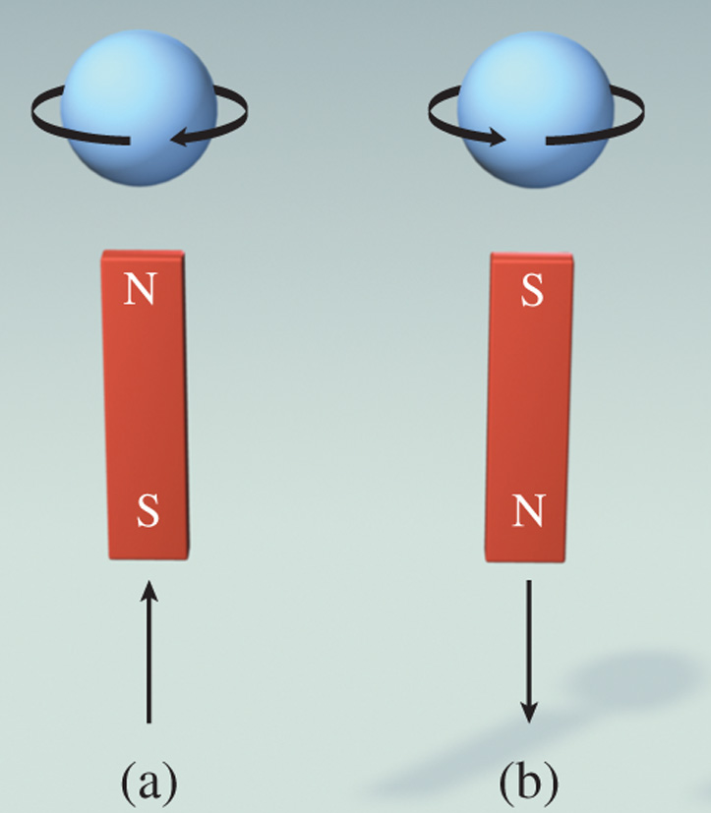
Atomic Orbitals
The electron spin quantum number (m_{s} ) is used to specify an electron’s spin. There are two possible directions of spin. Allowed values of m_{s} are +½ and –½.
To summarize quantum numbers:
principal (n) – size
angular (l ) – shape
magnetic (m_{l}) – orientation
electron spin (m_{s}) direction of spin
Angular Momentum (l =1)
Principal (n=2)
2p_{x}
Related to the Magnetic Quantum (m_{l} =1)

Slide 28
Practice
What are the possible values for the magnetic quantum number (m_{l}) when the principal quantum number (n) is 2 and the angular quantum number (l) is 0?
m_{l} = 0
List the values of n, l, and m_{l} for each of the orbitals in a 2p subshell.
n = 2
l = 1
m_{l} = –1, 0, +1
Which of the following is a legitimate set of quantum numbers for n, l, and m_{l} respectively, which corresponds to an 5f orbital?
A. 5, 4, –4 B. 3, 3, – 1 C. 5, 4, 0 D. 5, 3, 0
Which of the following is a list of allowed quantum numbers for an electron?
n = 1, l = 1, m_{l} = 0, m_{s} = ½
n = 2, l = 0, m_{l} = 1, m_{s} = ½
n = 3, l = 0, m_{l} = 0, m_{s} = ½
n = 4, l = 3, m_{l} = 4, m_{s} = –½

Slide 29
Practice
List one set of valid quantum numbers for an electron found in each of the following atomic shells.
2s
2p
3p
4d
5f

Slide 30
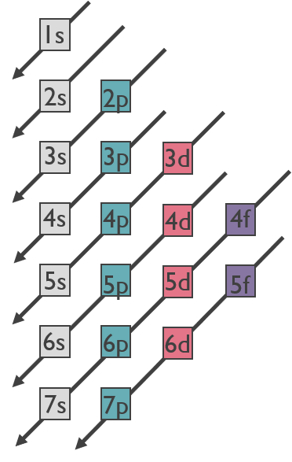
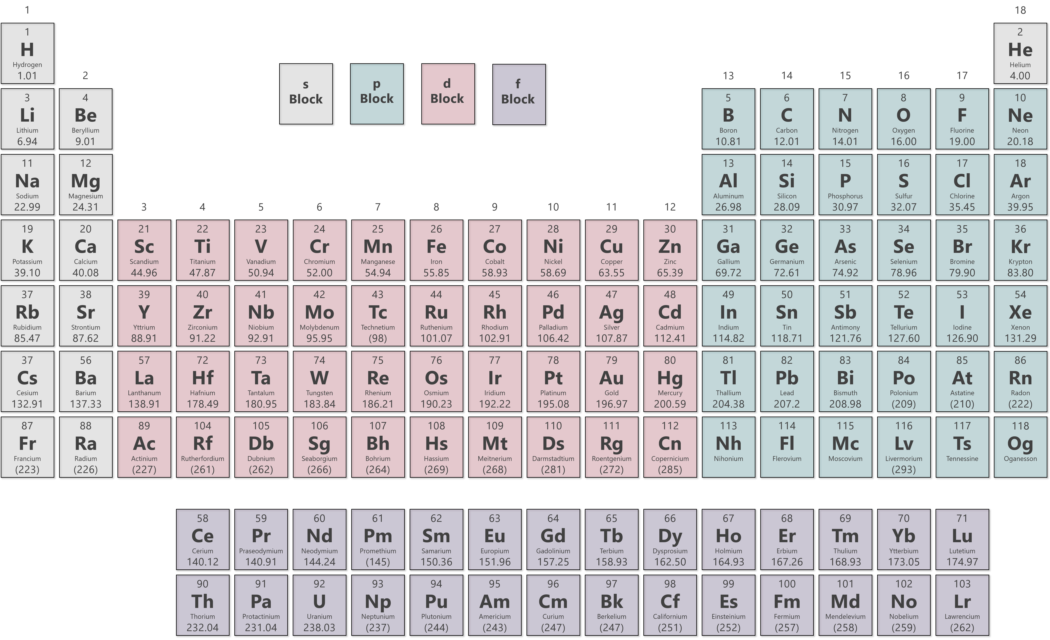
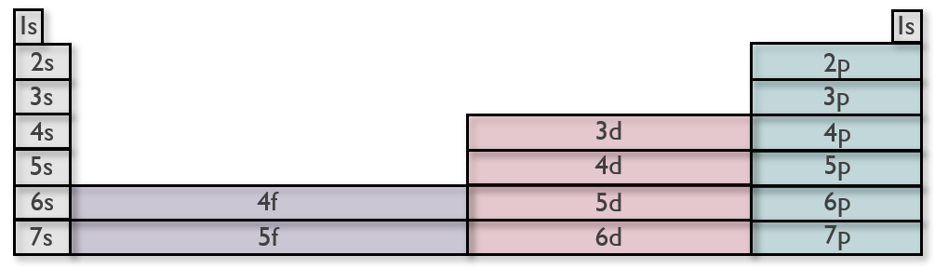
Electron Configurations
General rules for writing electron configurations:
1. Electrons will reside in the available orbitals of the lowest possible energy.
2. Each orbital can accommodate a maximum of two electrons.
3. Electrons will not pair in degenerate orbitals if an empty orbital is available.
4. Orbitals will fill in the order indicated in the figure.
Up-Side Down Christmas Tree
Periodic Table Method

Slide 31

Electron Configurations
The electron configuration describes how the electrons are distributed in the various atomic orbitals.
In a ground state hydrogen atom, the electron is found in the 1s orbital.
Energy
Ground state electron configuration of hydrogen
2s
2p
2p
2p
principal (n = 1)
1s¹
number of electrons in the orbital or subshell
$$↿$$
The use of an up arrow indicates an electron with m_{s} = + ½
angular momentum (l = 0)
1s

Slide 32
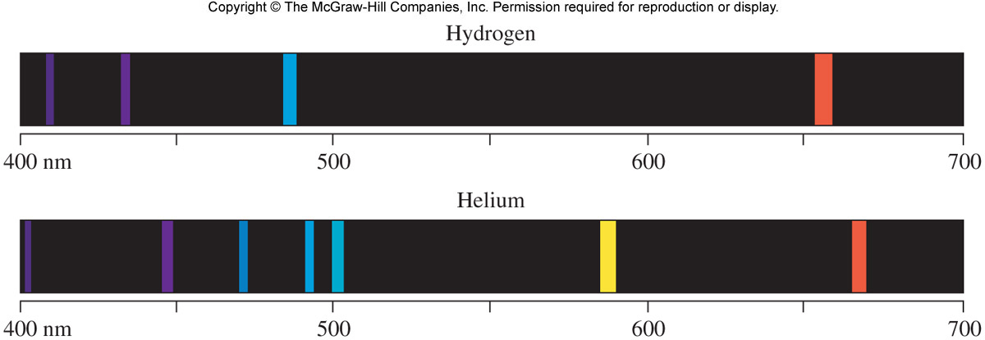

Electron Configurations
If hydrogen’s electron is found in a higher energy orbital, the atom is in an excited state.
$$↿$$
Possible excited state electron configuration of hydrogen.
Energy
2s
2p
2p
2p
2s¹
1s
The helium emission spectrum is more complex than the hydrogen spectrum. There are more possible energy transitions in a helium atom because helium has two electrons.

Slide 33
Electron Configurations
In a multi-electron atoms, the energies of the atomic orbitals are split.
4d
4d
4d
4d
4d
5s
4p
4p
4p
3d
3d
3d
3d
3d
Splitting of energy levels refers to the splitting of a shell (n=3) into subshells of different energies (3s, 3p, 3d)
4s
3p
3p
3p
Energy
3s
2p
2p
2p
2s
1s

Slide 34





Electron Configurations
According to the Pauli exclusion principle, no two electrons in an atom can have the same four quantum numbers.
The Aufbau principle states that electrons are added to the lowest energy orbitals first before moving to higher energy orbitals.
The ground state electron configuration of He (2 e–)
The ground state electron configuration of Li (3 e–)
1s²
1s²2s¹
$$↿$$
Energy
2p
2p
2p
Energy
2p
2p
2p
2s
2s
The 3rd e– must go in the next available orbital with the lowest possible energy
The 2nd e– has the same n, l, and m_{l} but m_{s} is opposite in sign.
$$↿$$
$$⇂$$
$$↿$$
$$⇂$$
1s
1s

Slide 35









Electron Configurations
The Aufbau principle states that electrons are added to the lowest energy orbitals first before moving to higher energy orbitals.
The ground state electron configuration of Be (4 e–)
The ground state electron configuration of B (5 e–)
1s²2s²
1s²2s²2p¹
$$↿$$
$$↿$$
$$⇂$$
$$↿$$
$$⇂$$
Energy
2p
2p
2p
Energy
2p
2p
2p
2s
2s
$$↿$$
$$⇂$$
$$↿$$
$$⇂$$
1s
1s

Slide 36













Electron Configurations
According to Hund’s rule, the most stable arrangement of electrons is the one in which the number of electrons with the same spin is maximized.
The ground state electron configuration of C (6 e–)
The ground state electron configuration of N (7 e–)
1s²2s²2p²
1s²2s²2p³
$$↿$$
$$↿$$
$$↿$$
$$↿$$
$$↿$$
$$↿$$
$$⇂$$
$$↿$$
$$⇂$$
Energy
2p
2p
2p
Energy
2p
2p
2p
2s
2s
The 2p orbitals are of equal energy, or degenerate.
Put 1 electron in each before pairing (Hund’s rule).
$$↿$$
$$⇂$$
$$↿$$
$$⇂$$
1s
1s

Slide 37











Electron Configurations
According to Hund’s rule, the most stable arrangement of electrons is the one in which the number of electrons with the same spin is maximized.
When there are one or more unpaired electrons, as in the case of oxygen and fluorine, the atom is called paramagnetic.
The ground state electron configuration of O (8 e–)
The ground state electron configuration of F (9 e–)
1s²2s²2p⁴
1s²2s²2p⁵
$$↿$$
$$⇂$$
$$↿$$
$$↿$$
$$↿$$
$$⇂$$
$$⇂$$
$$↿$$
$$↿$$
$$↿$$
$$⇂$$
$$↿$$
$$⇂$$
Energy
2p
2p
2p
Energy
2p
2p
2p
2s
2s
Once all the 2p orbitals are singly occupied, additional electrons will have to pair with those already in the orbitals.
$$↿$$
$$⇂$$
$$↿$$
$$⇂$$
1s
1s

Slide 38









Electron Configurations
When all electrons in an atom are paired, as in neon, it is called diamagnetic.
The ground state electron configuration of Ne (10 e–)
1s²2s²2p⁶
$$↿$$
$$⇂$$
$$↿$$
$$⇂$$
$$↿$$
$$⇂$$
$$↿$$
$$⇂$$
Energy
2p
2p
2p
2s
$$↿$$
$$⇂$$
1s

Slide 39
Practice
Write the electron configuration and give the orbital diagram of Fe (Z = 26) and Ar (Z = 18).
Fe 1s²2s²2p⁶3s²3p⁶4s²3d⁶
Ar 1s²2s²2p⁶3s²3p⁶
The 7 electrons in Nitrogen are found in the following atomic shells. List the quantum numbers for each electron.
1s (2 electrons)
2s (2 electrons)
2p (3 electrons)
n = 1, l = 0, m_{l} = 0, m_{s}= +1/2
n = 1, l = 0, m_{l} = 0, m_{s}= –1/2
n = 2, l = 0, m_{l} = 0, m_{s}= +1/2
n = 2, l = 0, m_{l} = 0, m_{s}= –1/2
n = 2, l =1, m_{l} = –1, m_{s}= +1/2
n = 2, l =1, m_{l} = 0, m_{s}= +1/2
n = 2, l =1, m_{l} = +1 m_{s}= +1/2
Which of the following electron configurations represents silicon?
1s²2s²2p⁶3s³3p²
1s²2s³2p⁶3s²3p²
1s²2s²2p⁶3s²3p²
1s²2s²2p⁶3s²3p⁴

Slide 40
Practice
Write the electron configuration for the following elements:
Mg
P
Ni
Ag
Pb
1s²2s²2p⁶3s²
Ba
V
Sr
W
O
1s²2s²2p⁶3s²3p⁶4s²3d¹⁰4p⁶5s²4d¹⁰5p⁶6s²
1s²2s²2p⁶3s²3p²
1s²2s²2p⁶3s²3p⁶4s²3d³
1s²2s²2p⁶3s²3p⁶4s²3d⁸
1s²2s²2p⁶3s²3p⁶4s²3d¹⁰4p⁶5s²
1s²2s²2p⁶3s²3p⁶4s²3d¹⁰4p⁶5s¹4d¹⁰
1s²2s²2p⁶3s²3p⁶4s²3d¹⁰4p⁶5s²4d¹⁰5p⁶6s²4f¹⁴5d⁴
1s²2s²2p⁶3s²3p⁶4s²3d¹⁰4p⁶5s²4d¹⁰5p⁶6s²4f¹⁴5d¹⁰6p²
1s²2s²2p⁴
What is the correct electron configuration for sulfur?
1s²2s²2p⁶3s²3p⁵
1s²2s²2p⁶3s²3p⁴
1s²2s²2p⁷3s²3p²
3s²3p⁴

Slide 41
Electron Configurations and the Periodic Table
The electron configurations of all elements except hydrogen and helium can be represented using a noble gas core. These core electrons are highly stable. Those not in the core are considered valence electrons.
The electron configuration of potassium (Z = 19) is 1s²2s²2p⁶3s²3p⁶4s¹. Ar has an electron configuration of 1s²2s²2p⁶3s²3p⁶, allowing us to simplify potassium’s configuration to [Ar]4s¹.
Ground State Electron Configuration of K:
1s²2s²2p⁶3s²3p⁶4s¹
[Ar]
Noble Gas Configuration of K:
[Ar]4s¹
Give the noble gas configuration for the following:
Ba
Hg
Fe
[Xe]6s²
[Xe]6s²4f¹⁴5d¹⁰
[Ar]4s²3d⁶

Slide 42

















Electron Configurations and the Periodic Table
There are several notable exceptions to the order of electron filling for some of the transition metals.
The reason for these anomalies is the slightly greater stability of d subshells that are either half-filled (d⁵) or completely filled (d¹⁰).
Copper (Z = 29) is [Ar]4s¹3d¹⁰ and NOT [Ar]4s²3d⁹ as expected.
$$↿$$
$$⇂$$
$$↿$$
$$⇂$$
$$↿$$
$$⇂$$
$$↿$$
$$↿$$
$$⇂$$
Cu:
[Ar]
$$↿$$
$$⇂$$
4s
3d
3d
3d
3d
3d
Chromium (Z = 24) is [Ar]4s¹3d⁵ and NOT [Ar]4s²3d⁴ as expected.
Cr:
[Ar]
$$↿$$
$$↿$$
$$↿$$
$$↿$$
$$↿$$
$$↿$$
4s
3d
3d
3d
3d
3d

Slide 43
Diamagnetic and Paramagnetic
Spinning e– = tiny magnet. If all e– are paired, then the magnets cancel.
  The atom is diamagnetic and is pushed weakly away from magnetic fields.
With unpaired e–:
  Unpaired spins point in the same direction (Hund’s rule) making the magnets add together.
  The atom is paramagnetic and are attracted to magnetic fields.
If individual atom-magnets line up in a bulk sample
  A ferromagnet – a permanent magnet.

Slide 44



































Diamagnetic and Paramagnetic
For each of the atoms/ions below, draw out the electrons with energy levels and determine if it would be diamagnetic or paramagnetic. How many unpaired electrons?
Ca
N
F
$$↿$$
$$⇂$$
Diamagnetic
Paramagnetic
Paramagnetic
4s
$$↿$$
$$⇂$$
$$↿$$
$$⇂$$
$$↿$$
$$⇂$$
Energy
$$↿$$
$$⇂$$
3p
3p
3p
3s
$$↿$$
$$⇂$$
$$↿$$
$$⇂$$
$$↿$$
$$⇂$$
$$↿$$
$$↿$$
$$↿$$
$$↿$$
$$⇂$$
$$↿$$
$$⇂$$
$$↿$$
$$↿$$
$$⇂$$
2p
2p
2p
$$↿$$
$$⇂$$
2p
2p
2p
$$↿$$
$$⇂$$
2p
2p
2p
2s
2s
2s
$$↿$$
$$⇂$$
$$↿$$
$$⇂$$
$$↿$$
$$⇂$$
1s
1s
1s

Slide 45
Development of the Periodic Table
However, Mendeleev could not explain inconsistencies such as argon coming before potassium in the periodic table, despite having a higher atomic mass.
In 1913, Henry Moseley discovered the correlation between the number of protons (atomic number) and frequency of X-rays generated. Ordering the periodic table by atomic number instead of atomic mass enabled scientists to make sense of discrepancies. Entries today include atomic number and symbol; and are arranged according to electron configuration.
Summarizes
Atomic numbers.
Atomic weights.
Physical state (solid/liquid/gas).
Type (metal/non-metal/metalloid).
Periodicity
Elements with similar properties are arranged in vertical groups.

Slide 46
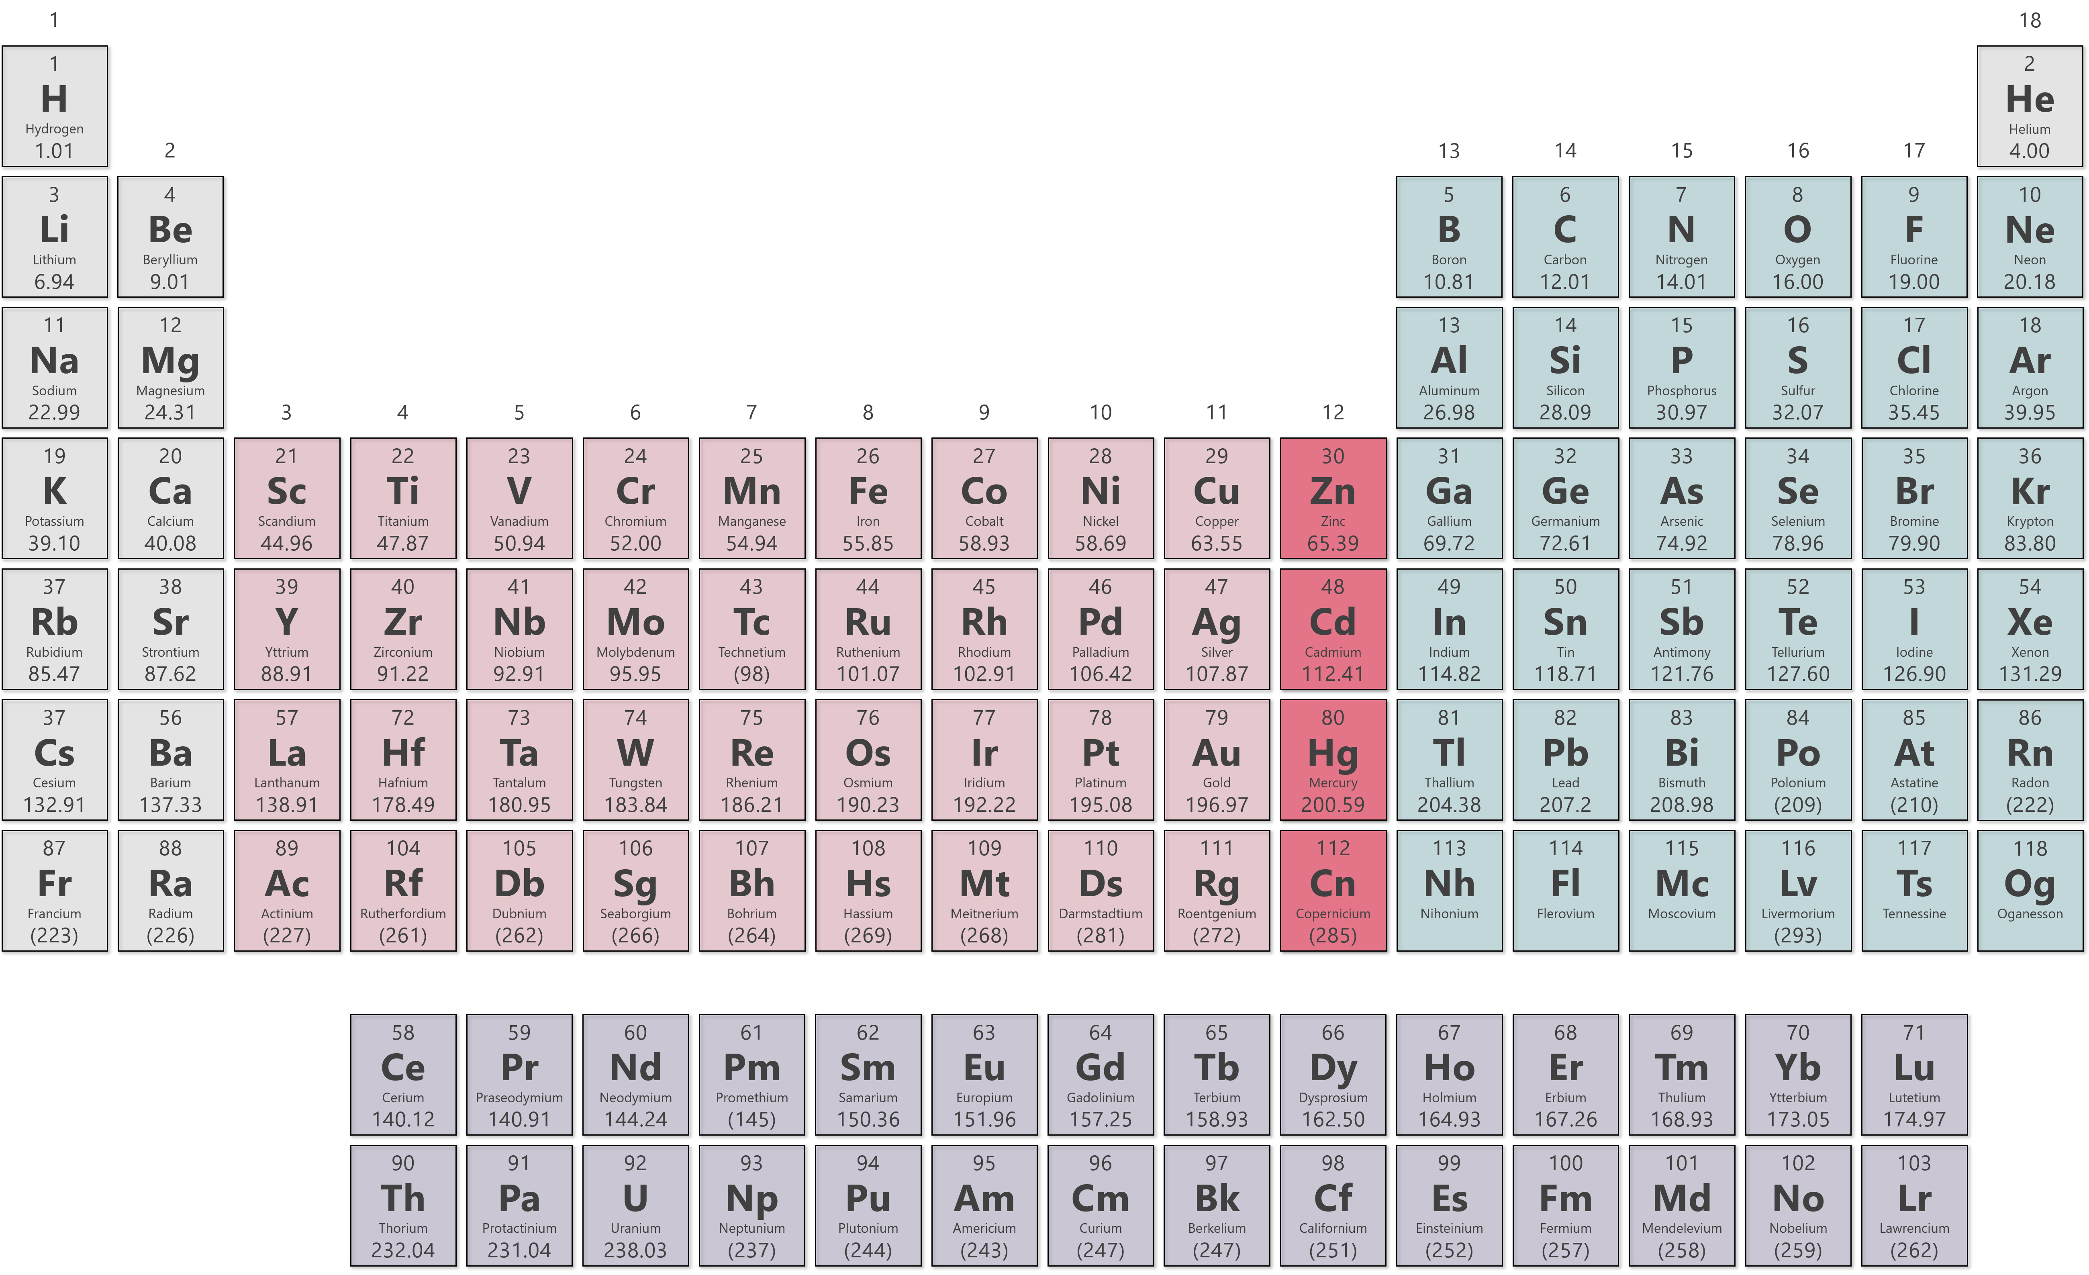
Modern Periodic Table

Slide 47
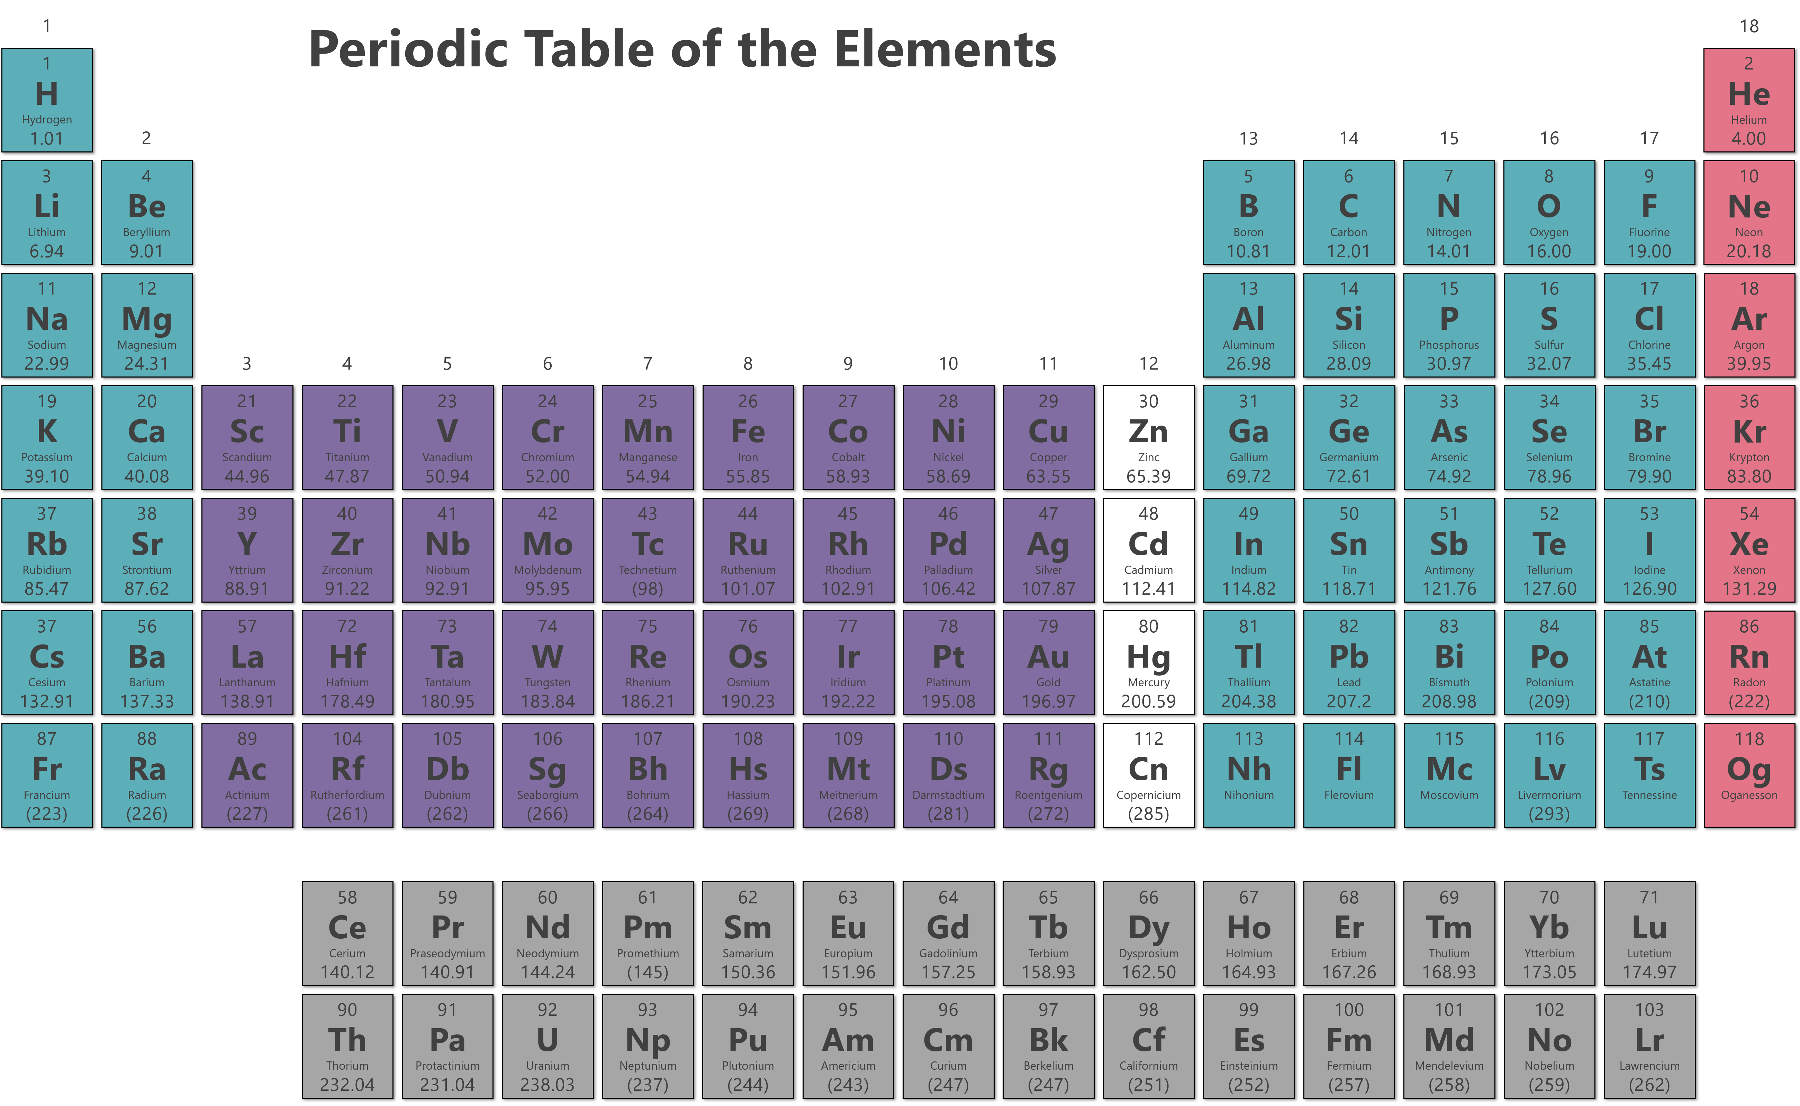
Classification of Elements
The main group elements (also called the representative elements) are the elements in Groups 1A through 7A.
The noble gases are found in Group 8A and have filled p subshells.
The transition metals are found in Group 1B and 3B through 8B.
Group 2B have filled d subshells and are NOT transition metals.
The lanthanides and actinides make up the f-block transition elements.

Slide 48
The Modern Periodic Table
There is a distinct pattern to the electron configurations of the elements in a particular group.
For Group 1A: [noble gas]ns¹
For Group 2A: [noble gas]ns²
Electron Configurations of Group 1A and Group 2A Elements
Group 1A |  | Group 2A
Li | [He]2s¹ | Be | [He]2s²
Na | [Ne]3s¹ | Mg | [He]2s²
K | [Ar]4s¹ | Ca | [He]2s²
Rb | [Kr]5s¹ | Sr | [He]2s²
Cs | [Xe]6s¹ | Ba | [He]2s²
Fr | [Rn]7s¹ | Ra | [He]2s²
The outermost electrons of an atom are called the valence electrons.
Valence electrons are involved in the formation of chemical bonds.
Similarity of valence electron configurations help predict chemical properties.
All electrons associated with the highest principle quantum number are valence
For Group 1A: [noble gas]ns¹
For Group 7A: [noble gas]ns²np⁵
core
valence
core
valence

Slide 49
Practice
Determine the number of valence electrons for the following elements:
K
Mg
Se
I
Al
Si
Cu
Mo
Ni
Zn
Fe
Cr
1 valence e–
1 valence e–
2 valence e–
6 valence e–
6 valence e–
10 valence e–
7 valence e–
2 valence e–
3 valence e–
8 valence e–
4 valence e–
6 valence e–
When the d shell is filled (d¹⁰), then the d electrons don’t count as valence.

Slide 50
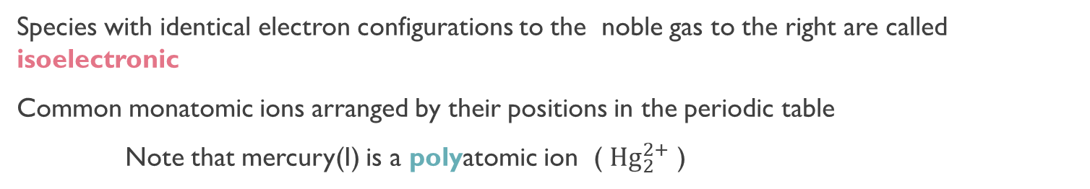
Electron Configurations of Ions
To write the electron configuration of an ion formed by a main group element:
1. Write the configuration for the atom.
2. Add or remove the appropriate number of electrons. Positive ions, remove electrons; negative ions, add electrons
Na: 1s²2s²2p⁶3s¹
Na⁺: 1s²2s²2p⁶
10 electrons total, isoelectronic with Ne
Cl: 1s²2s²2p⁶3s²3p⁵
Cl–: 1s²2s²2p⁶3s²3p⁶
18 electrons total, isoelectronic with Ar
Species with identical electron configurations to the noble gas to the right are called isoelectronic
Common monatomic ions arranged by their positions in the periodic table
Note that mercury(I) is a polyatomic ion ( ${Hg}_{2}^{2+}$ )

Slide 51
Practice
Write electron configurations for the following ions of main group elements: (a) N^{3–}, (b) Ba²⁺, and (c) Be²⁺.
(a) [He]2s²2p⁶
(b) [Kr]5s²4d¹⁰5p⁶
(c) 1s²
Determine the electron configuration for the following ions:
Cl–
N^{3–}
K⁺
Ca²⁺
Are any of them isoelectronic?
[Ne]3s²3p⁶
[He]2s²2p⁶
[Ne]3s²3p⁶
[Ne]3s²3p⁶
Cl–, K⁺, Ca²⁺

Slide 52
Electron Configurations of d-block Elements
Ions of d-block elements are formed by removing electrons first from the shell with the highest value of n.
For Fe to form Fe²⁺, two electrons are lost from the 4s subshell not the 3d.
Fe: [Ar]4s²3d ⁶
Fe²⁺: [Ar]3d ⁶
Fe can also form Fe³⁺, in which case the third electron is removed from the 3d subshell.
Fe: [Ar]4s²3d ⁶
Fe³⁺: [Ar]3d ⁵
Write electron configurations for the following ions of d-block elements: (a) Zn²⁺, (b) Mn²⁺, and (c) Cr³⁺.
(a) [Ar]3d¹⁰ (b) [Ar]3d⁵ (c) [Ar]3d³

Slide 53
Practice
Determine the electron configuration for the following ions:
Fe⁺²
Fe⁺³
Cr⁺³
Ti⁺²
Ti⁺⁴
Ni⁺²
Ag⁺
[Ar]3d⁶
[Ar]3d⁵
[Ar]3d³
[Ar]3d²
[Ne]3s²3p⁶
[Ar]3d⁸
[Kr]4d¹⁰

Slide 54
Periodic Trends and Properties of Elements
Atomic radius is the distance between the nucleus of an atom and its valence shell.
  (a) Atomic radius in metals, or metallic radius, is half the distance between the nuclei of two adjacent, identical metal atoms.
  (b) Atomic radius in nonmetals, or covalent radius, is half the distance between adjacent, identical nuclei connected by a chemical bond.
Effective nuclear charge (Z_{eff} ) is the actual magnitude of positive charge that is “experienced” by an electron in the atom.
In a multi-electron atom, electrons are simultaneously attracted to the nucleus and repelled by one another.
This results in shielding, where an electron is partially shielded from the positive charge of the nucleus by the other electrons.
Although all electrons shield one another to some extent, the most effective are the core electrons.
As a result, the value of Z_{eff} increases steadily from left to right because the core electrons remain the same but Z increases.

Slide 55
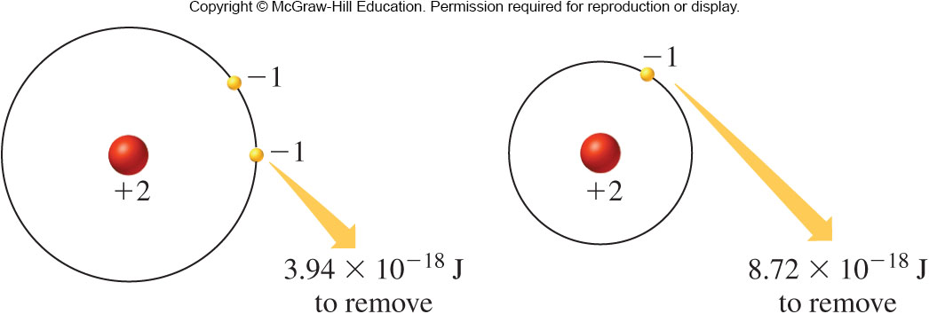
Effective Nuclear Charge
Z_{eff} increases steadily from left to right because the core electrons remain the same but Z increases.
 | Li | Be | B | C | N | O | F
Z | 3 | 4 | 5 | 6 | 7 | 8 | 9
Z_{eff} | 1.28 | 1.91 | 2.42 | 3.14 | 3.83 | 4.45 | 5.10
In general, the effective nuclear charge is given by:
Z is the nuclear charge, the number of protons in the nucleus.
σ is the shielding constant.
Z_{eff} increases from left to right across a period; changes very little down a column.
Z_{eff} = Z – σ
Example of He:
Removal of 1st e– requires less energy than removal of the second e– due to shielding

Slide 56
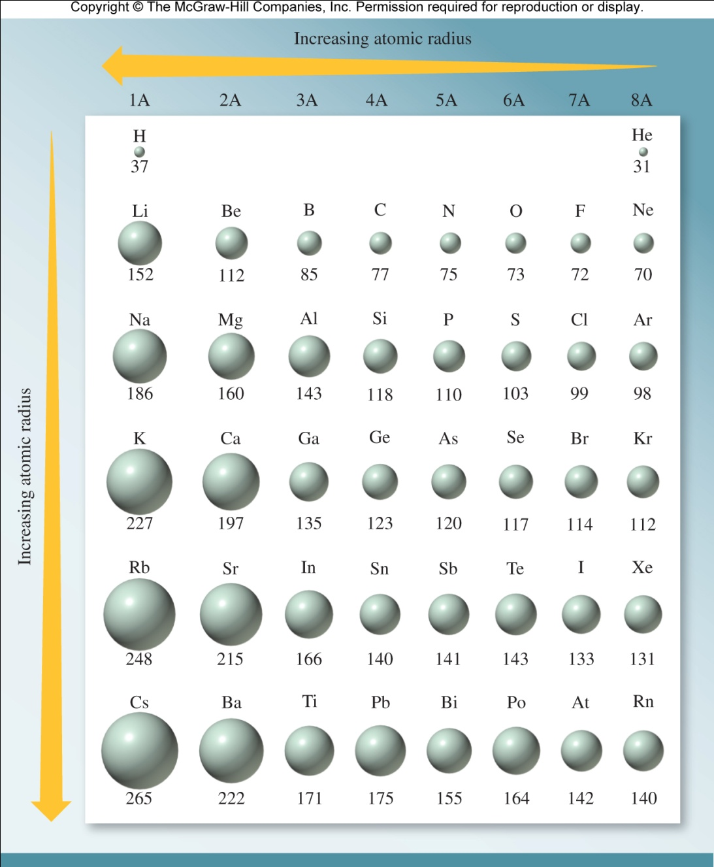
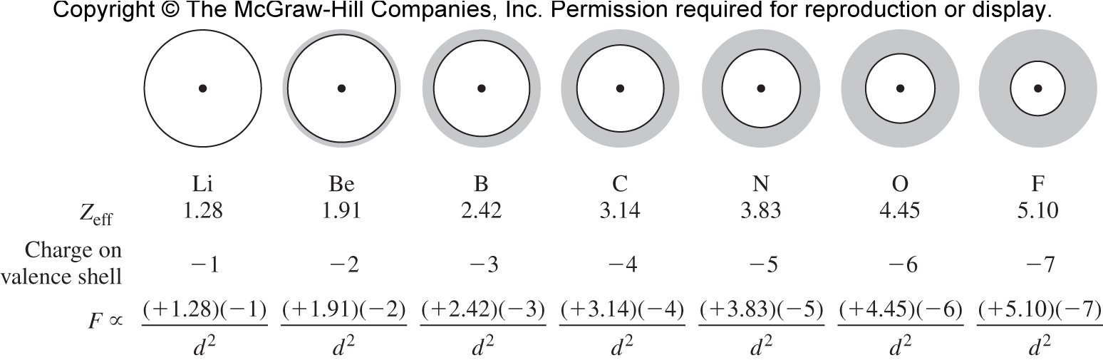
Atomic Radius
The atomic radius increases from top to bottom down a group.
Increasing n, so outermost shell lies farther from the nucleus
Atomic radius decreases from left to right across a period.
Increasing Z_{eff} which draws the valence shell closer to the nucleus
Atomic radius decreases left to right across a period due to increased electrostatic attraction between the effective nuclear charge and the charge on the valence shell.

Slide 57
Increasing
ATOMIC RADIUS
Practice
Referring only to a periodic table, arrange the elements P, S, and O in order of increasing atomic radius.
Cs
O < S < P
Using only the periodic table arrange the following elements in order of increasing atomic radius: Astatine, Bromine, Chlorine, Fluorine, Iodine
F < Cl < Br < I < At
Which is the largest atom below?
O
N
Al
S
Mg

Slide 58
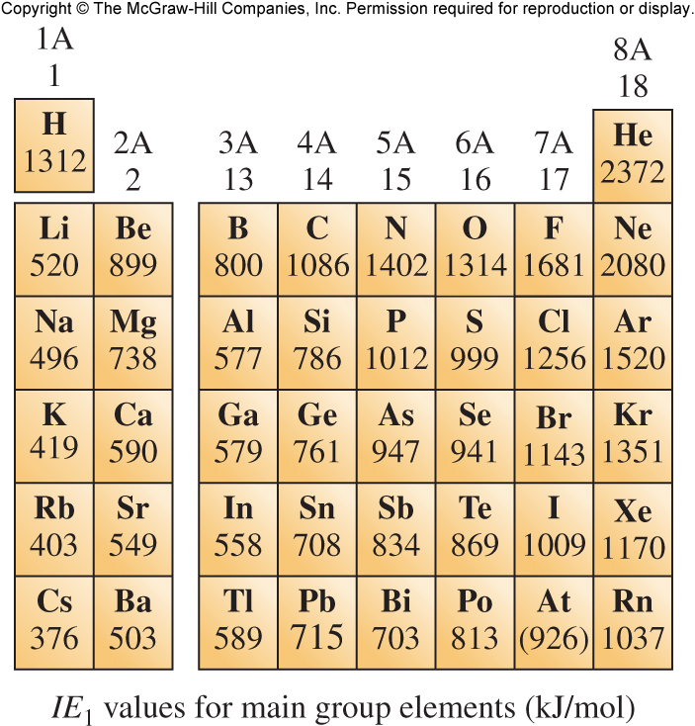
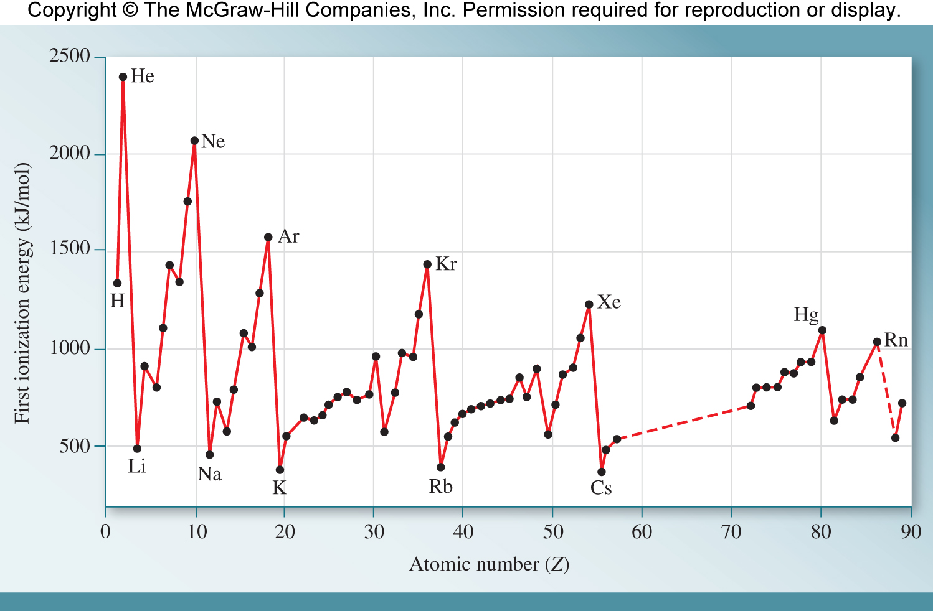

Ionization Energy
Ionization energy (IE) is the minimum energy required to remove an electron from an atom in the gas phase.
The result is an ion, a chemical species with a net charge.
Sodium has an ionization energy of 495.8 kJ/mol. Specifically, 495.8 kJ mol^{–1} is the first ionization energy of sodium, IE₁(Na), which corresponds to the removal of the most loosely held electron.
Na(g) $⟶$ Na⁺(g) + e⁻
In general, as Z_{eff} increases, ionization energy also increases. Thus, IE₁ increases from left to right across a period.

Slide 59
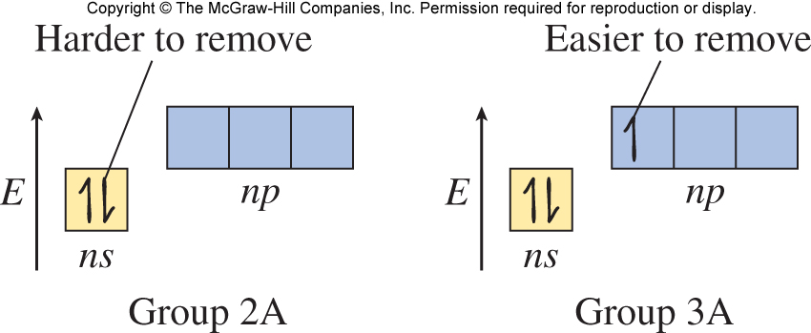
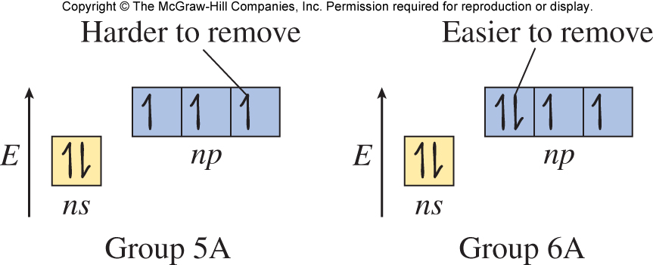


Ionization Energy
Within a given shell, electrons with a higher value of l are higher in energy and thus, easier to remove.
Removing a paired electron is easier because of the repulsive forces between two electrons in the same orbital.
It is possible to remove additional electrons in subsequent ionizations, giving IE₁, IE₂, and so on.
Na(g) $⟶$ Na⁺(g) + e⁻
Na⁺(g) $⟶$ Na⁺²(g) + e⁻
IE₁(Na) = 496 kJ/mol
IE₂(Na) = 4562 kJ/mol

Slide 60
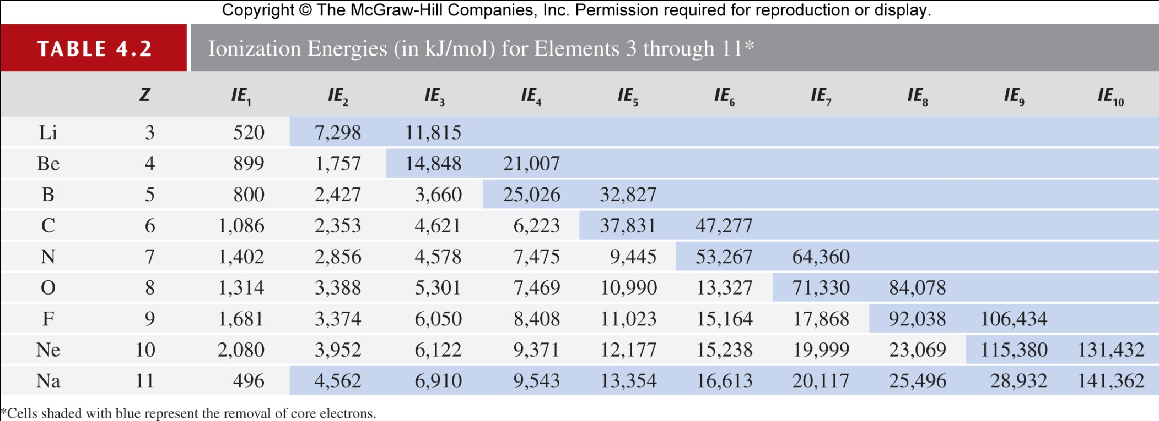
Increasing
Ionization Energy
Ionization Energy
F
It takes more energy to remove the 2nd, 3rd, 4th, etc. electrons because it is harder to remove an electron from a cation than an atom.
It takes much more energy to remove core electrons than valence.
Core electrons are closer to nucleus.
Core electrons experience greater Z_{eff} because of fewer filled shells shielding them from the nucleus.

Slide 61
Practice
Would you expect Na or Mg to have the greater first ionization energy (IE₁)? Which should have the greater second ionization energy (IE₂)?
IE₁(Mg) > IE₁(Na) because Mg is to the right of Na in the periodic table (i.e., Mg has the greater Z_{eff}, so it is more difficult to remove its electron).
IE₂(Na) > IE₂(Mg) because the second ionization of Mg removes a valence electron, whereas the second ionization of Na removes a core electron.
Which atom below has the greatest ionization energy?
Li
Ne
Na
Kr

Slide 62
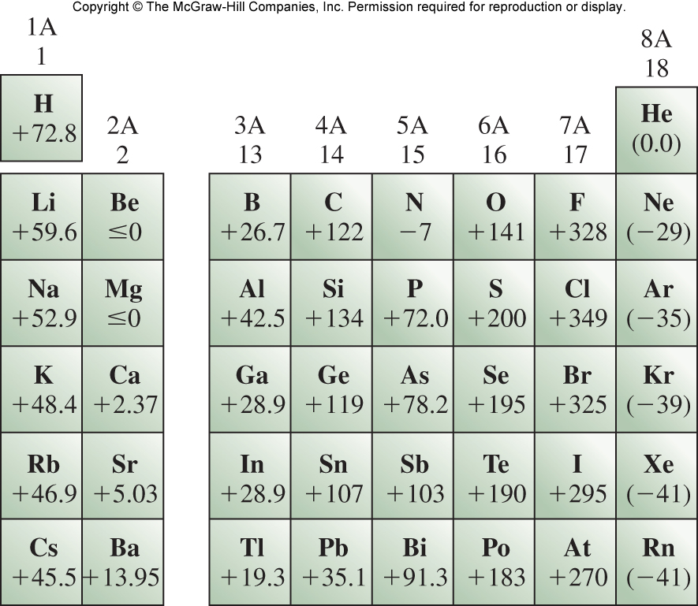
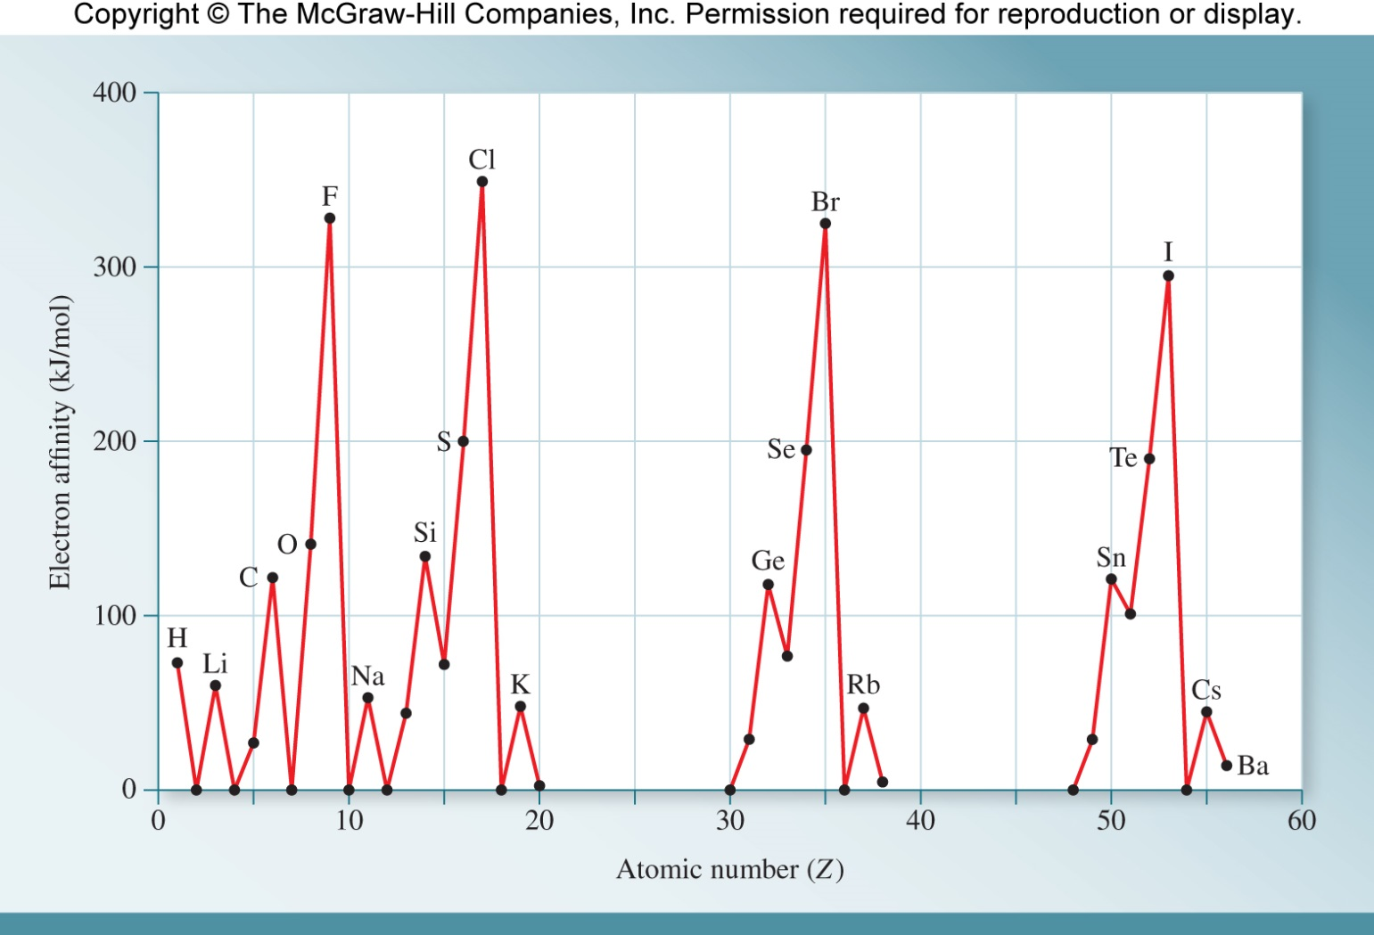

Electron Affinity
Electron affinity (EA) is the energy released when an atom in the gas phase accepts an electron.
Cl(g) + e⁻ $⟶$ Cl–(g)
Like ionization energy, electron affinity increases from left to right across a period as Z_{eff} increases.
Easier to add an electron as the positive charge of the nucleus increases.

Slide 63












Electron Affinity
It is easier to add an electron to an s orbital than to add one to a p orbital with the same principal quantum number.
Energy
Easier to add an e–
Energy
Harder to add an e–
$$↿$$
$$↿$$
$$⇂$$
np
np
np
np
np
np
ns
ns
Group 1A
Group 2A
Within a p subshell, it is easier to add an electron to an empty orbital than to add one to an orbital that already contains an electron.
Group 4A
Group 5A
Energy
Easier to add an e–
Energy
Harder to add an e–
$$↿$$
$$↿$$
$$↿$$
$$↿$$
$$↿$$
$$↿$$
$$⇂$$
$$↿$$
$$⇂$$
np
np
np
np
np
np
ns
ns

Slide 64
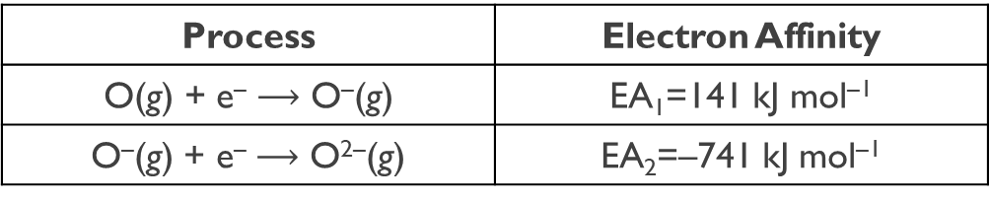
Electron Affinity
More than one electron may be added to an atom.
Process | Electron Affinity
O(g) + e– $⟶$ O–(g) | EA₁=141 kJ mol^{–1}
O–(g) + e– $⟶$ O^{2–}(g) | EA₂=–741 kJ mol^{–1}
While many first electron affinities are positive, subsequent electron affinities are always negative.
Considerable energy is required to overcome the repulsive forces between the electron and the negatively charged ion.
Increasing
Electron Affinity
F

Slide 65
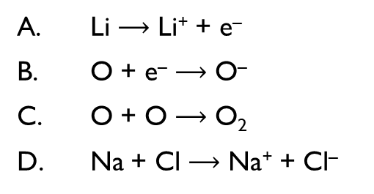
Practice
For each pair of elements, indicate which one you would expect to have the greater first electron affinity, EA₁: (a) Al or Si, (b) Si or P.
EA₁(Si) > EA₁(Al) because Si is to the right of Al and therefore has a greater Z_{eff}.
EA₁(Si) > EA₁(P) because although P is to the right of Si, adding an electron to a P atom requires placing it in a partially occupied 3p orbital. The energy cost of pairing electrons outweighs the energy advantage of adding an electron to an atom with a larger Z_{eff}.
Which process illustrates electron affinity?
Li $⟶$ Li⁺ + e–
O + e– $⟶$ O–
O + O $⟶$ O₂
Na + Cl $⟶$ Na⁺ + Cl–

Slide 66
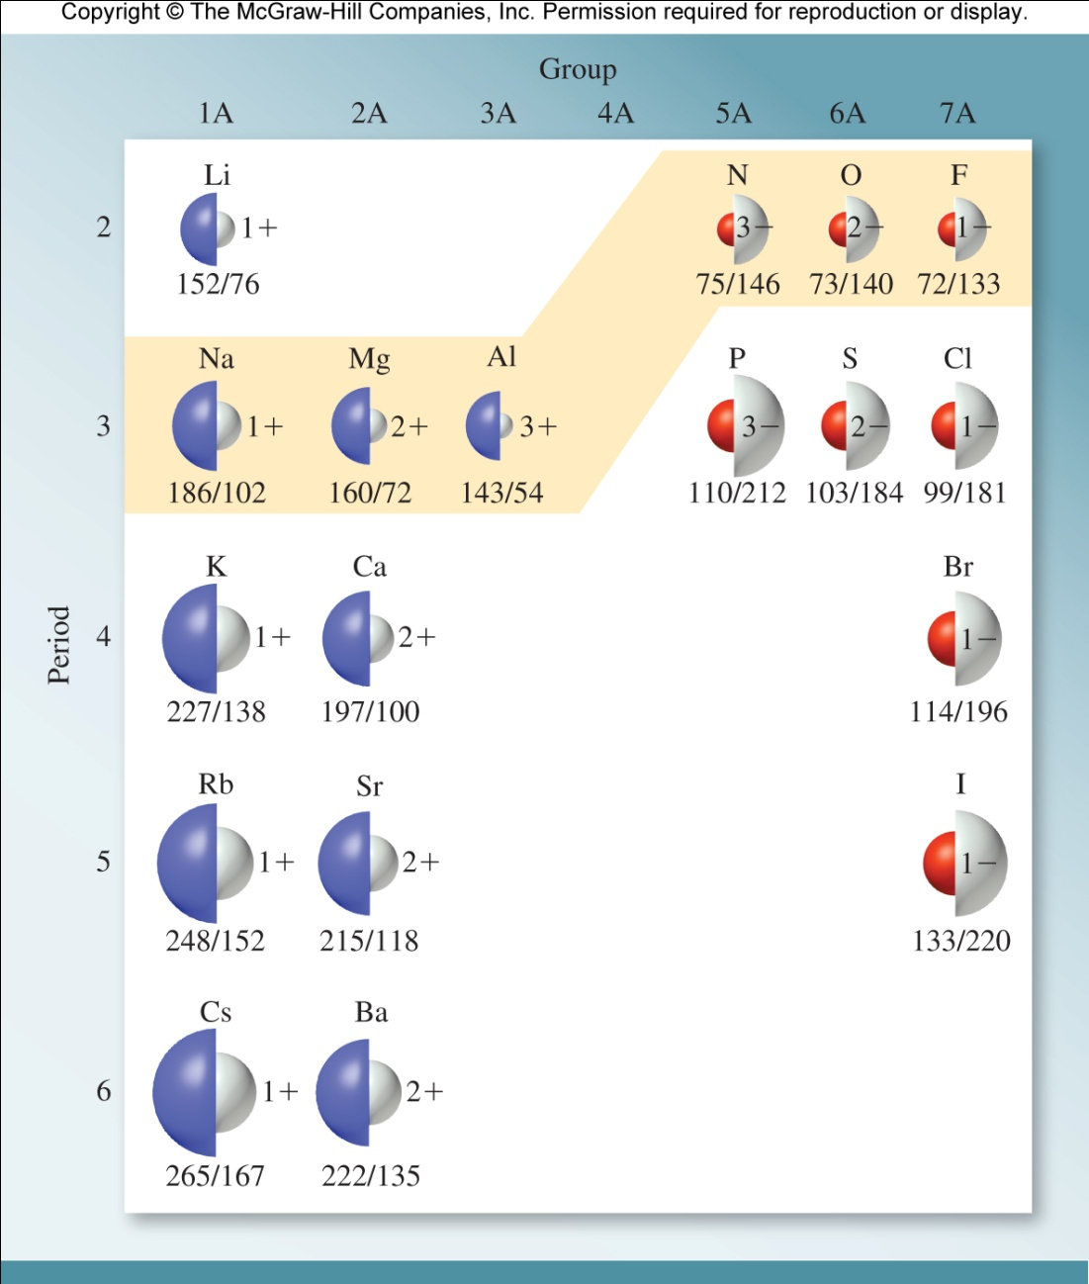
Ionic Radius
The ionic radius is the radius of a cation or an anion.
When an atom loses an electron to become a cation, its radius decreases due in part to a reduction in electron-electron repulsions in the valence shell.
A significant decrease in radius occurs when all of an atom’s valence electrons are removed.
When an atom gains one or more electrons and becomes an anion, its radius increases due to increased electron-electron repulsions.

Slide 67
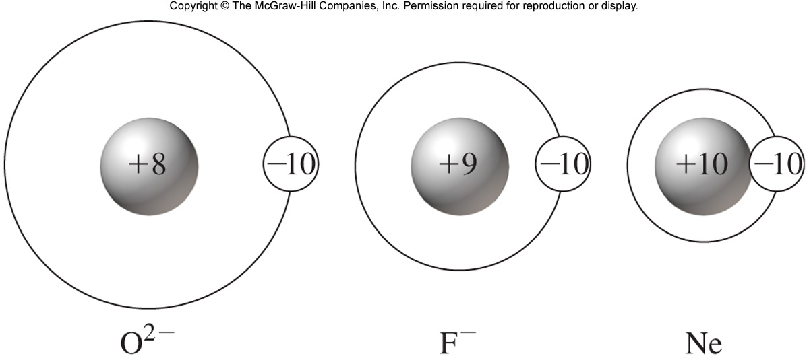
Isoelectronic Series
An isoelectronic series is a series of two or more species that have identical electron configurations, but different nuclear charges.
All Are Isoelectronic
O^{2–} : 1s²2s²2p⁶
F–: 1s²2s²2p⁶
Ne: 1s²2s²2p⁶
Isoelectronic Ions | O^{2–} | F– | Na⁺ | Mg²⁺
Ionic Radius (pm) | 126 | 119 | 116 | 86
Number of Protons | 8 | 9 | 11 | 12
Number of Electrons | 10 | 10 | 10 | 10
Increasing nuclear charge
decreasing size

Slide 68
Practice
Identify the isoelectronic series in the following group of species and arrange them in order of increasing radius: K⁺, Ne, Ar, Kr, P^{3–}, S^{2–}, and Cl–.
Ne,K⁺, Ar, Cl–, S^{2–}, P^{3–},Kr
Which of two species below are isoelectronic?
O^{2–}, C^{4–}
N^{2–}, Cl–
Mg, Na
Li⁺, Be⁺

Slide 69
Periodic Trends Review
ATOMIC RADIUS
INCREASING
ELECTRON AFFINITY
IONIZATION ENERGY
F
Cs

Slide 70

The Periodic Table
The periodic table is a chart in which elements having similar chemical and physical properties are grouped together.
Atomic Number
2
He
Symbol
Name
Helium
4.003
Average Atomic Mass

Slide 71
The Periodic Table
Elements are arranged in periods, horizontal rows, in order of increasing atomic number.
A vertical column is known as a group. Group 1A elements (Li, Na, K, Rb, Cs, Fr) are called alkali metals.
Alkali
metals

Slide 72
The Periodic Table
Noble Gases
Alkaline
earth metals
Halogens
Chalcogens
Transition
Metals
Alkali
metals

Slide 73

The Periodic Table
Elements can be categorized as metals, nonmetals, or metalloids.
Metals are good conductors of heat and electricity.
solids (except mercury – a liquid)
ductile (can be drawn into wires)
malleable (can be rolled into sheets)
Nonmetals are poor conductors of heat or electricity. (graphite is the one exception)
Occur in all physical states.
Metalloids have intermediate properties.
Boron, silicon, germanium, arsenic, antimony, tellurium, (astatine)
They exhibit metallic and nonmetallic properties:
Conduct electricity (not as well as metals).
Look like metals (shiny).
  semiconductors.

Slide 74

Types of Compounds
Ionic compounds: compounds comprised of ions. These are usually formed with a metal and non-metal. These ions are cations (positive ion) and anions (negative ion). The negative and positive charges of the cations and anions form the electrostatic forces that hold the compound together. (Look for a metal and nonmetal)
$F=k_{e}\frac{q_{1}q_{2}}{r^{2}}$ k_{e}: constant, q: scalar charge, r: distance between charges
Molecular (covalent) Compounds: Do not contain ions but are comprised of neutral molecules. These are compounds in which the electrons are shared between the two different atoms through a covalent bond. These are usually formed with two non-metals.
Acids: (for now), Release hydrogen ions (protons, H⁺) when dissolved in water. Two types:
Binary Acids
Oxyacids
Hydrates: Any compound containing water in the form of H₂O molecules

Slide 75


Ionic Charge Patterns in Periodic Table
+1
0
+4
+2
+3
-4
-3
-2
-1
Transition metals can have a variety of charges.

