Slide 1
Chapter 2: Atoms, Molecules, and Ions
Start Learning the Elemental Names and Symbols: Table 2.3 in Textbook (Table 2.3 Link Here)

Slide 2
Basic Structure of Matter
Chemistry
An atom is the smallest quantity of matter that still retains the properties of matter.
An element is a substance that cannot be broken down into two or more simpler substances by any means. These are shown on the periodic table, with their symbols.
Examples: gold (Au), oxygen (O), helium (He)
Car (object)
Wheel (part)
Tire (smallest part)
Molecule or element
Atom (smallest part)

Slide 3
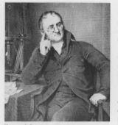
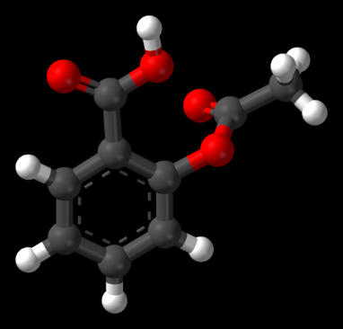
Early Ideas in Atomic Theory
An element is a substance that cannot be broken down into two or more simpler substances by any means. These are shown on the periodic table, with their symbols.
John Dalton (1803-1807) Dalton’s Atomic Theory
1) All matter is composed of tiny particles called atoms. An atom is the smallest unit of an element that can participate in a chemical change.
2) All atoms of a given element have identical chemical properties that are characteristic of that element.
3) Atoms of one element differ in properties from atoms of all other elements.
4) A compound consists of atoms of 2 or more elements combined in a small, whole-number ratio.
5) Atoms can change how they are combined, but they are neither created nor destroyed in chemical reactions.
Law of Constant Composition/Law of Definite Proportion
All samples of a pure compound contain the same elements in the same proportion by mass (experiments of French chemist Joseph Proust)

Slide 4
The Atomic Theory
Dalton used the data from Proust (who developed the Law of definite proportions) to formulate the Law of Multiple Proportions.
Law of Multiple Proportions (Dalton’s Law):
When two elements react, the mass of one element will react with masses of a second element so compounds always equals a ratio of small, whole number.
Compound A
32 grams O reacts with 24 grams C
$⟶$ ratio = $\frac{g O }{g C}\text{=}\frac{32}{24}$
= $\frac{1.33 g O}{1 g C}$
Compound B
64 grams O reacts with 24 grams C
$⟶$ ratio = $\frac{g O }{g C}\text{=}\frac{64}{24}$
= $\frac{ 2.66 g O}{1 g C}$
$\frac{Compound B}{Compound A}\text{=}\frac{\left(\frac{2.66 grams O}{1 gram C}\right)}{\left(\frac{1.33 grams O}{1 gram C}\right)}\text{=}\frac{\left(\frac{2 grams O}{1 gram C}\right)}{\left(\frac{1 gram O}{1 gram C}\right)}=\frac{2}{1}$
Therefore, compound B has 2 grams O for every 1-gram carbon; compound A has 1-gram oxygen for every 1-gram carbon. This means compound B has twice the amount of oxygen per carbon.

Slide 5
Subatomic Particles and Atomic Structure
In the late 1800’s, many scientists were doing research involving radiation, the emission and transmission of energy in the form of waves.
They commonly used a cathode ray tube, which consists of two metal plates sealed inside a glass tube from which most of the air has been evacuated.
fluorescent
screen
– high voltage +
cathode ray

Slide 6
Subatomic Particles and Atomic Structure
Researchers discovered that like charges repel each other, and opposite charges attract one another. J. J. Thomson (1856–1940) noted the rays were repelled by a plate bearing a negative charge and attracted to a plate bearing a positive charge.
Cathode Ray Tube Experiment Video
J.J. Thomson Talking about an electron
Thomson’s contributions:
He proposed the rays were a stream of negatively charged particles and these are called electrons.
He determined the charge–to–mass ratio of electrons to be 1.76×10⁸ C/g.
Thomson proposed the “plum pudding” model of an atom (“+” and “–” charges are squished together like a chocolate chip cookie).
Electric and magnetic fields deflect the beam.
Gives charge/mass of e– = 1.76×10⁸ C/g
Coulomb (C) = SI unit of charge
1 C = (A$∙$s)

Slide 7
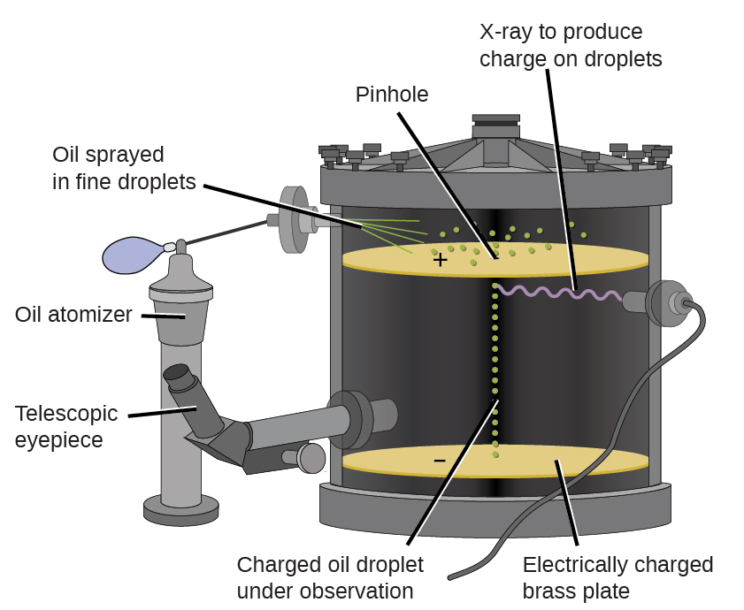
Subatomic Particles and Atomic Structure
Millikan (1911) studied electrically–charged oil drops.
R. A. Millikan (1868–1953) determined the charge on an electron by examining the motion of tiny oil drops.
The charge of an electron was determined to be –1.6022×10^{–19} C.
Oil Drop Experiment Video

Slide 8
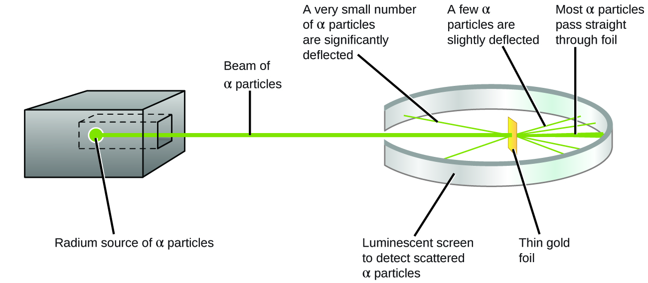
Subatomic Particles and Atomic Structure
Ernest Rutherford used α particles to find the structure of atoms. Most particles penetrated the gold foil undeflected, but some were deflected at a large angle, while others bounced back in the direction from which they had come.
Gold Foil Experiment Video1
Gold Foil Experiment Video 2
Gold Foil Textbook Link
Rutherford proposed the nuclear model where the positive charge is concentrated in the nucleus.
The nucleus accounts for most of an atom’s mass (extremely dense central core in the atom).
A typical atomic radius is about 100 pm
A typical nucleus has a radius of about 5 $×$10^{–3} pm
1 pm = 1×10^{–12} m

Slide 9
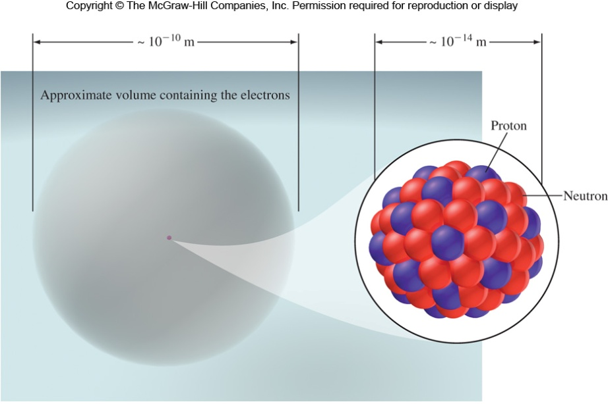
Subatomic Particles and Atomic Structure
Protons are positively charged particles found in the nucleus.
Neutrons are electronically neutral particles found in the nucleus.
Neutrons are slightly larger than protons.
Electrons are negatively charged particles distributed around the nucleus.
Particle | Mass (g) | Mass (amu) | Charge (C) | Charge Unit
Electron* | 9.10938 x 10^{–28} | 5.534 x 10^{–4} | –1.6022 x 10^{–19} | –1
Proton | 1.67262 x 10^{–24} | 1.0073 | +1.6022 x 10^{–19} | +1
Neutron | 1.67493 x 10^{–24} | 1.0086 | 0 | 0

Slide 10
Subatomic Particles and Atomic Structure
Which of the following is true about protons and neutrons?
They both have a charge.
They have approximately the same mass.
They are unstable with respect to radioactive decay.
They are found in the same region of space around the nucleus as the electron.
Which experiment can be linked to Millikan?
Photographic plate fogged with Uranium – discovering radioactivity
Oil drop experiment – charge of an electron
Shooting alpha particles at gold foil – structure of the atom
Cathode ray tube – mass of an electron

Slide 11
Atomic Number, Mass Number, and Isotopes
All atoms can be identified by the number of protons and neutrons they contain.
The atomic number (Z) is the number of protons in the nucleus.
Atoms are neutral, so it’s also the number of electrons.
Protons determine the identity of an element.
For example, nitrogen’s atomic number is 7, so every nitrogen has 7 protons.
The mass number (A) is the total number of protons and neutrons.
Protons and neutrons are collectively referred to as nucleons.
Mass number
(number of protons + neutrons)
$${}_{Z}^{A}X$$
Chemical symbol
Atomic number
(number of protons: Constant for a given element)
or ^{A}X e.g. ¹²C
or X–A e.g. carbon–12
For atoms: we use small units of measurement
1 amu = 1 atomic mass unit = 1/12 the mass of 1 carbon 12 atom
1 amu = 1.6605 x 10^{–24} g

Slide 12
Examples
Determine the numbers of protons, neutrons, and electrons in each of the following species: (a)²⁸Si, (b) ¹⁹F, (c) ⁵⁷Fe, and (d) carbon–13.
Z = 14 (14 protons); A = 28 (28–14 = 14 neutrons); # of e– = # of protons (14 e–)
Z = 9 (9 protons); A = 19 (19–9 = 10 neutrons); 9 protons, so 9 electrons
(c) Z = 26 (26 protons); A = 57 (57–26 = 31 neutrons); 26 electrons
(d) Carbon-13 can also be represented as ¹³C
Z = 6 (6 protons); A = 13 (13–6 = 7 neutrons); 6 electrons
Identify the # of protons, neutrons and electrons given the following information:
¹⁹⁷Au
⁴⁸Ti
⁵⁵Mn
Which neutral element are the following?
26 protons, 56 neutrons
20 neutrons, 18 electrons, no charge
76 neutrons, 52 protons
p⁺ = 79; n°=118; e– = 79
p ⁺ = 22; n° = 26; e– = 22
p ⁺ = 25; n° = 30; e– = 25
Fe
Ar
Te
Pick the correct description for ⁵⁹Co.
A. 59 protons, 27 neutrons B. 27 protons, 59 neutrons
C. 32 protons, 27 neutrons D. 27 protons, 32 neutrons

Slide 13
Atomic Number, Mass Number, and Isotopes
Most elements have two or more isotopes, atoms that have the same atomic number (Z) but different mass numbers (A). This is due to each isotope having a different number of neutrons.
Isotopes are atoms of the same element with different A (mass).
equal numbers of p⁺
different numbers of n⁰
Hydrogen isotopes:
1 proton
0 neutrons
1 proton
1 neutron
1 proton
2 neutrons
The mass of H is 1: 1 proton and zero neutrons
The mass is increased: 1 neutron/1 proton giving a mass of 2
The mass is increased: 2 neutrons/1 proton giving a mass of 2
Isotopes of the same element typically exhibit very similar chemical properties
same types of compounds and similar reactivities.

Slide 14
Isotopes and Atomic Weight
Most elements occur as a mixture of isotopes.
Magnesium is a mixture of:
 | ²⁴Mg | ²⁵Mg | ²⁶Mg
Number of p⁺ | 12 | 12 | 12
Number of n° | 12 | 13 | 14
Mass/amu | 23.985 | 24.986 | 25.982
Atomic mass is the mass of an atom in atomic mass units (amu). The average atomic mass on the periodic table represents the average mass of the naturally occurring mixture of isotopes.
Isotope | Isotopic Mass (amu) | Natural abundance (%)
¹²C | 12.00000 | 98.93
¹³C | 13.003355 | 1.07

Slide 15
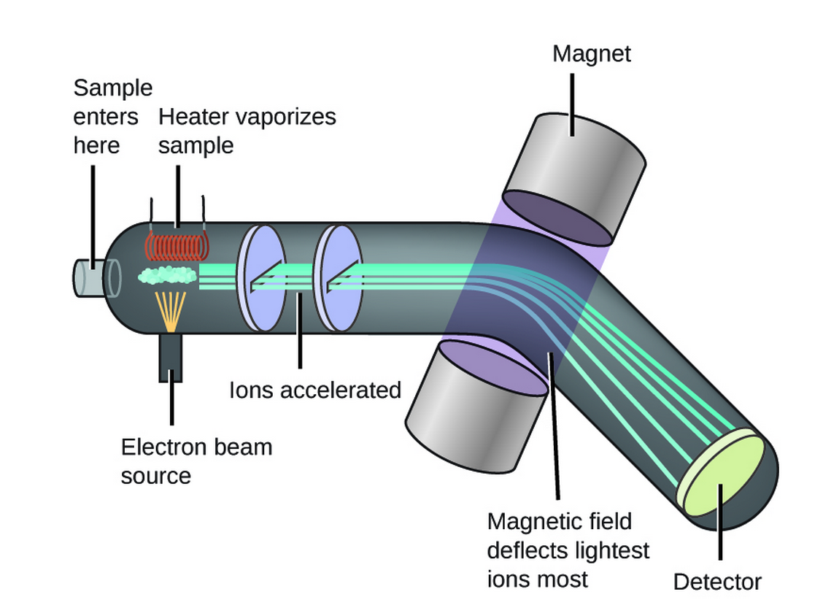
Average Atomic Mass
Measuring Atomic Mass: The most direct and most accurate method for determining atomic and molecular masses is mass spectrometry, using a mass spectrometer.
Mass Spectrometry Video
Isotopes and Mass Spectrometry Description
Chlorine has two stable isotopes, ³⁵Cl (75.78 percent) and ³⁷Cl (24.22 percent) which have masses of 34.9689 and 36.9659 amu, respectively. Calculate the average atomic mass of chlorine.
Strategy: Multiplying the mass of each isotope by its fractional abundance (percent value divided by 100) will give its contribution to the average atomic mass.
Solution
(0.7578)(34.9689 amu)
+ (0.2422)(36.9659 amu)
= 35.44518022 amu
= 35.45 amu

Slide 16
Example
Natural lithium is: 97.42% ⁶Li (6.015 amu) and 2.58% ⁷Li (7.016 amu), what is the average atomic mass of lithium?
$$\frac{97.42 \%}{100}=0.9742$$
$$\frac{2.58 \%}{100}=0.0258$$
$$Average Atomic Mass=$$
$$\left(0.9742\right)\left(6.015 amu\right)$$
$$+ \left(0.0258\right)\left(7.016 amu\right)$$
$$Average Atomic Mass=6.041 amu$$
Argon has three naturally occurring isotopes: 0.337% Ar-36 (35.968 amu), 0.063% Ar-38 (37.963 amu) and 99.60% Ar-40 (39.962 amu). What is the atomic weight of natural Argon?
$$\frac{0.337 \%}{100}=0.00337$$
$$\frac{0.063 \%}{100}=0.00063$$
$$\frac{99.60 \%}{100}=0.996$$
$Average Atomic Mass= \left(0.00337\right)\left(35.968 amu\right)+ \left(0.00063\right)\left(37.963 amu\right)$ $+ \left(0.996\right)\left(39.962 amu\right)$
$$Average Atomic Mass=39.947$$
The average atomic mass of nitrogen is 14.0067. The atomic masses of the two stable isotopes of nitrogen, ¹⁴N and ¹⁵N are 14.003074002 and 15.00010897 amu, respectively. Determine the percent abundance of each nitrogen isotope.
Fraction of ¹⁴N + Fraction of ¹⁵N = 1
Fraction of ¹⁵N = 1– Fraction of ¹⁴N
Fraction of ¹⁵N = 1– x
$$Average Atomic Mass= \left(x\right)\left(14.003074004 amu\right)+ \left(1−x\right)\left(15.000108898 amu\right)$$
$$14.007= \left(x\right)\left(14.003074004 amu\right)+ \left(1−x\right)\left(15.000108898 amu\right)$$
$$14.007=14.003074004x amu +15.000108898 amu−15.000108898x amu$$
$$−0.993108898=−0.997034894x amu$$
$$x=0.9960623284$$
(*100)
$$x (14N)=99.6\%$$
Fract. ¹⁵N = 1– x
Fract. ¹⁵N = 1– $0.9960623284$
Fract. ¹⁵N = 0.00393767
(*100)
¹⁵N = 0.39 %

Slide 17
Example
Silver has two stable isotopes; Ag-107 (106.90509 amu) and Ag-109 (108.90476 amu). Determine the percentage abundance of these two isotopes of silver.
¹⁰⁷Ag: 51.8%; ¹⁰⁹Ag: 48.2%
Rubidium has two naturally occurring isotopes, ⁸⁵Rb (relative mass 84.9118 amu) and ⁸⁷Rb (relative mass 86.9092 amu). If rubidium has an average atomic mass of 85.47 amu, what is the percent abundance of each isotope?
52.45% ⁸⁵Rb, 47.55% ⁸⁷Rb
26.81% ⁸⁵Rb, 73.19% ⁸⁷Rb
⁸⁵Rb :72.05%, ⁸⁷Rb: 27.95%
Aaaggh!

Slide 18
Poll Question: Campusknot
(Ch. 2-slide 19) If Potassium-39 has a mass of 38.82 AMU and Potassium-41 has a mass of 41.02 AMU, what is the % abundance of each isotope of Potassium given an average atomic mass of 39.10 AMU?

Slide 19
Covalent Bonding and Molecules
A molecule is a combination of at least two atoms in a specific arrangement held together by chemical forces (chemical bonds).
A molecule may be an element or a compound. Some elements that naturally exist as molecules include:
Br₂, I₂, N₂, Cl₂, H₂, O₂, F₂, and C₆₀ and S₈
BrINClHOF (The super 7)
Different samples of a given compound always contain the same elements in the same ratio. This is known as the law of definite proportions.
Sample | Mass of O (g) | Mass of C (g) | Ratio (O(g):C(g)
123 g carbon dioxide | 89.4 | 33.6 | 2.66:1
50.5 g carbon dioxide | 36.7 | 13.8 | 2.66:1
88.6 g carbon dioxide | 64.4 | 24.2 | 2.66:1

Slide 20
Covalent Bonding and Molecules
If two elements can form a series of different compounds, the law of multiple proportions tells us that the ratio of masses of one element that combine with a fixed mass of the other element can be expressed in small whole numbers.
In addition to carbon dioxide, carbon also combines with oxygen to form carbon monoxide.
Sample | Mass of O (g) | Mass of C (g) | Ratio (O(g):C(g))
123 g CO₂ | 89.4 | 33.6 | 2.66:1
50.5 g CO₂ | 36.7 | 13.8 | 2.66:1
88.6 g CO₂ | 64.4 | 24.2 | 2.66:1
Sample | Mass of O (g) | Mass of C (g) | Ratio (O(g):C(g)
16.3 g CO | 9.31 | 6.99 | 1.33:1
25.9 g CO | 14.8 | 11.1 | 1.33:1
88.4 g CO | 50.5 | 37.9 | 1.33:1
$$\frac{2.66 O}{1.33 O}=\frac{2 O in CO_{2}}{1 O in CO}$$
law of multiple proportions tells us 2O in CO₂:1O in CO

Slide 21
Molecular Formulas
Diatomic molecules contain two atoms and may be either heteronuclear or homonuclear (BrINClHOF). Polyatomic molecules contain more than two atoms.
Homonuclear diatomic: H₂
Heteronuclear diatomic: CO
Polyatomic: PO₄^{3–}
A chemical formula denotes the composition of the substance through element symbols and numbers, as well as parentheses, dashes, brackets, commas, plus, and minus signs.
A molecular formula shows the exact number of atoms of each element in a molecule.
Some elements have two or more distinct forms known as allotropes.
For example, oxygen (O₂) and ozone (O₃) are allotropes of oxygen.
C, S, and P also have allotropic forms
A structural formula shows not only the elemental composition, but also the general arrangements.

Slide 22
Empirical Formulas
Molecular substances can also be represented using empirical formulas, the whole–number ratio of elements.
While the molecular formulas tell us the actual number of atoms in the molecule (the true formula), the empirical formula gives the lowest whole–number ratio of elements (the simplest formula).
Molecular formula: N₂H₄
Empirical formula: NH₂
The molecular and empirical formulas are often the same.
Compound | Molecular Formula | Empirical Formula
Water | H₂O | H₂O
Hydrogen peroxide | H₂O₂ | HO
Ethane | C₂H₆ | CH₃
Propane | C₃H₈ | C₃H₈
Acetylene | C₂H₂ | CH
Benzene | C₆H₆ | CH

Slide 23
Examples
Write the empirical formulas for the following molecules: (a) glucose (C₆H₁₂O₆), a substance known as blood sugar; (b) adenine (C₅H₅N₅), also known as vitamin B₄; and (c) nitrous oxide (N₂O), a gas that is used as an anesthetic (“laughing gas”) and as an aerosol propellant for whipped cream.
Strategy To write the empirical formula, the subscripts in the molecular formula must be reduced to the smallest possible whole numbers
(a) $\frac{\text{C}\text{6}\text{H}\text{12}\text{O}\text{6}}{6}$ = CH₂O.
(b) $\frac{\text{C}\text{5}\text{H}\text{5}\text{N}\text{5}}{5}$= CHN.
(c) N₂O = N₂O
True or False: If any coefficient (subscript) in the molecular formula is 1, then the molecular formula and empirical formula are the same.
True
False

Slide 24
Molecular and Formula Mass
The molecular mass is the mass in atomic mass units (amu) of an individual molecule.
To calculate molecular mass, multiply the atomic mass of each element in a molecule by the number of atoms of that element and then total the masses
Molecular mass of H₂O:
2(atomic mass units of H) +(1)(atomic mass units of O)
2(1.008 amu)
+ (1)(16.00 amu) =
18.02 amu
Because the atomic masses on the periodic table are average atomic masses, the result of such a determination is an average molecular mass, sometimes referred to as the molecular weight.
Although an ionic compound does not have a molecular mass, we can use its empirical formula to determine its formula mass (the mass of a “formula unit”), sometimes called the formula weight.
The process is the same:
To calculate formula mass, multiply the atomic mass for each element
in a formula unit by the number of atoms of that element and
then total the masses

Slide 25
Example Problem
Calculate the molecular mass or the formula mass, as appropriate, for each of the following:
(a) ethane, C₂H₆, (b) lithium hydroxide, (c) CaCl₂
(a) C₂H₆ : This says 2 carbon atoms and 6 hydrogen atoms. The molecular mass of ethane is:
$$(2)(12.01 amu)$$
$$+ (6)(1.008 amu)$$
$$=30.07 amu$$
(b) LiOH : This says 1 lithium atom and 1 oxygen atom and 1 hydrogen atom. The formula mass is:
$$(1)(6.94 amu)$$
$$+(1)(16.00 amu)$$
$$+ (1)(1.008 amu)$$
$$=23.95 amu$$
(c) CaCl₂: This says 1 calcium atom and 2 chlorine atoms. The formula mass is:
$$(1)(40.078 amu)$$
$$+ (2)(35.453 amu)$$
$$=110.984 amu$$

Slide 26
Practice Problem
Determine the Formula/Molecular weight for the following compounds:
Li₂NO₃
Potassium cyanide
Al₂O₃
Iron(III) sulfate
Carbon dioxide
Formula mass = 75.89 amu
Formula mass for KCN = 65.12 amu
Formula mass = 101.96 amu
Formula mass for Fe₂(SO₄)₃ = 399.88 amu
Molecular mass for CO₂ = 44.01 amu

Slide 27
Poll Question: Campusknot
(Ch. 2-slide 27) What is the molar mass of potassium permanganate (KMnO₄)?

Slide 28
The Mole and Molar Mass
The mole is defined as the amount of a substance that contains as many elementary entities as there are atoms in exactly 12 g of carbon–12. This experimentally determined number is called Avogadro’s number (N_{A})
1 mole = 6.022 x 10²³
Molar Mass is the mass (grams) in 1 mole of a compound or element given in units of g mol^{–1}.
Example Problem 3:
What is the molar mass of nitrogen dioxide (NO₂)?
Hint: Use a similar strategy you would use to calculate the molecular mass of NO₂.
Molecular mass of NO₂ = atomic mass of N + 2(atomic mass of O)
=14.01 amu
+(2)(16.00 amu) =
46.01 amu
Molar Mass of NO₂ = molar mass of N + 2(molar mass of O)
$=\frac{14.01 g}{mol}$
$$=\frac{46.01 g}{mol}$$
+ (2)($\frac{16.00 g}{mol}$)

Slide 29
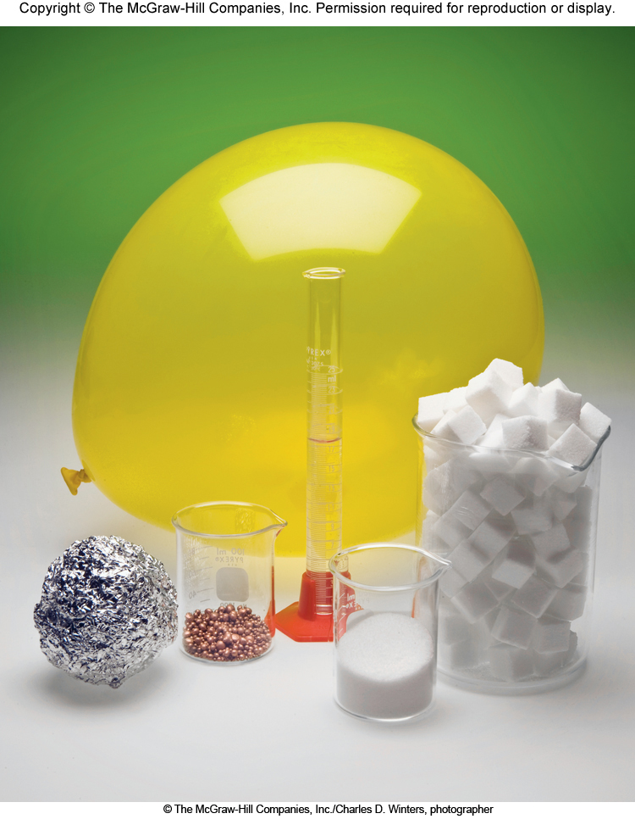
The Mole
He
(inside balloon)
One mole of some familiar substances:
4.0 g of He
~ 18.0 g of H₂O
~ 26.98 g Al
~ 63.55 g Cu
~ 58.44 g salt (NaCl)
~ 180.16 g sugar (C₆H₁₂O₆)
H₂O
Sucrose
Cu
NaCl
Al
Mole Video
Mole Textbook Link
1 mole of marshmallows would be enough marshmallows to make a 19 km (12 mi) thick layer of marshmallows covering the entire face of the Earth. (Marshmallows would be in the clouds)
1 mole of cells would be approximately equivalent to the number of cells found composing every human on earth.
(100 trillion cells per person x 7.4 billion people = 7.4 x 10²³ cells)

Slide 30
Example Problems
Determine (a) the number of C atoms in 12.00 moles of carbon and (b) the number of moles of sodium in a sample containing 3.23×10¹⁰ Na atoms.
(a) $\left(\frac{(12.00 mol C)}{}\right)$
$$\left(\frac{{6.022 x 10}^{23} C atoms}{1 mol C}\right)=$$
$${7.2264 x 10}^{24} C atoms$$
$${7.226 x 10}^{24} C atoms$$
(b) $\left(\frac{{3.23 x 10}^{10 }Na atoms}{}\right)$
$$\left(\frac{1 mol Na}{{6.022 x 10}^{23} Na atoms}\right)=$$
${5.36267 x 10}^{−14} mol$ Na
${5.36 x 10}^{−14} mol$ Na

Slide 31
Poll Question: Campusknot
(Ch. 2-slide 32) How many moles are in 144 grams of carbon tetrachloride (CCl₄)?

Slide 32
Molar Mass
The molar mass of a substance is the mass in grams of one mole of the substance.
The mass of 1 mole of carbon–12 is exactly 12 g.
The mass of 1 carbon–12 atom is exactly 12 amu
We usually express molar masses in units of grams per mole (g mol^{–1}) to facilitate cancellation of units in calculations. Molar masses can be found on the periodic table. For example, in1 mole of carbon–12, we have:
$$\frac{12 g carbon}{1 mole carbon}$$
$$\frac{1 mole carbon}{12 g carbon}$$
$$OR$$
How many moles are in 62.8 grams of Fe?
$$\left(\frac{62.8 g Fe}{}\right)$$
$$\left(\frac{1 mol Fe}{55.85 g Fe}\right)$$
$$=1.12 mol Fe$$

Slide 33
Molecular Mass and Molar Mass
Molecular mass (or molecular weight) is the sum of the atomic masses (in amu) in a molecule.
1 Sulfur
32.07 amu
2 Oxygen
+ (2 x 16.00 amu)
SO₂
64.07 amu
For any molecule
molecular mass (amu) = molar mass (grams)
1 molecule SO₂ = 64.07 amu
1 mole SO₂ = 64.07 g SO₂
How many moles of Ca₃(PO₄)₂ are in 10.0 g of the compound?
Formula mass (Molar mass)
+$\left[\left(3\right)\left(\frac{40.08 g}{1 mol}\right)\right]$
+$\left[\left(2\right)\left(\frac{30.97 g}{1 mol}\right)\right]$
+$\left[\left(8\right)\left(\frac{16.00 g}{1 mol}\right)\right]$
= $\frac{310.18 g}{1 mol}$
+$\left(\frac{10.0 g {Ca}_{3}{\left({PO}_{4}\right)}_{2}}{}\right)$
x$\left(\frac{1 mol{ Ca}_{3}{\left({PO}_{4}\right)}_{2}}{310.2 g{Ca}_{3}{\left({PO}_{4}\right)}_{2}}\right)$
$=0.0322 mol{ Ca}_{3}{\left({PO}_{4}\right)}_{2}$

Slide 34
Conversion between Mass, Moles, Number of Atoms
Molar mass is the conversion factor from mass to moles, and vice versa. Avogadro’s constant converts from moles to atoms.
Divide by Molar Mass
Multiply by N_{A}
$$\left(\frac{\# g}{}\right)\left(\frac{1 mol}{\# g}\right)=mol$$
$$\left(\frac{\# mol}{}\right)\left(\frac{6.022 x {10}^{23} particles}{1 mol}\right)=particles$$
Particles
Atoms
Molecules
Formula Units
Grams
Moles
Multiply by Molar Mass
Divide by N_{A}
$$\left(\frac{\# mol}{}\right)\left(\frac{\# g}{1 mol}\right)=g$$
$$\left(\frac{\# particles}{}\right)\left(\frac{1 mol}{6.022 x {10}^{23} particles}\right)=mol$$
Determine (a) the number of Ca atoms in 0.515 g of Ca, and (b) the mass of H that contains 6.89×10¹⁸ H atoms.
(a)
$$\left(\frac{0.515 g Ca }{}\right)$$
$$\left(\frac{1 mol Ca}{40.0801 g Ca}\right)$$
$$\left(\frac{{6.022 x 10}^{23} Ca atoms}{1 mol Ca}\right)$$
$$=7.74 x {10}^{21} Ca atoms$$
(b)
$$\left(\frac{{6.89 x 10}^{18} H atoms}{}\right)$$
$$\left(\frac{1 mol H}{{6.022 x 10}^{23} H atoms}\right)$$
$$\left(\frac{1.008 g H}{1 mol H}\right)$$
$$=1.15 x {10}^{−5} g H$$

Slide 35
Practice
(a) Determine the number of water molecules and the numbers of H and O atoms in 3.26 g of water. (b) Determine the mass of 7.92×10¹⁹ carbon dioxide molecules.
(a)
$$\left(\frac{3.26 g H_{2}O }{}\right)$$
$$\left(\frac{1 mol{ H}_{2}O}{18.02 g H_{2}O}\right)$$
$$\left(\frac{{6.022 x 10}^{23}{ H}_{2}O molecules}{1 mol{ H}_{2}O}\right)$$
$$=1.09 x {10}^{23}{ H}_{2}O molecules$$
Using the molecular formula, we can determine the number of H and O atoms in 3.26 g of H₂O as follows:
$$\left(\frac{{1.09 x 10}^{23}{ H}_{2}O molecules}{}\right)$$
$$\left(\frac{2 H atoms}{1{ H}_{2}O molecule}\right)$$
$$=2.18 x {10}^{23}H atoms$$
$$\left(\frac{{1.09 x 10}^{23}{ H}_{2}O molecules}{}\right)$$
$$\left(\frac{1 O atoms}{1{ H}_{2}O molecule}\right)$$
$$=1.09 x {10}^{23}O atoms$$
(b)
$$\left(\frac{{7.92 x 10}^{19}{ CO}_{2} molecules}{}\right)$$
$$\left(\frac{1 mol {CO}_{2}}{{6.022 x 10}^{23}{CO}_{2}molecules}\right)$$
$$\left(\frac{44.01 g {CO}_{2}}{1 mol {CO}_{2}}\right)$$
$$=5.79x {10}^{−3}g{ CO}_{2}$$

Slide 36
Molar Mass
The molar mass (M) of a substance is the mass in grams of one mole of the substance. The molar mass of a compound is the sum of molar masses of the elements it contains.
1 mol H₂O = 2 ×1.008 g + 16.00 g = 18.02 g
How many moles are in 73.7 g of calcium nitrite?
$\left(\frac{73.7 g {Ca\left({NO}_{2}\right)}_{2}}{}\right)$
$\left(\frac{1 mol{ Ca\left({NO}_{2}\right)}_{2}}{132.089 g{ Ca\left({NO}_{2}\right)}_{2}}\right)$
$=0.558 mol{ Ca\left({NO}_{2}\right)}_{2}$
(b) How many atoms are in 0.551 g of potassium (K) ?
$\left(\frac{0.551 g K}{}\right)$
$\left(\frac{1 mol K}{39.10 g K}\right)$
$\left(\frac{6.022 x {10}^{23} atoms K}{1 mol K }\right)$
$=8.49 x {10}^{21} atoms K$
(c) What is the number of moles of CO₂ in 10.00 g of carbon dioxide?
$\left(\frac{10.00 g {CO}_{2}}{}\right)$
$\left(\frac{1 mol{ CO}_{2}}{44.01 g{ CO}_{2}}\right)$
$=0.227 mol{ CO}_{2}$
(d) How many H atoms are in 72.5 g of C₃H₈O ?
$\left(\frac{72.5 g C_{3}H_{8}O}{}\right)$
$\left(\frac{1 mol C_{3}H_{8}O}{60.11 g{ C}_{3}H_{8}O}\right)$
$\left(\frac{6.022 x {10}^{23} molecules C_{3}H_{8}O}{1 mol C_{3}H_{8}O}\right)$
$\left(\frac{8 atoms H }{1 molecules{ C}_{3}H_{8}O}\right)=$
$=5.81 x {10}^{24} atoms H$

Slide 37
Poll Question: Campusknot
(Ch 2.-slide 38) How many H atoms are found in 888 grams of C₆H₁₂O₆ (MM=180.18 g mol^{–1})?

Slide 38
Molar Mass
How many moles of Na are in 50.4 g of sodium?
How many atoms are in 0.0034 g Platinum?
The moles in 143.5 g of Zn(NO₃)₂
What is the mass in grams of 7.70 x 10²⁰ molecules of caffeine, C₈H₁₀N₄O₂?
What is the molar mass of cholesterol if 0.00105 mol has a mass of 0.406 g?
The most important beryllium-containing compound is beryl, which occurs mostly as blue-green crystals with the formula Be₃Al₂(SiO₃)₆. How many moles of beryl are there in a 0.25 g crystal? How many molecules? How many Be atoms?

