Slide 1
Chapter 1: Essential Ideas

Slide 2
The Study of Chemistry
Chemistry is the study of matter and the changes that matter undergoes.
Matter is anything that has mass and occupies space.
Scientists follow a set of guidelines known as the scientific method:
Make observations
Formulate a hypothesis
Experiment to test hypothesis
may evolve into a theory
Further experimentation to test predictions based on theory
theory could become a law (if others see same thing)

Slide 3
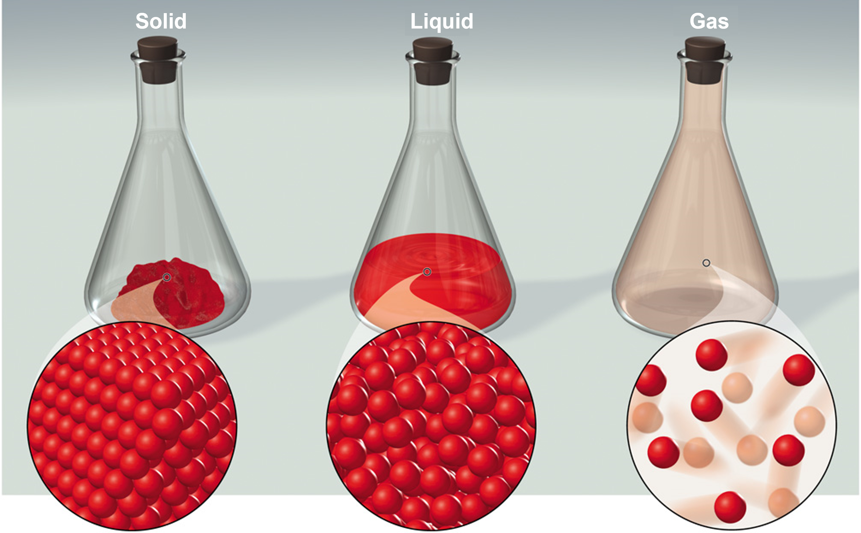
Classification of Matter
Solid, liquid and gas are the three states of matter commonly found on earth. A substance can convert from one state to another without changing the identity of the substance.
Solids Rigid and do NOT conform to the shape of their container.
Liquids conform to the shape of their container.
Gases assume both the shape and volume of their container.

Slide 4
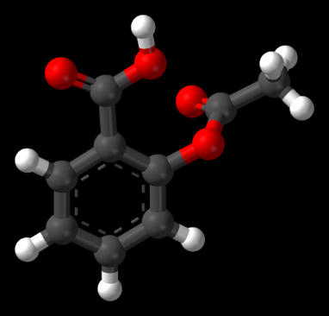
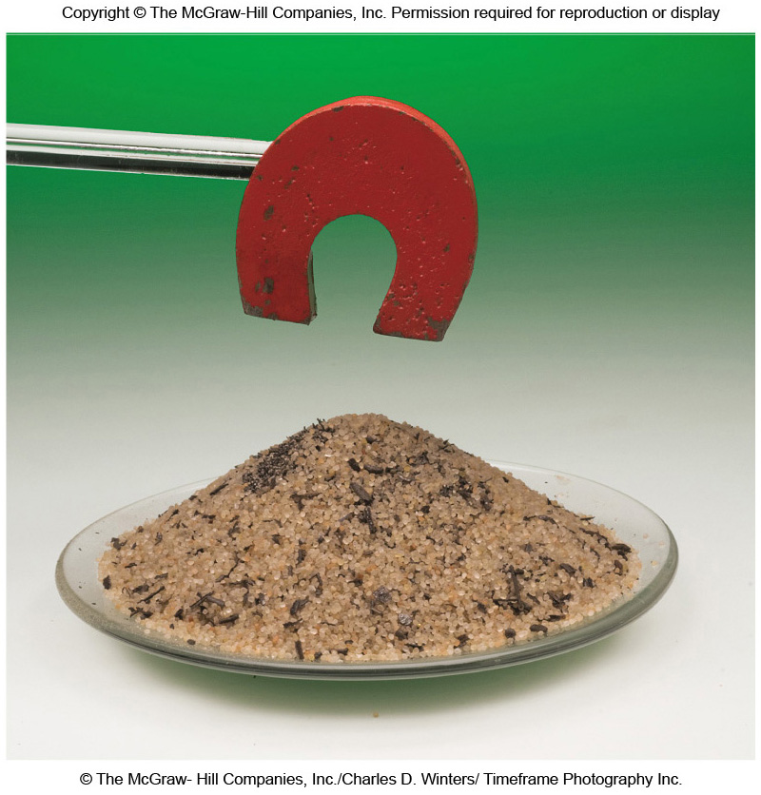
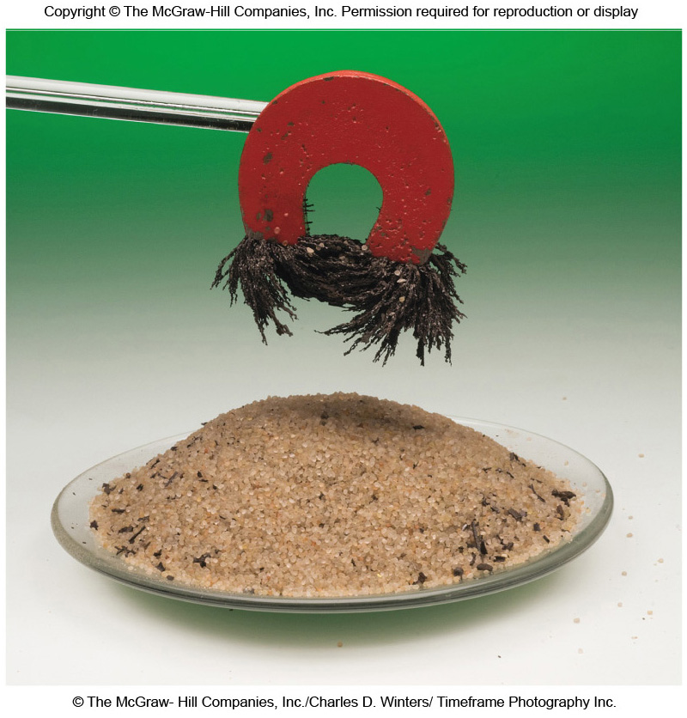
Atoms
Atom: smallest indivisible unit for an element
Molecule: consists of two or more atoms joined by chemical bonds.
Law of Conservation of Mass: No detectable change in mass during an ordinary chemical reaction.
Law of Definite proportions: A chemical compound always contains the same elements in the same proportions by mass
Example: Aspirin will always have 9 Carbon, 8 Hydrogen and 4 Oxygen Atoms (C₉H₈O₄)
A mixture can be separated by physical means into its components without changing the identities of the components.

Slide 5
Classification of Matter
Chemists classify matter as either a substance or a mixture of substances.
Pure Substance is a form of matter that has definite composition and distinct properties.
Examples: salt (sodium chloride), iron, water, mercury, carbon dioxide, and oxygen
Pure substances may be divided into two classes: elements and compounds.
Pure substances that cannot be broken down into simpler substances by chemical changes are called elements.
Pure substances that are comprised of two or more elements are called compounds. Compounds may be broken down by chemical changes to yield either elements or other compounds, or both.
Mixture is a physical combination of two or more substances.
A homogeneous mixture is uniform throughout. Also called a solution.
(Examples: seawater, apple juice)
A heterogeneous mixture is not uniform throughout.
(Examples: trail mix, chicken noodle soup)
Notes:
Substances differ from one another in composition and may be identified by appearance, smell, taste, and other properties.

Slide 6
Types of Matter
Matter (may be solid, liquid, or
gas): anything that occupies
space and has mass
Physically
separable into
Heterogeneous matter:
nonuniform composition
Homogeneous matter:
uniform composition throughout
Physically
separable into
Pure Substances: fixed
composition; cannot
be further purified
Solutions: homogeneous
mixtures; uniform compositions
that may vary widely
Chemically
separable into
Compounds: elements
united in fixed ratios
Elements: cannot be subdivided
by chemical or physical changes
Combine chemically
to form

Slide 7
The Properties of Matter
There are two general types of properties of matter:
Quantitative properties are measured and expressed with a number.
(Quantity = An Amount)
Qualitative properties do not require measurement and are usually based on observation.
Examples:
Extracts from Pacific-yew bark kill cancer cells.
Qualitative
Compound “13a” is twenty times more effective than paclitaxel in killing ovarian cancer cells.
Quantitative

Slide 8
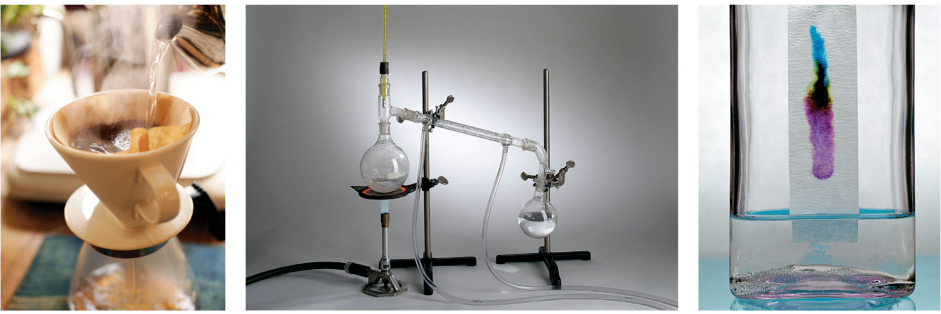
The Properties of Matter
A physical property is one that can be observed and measured without changing the identity of the substance.
Examples: color, melting point, boiling point, density
A physical change is one in which the state of matter changes, but the identity of the matter does not change.
Examples: changes of state (melting, freezing, condensation)
Examples of physical processes, mixtures are separated , but the identities of the matter does not change

Slide 9
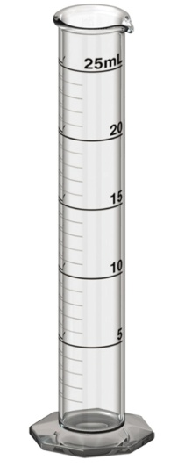
The Properties of Matter
A chemical property is one a substance exhibits as it interacts with another substance. Examples: flammability, corrosiveness
A chemical change is one that results in a change of composition; the original substances no longer exist.
Examples: digestion, combustion, oxidation
An extensive property depends on the amount of matter.
Examples: mass, volume
An intensive property does not depend on the amount of matter.
Examples: temperature, density
Properties that can be measured are called quantitative properties.
A measured quantity must always include a unit.
The English system has units such as the foot, gallon, pound, etc.
The metric system includes units such as the meter, liter, kilogram, etc.

Slide 10
SI Base Units
The revised metric system is called the International System of Units (abbreviated SI Units) and was designed for universal use by scientists.
SI Base Units
Base Quantity | Name of Unit | Symbol
Length | meter | m
Mass | kilogram | kg
Time | second | s
Electric Current | ampere | A
Temperature | kelvin | K
Amount of Substance | mole | mol
Luminous Intensity | candela | cd

Slide 11
SI Base Units
The magnitude of a unit may be tailored to an application using prefixes.
Prefix | Symbol | Meaning | Example (base unit grams)
Tera– | T | 1 x 10¹² | 1 Tg = 1 x 10¹² g
Giga– | G | 1 x 10⁹ | 1 Gg = 1 x 10⁹ g
Mega– | M | 1 x 10⁶ | 1 Mg = 1 x 10⁶ g
Kilo– | k | 1 x 10³ | 1 kg = 1 x 10³ g
Hecto– | h | 1 x 10² | 1 hg = 1 x 10² g
Deka– | da | 1 x 10¹ | 1 dag = 1 x 10¹ g
Unit (g, L, etc.) |  | 1 | 1 g = 1 g
Deci– | d | 1 x 10^{–1} | 1 dg = 1 x 10^{–1} g
Centi– | c | 1 x 10^{–2} | 1 cg = 1 x 10^{–2} g
Milli– | m | 1 x 10^{–3} | 1 mg = 1 x 10^{–3} g
Micro– | μ | 1 x 10^{–6} | 1 μg = 1 x 10^{–6} g
Nano– | n | 1 x 10^{–9} | 1 ng = 1 x 10^{–9} g
Pico– | p | 1 x 10^{–12} | 1 pg = 1 x 10^{–12} g
The great mighty king hector died unexpectedly drinking chocolate milk many nights past.

Slide 12
Using the conversion chart
1 T(base unit) = 1 x 10¹² (base unit)
1 G(base unit) = 1 x 10⁹ (base unit)
1 M(base unit) = 1 x 10⁶ (base unit)
1 k(base unit) = 1 x 10³ (base unit)
1 h(base unit) = 1 x 10² (base unit)
1 da(base unit) = 1 x 10¹ (base unit)
1 (base unit) = 1 (base unit)
1 d(base unit) = 1 x 10^{–1} (base unit)
1 c(base unit) = 1 x 10^{–2} (base unit)
1 m(base unit) = 1 x 10^{–3} (base unit)
1 μ(base unit) = 1 x 10^{–6} (base unit)
1 n(base unit) = 1 x 10^{–9} (base unit)
1 p(base unit) = 1 x 10^{–12} (base unit)
How do we use this chart? So let's say our base units are liters? How could we find our conversion factor?

Slide 13
Using the chart
1 T(unit) = 1 x 10¹² (unit)
1 G(unit) = 1 x 10⁹ (unit)
1 M(unit) = 1 x 10⁶ (unit)
1 k(unit) = 1 x 10³ (unit)
1 h(unit) = 1 x 10² (unit)
1 da(unit) = 1 x 10¹ (unit)
1 (base unit) = 1 (base unit)
1 d(unit) = 1 x 10^{–1} (unit)
1 c(unit) = 1 x 10^{–2} (unit)
1 m(unit) = 1 x 10^{–3} (unit)
1 μ(unit) = 1 x 10^{–6} (unit)
1 n(unit) = 1 x 10^{–9} (unit)
1 p(unit) = 1 x 10^{–12} (unit)
1 TL = 1 x 10¹² L
1 GL = 1 x 10⁹ L
1 ML = 1 x 10⁶ L
1 kL = 1 x 10³ L
1 hL = 1 x 10² L
1 daL = 1 x 10¹ L
1 L = 1 L
1 dL = 1 x 10^{–1} L
1 cL = 1 x 10^{–2} L
1 mL = 1 x 10^{–3} L
1 μL = 1 x 10^{–6} L
1 nL = 1 x 10^{–9} L
1 pL = 1 x 10^{–12} L
Replace the word base unit with the symbol for liter (L) (gives an equality statement).
This can be done with all standard units of measurement (grams, meter, second, kelvin, etc.). You need to know these conversions!

Slide 14
Conversion Factors
A conversion factor is a fraction in which the same quantity is expressed one way in the numerator and another way in the denominator. Created from an equality statement (shows the relationship between two units. When we multiply by a conversion factor, we are only multiplying by 1, so nothing is changed!
Conversion Factors
$$\frac{1 hour}{60 minutes}$$
Equality Statement
1 hour = 60 minutes
$$\frac{60 minutes}{1 hour}$$
Divide one side of the equality statement by the other side of the equality statement and you have one of the two conversion factors…. They mean the same thing!! Both are saying there is 1 hour in 60 minutes, meaning either fraction is correct because both came from the equality statement.
We are going to use this concept of conversion factors to convert (or move) between SI base units…

Slide 15
How many kg are in 3.6 g?
1 kg = 10³g
1 T(base unit) = 1 x 10¹² (base unit)
1 G(base unit) = 1 x 10⁹ (base unit)
1 M(base unit) = 1 x 10⁶ (base unit)
1 k(base unit) = 1 x 10³ (base unit)
1 h(base unit) = 1 x 10² (base unit)
1 da(base unit) = 1 x 10¹ (base unit)
1 (base unit) = 1 (base unit)
1 d(base unit) = 1 x 10^{–1} (base unit)
1 c(base unit) = 1 x 10^{–2} (base unit)
1 m(base unit) = 1 x 10^{–3} (base unit)
1 μ(base unit) = 1 x 10^{–6} (base unit)
1 n(base unit) = 1 x 10^{–9} (base unit)
1 p(base unit) = 1 x 10^{–12} (base unit)
Equality Statement….We can make conversion factors. Think of conversion factors as the roads to the next unit….
What are the two possible conversion factors from the equality statement?
$$\frac{1 kg}{{10}^{3}g}$$
$$\frac{{10}^{3}g}{1 kg}$$
and
Which is the correct one to use? We let the units tell us. Write down what is given in the problem and those units will need to be crossed out….
We were given 3.6 g and asked to convert it to kg. So the first thing we write down is 3.6 g. Then we will use the conversion factor that allows us to cancel the grams so that we are left with kg.
$$\left(\frac{3.6 g}{}\right)$$
$$\left(\frac{1 kg}{{10}^{3}g}\right)$$
= 0.0036 kg

Slide 16
Conversion Practice
Calculate the number of kg that are found in 1.3 g?
1 kg = 10³ g
$$\left(\frac{1.3 g}{}\right)$$
$$\left(\frac{1 kg}{{10}^{3}g}\right)$$
= 0.0013 kg
How many Mg are in 43.7 mg?
1 Mg = 10⁶ g
1 mg = 10^{–3} g
$$\left(\frac{43.7 mg}{}\right)$$
$$\left(\frac{10^{−3} g}{1 mg}\right)$$
$$\left(\frac{1 Mg}{{10}^{6}g}\right)$$
= 4.37 x 10^{–8} Mg

Slide 17
Poll Question: Campusknot
(Ch. 1-Slide 17) How many ng are in 40 kg?

Slide 18
Mass
Mass is a measure of the amount of matter in an object or sample.
Because gravity varies from location to location, the weight of an object varies depending on where it is measured. But mass doesn’t change.
The SI base unit of mass is the kilogram (kg), but in chemistry the smaller gram (g) is often used.
1 kg = 1000 g = 1×10³ g
Atomic mass unit (amu) is used to express the masses of atoms and other similar sized objects.
1 amu = 1.6605378×10^{–24} g
Temperature
There are two temperature scales used in chemistry:
The Celsius scale (°C): Freezing point (pure water): 0°C; Boiling point (pure water):100°C
The Kelvin scale (K): The “absolute” scale; Lowest possible temperature: 0 K (absolute zero)
K = °C + 273.15

Slide 19
Practice
Normal human body temperature can range over the course of a day from about 36°C in the early morning to about 37°C in the afternoon. Express these two temperatures and the range that they span using the kelvin scale.
36°C + 273.15 = 309.15 K
37°C + 273.15 = 310.15 K
What range do they span?
310.15 K – 309.15 K= 1K
The Fahrenheit scale is common in the United States.
Freezing Point (pure water) | 32°F
Boiling Point (pure water) | 212°F
There are 180 degrees between freezing and boiling in Fahrenheit (212°F–32°F) but only 100 degrees in Celsius (100°C–0°C).
The size of a degree on the Fahrenheit scale is only $\frac{9}{5}$ of a degree on the Celsius scale.
Temp in °F =$\left(\frac{9 ℉}{5 ℃}\right)\left(temp in ℃\right)+32 ℉$

Slide 20
Practice
A body temperature above 39°C constitutes a high fever. Convert this temperature to the Fahrenheit scale.
$=\left(\frac{9 ℉}{5 ℃}\right)\left(39 ℃\right)+32 ℉$
Temp in °F =$\left(\frac{9 ℉}{5 ℃}\right)\left(temp in ℃\right)+32 ℉$
Temp in °F =$102 ℉$
Gold Boils at 5173ºF. What is the Boiling Point of Gold in Celsius?
Temp in °C = (Temp in °F $−32℉$) $\left(\frac{5 ℃}{9 ℉}\right)$
$=\text{(}\text{5173}\text{°}\text{F}−32℉\text{) }\left(\frac{5 ℃}{9 ℉}\right)$
Temp in °C = 2856 $℃$
Chlorine melts at –100.95 ºC what is that in ºF?
Temp in °F =$\left(\frac{9 ℉}{5 ℃}\right)\left(temp in ℃\right)+32 ℉$
$=\left(\frac{9 ℉}{5 ℃}\right)\left(−100.95 ℃\right)+32 ℉$
Temp in °F =$−149.71 ℉$

Slide 21
Poll Question: Campusknot
(Ch. 1-slide 21) If dry ice sublimates at -196 °F, what is that temperature in °C and Kelvin?

Slide 22
Practice
Perform the following conversions:
41°F to °C
Temp in °C = (Temp in °F$−32℉$) $\left(\frac{5 ℃}{9 ℉}\right)$
$=\text{(}\text{41}\text{°}\text{F}−32℉\text{) }\left(\frac{5 ℃}{9 ℉}\right)=$
$$5.0℃$$
68 °C to Kelvin
$$68 ℃+273.15=341.15 K$$
426 K to °C
$$426K −273.15=152.85 ℃$$
681 K to °F
$$681 K −273.15=407.85 ℃$$
Temp in °F =$\left(\frac{9 ℉}{5 ℃}\right)\left(temp in ℃\right)+32 ℉=$
$\left(\frac{9 ℉}{5 ℃}\right)\left(407.85 ℃\right)+32 ℉=$
$$766.13 ℉$$
Normal body temperature is 37ºC. What is this in Kelvin?
$$37 ℃+273.15=310.15 K$$

Slide 23
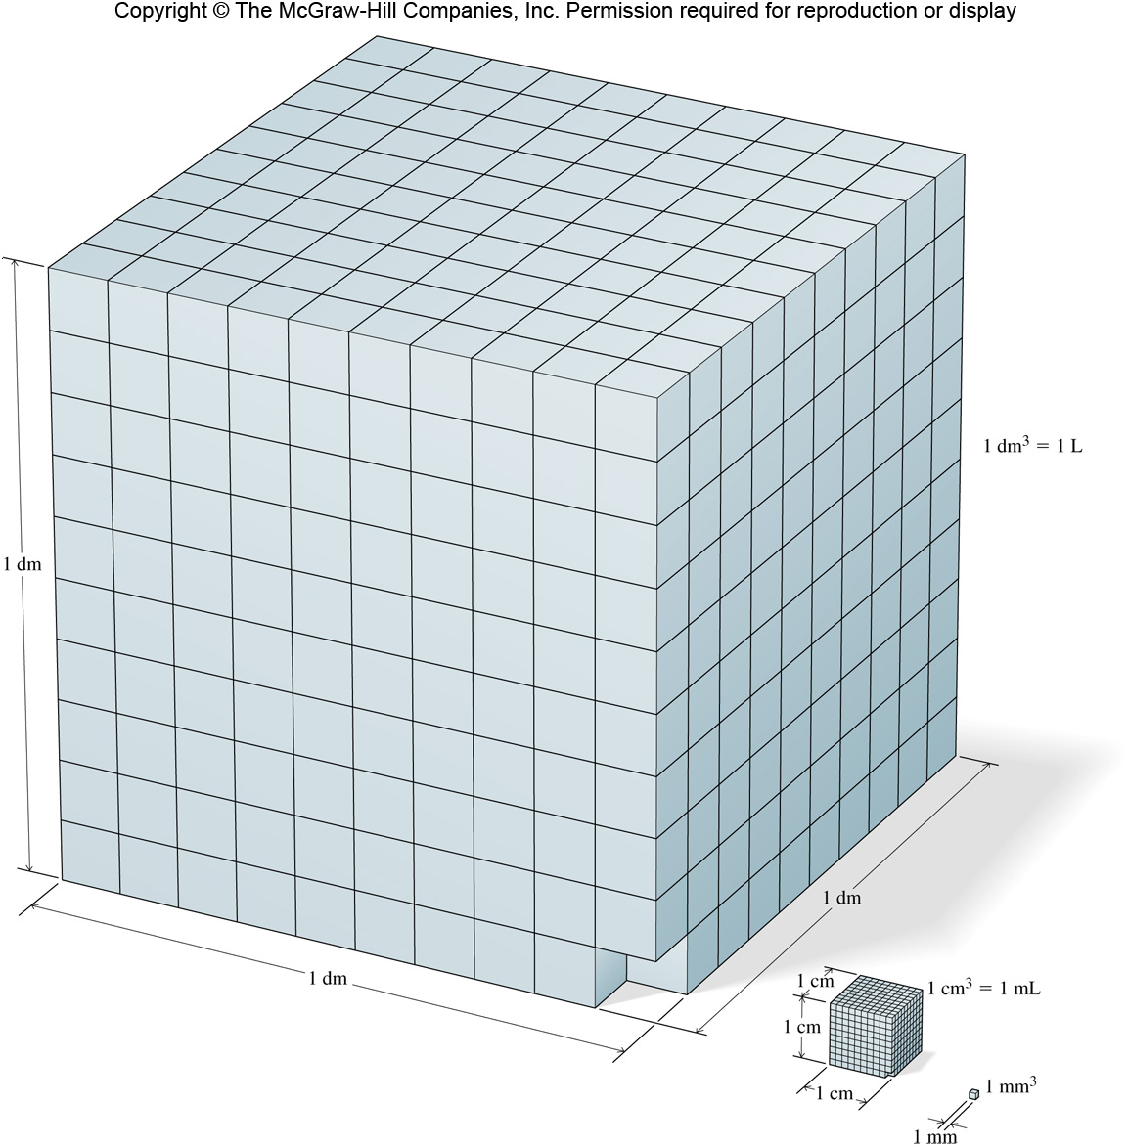
Derived Units: Volume and Density
The density of a substance is the ratio of mass to volume.
d = density
m = mass
V = volume
$$d= \frac{m}{V}$$
There are many units (such as volume) that require units not included in the base SI units.
The derived SI unit for volume is the meter cubed (m³).
A more practical unit for volume is the liter (L).
1 dm³ = 1 L
1 cm³ = 1 mL
SI-derived unit: kilogram per cubic meter (kg/m³)
Common units based on state of matter:
$\frac{g}{{cm}^{3}}$ (solids)
g cm^{–3} (solids)
$\frac{g}{mL}$ (liquids)
Same As:
g mL^{–1} (liquids)
$\frac{g}{L}$ (gases)
g L^{–1} (gases)

Slide 24
Density at 20 $℃$
Substance | D ( g mL^{–1})
Magnesium | 1.74
Aluminum | 2.70
Titanium | 4.50
Copper | 8.93
Lead | 11.34
Mercury | 13.55
Gold | 19.32
Practice
A piece of metal has mass = 215.8 g. When placed into a measuring cylinder it displaces 19.1 mL of water. Identify the metal.
Most consistent with lead
$$d= \frac{m}{V}=$$
$$\frac{215.8 g}{19.1 mL}=$$
$$11.3 g {mL}^{–1}$$
What is the density of CO gas if 0.196 g occupies a volume of 100 mL?
$$d= \frac{m}{V}=$$
$$\frac{0.196 g}{100 mL}=$$
$$\frac{0.00196 g}{ mL}=$$
$$0.00196 g {mL}^{–1}$$
An irregularly-shaped sample of aluminum (Al) is put on a balance and found to have a mass of 43.6 g. The student decides to use the water-displacement method to find the volume. The initial volume reading is 25.5 mL and, after the Al sample is added, the water level has risen to 41.7 mL. Find the density of the Al sample in g cm^{–3}. (Remember: 1 mL = 1 cm³.)
$$d= \frac{m}{V}=$$
$$\frac{43.6 g}{\left(41.7 mL −25.5 mL\right)}=$$
$$\frac{2.69 g}{ mL}=$$
$$\frac{2.69 g}{ {cm}^{3}}$$

Slide 25
Practice
Gasoline is a non-polar liquid that will float on water. 450 grams of gasoline is spilled into a puddle of water. If the density of gasoline is 0.665 g mL^{–1}, what volume of gasoline is spilled?
$$V= \frac{m}{d}=$$
$$\frac{450 g}{\left(\frac{0.665 g}{mL}\right)}$$
$$\left(450 g\right)\left(\frac{1 mL}{0.665 g}\right)=$$
$$677 mL$$
A cup of gold colored metal beads was measured to have a mass 425 grams. By water displacement, the volume of the beads was calculated to be 48.0 cm³. Given the following densities, identify the metal. (Gold: 19.3 g mL^{–1}; Copper: 8.86 g mL^{–1}; Bronze: 9.87 g mL^{–1})
Copper
$$d= \frac{m}{V}=$$
$$\frac{425 g}{48.0 {cm}^{3}}=$$
$$\frac{8.85 g}{{cm}^{3}}=$$
$$\frac{8.85 g}{mL}$$
Calculate the mass of a liquid with a density of 3.2 g mL^{–1} and a volume of 25 mL.
$$\left(25 mL\right)\left(\frac{3.2 g}{mL}\right)=$$
$$m=dV=$$
$$80 g$$
Find the volume that 35.2 g of carbon tetrachloride (CCl₄) will occupy if it has a density of 1.60 g mL^{–1}.
$$V= \frac{m}{d}=$$
$$\frac{35.2 g}{\left(\frac{1.60 g}{mL}\right)}$$
$$\left(35.2 g\right)\left(\frac{1 mL}{1.60 g}\right)=$$
$$22.0 mL$$

Slide 26
Poll Question: Campusknot
(Ch. 1-slide 26) What is the density of a 125-gram cube with 3-inch sides?

Slide 27
Uncertainty in Measurement
There are two types of numbers used in chemistry:
1) Exact numbers:
are those that have defined values
1 kg = 1000 g
1 dozen = 12 objects
are those determined by counting
28 students in a class
2) Inexact numbers:
measured by any method other than counting
length, mass, volume, time, speed, etc.
An inexact number must be reported to indicate its uncertainty.

Slide 28
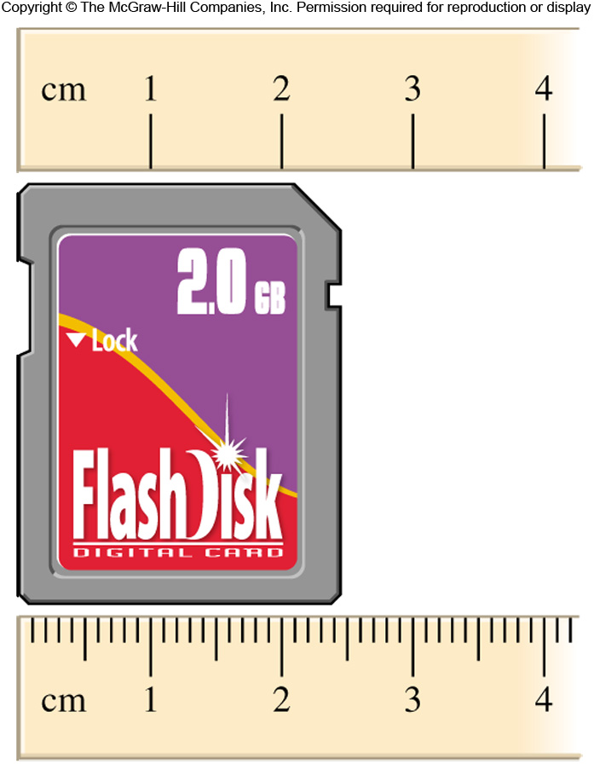
Uncertainty in Measurement
Significant figures (or digits) are the meaningful digits in a reported number.
2.5 cm
When using the top ruler to measure the memory card, we could estimate 2.5 cm. We are certain about the 2, but we are not certain about the 5.
When using the bottom ruler to measure the memory card, we might record 2.45 cm. Again, we estimate one more digit than we are certain of.
As a rule, estimate between the markings and the estimated digit is the uncertain digit.
2.45 + 0.01 cm

Slide 29
Significant Figures
The number of significant figures (S.F.) can be determined using the following guidelines:
1) Any nonzero digit is significant.
112.1
4 significant figures
2) Zeros between nonzero digits are significant.
305
3 significant figures
50.08
4 significant figures
3) Zeros to the left of the first nonzero digit are not significant.
0.0023
2 significant figures
0.000001
1 significant figure
4) Zeros to the right of the last nonzero digit are significant if a decimal is present.
1.200
4 significant figures
5) Zeros to the right of the last nonzero digit in a number that does not contain a decimal point may or may not be significant.
100
1, 2, or 3 – ambiguous
To avoid ambiguity, use scientific notation…
1 S.F. = 1 x 10²
2 S.F. = 1.0 x 10²
3 S.F. = 1.00 x 10²

Slide 30
Practice
Determine the number of significant figures in the following measurements:
123 cm
(c) 0.0857 kg
(e) 50.0 mL
3 s.f.
(b) 25.03 g
4 s.f.
3 s.f.
(d) 1.106×10^{–7} L
4 s.f.
3 s.f.
(f) 0.1600 m
4 s.f.
Number | Sig. Figs. | Comment on Zeros
2.12
3
4.500
4
Not placeholders. Significant
0.002541
4
Placeholders (not significant)
0.00100
3
Only the last two are significant
500
1, 2, 3?
Ambiguous (go with 1 when info not given)
500.
3
Decimal point shows significance
5.0 x 10²
2
No ambiguity
1.05 g
3
Between nonzero digits, significant
Dozen Eggs
Infinite
Exact count
0.90 x 10⁴⁵ L
2
Not placeholders. Significant

Slide 31
Calculations with Measured Numbers
In addition and subtraction, the answer cannot have more digits to the right of the decimal point than any of the original numbers.
102.50
← two digits after the decimal point
+
0.230
← three digits after the decimal point
102.73
← round to two digits after the decimal point, 102.73
143.29
← two digits after the decimal point
–
20.1
← one digit after the decimal point
123.19
← round to one digit after the decimal point, 123.2
In multiplication and division, the number of significant figures in the final product or quotient is determined by the original number that has the smallest number of significant figures.
(1.4)(8.011) = 11.2154
← fewest significant figures is 2, so round to 11
2 S.F.
4 S.F.
4 S.F.
$$\frac{11.57}{305.88}=0.0378252$$
← fewest significant figures is 4, so round to 0.03783
5 S.F.

Slide 32
Calculations with Measured Numbers
Exact numbers can be considered to have an infinite number of significant figures and do not limit the number of significant figures in a result.
Example
Three pennies each have a mass of 2.5 g. What is the total mass?
Exact
(counting number)
Inexact
(measurement)
3 × 2.5 = 7.5 g
In calculations with multiple steps, round at the end of the calculation to reduce any rounding errors.
If the 1st digit to be dropped is < 5, round down
If the 1st digit to be dropped is $>$ 5, round up
If the dropped digit is 5, we round up or down to yield a value for the retained digit that is even.
Do not round after each step!
Compare the following:
Rounding after each step
Rounding at end
1) 3.66 × 8.45 = 30.9
2) 30.9 × 2.11 = 65.2
1) 3.66 × 8.45 = 30.93
2) 30.93 × 2.11 = 65.3
In general, keep at least one extra digit until the end of a multistep calculation.

Slide 33
Summary– Significant Figures
Functions | Rule
Addition and Subtraction | Least number of decimals
Multiplication and Division | Least number of digits
$$x=\frac{(1.278+0.3480)}{1.08881}$$
$$=\frac{3 places after the decimal (4 sig figs)}{1.08881 (6 sig figs)}$$
= 1.493
$$x=\frac{(8.278+2.34)}{1.08}$$
$$=\frac{2 places after the decimal and 2 places before (4 sig figs)}{1.08 (3 sig figs)}$$
= 9.83
583.00 ÷ 83
= 7.0
$$=\frac{172.8}{8925.714}$$
= 0.2
(57.6 * 3) ÷ (34 * 3.00 * 87.507)

Slide 34
Poll Question: Campusknot
(Ch. 1-slide 34) How many significant figures should the answer to the following problem have?
$$\frac{\left(5.69+6.3\right)}{4.561}=$$

Slide 35
Accuracy and Precision
Accuracy tells us how close a measurement is to the true value.
Precision tells us how close a series of replicate measurements are to one another.
Good accuracy/
good precision
Poor accuracy /
good precision
Poor accuracy /
poor precision
Three students were asked to find the mass of an aspirin tablet. The true mass of the tablet is 0.370 g.
Student A: Precise but not accurate
Student B: Neither precise nor accurate
Student C: Both precise and accurate
A B C

Slide 36
Dimensional Analysis – Tracking Units
A conversion factor is a fraction in which the same quantity is expressed one way in the numerator and another way in the denominator.
For example, 1 in = 2.54 cm, may be written:
$\frac{1 in}{2.54 cm}$ or $\frac{2.54 cm}{1 in}$
The use of conversion factors in problem solving is called dimensional analysis or the factor–label method.
Example
$$\left(\frac{12.00 in}{}\right)$$
Convert 12.00 inches to meters.
What conversion factor will cancel inches and give us centimeters?
$$\left(\frac{12.00 in}{}\right)\left(\frac{2.54 cm}{1 in}\right)$$
$$\left(\frac{12.00 in}{}\right)\left(\frac{1 in}{2.54 cm}\right)$$
or
= 30.5 cm

Slide 37
Common Conversion Factors
Length | Volume | Mass
1 m = 1.0936 yd | 1 L = 1.0567 qt | 1 kg = 2.2046 lb
1 in. = 2.54 cm (exact) | 1 qt = 0.94635 L | 1 lb = 453.59 g
1 km = 0.62137 mi | 1 ft³ = 28.317 L | 1 (avoirdupois) oz = 28.349 g
1 mi = 1609.3 m | 1tbsp = 14.787 mL | 1 (troy) oz = 31.103 g

Slide 38
Example
Convert 20.0 milligrams of gold into pounds.
Start with what you are given. Look for a pathway: compare the units. What units are shared between the conversion factors?
To find the path you must find the necessary conversion factors derived from the equality statements. From the textbook we know: 1 g = 1000 mg and 1 lb = 453.6 g.
milligrams
grams
pounds
$\frac{1 g}{1000 mg} or \frac{1000 mg}{1 g}$
$\frac{1 lb}{453.6 g} or \frac{453.6 g}{1 lb}$
$$\left(\frac{20.0 mg}{}\right)$$
$$\left(\frac{1 g}{1000 mg}\right)$$
$$\left(\frac{1 lb}{453.6 g}\right)=$$
$$4.41 x {10}^{−5} lb$$
20.0 mg of gold is 4.41 x 10⁻⁵ lbs

Slide 39
Example
An average adult has 5.2 L of blood. What is the volume of blood in pints?
$$\left(\frac{5.2 L}{}\right)$$
$$\left(\frac{4.23 cups}{1.0 L}\right)$$
$$\left(\frac{0.50 pints}{1.00 cups}\right)=$$
$$10.998 pints$$
If someone weighs 175 lbs. What is that in kilograms. (1 lb = 453.6 g)
$$\left(\frac{175 lb}{}\right)$$
$$\left(\frac{453.6 g}{1.0 lb}\right)$$
$$\left(\frac{1 kg}{1000 g}\right)=$$
$$79.38 kg$$
A child requires a 5 ml dose of medicine each day. How many days would a gallon of this medicine last? Note that each gallon has 3.7854 L.
$$\left(\frac{1 gallon}{}\right)$$
$$\left(\frac{3.7854 L}{1 gallon}\right)$$
$$\left(\frac{1000 mL}{1 L}\right)$$
$$\left(\frac{1 day}{5 mL}\right)=$$
$757$days = 8 x 10² days
The moon is 384,403 km from the earth. Estimate how many quarters laid end to end will it take to reach the moon if a quarter has a diameter of 2.3 cm.
$$\left(\frac{384,403 km }{}\right)$$
$$\left(\frac{1000 m}{1 km}\right)$$
$$\left(\frac{100 cm}{1 m}\right)$$
$$\left(\frac{1 quarter}{2.3 cm}\right)=$$
$$1.7 x {10}^{10} quarters$$

Slide 40
Example
Convert 14.62 in³ to cubic centimeters, given that there are 2.54 centimeters for every inch.
$$\left(\frac{14.62 {in}^{3} }{}\right)$$
$$\left(\frac{{(2.54 cm)}^{3}}{{(1 in)}^{3}}\right)=$$
$$239.58 {cm}^{3}$$
A chair lift at the Divide ski resort in Cold Springs, WY is 4806 feet long and takes 9 minutes. A.)What is the average speed in miles per hour (There are 5280 ft per every mile)? B.)How many feet per second does the lift travel?
A.)
$$\left(\frac{4806 ft }{9 min}\right)$$
$$\left(\frac{60 min}{1 hr}\right)$$
$$\left(\frac{1 mile}{5280 ft}\right)=$$
$$\frac{6.07 miles}{1 hr}$$
B.)
$$\left(\frac{4806 ft }{9 min}\right)$$
$$\left(\frac{1 min}{60 sec}\right)=$$
$$\frac{8.9 ft}{1 sec}$$
An average human heart beats 60 times per minute. If an average person lives to the age of 75, how many times does the average heartbeat in a lifetime?
$$\left(\frac{75 years }{1 lifetime}\right)$$
$$\left(\frac{365 days}{1 year}\right)$$
$$\left(\frac{24 hours}{1 day}\right)$$
$$\left(\frac{60 min}{1 hour}\right)$$
$$\left(\frac{60 beats}{1 min}\right)=$$
$$\frac{2365200000 beats}{1 lifetime}$$
A car travels 14 miles in 15 minutes. A.)How fast is it going in miles per hour? How fast is it going in meters per second (1.60933 km = 1 mile)?
A.)
$$\left(\frac{14 miles }{15 min}\right)$$
$$\left(\frac{60 min}{1 hour}\right)=$$
$$\frac{56 miles}{1 hour}$$
B.)
$$\left(\frac{14 miles}{15 min}\right)$$
$$\left(\frac{1.60933 km}{1 mile}\right)$$
$$\left(\frac{1000 m}{1 km}\right)$$
$$\left(\frac{1 min}{60 sec}\right)=$$
$$\frac{25.03 m}{1 sec}$$

Slide 41
Example
How many ng are there in 5.27x10⁻¹³ kg?
5.27 x 10^{–16} ng
5.27 x 10^{–7} ng
5.27 x 10^{–4} ng
5.27 x 10^{–1} ng
$$\left(\frac{5.27 x {10}^{−13} kg}{}\right)$$
$$\left(\frac{1000 g}{1 kg}\right)$$
$$\left(\frac{1 ng}{1.0 x {10}^{−9} g}\right)=$$
$$0.527 ng$$
If the density of an object is 2.87 x 10⁻⁴ lbs per cubic inch, what is its density in g mL^{–1}? There are 453.592 grams in each pound and 2.54 centimeters in every inch.
2.49 x 10^{–7} g/mL
1.13 x 10⁻⁴ g/mL
7.95 x 10^{–3} g/mL
5.13 x 10^{–2} g/mL
$$\left(\frac{2.87 x {10}^{−4} lb}{{in}^{3}}\right)$$
$$\left(\frac{{(1 in)}^{3}}{{(2.54 cm)}^{3}}\right)$$
$$\left(\frac{1 {cm}^{3}}{1 mL}\right)$$
$$\left(\frac{453.592 g}{1 lb}\right)=$$
$$\frac{0.0079 g}{1 mL}$$

